Slide 1
Executive Branch
The Presidency

Slide 2
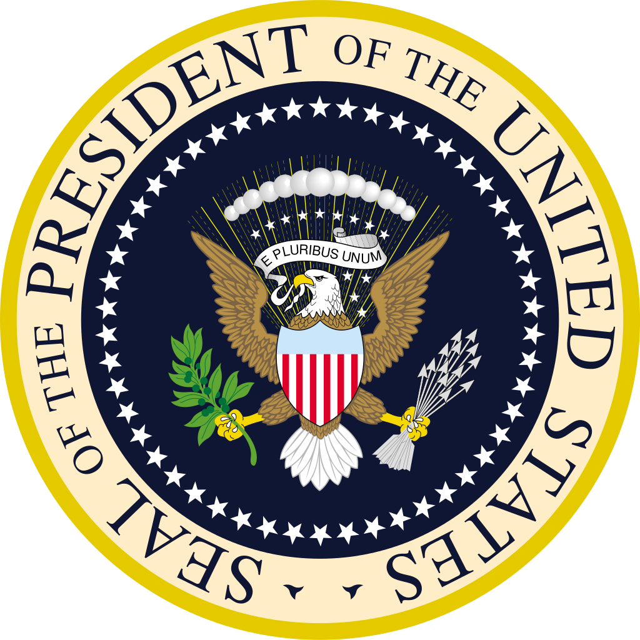
Lesson 1: Sources of Presidential Powers

Slide 3
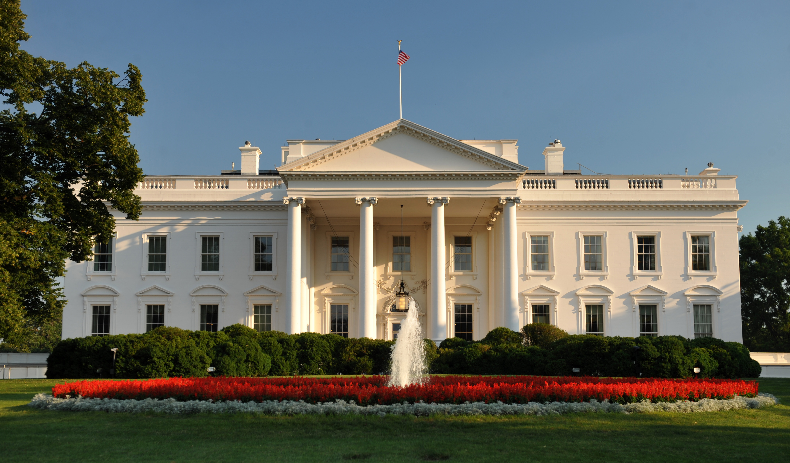
Constitutional Powers
Need for a Strong Executive
The Framers of the Constitution did not want the leader of our country to become a tyrant
The Framers knew that a strong executive was needed to carry out the acts of Congress
The Framers also wanted a strong executive because the distrusted direct participation by the people in decision making.

Slide 4
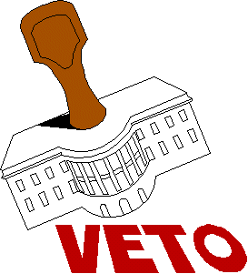
Constitutional Powers
Powers Defined in the Constitution
Article II of the Constitution gives lays out the power of the President
Defined Powers include:
Execute laws
Veto legislation
Command the military
Engage with foreign leaders
With Senate approval the President can:
Make treaties with foreign nations
Appoint ambassadors & federal judges

Slide 5
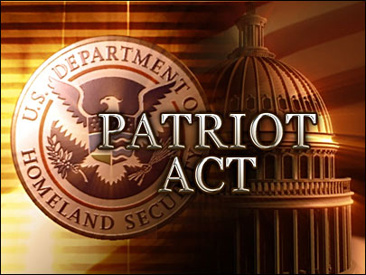
Growth of Presidential Power
Inherent Powers
Inherent powers are the reason for which Presidents have justified enlarging their powers
Inherent Powers- are those claimed by the president that are not clearly expressed in the Constitution
Presidents say they have these powers because of loosely worded phrases in the Constitution
“The executive power shall be vested in a President”
They also claim inherent powers is part of the Presidents job.
When Presidents exercise these powers, Congress and the courts may either try to limit the power or go along with it

Slide 6
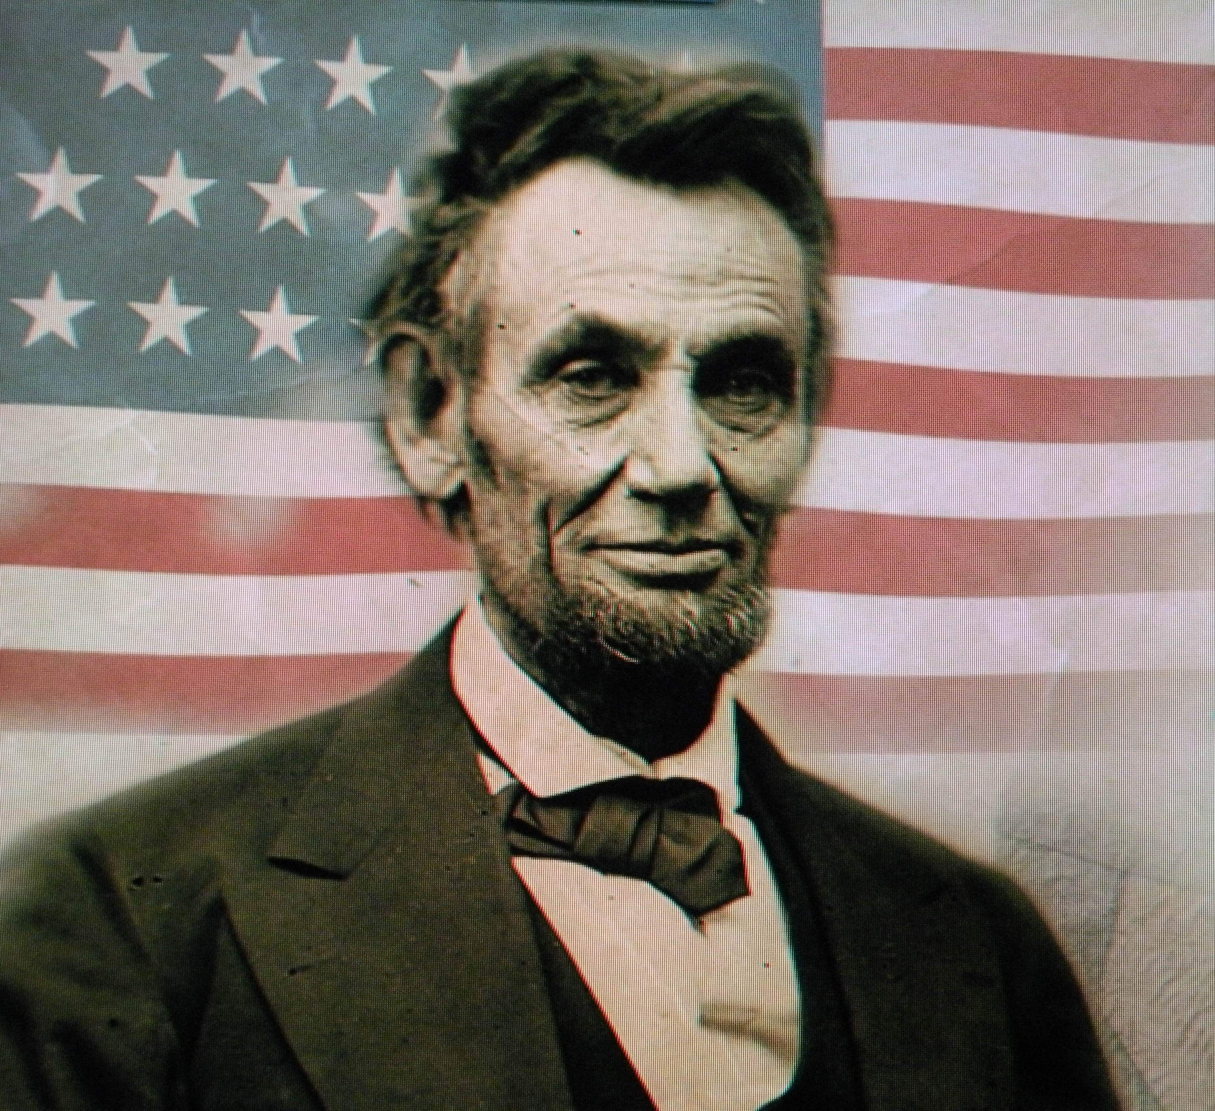
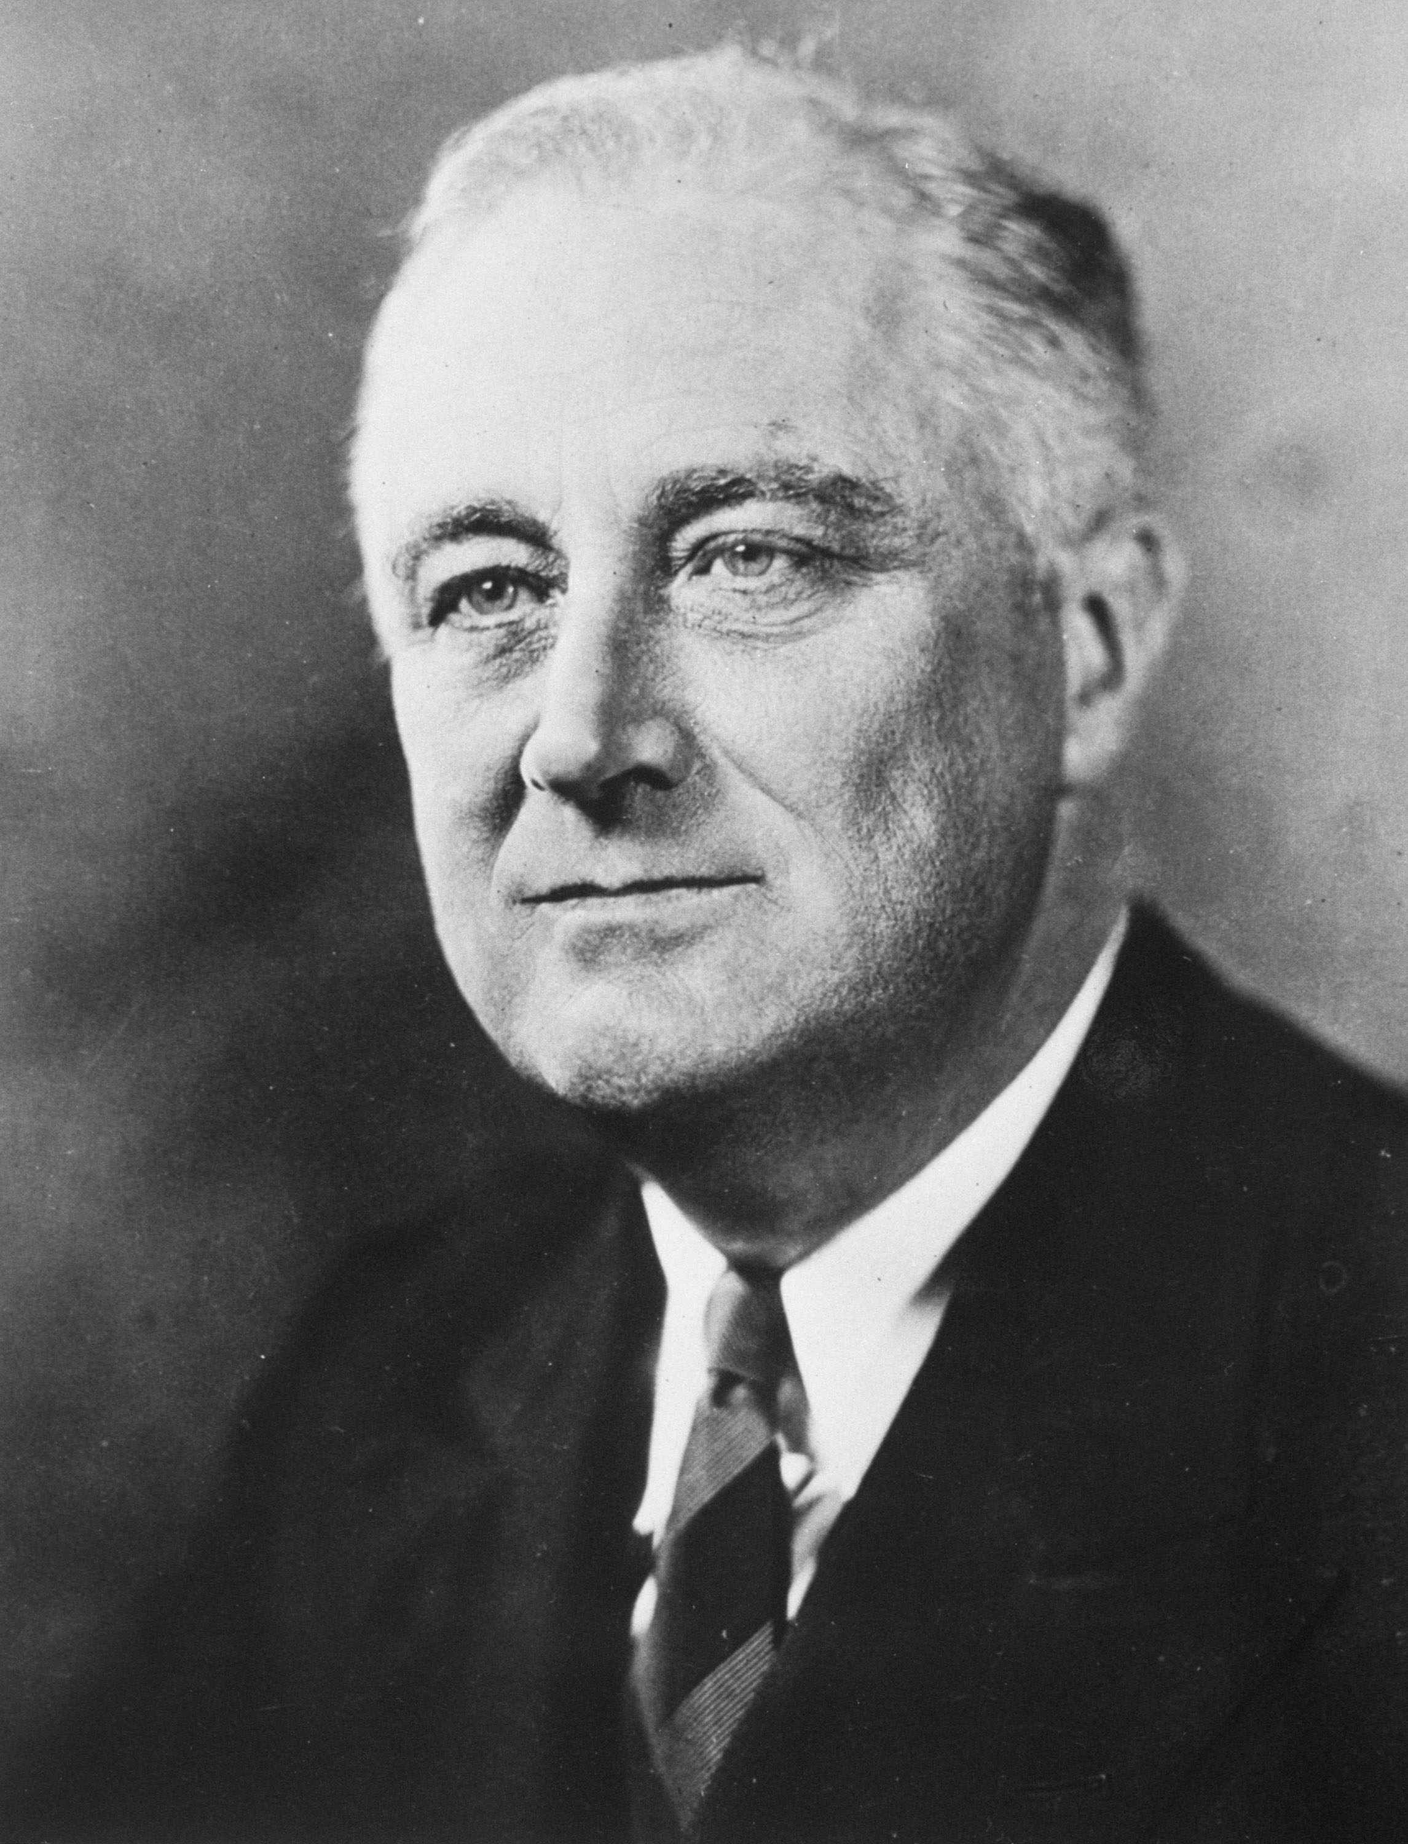
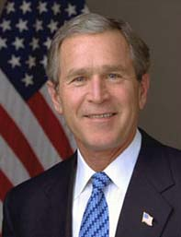
Growth of Presidential Power
Immediate Needs of the Nation
Presidents often have to use inherent powers during war or other times of emergency
Examples throughout history
President Lincoln suspended the writ of habeas corpus
President FDR had to use inherent powers to help get the country out of the Great Depression
President George W. Bush, declared “war on terrorism” and expanded the power of the President to combat terrorism

Slide 7
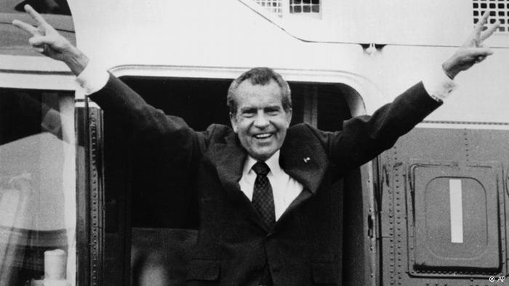
Growth of Presidential Power
Executive Privilege
This power is not named in the Constitution
This is the right to withhold from Congress or the courts information about communications between the President and his or her advisers
The Supreme Court ruled that executive privilege only applies with certain qualifications, but is still a part of Separations of Power

Slide 8
Growth of Presidential Power
Popular Opinion
All Presidents like to claim that their ideas and polices represent a mandate from the people
Mandate can be an informal source of presidential power, but popularity ratings can change quickly
Modern day Presidents use social media as a way to sway public opinion
Public opinion can also limit eh President because without favorable public opinion it can be hard for Presidents to enact a political program

Slide 9
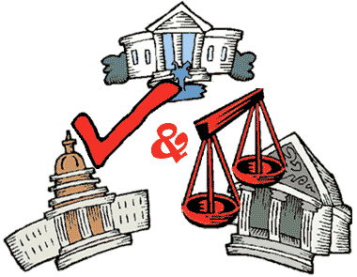
Growth of Presidential Power
Checks and Balances on Presidential Powers
The Founders built significant safeguards into the Constitution against the possibility that the President would abuse their lawful powers
The Supreme Court can rule executive actions unconstitutional
Congress can pass legislation even if a president vetoes the law
The Senate must confirm a president’s appointees and all treaties
The House & Senate can also impeach the president

Slide 10
Presidential Roles
Head of State- the president serves as a ceremonial figure representing the United States
Chief Executive-the president lead the executive branch of government, which implements the laws that Congress passes, and appoints federal judges and heads of executive departments and agencies
Commander in Chief-the president is responsible for the nation’s security and is in charge of the military
Chief Diplomat-the president meets with foreign leaders, appoints ambassadors, and makes treaties
Legislative Leader-the president delivers an annual State of Union message to Congress, proposes legislation, sign or vetoes laws, and can call Congress into special session when necessary
Economic Planner- the president appoints economic advisors, meets with business leaders, prepares an annual budget request, and submits economic reports to Congress
Party Leader- the president leads his or her own political party, rewarding party supporters with positions in government, and helps to elect other party members by raising money and campaigning for party members

Slide 11
Lesson 2: Head of State & Chief Executive

Slide 12
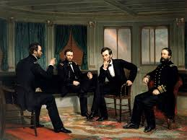
Head of State
The president, as head of state, represents the nation and performs many ceremonial roles
Some of the duties as head of state are mentioned in Article II of the Constitution
Modern presidents play an important role as a leader when a natural disaster strikes, especially to give words of comfort
Some duties that are less serious include:
Throw out the first pitch to begin the baseball season
Light the nation’s Christmas tree and Menorah
Meet public figures
To millions around the world the president is the symbol of the United States

Slide 13
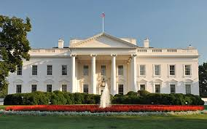
Chief Executive
The president is the leader of the executive branch of government and carries out laws that Congress passes
There are more that 150 departments and agencies that follow under the jurisdiction of the President
More than 2 million people work for the Federal government
The President’s executive power is described in the Constitution, but the document does not provide much detail about the components of this power
The Constitution states the President shall have powers & that “he shall take Care that the Laws be faithfully executed” (Articled II Section 3)

Slide 14
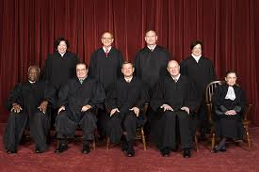
Chief Executive
The Appointment Power
The President appoints about 2,200 top level federal officials who run the executive branch
The authority to appoint officials is the most important tool a president has to influence legislation
Presidents try to appoint officials that share their political beliefs
Presidents can also control the implementation of laws by firing officials they have appointed
The President also appoints all federal judges, include the justices of the Supreme Court

Slide 15
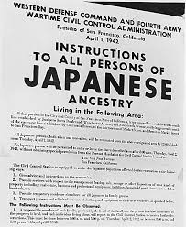
Chief Executive
Executive Orders
Executive orders are presidential directives that have the force of law without the approval of Congress
This is an implied power of the Constitution
Executive orders maybe issued to detail specific actions federal agencies must make to implement a law
They have also been used to make dramatic new policy
Even though Presidents can use the executive order their successors may just as easily reverse them.

Slide 16
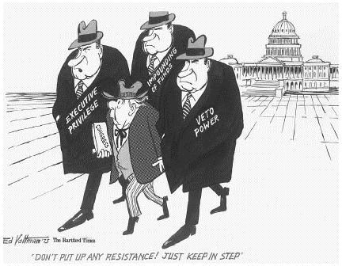
Chief Executive
Impoundment of Funds
Happens when the President has a deep disagreements with Congress on what programs should exist
Impoundment of Funds means that the President refuses to spend funds Congress approved to carry out the programs they are disagreeing about.
Supporters of impoundment argue that it is an inherent power of the executive
Opponents argue that impoundments undermine the will of the people who have chosen the legislators who created and funded the programs

Slide 17
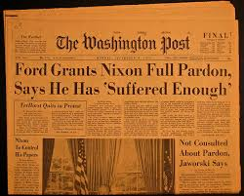
Chief Executive
Reprieves, Pardons, and Amnesty
A reprieve postpones legal punishment
Pardon releases a person from legal punish, usually people who have been convicted of a federal crime
Amnesty is a pardon for a group of people who have committed an offense against the government

Slide 18
Lesson 3: Commander in Chief/Chief Diplomat

Slide 19
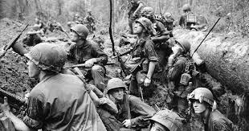
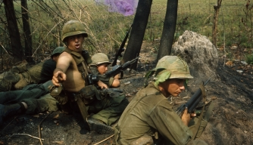
Commander in Chief
Power to Make War
Congress retains the power to declare war, and to fund the military
Presidents have sent American forces into action many times without declarations of war
War Powers Act (1973) does limit the power of the president to wage war without a formal declaration
Prevents presidents from committing troops to combat for more than 60 days without Congress’s approval
Allows Congress to order the president to disengage troops involved in an undeclared war
Since the War Powers Act there have been many instances where the President has engaged in military operations

Slide 20
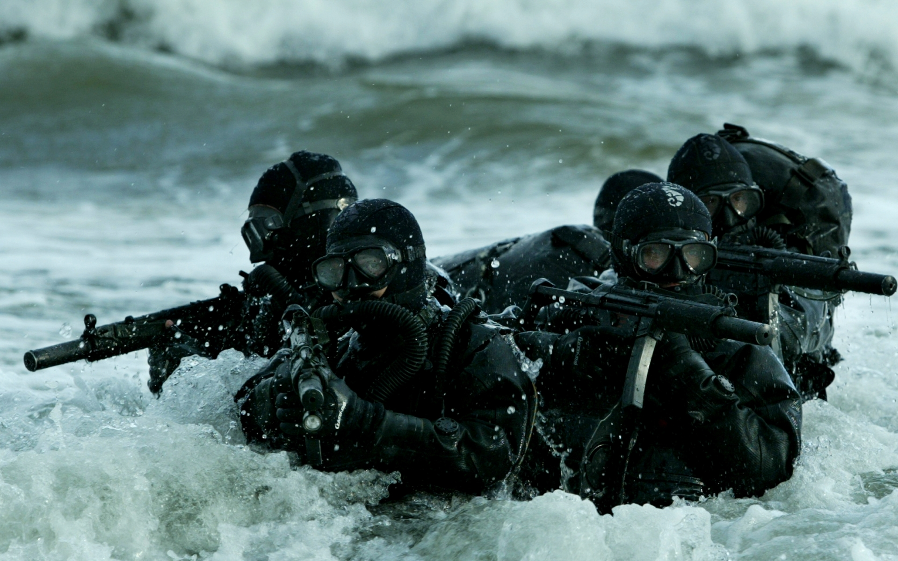
Commander in Chief
Military Operations and Strategy
Presidents are responsible for key military decisions that define military policy and strategy
The president is a civilian, and not an active member of the military, and thus may not have any military experience
The president will receive regular reports from the military and national security leaders that help him or her know about national security threats
The Shadow War
In the last 15 years, the US has conducted shadow war
Shadow Warfare is fought in secret by special operations troops, hired contractors and armed drones
Many shadow war activities are classified (information not made public)
There are groups out there who want to try to make the information about special activities public, so that the public can hold the government accountable.

Slide 21
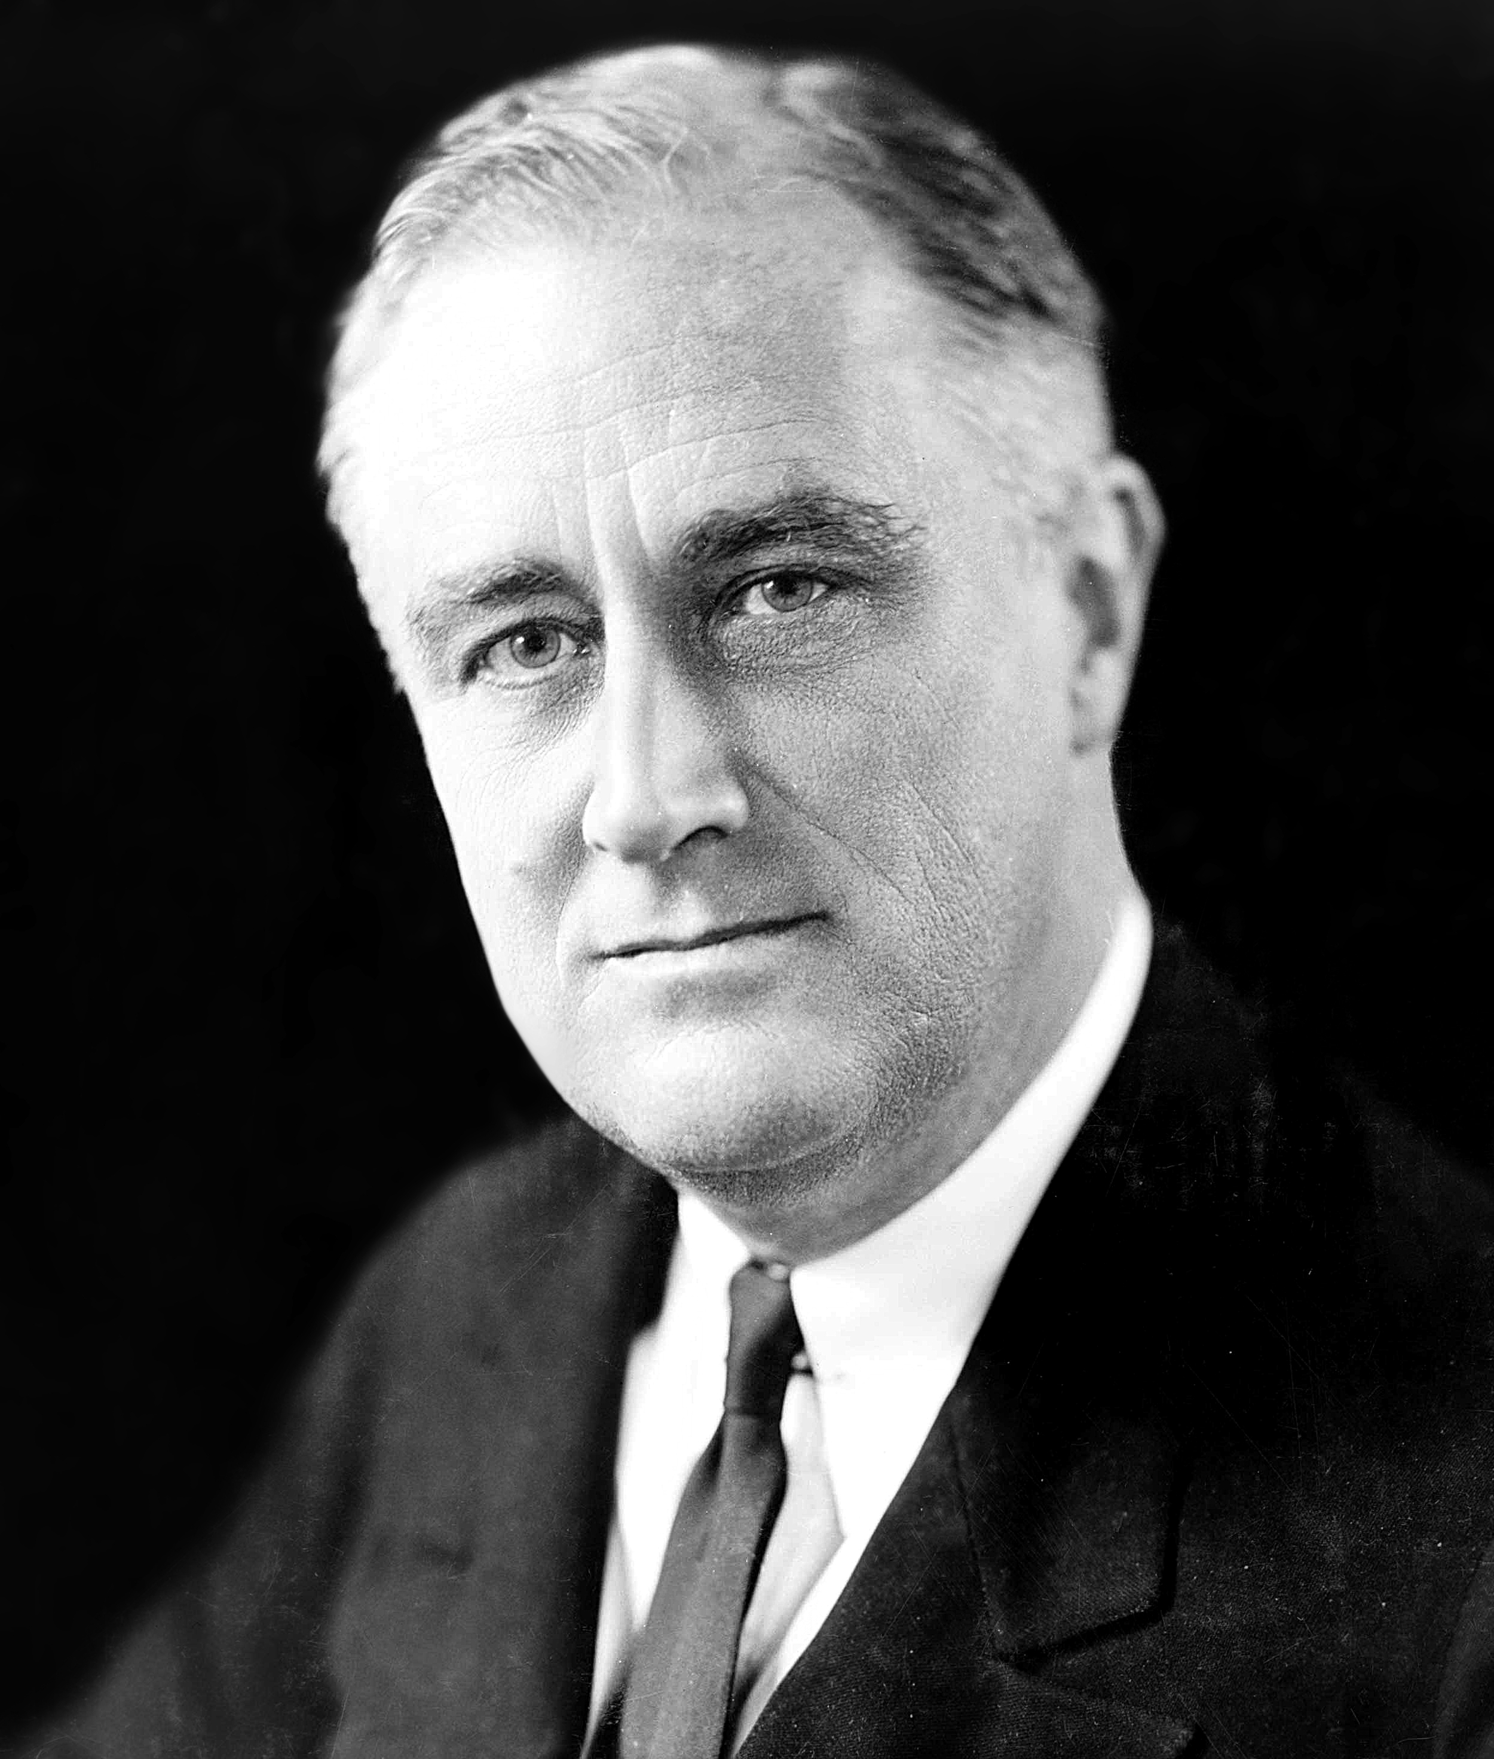
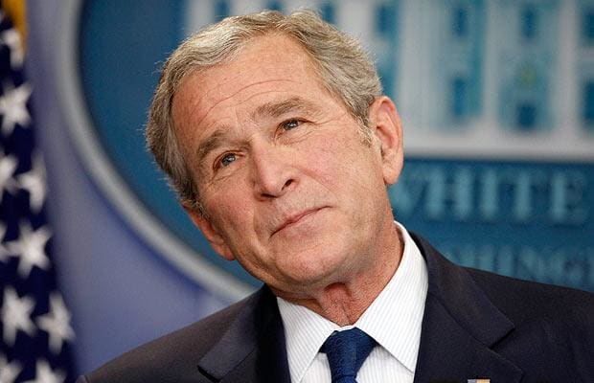
Commander in Chief
The Presidency in Times of War
During a war, the president often claims powers to protect the nation
Congress is also more likely to give the president special powers at home and abroad
Examples:
FDR during WWII was given the power by Congress to control prices, ration gas and food, and manage the industries needed to produce military weapons
President George W. Bush after 9/11 expanded presidential powers as a way to fight terrorism & a few weeks after the attacks Congress passed the US Patriot Act

Slide 22
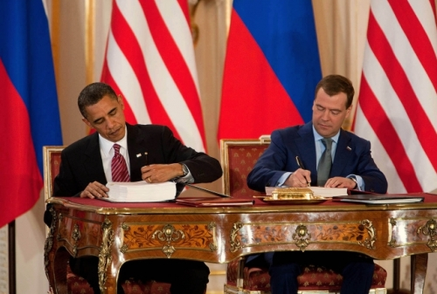
Chief Diplomat
Treaties and Diplomatic Resolutions
Under the Constitution the President has the sole power to negotiate and sign treaties, but Congress has to approve it
The Senate takes its powers to approve treaties very seriously, sometimes Congress can even restrict or deny funds to foreign policy initiatives
In the struggle over foreign policy the President has two advantages over Congress:
Access to information
Decisive ability

Slide 23
Chief Diplomat
Executive Agreements
These are pacts between the president and the had of a foreign government
They have the same legal status as treaties, but do not require Senate consent
They involve routine matters, but could include more serious arrangements
Some presidents have tried to keep these agreements but Congress passed a law in 1972 requiring the president to make public all executive agreements
Recognition of Foreign Governments
The president decides whether the United States will recognize government of other countries
Presidents determine whether the government will acknowledge the legal status of another country
Presidents sometimes use recognition as a foreign tool

Slide 24
Lesson 4: Legislative, Economic, and Party Leader

Slide 25
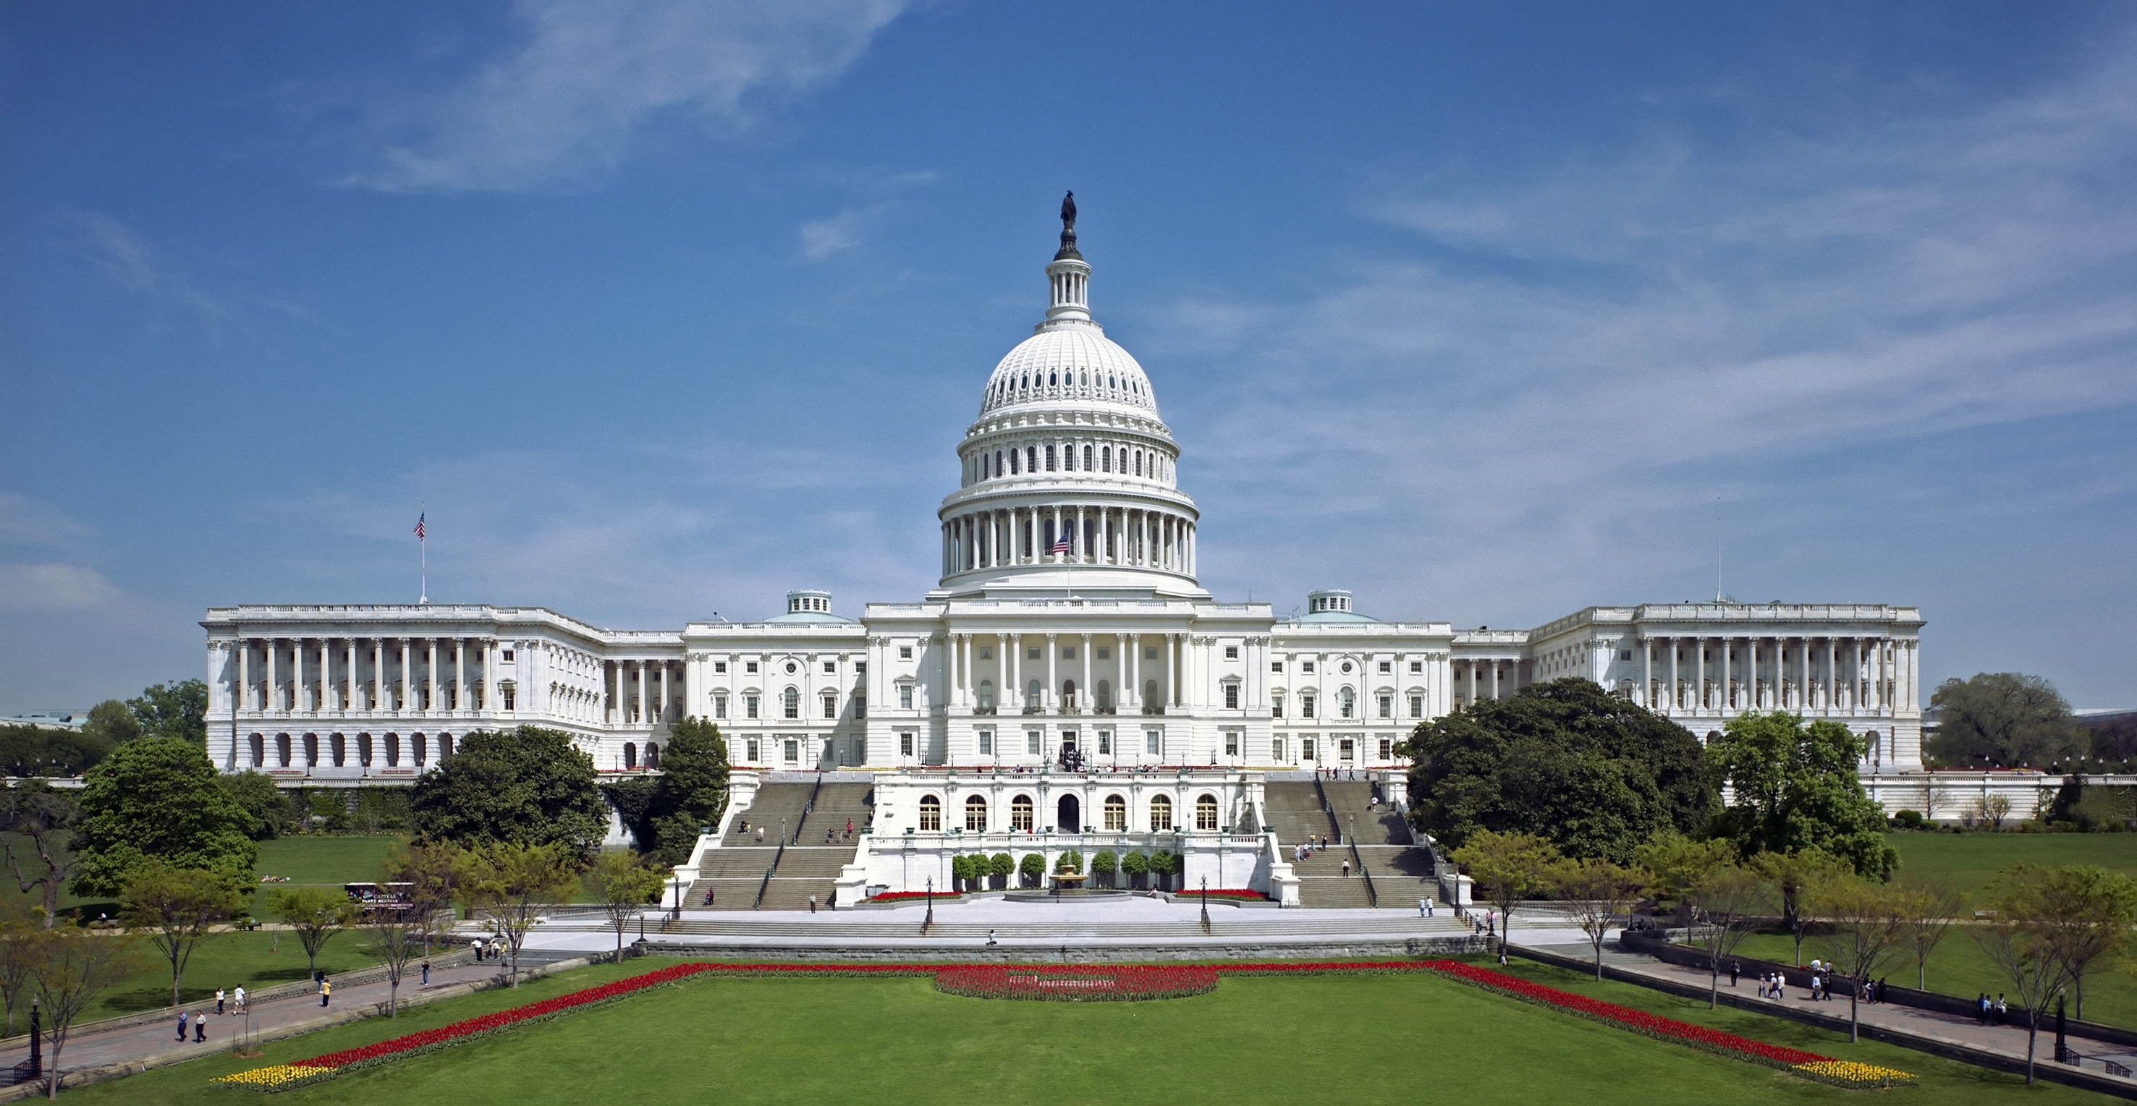
Influencing Legislation
Tools to Influence Congress
The president works to influence Congress in several ways
If the Congress has a majority in Congress from the party then several of the presidents laws will get passed
A standard measure of presidential success with Congress is how frequently presidents get their way on congressional roll call votes
When Presidents and the majority of Congress are from different political parties the president must work harder to influence Congress to support his goals
Presidents may do the following to influence Congress:
Hand out political favors
Visit the home state of a member of Congress
Start a federal project that will bring money and jobs to a member’s home state or district

Slide 26
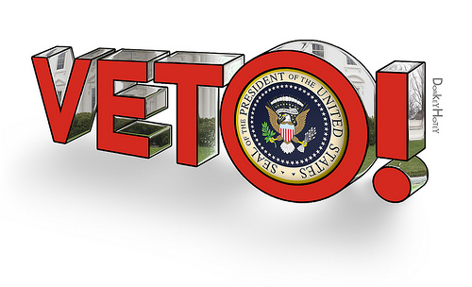
Influencing Legislation
The Veto
This is a very important tool in lawmaking
The president has 10 days to veto or sign the law or it automatically becomes a law
Pocket veto: is where Congress adjourns before the 10 day period and thus a bill does not become a law
Presidents sometimes use the threat of veto to force Congress to stop a bill or change it
The president does not have the power to veto selected items in the bill (governors have this power)
Congress did attempt to give the president more power for line item vetoes in 1996, but the Supreme Court in Clinton v. City of New York found the law unconstitutional

Slide 27
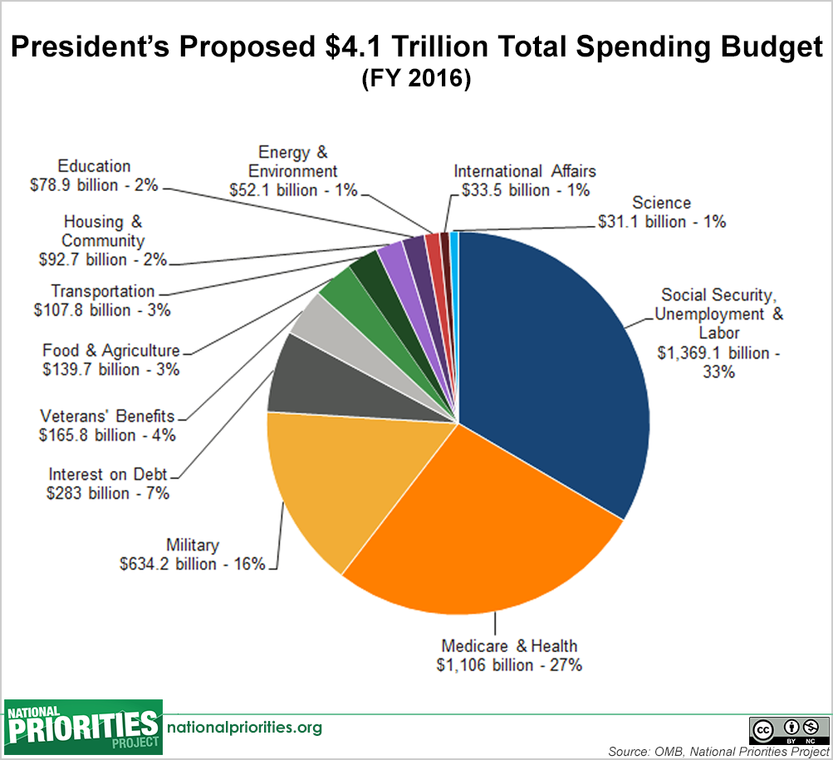
Economic Planning
The president’s role as chief economic planner was not set out in the Constitution but it developed over time
One of the economic duties of the president is to prepare an annual budget
Presidents work with budget officials to decide what government programs to support or programs to cut back
Decisions on budgeting reflect the presidents priorities
The annual budge proposal is submitted to the House, where it is modified and debated
Ultimately, Congress passes a law that creates the budge and the president can sign or veto the law

Slide 28
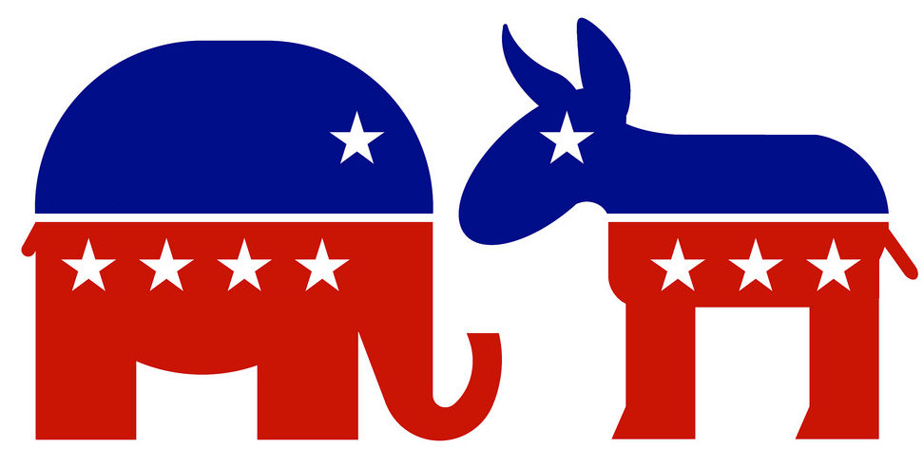
Political Party Leader
The presidents political party expects the chief executive to be the party leader
The president may give speeches to help party members who are running for office
The president also selects the party’s national chair and often helps plan future election strategies
Presidents are also expected to appoint members of their party to government jobs

