Slide 1
The Legislative Branch
Chapter 8: State and Local Legislatures

Slide 2
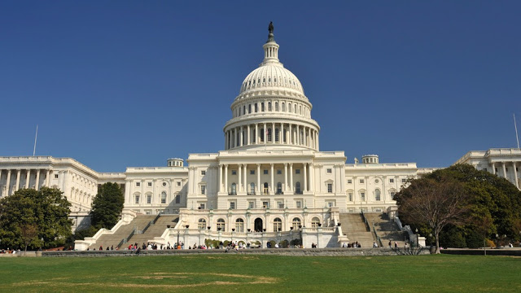
Lesson 1: State Legislatures

Slide 3
State Legislatures
Legislatures- are lawmakers that are voted in by the citizens in order to pass laws on their behalf.
Bicameral legislature: States whom legislatures are divided into two houses.
House of Representatives (larger of the two)
Senate (smaller of the two)
Unicameral legislature: Is a one-house legislature
Only Nebraska, called the Senate.

Slide 4
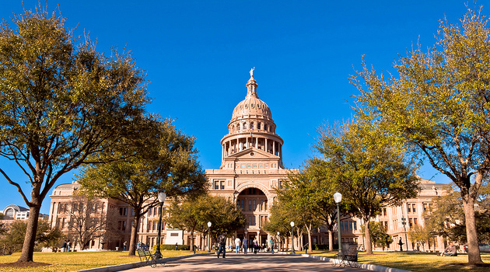
Organization of State Legislatures
State legislatures vary greatly in size.
Largest: New Hampshire, 400 Representatives and 24 Senators.
Smallest: Alaska, 40 Representatives and 20 Senators.
These state legislatures are organized to represent all citizens of the state equally.
Therefore each state is divided into districts.
Reynolds v. Sims, ruled that state legislative districts must be equal in population.

Slide 5
Sessions and Leaders
This process is similar to that of Congress.
Most state legislatures meet in regular sessions every year, some every two years.
In most states the lieutenant governor presides over the state Senate.
In the House of Representatives they often elect their leader, called the Speaker.
The leader of each house appoints its committee members.

Slide 6
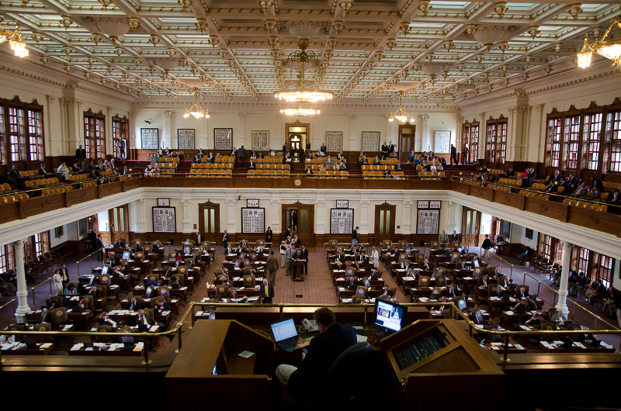
Qualifications and Terms
The qualifications and terms of state legislatures vary from state to state.
Most require that they be U.S. citizens.
In almost all states you must live in the district you are representing.
Generally speaking you must be 25 years old to be a Senator and 21 to be a Representative.
In most states Senators serve four year terms and Representatives serve two year terms.
Salaries vary by state, EX. In Rhode Island they make $10,000 per year and in New York $79,500.

Slide 7
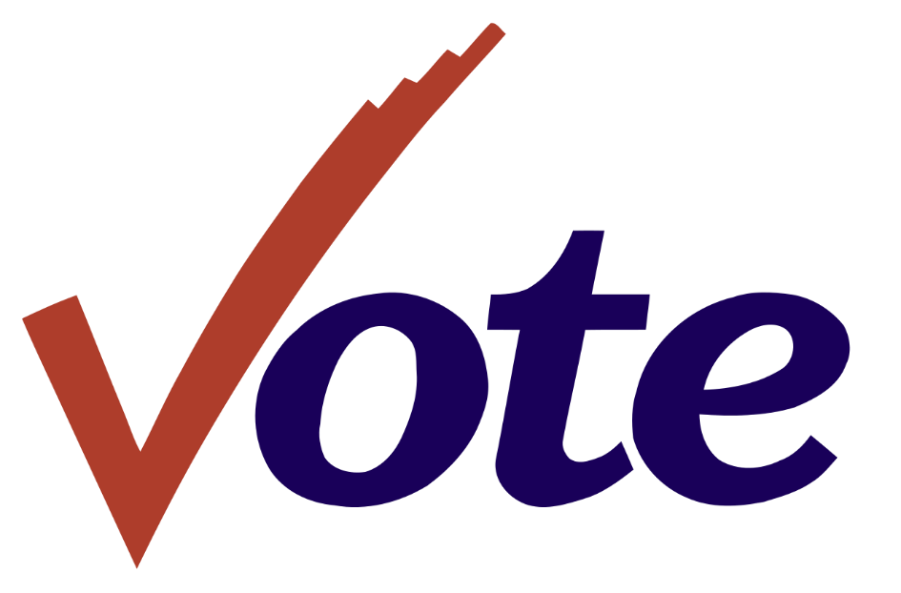
State Legislative Elections
Primary Elections
All state senators and representatives are directly elected by the people in their voting districts
Major states the process of election looks similar to the congressional elections but on a smaller scale
Candidates typically take part in elections to be put on the general election ballot
Some states require a two-part process consisting of a closed or semi-closed primary which only voters registered of a certain party can choose candidates from their party
Other states any voter can vote on either party’s candidates

Slide 8
State Legislative Elections
Campaign Finance
Some candidates for state legislatures spend millions of dollars trying to get elected, others very little
The amount of money spent on a state election depends on the political importance of he district in question and the party affiliations of its voters
Some state legislative elections attract quite a bit of national attention (example: when a state prepares to redraw districts)

Slide 9
Lesson 2: Local Governments

Slide 10
Civic Participation in Local Government
The people have more power at the local level than any other level
Participating in local government is easier than it is at other levels of government simply because of proximity
At the local level the elected officials do not wait for the citizens to come to they often go to the people
Many public and private groups make it their mission to educate people about how to be informed, engaged, and involved in local government

Slide 11
Government Structure and Lawmaking
Counties-are normally the largest territorial and political subdivision within the state
Cities-can be called municipality, they have a certain size population and geographic area
Townships-exist as units of local government in 20 states, services vary state to state, historically they were governed with very direct participation of their residents
Special Districts-are designed to be able to better respond to specific problems, they are units of local government that deal with a specific function
School Districts-are usually governed by an elected local body (school board), and they determine the budge for the school system and decide on new school programs and facilities

Slide 12
Lesson 3: State and Local Legislative Policy

Slide 13
Public Policy Concerns of State Legislatures
Many states have moved to add more stringent requirements to voting
Example: Laws to prevent voter fraud
There are opponents to these laws arguing that it impacts certain groups of people
Some states who have initiated voter ID have been blocked by the federal government
States are attempting to balance their energy needs to protect the environment by regulating the use of energy sources
Some states governments are in charge of ensuring that schools and education programs are providing the best outcomes for students
Example: passing laws to allow public charter schools to not follow state laws
Looking for ways to assess and evaluate teacher quality
Finding ways to fund higher education
Legislatures often enact laws in responds to trends in crime

Slide 14
Public Policy Concerns in local legislatures
One of the goals of local governments is to create livable cites, and so they must regulate land use by passing zoning ordinances
Both state and local governments address transportation issues by providing mass transit systems
Economic develop is handled by both the state and local government as it is their number one concern
Smaller cities have to find away ways to promote business to compete with larger cities
Many states and cities offer incentives to get investments into their economy
They also pass policies that will help the workers of their state and cities

