Slide 1
Legislative Branch
Chapter 6: Congressional Powers

Slide 2
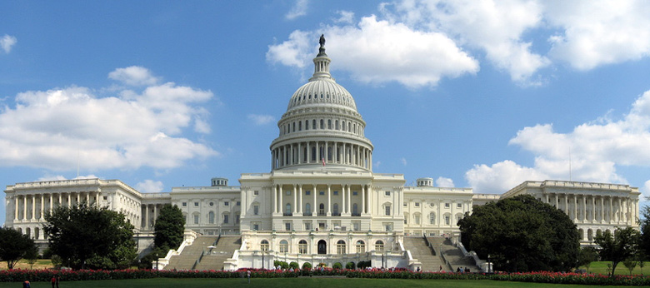
Lesson 1: Constitutional Powers

Slide 3
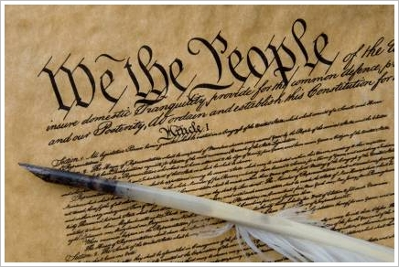
Constitutional Provisions
The Constitution grants Congress a number of specific powers in three different ways:
The expressed powers are granted to Congress explicitly in the Constitution.
The implied powers are granted by reasonable deduction from the expressed powers.
The inherent powers are granted through the Constitution’s creation of a National Government for the United States.

Slide 4
Legislative Powers
A tax is a charge levied by government on persons or property to meet public needs.
The Constitution places four limits on Congress’s power to tax:
(1) Congress may tax only for public purposes, not for private benefit. | (2) Congress may not tax exports.
(3) Direct taxes must be apportioned among the States, according to their populations. | (4) Indirect taxes must be levied at a uniform rate in all parts of the country.

Slide 5
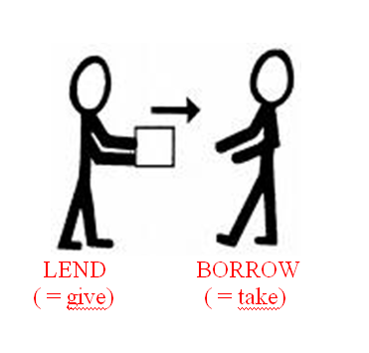
Legislative Powers
Borrowing Money
Article I, Section 8, Clause 2 gives Congress the power “[t]o borrow Money on the credit of the United States.”
Deficit financing is the practice of spending more money than received in revenue and borrowing to make up the difference.
The public debt is all of the money borrowed by the government over the years and not yet repaid, plus the accumulated interest on that money.

Slide 6
Legislative Powers
Currency Power
Article I, Section 8, Clause 5 gives Congress the power “[t]o coin Money [and] regulate the value thereof.”
Legal tender is any kind of money that a creditor must by law accept in payment for debts.
The Bankruptcy Power
Article I, Section 8, Clause 4 gives Congress the power “[t]o establish…uniform Laws on the subject of Bankruptcies throughout the United States.”
Bankruptcy is the legal proceeding in which the bankrupt person’s assets are distributed among those to whom a debt is owed.

Slide 7
Legislative Powers
Commerce Power
The commerce power—the power of Congress to regulate interstate and foreign trade—is granted in the Commerce Clause of the Constitution.
The Constitution places four limits on Congress’s use of the commerce power:
(1) Congress cannot tax exports. | (2) Congress cannot favor the ports of one State over those of any other in the regulation of trade.
(3) Congress cannot require that “Vessels bound to, or from, one State, be obliged to enter, clear or pay Duties in another.” | (4) Congress could not interfere with the slave trade (through 1808).

Slide 8
Legislative Powers
Foreign Policy Power
Congress has the inherent power to act on matters affecting the security of the nation.
Congress’s war powers are extensive and substantial, including: the power to raise and support armies, to provide and maintain a navy, and to organize, arm, and discipline the military.
Congress also has the power to restrict the use of American forces in combat in areas where a state of war does not exist (War Powers Resolution of 1973).

Slide 9
Legislative Powers
Other Legislative Powers
Naturalization is the process by which citizens of one country become citizens of another.
Article I, Section 8, Clause 7 says that Congress has the power “[t]o establish Post Offices and post Roads.”
A copyright is the exclusive right of an author to reproduce, publish, and sell his or her creative work.
A patent grants a person the sole right to manufacture, use, or sell “any new and useful art, machine, manufacture, or composition of matter.”

Slide 10
Non legislative Powers
Constitutional Amendments
Article V gives Congress the power to propose amendments by a two-thirds vote in each house.
Electoral Duties
In certain circumstances, the Constitution gives Congress special electoral duties.
If no candidate for President receives a majority in the electoral college, the House decides the election.
If no candidate for Vice President receives a majority in the electoral college, the Senate decides the election.
Also, if the vice presidency is vacated, the President selects a successor, who faces congressional approval by a majority vote in both houses.

Slide 11
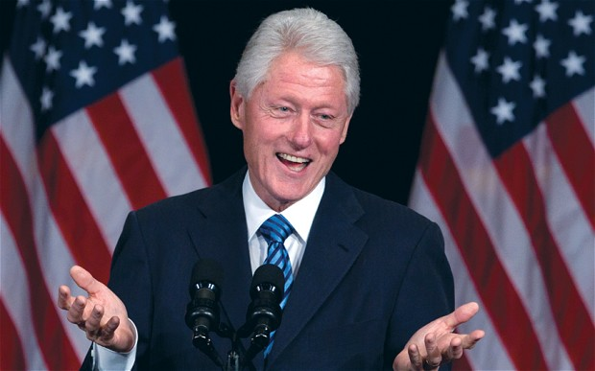
Non legislative Powers: Impeachment Power
The Constitution grants Congress the power of removing the President, Vice President, or other civil officers from their office through impeachment.
The House has the sole power to impeach, or bring charges against the individual.
There is then a trial in the Senate. A two-thirds vote of the senators present is needed for conviction.
The penalty for conviction is removal from office.

Slide 12
Lesson 2: Investigations and Oversight

Slide 13
Investigatory Power
Congress may choose to conduct investigations through its standing committees for several reasons:
(1) to gather information useful to Congress in the making of some legislation; | (2) to oversee the operations of various executive branch agencies;
(3) to focus public attention on a particular subject; | (4) to expose the questionable activities of public officials or private persons;
(5) to promote the particular interests of some members of Congress.

Slide 14
The Power of Oversight
Checks and Balances
Congress can check how the executive branch has administered the law and decide whether it met the law’s goal
Even though they have broad oversight they use them inconsistently
Reasons why oversight fails:
Not enough staff
Oversight does not interest many voters, unless a scandal is uncovered or major problem
Some regulations are so vague that it is difficult to know what they mean
Committees sometimes come to favor the federal agencies they are supposed to oversee

Slide 15
The Power of Oversight
How Congress Limits the Executive
Appointments
All major appointments made by the President must be confirmed by the Senate by majority vote.
Only 12 of 600 Cabinet appointments to date have been declined.
“Senatorial courtesy” is the practice in which the Senate will turn down an appointment if it is opposed by a senator of the President’s party from the State involved.
Treaties
The President makes treaties “by and with the Advice and Consent of the Senate,... provided two thirds of the Senators present concur.”
Presently, the President often consults members of the Senate Foreign Relations Committee.

Slide 16
Lesson 3: Congress and the President

Slide 17
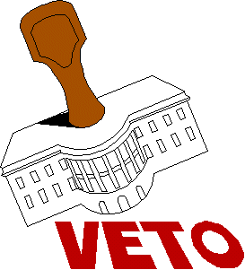
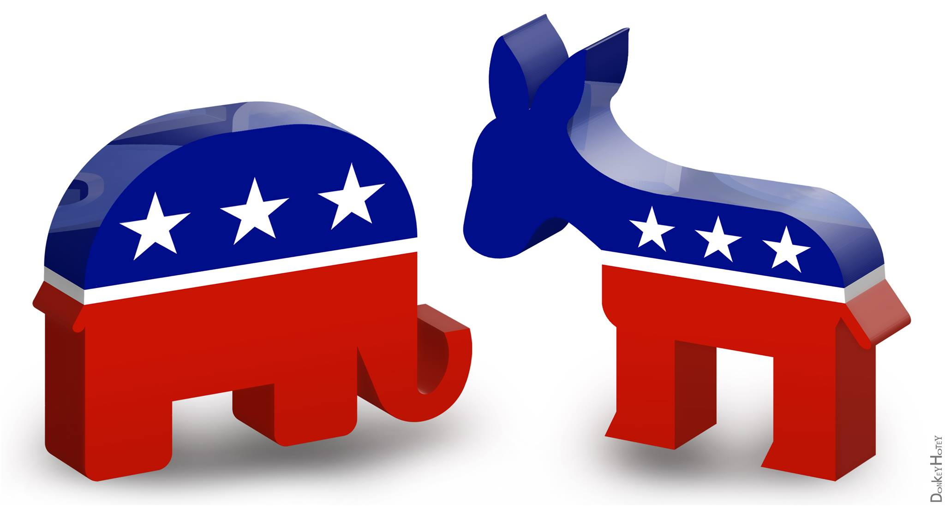
Sources of Tension
Checks and Balances
Under the Constitution, the President shares his most important duties with Congress
All bill Congress passes require the executives cooperation
The system of checks and balances gives Congress and the president several tools to counteract each other
Party Politics
Most elected officials are loyal to their political party and philosophies
Partisan politics can affect relations between the president and congress
This issue is obvious if one party controls the White House and the other controls the House and Senate, this divides the government

Slide 18
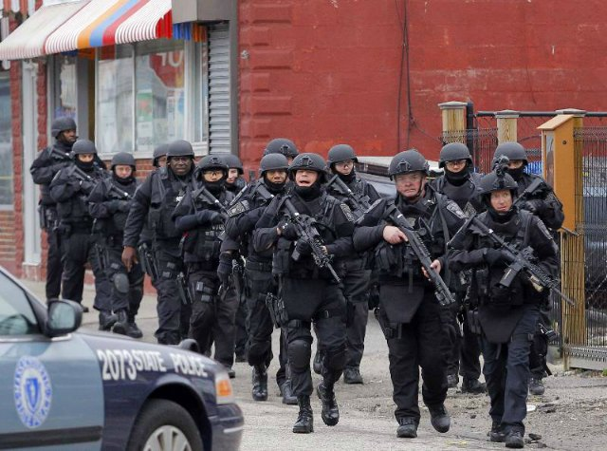
The Balance of Power
Emergency Powers
In times of crisis Congress has given extra power to the Presidents
Presidents have declared martial law, seized property, and controlled transportation and communications
Balancing Budget Powers
Presidents have assumed more responsibility for planning the national budget
Congress merely reacts to budget proposals, but they increased their role to ensure that the President was spending the funds on programs they have approved

Slide 19
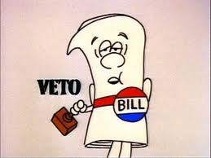
The Balance of Power
Legislative and Line-Item Vetoes
Congress wields legislative veto to invalidate actions by the executive branch
Budgets must go through congress giving them a veto ability on the budget
Line-item veto is a power that many state governments have, but in the federal government vetoing only part of a bill

