Slide 1
Legislative Branch
Chapter 5: Structure of Congress

Slide 2
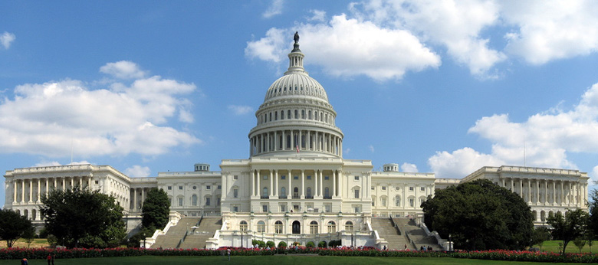
Lesson 1: Congressional Membership

Slide 3
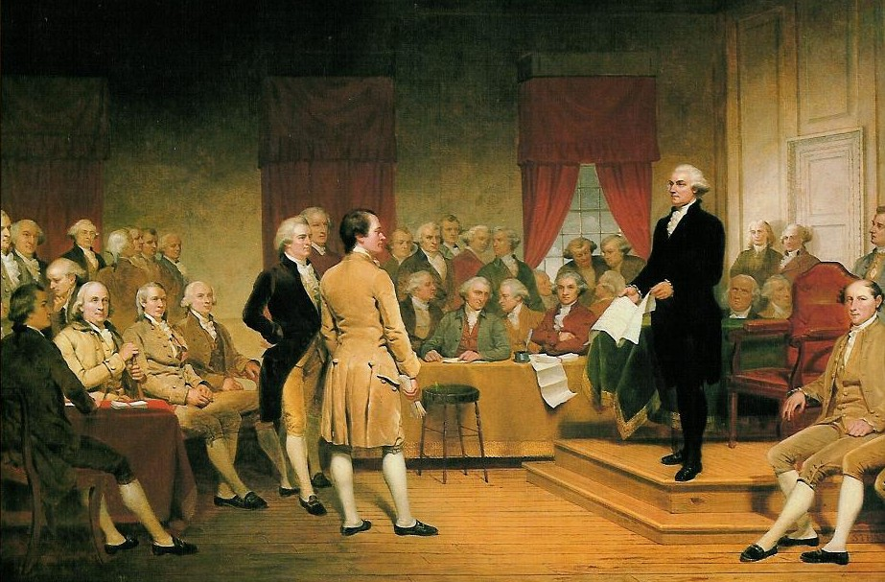
Organization of Congress
Bicameral Legislature
Reasons behind two chamber legislature:
Historical: The British Parliament consisted of two houses since the 1300s, and many colonial assemblies were similar in form.
Practical: A bicameral legislature was necessary to compromise the Virginia and New Jersey plans of representation.
Theoretical: The Framers favored a bicameral Congress in order that one house might act as a check on the other.

Slide 4
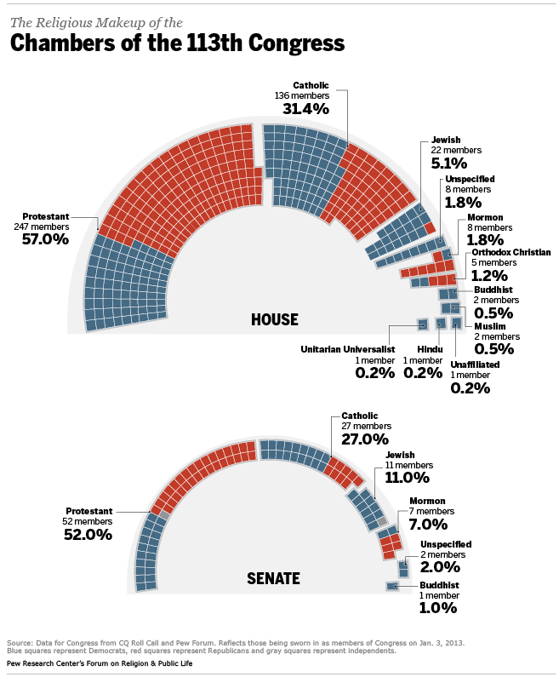
Organization of Congress
Bicameral Legislature
It is quite common for the two champers to pass similar bills
Before any bill can be sent toe the President, both chamber must agree on the which bill to send
At their best they can produce compromise and national consensus, at their worst legislative gridlock or failure of critical legislative work

Slide 5
Organization of Congress
Terms
A term is the length of time that officials serve after an election, as in a two- or six-year term.
Senators enjoy six year terms
Representatives enjoy two year terms
The date for the start of each new term has been set by the Twentieth Amendment (1933) as “noon of the 3d day of January” of every odd-numbered year.

Slide 6
Organization of Congress
Congressional Sessions
A session is the regular period of time during which Congress conducts business.
Congress adjourns, or suspends until the next session, each regular session as it sees fit.
If necessary, the President has the power to prorogue, or adjourn, a session, but only when the two houses cannot agree on a date for adjournment.
Only the President may call Congress into a special session—a meeting to deal with some emergency situation.

Slide 7
Membership of the House
Qualifications
The Constitution says that a member of the House
(1) must be at least 25 years of age,
(2) must have been a citizen of the United States for at least seven years, and
(3) must have been an inhabitant of the State from which he or she is elected.
The realities of politics also require some informal qualifications, such as party identification, name familiarity, gender, ethnic characteristics, and political experience.

Slide 8
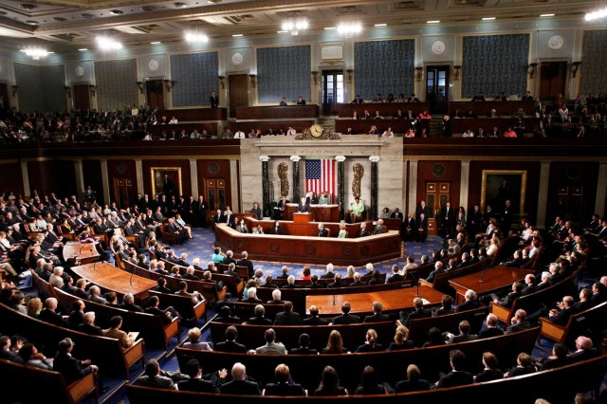
Membership of the House
Terms
Members are elected to the House of Representatives for two-year terms
Representatives begin their term January 3 after the November election
Sometimes if a representative dies or retires a special state election must be held to fill the vacancy

Slide 9
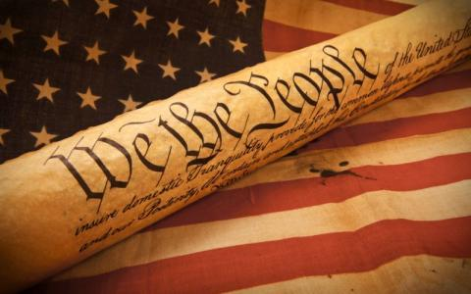
Membership of the House
Representation and Repatriation
Article I of the Constitution directs Congress to reapportion—redistribute—the seats in the House after each decennial census.
As the United States grew in population, the number of representatives in the House also grew.
The Reapportionment Act of 1929 set the “permanent” size of the House at 435 members, and provided for “automatic reapportionment.”

Slide 10
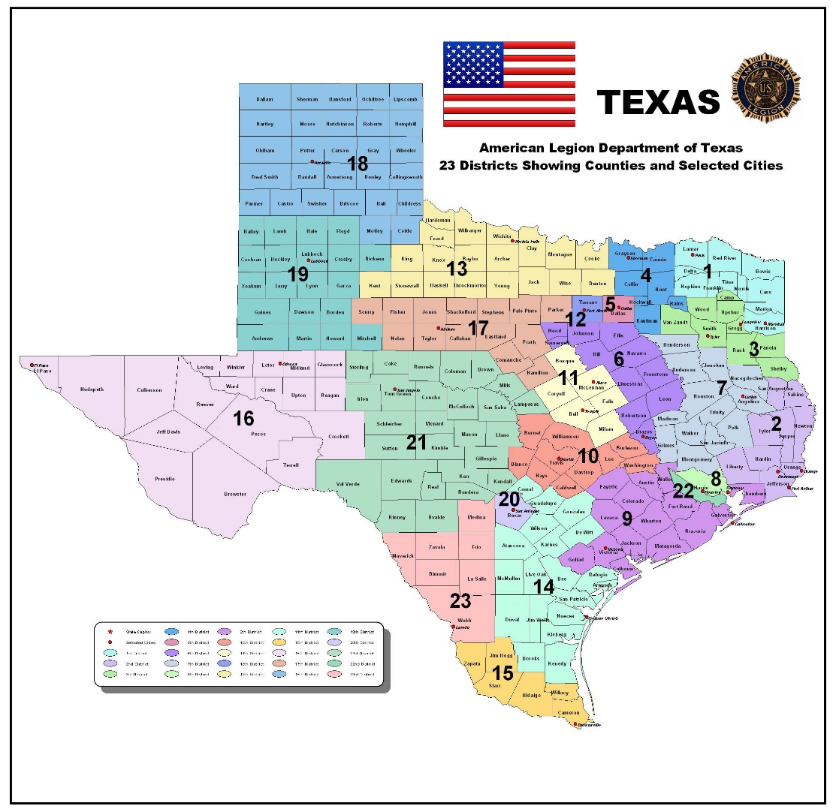
Membership of the House
Congressional Redistricting
Each state every 10 years draws the boundaries for the congressional districts (one for each representative)
Representatives are elected from these districts
Reynolds v Sims (1964) states that under the 14th amendment Both houses of bicameral STATE legislatures had to be apportioned on a population basis.

Slide 11
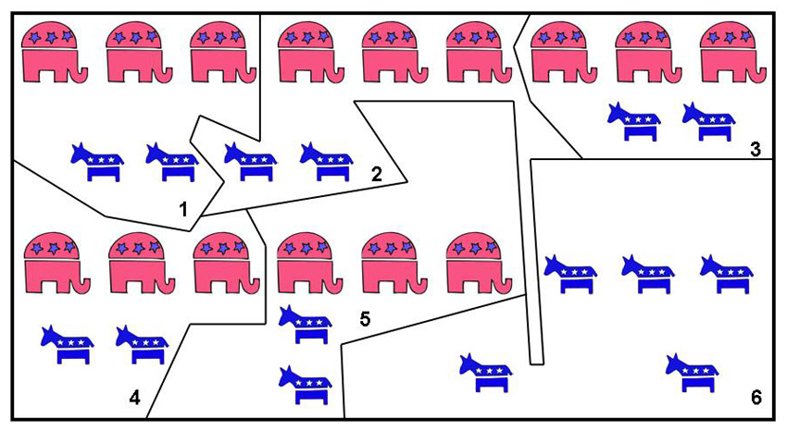
Membership of the House
Gerrymandering
Under the single-member district arrangement, the voter’s in each district elect one of the State’s representatives.
The general-ticket system, no longer in use, provided that all of a State’s seats were filled at-large.
Districts that have unusual shapes or even defy description have sometimes been gerrymandered.
Gerrymandering refers to the act of drawing congressional districts to the advantage of the political party that controls the State legislature.

Slide 12
Membership of the Senate
Qualifications
The requirements for the U.S. Senate are higher than for the House of Representatives.
The Constitution says that a Senator
(1) must be at least 30 years of age,
(2) must have been a citizen of the United States for at least nine years, and
(3) must be an inhabitant of the State from which he or she is elected.

Slide 13
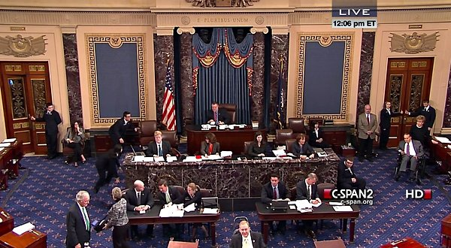
Membership of the Senate
Terms
The Constitution says that the Senate “shall be composed of two Senators from each State.” Today’s Senate consists of 100 Senators.
Originally, the Constitution provided that senators were chosen by the State legislatures.
In 1912 the Seventeenth Amendment was passed and called for the popular election of senators.
Senators serve for six-year terms.
The Senate is a continuous body, meaning that all of its seats are never up for election at the same time.

Slide 14
Lesson 2: The House

Slide 15
Rules in the House
Complex Rules
Each chamber has scores of precedents based on past rulings that serve as a guide for conducting business
House rules are generally aimed at defining the actions an individual representative can take.
Complex rules are geared toward moving legislation quickly once it reaches the floor

Slide 16
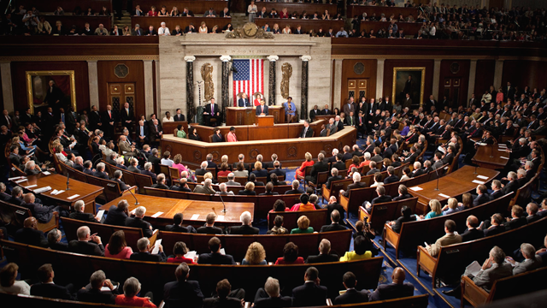
Rules in the House
Committee Work
Because of its size committee work is more important in the House
Committee work allows representatives to have more influence on the House floor
It also gives representatives the time to study and shape bills
Representatives serve on committees that are important to their constituents

Slide 17
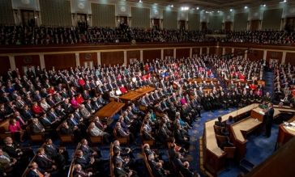
House Leadership
Goals of the House Leadership
Organizing and unifying party members
Scheduling work
Making certain that lawmakers are present for key floor votes
Disturbing and collecting information
Keeping the House in touch with the President
Influencing lawmakers to support their party positions

Slide 18
House Leadership
Speaker of the House
The Speaker of the House is the presiding officer of the House of Representatives and the acknowledged leader of the majority party.
The Speaker’s main duties revolve around presiding over and keeping order in the House.
The Speaker names the members of all select and conference committees, and signs all bills and resolutions passed by the House.

Slide 19
House Leadership
House Floor Leaders
The floor leaders are party officers picked for their posts by their party colleagues.
The party whips assist the floor leaders and serve as a liaison between the party’s leadership and its rank-and-file members.

Slide 20
Lesson 3: The Senate

Slide 21
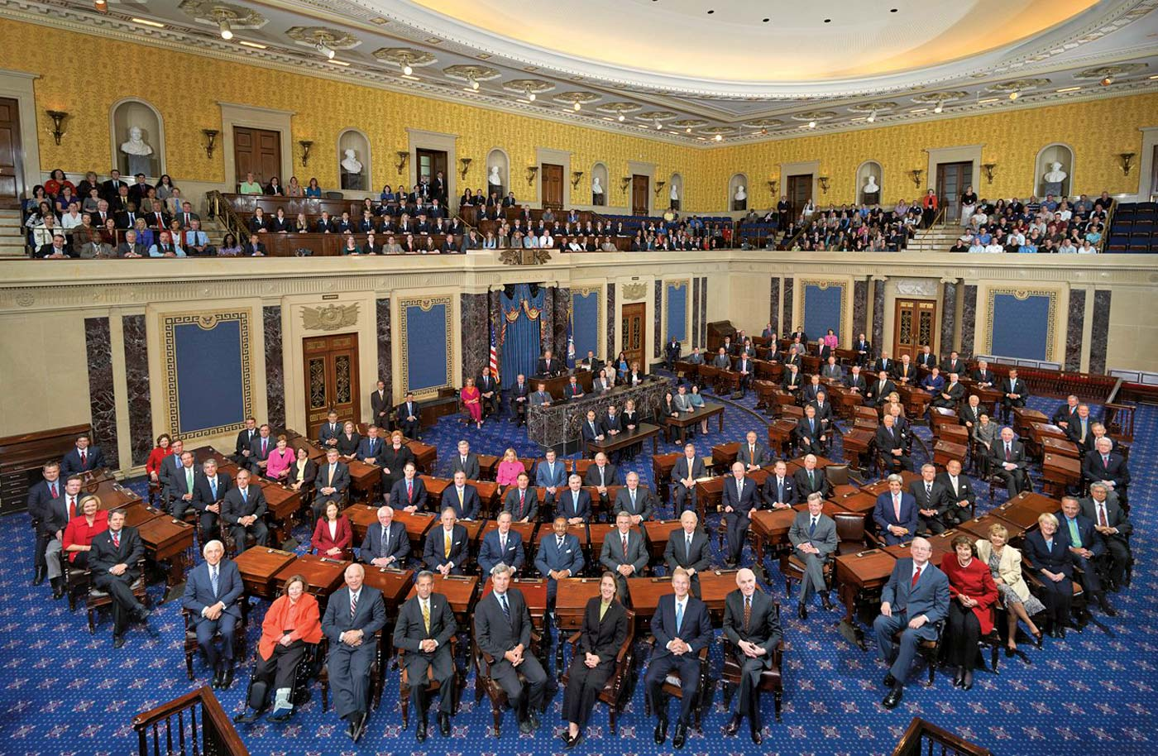
The Senate at Work
The Senate is called a deliberative body because it deliberate (formally discusses), public policies
Senators handle issues that are of specific interest to their committees
They need to be very knowledgeable about many issues from national defense to farming
The chamber for the Senate only contains 100 desks
The rules in the Senate are more flexible giving Senators maximum freedom to express their ideas

Slide 22
Leadership in the Senate
The Vice President
The job of president of the Senate is assigned by the Constitution to the Vice President.
The president of the Senate has many of the same duties as the Speaker of the House, but cannot cast votes on legislation.
Majority and Mintority Leaders
The president pro tempore, the leader of the majority party, is elected from the Senate and serves in the Vice President’s absence.
The party caucus is a closed meeting of the members of each party in each house which deals with matters of party organization

Slide 23
Lesson 4: Congressional Committees

Slide 24
Purpose of Committees
It allows members of Congress to divide their work among many smaller groups
From the huge number of bills that are introduced in Congress, committees select those few that are to receive further consideration
Lastly, they are there to hold public hearing and investigations, committees help the public learn about key problems and issues facing the nation

Slide 25
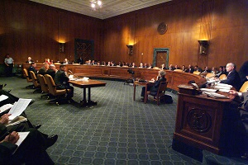
Kinds of Committees
Standing Committees
Standing committees are permanent panels in Congress to which bills of similar nature could be sent.
Most of the standing committees handle bills dealing with particular policy matters, such as veterans’ affairs or foreign relations.
The majority party always holds a majority of the seats on each committee (the lone exception being the House Committee on Standards of Official Conduct).

Slide 26
Kinds of Committees
House Rules Committee
The Rules Committee decides whether and under what conditions the full House will consider a measure.
This places great power in the Rules Committee, as it can speed, delay, or even prevent House action on a measure.
Select Committees
Select committees are panels established to handle a specific matter and usually exist for a limited time.
Most select committees are formed to investigate a current matter.

Slide 27
Kinds of Committees
Joint Conference
A joint committee is one composed of members of both houses.
Examples of joint committees include the Joint Economic Committee, the Joint Committee on Printing, and the Joint Committee on the Library of Congress
Conference Committees
A conference committee—a temporary, joint body—is created to iron out differences between bills passed by the House and Senate before they are sent to the President.

Slide 28
Committee Chairman & Seniority Rule
The committee chairmen are the members who head the standing committees in each chamber of Congress.
The chairman of each of these permanent committees is chosen from the majority party by the majority party caucus.
The seniority rule, an unwritten custom, holds that the most important posts will be held by those party members with the longest records of service in Congress.
The head of each committee is often the longest-serving member of the committee from the majority party.

