Slide 1
Foundations of Government
Federalism

Slide 2
Lesson 1: Dividing and Sharing Power

Slide 3
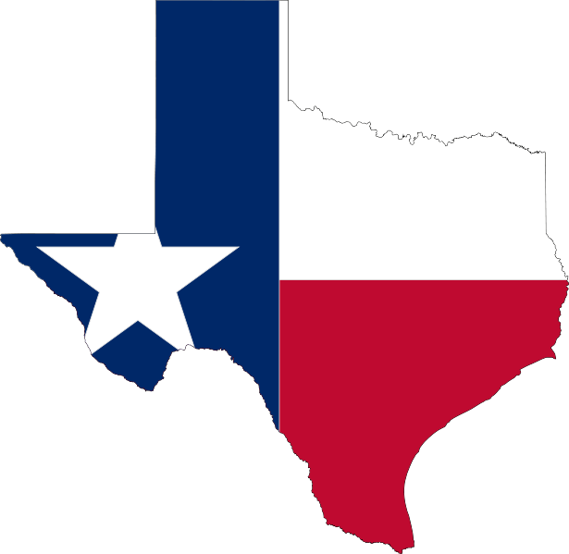
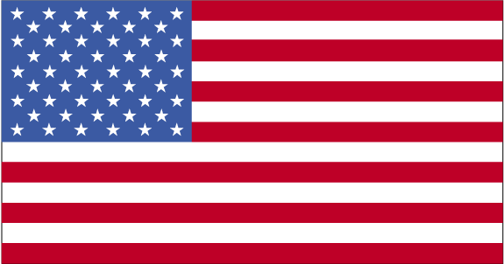
Why Federalism
It was a new approach of governing the people
Federalism-two or more governments exercise power over the same people and the same territory
In this system the federal government has some special powers over al citizens
The states have certain powers reserved for them
They are supposed to share some powers
It can end with some disagreements on the right formula for dividing and sharing power

Slide 4
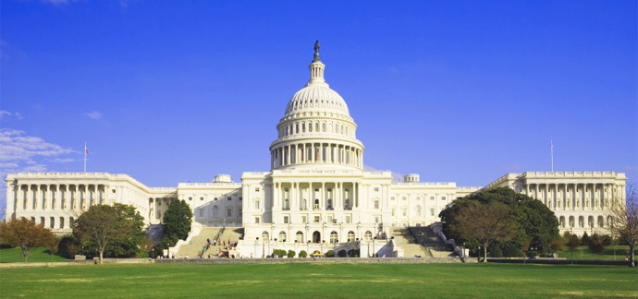
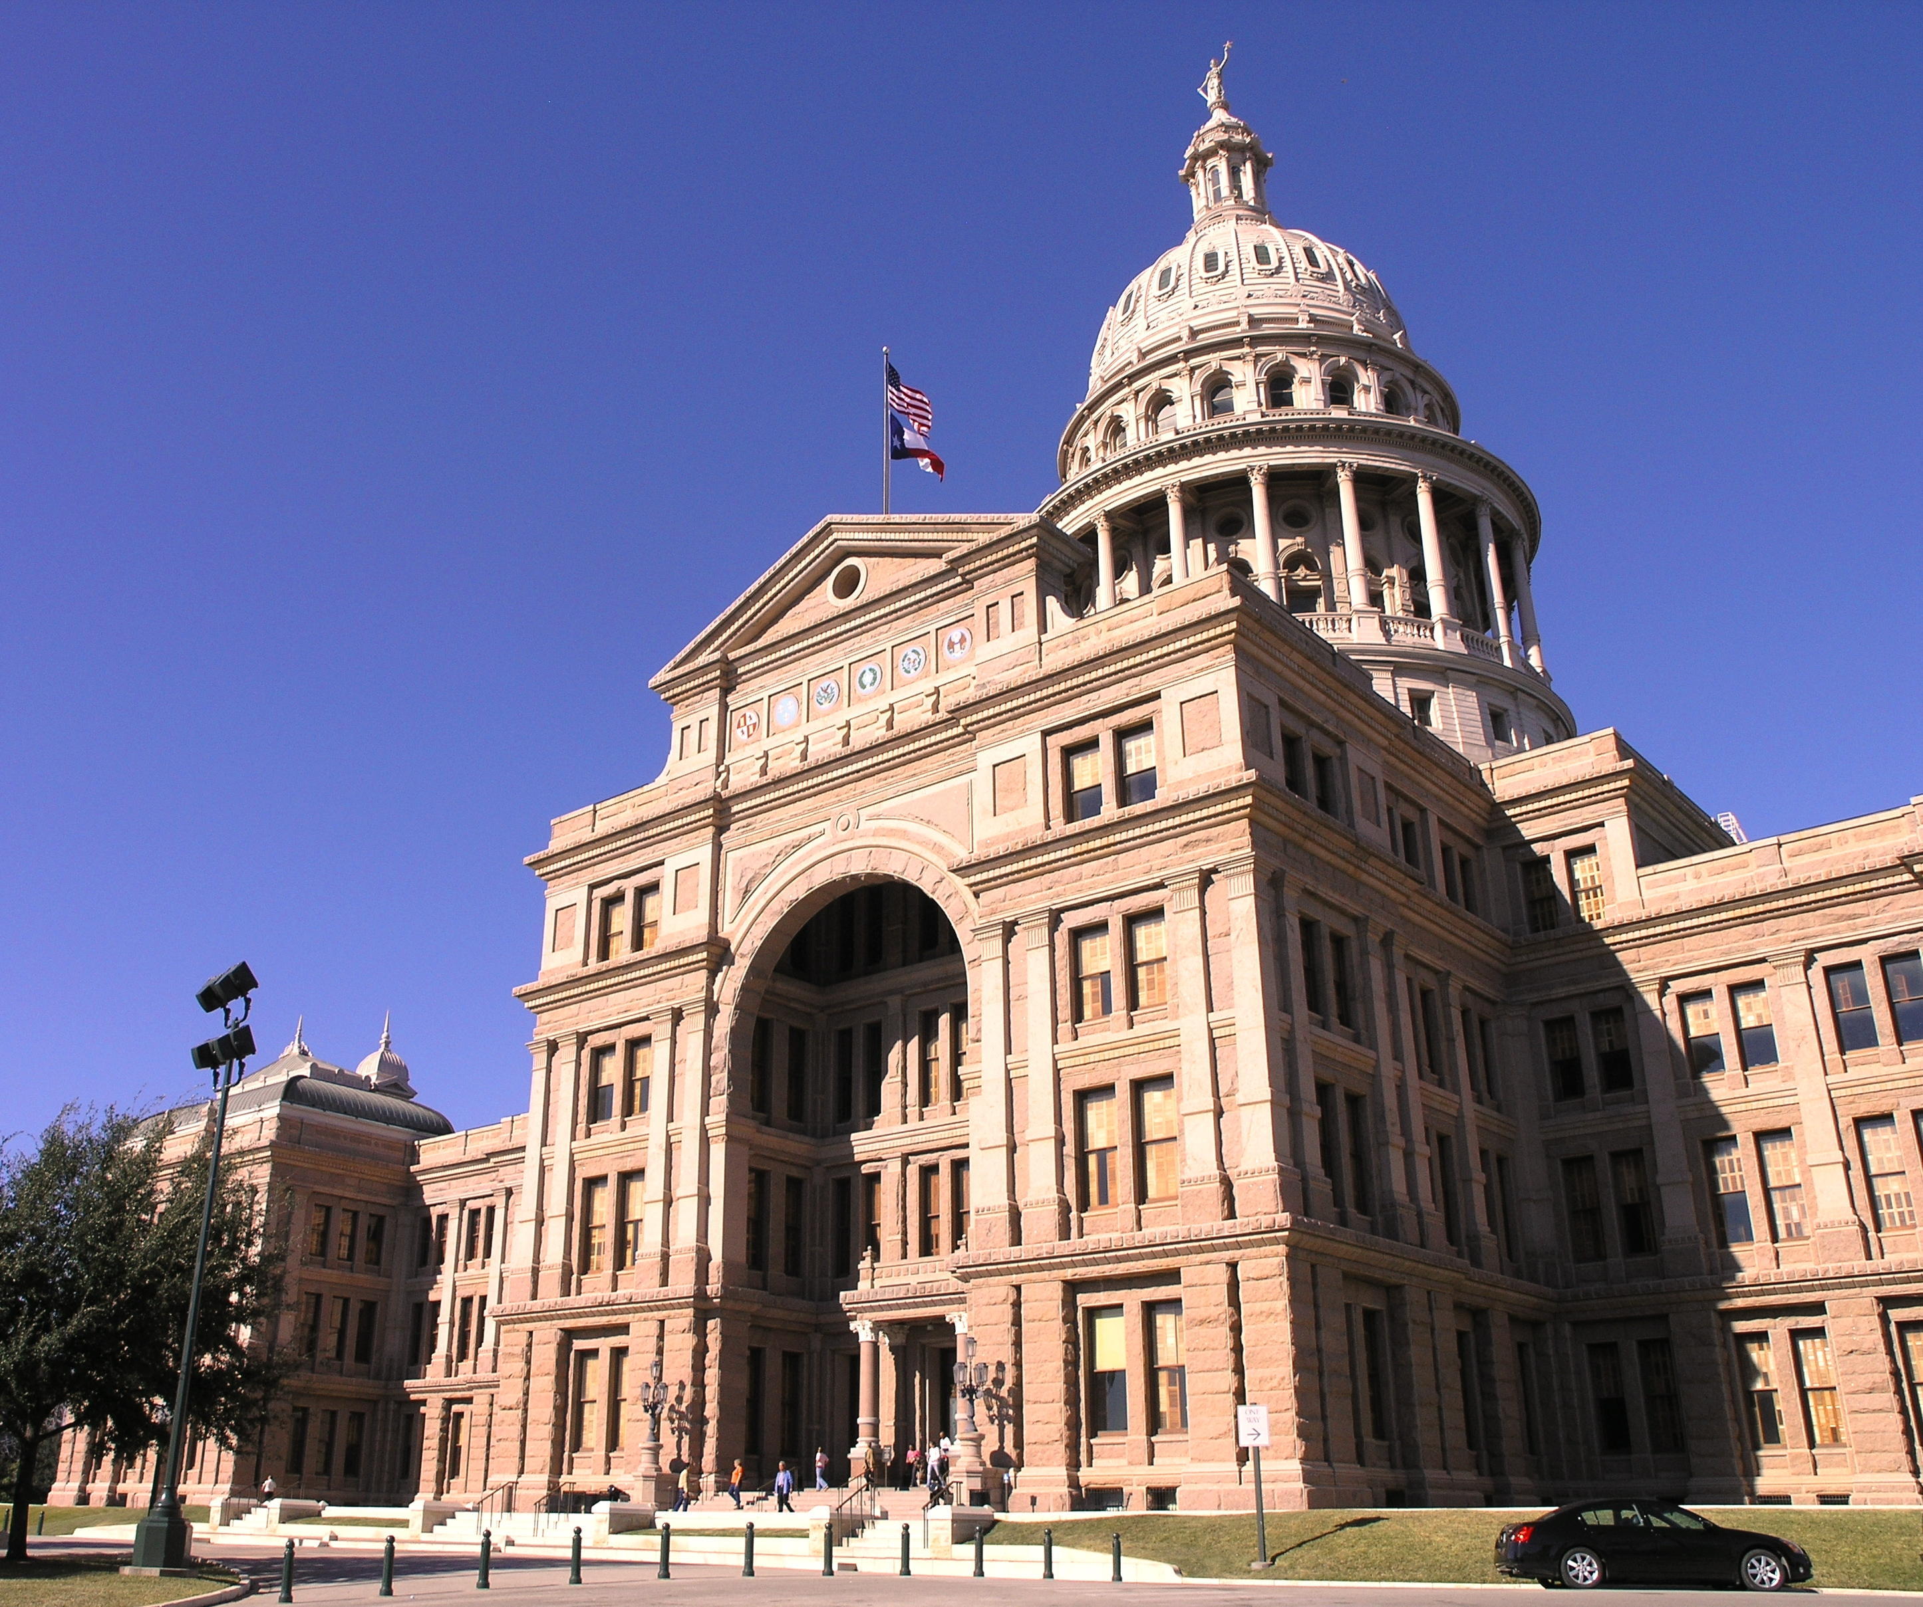
Federalism in the Constitution
National Powers
The Constitution grants both expressed and implied powers to the national government
Expressed powers (enumerated powers) are those powers directly expressed or stated in the Constitution
Implied powers are those powers that are not stated specifically in the Constitution
State and local powers
States have more powers
The Constitution says that states will have any powers not delegated to the national government (Reserved Powers)
Powers include: conduct elections, education, regulated business and trade within the state

Slide 5
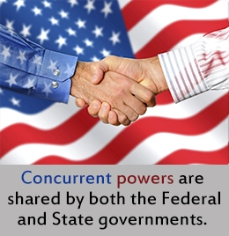
Federalism in the Constitution
Concurrent Powers
Shared powers between the federal government and state government
Each level of government operates independently
State actions must not conflict with any national laws
Denied Powers
The Constitution denies power to all levels of government
Neither government can:
Pass retroactive laws (punish actions before law passed)
Tax exports
Hold or sentence a person to jail without fair trial
Pass any law that violates the Constitution
Grant tiles of nobility

Slide 6
Federalism in the Constitution
The Supremacy Clause
Article VI makes the acts and treaties of the United States supreme
No state law or state constitution may conflict with any form of national law
Local governments can not come into conflict with their own state constitution as well as the federal government

Slide 7
Lesson 2: Relations between the National and State governments

Slide 8
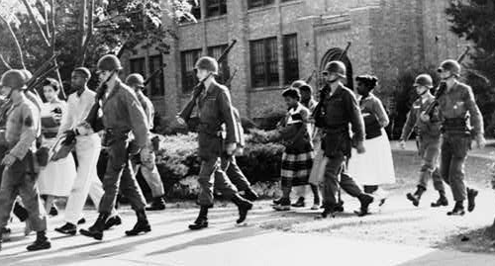
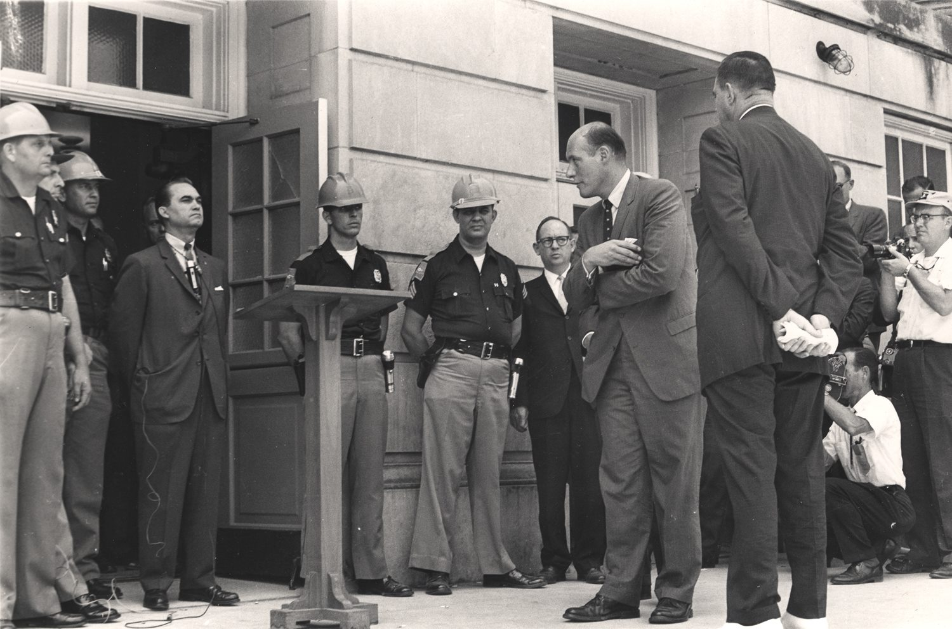
Guarantees to and Obligations of the states
Republican Form of Government and Protection
The national government must guarantee each state a republican form of government
Voters must hold sovereign power
The national government must protect states from invasion and unrest within the United States, or attacks by foreign power
Congress has given the president authority to send federal troops to a state where there is civil unrest and the governor or state legislature has requested help
The president can send troops in to a state that violate federal laws
The national government can also intervene in the aftermath of a natural disaster

Slide 9
Guarantees to and Obligations of the states
Territorial Integrity and Admission of New States
Article IV, Section 3 says that the national government has the duty to respect the territorial integrity of each state
The Constitution also gives Congress to pass laws that allow new states to join the nation
Like all other laws, the admission of new states is subject to presidential veto
Before a territory can become a state, Congress must pass an enabling act, so the territory can develop a constitution
Once the constitution is approved by popular vote in the territory, Congress then votes on whether or not to accept the proposal

Slide 10
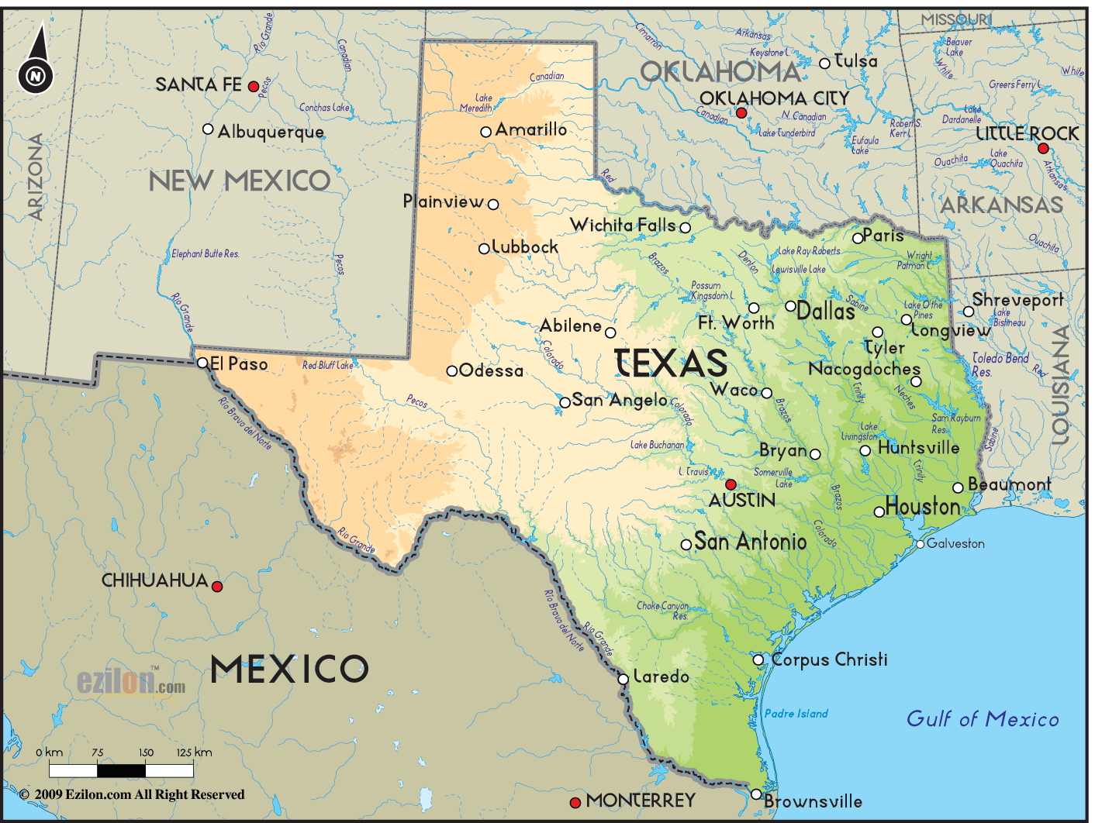
Guarantees to and Obligations of the states
Obligations of the States
Two functions states perform for the national government:
State and local governments conduct and pay for elections of all national government officials
States play a key role in the process of amending the Constitution

Slide 11
Federal Aid and Mandates
Federal Aid
The national government has always provided different types of aid to the states
The main form of aid is through federal grants
Sums of money given to state or local governments for specific purposes
Federal grants redistribute income among the states
Funds come at a price, with aid comes federal control and red tape
Funds are only given if the state or local government are willing to meet certain conditions

Slide 12
Federal Aid and Mandates
Mandates and Preemption
Mid-1960s Congress has taken over some functions that used to be controlled by the state governments
A mandate is a law that requires states to take on an activity or provide a service that meets minimum national standards
Congress may also pass a restraint that limits a state’s ability to regulate an area
Congress can pass laws that allow the national government to assume responsibility for a state government function (preemption)

Slide 13
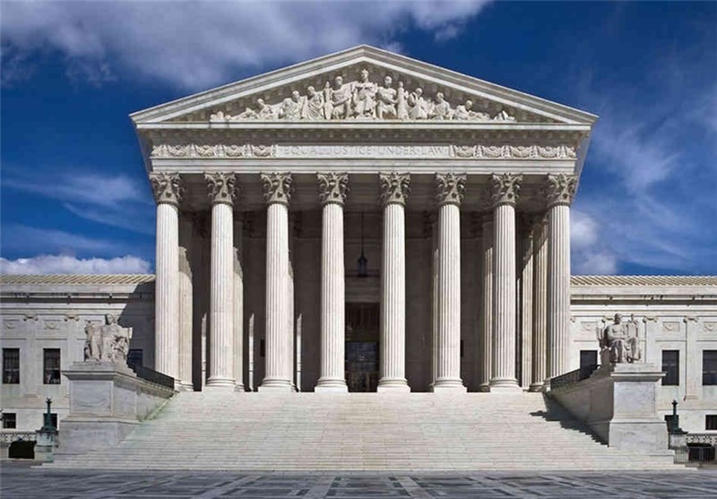
Conflicts
Federalism divides the powers of government, but conflicts do arise between the federal and state governments
The federal court system, Supreme Court, plays a key role to end these disputes
McCulloch v. Maryland (1819)-concluded that when the national government and a state government come into conflict, the national government is supreme
Throughout the years, the Supreme Court has shifted on this issue, sometimes siding with the national government other times the state.

Slide 14
Lesson 3: State Powers and Interstate Relations

Slide 15
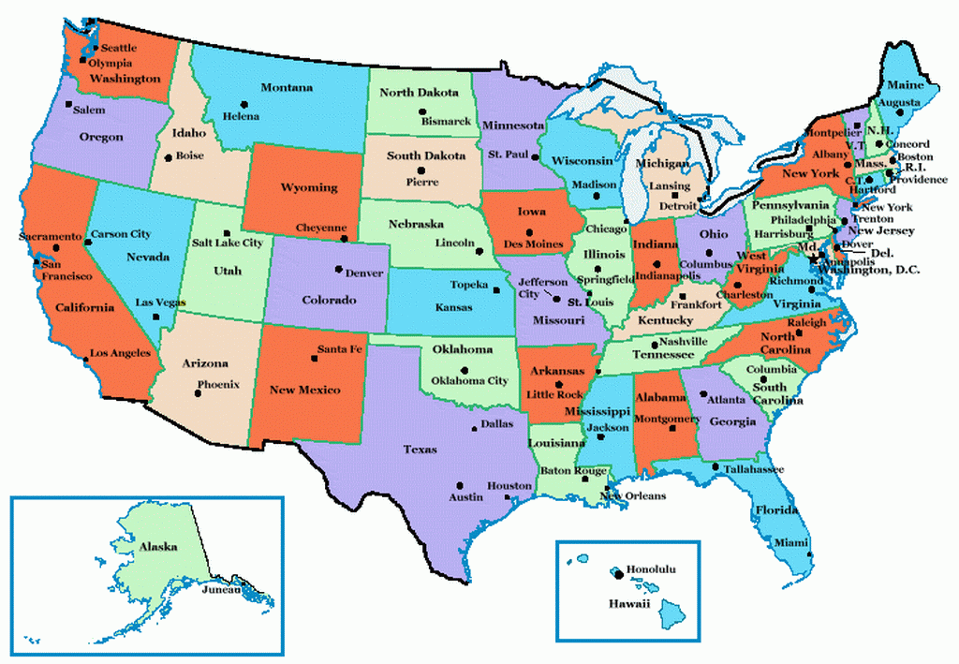
State Powers
Regulating and Promoting Business
States regulate corporations within their borders and promote those businesses
The main goal is to help the states economy and provide employment for state residents
States regulate business to also protect the consumer
States regulate business to protect the worker, to ensure safe and sanitary working conditions
States also might provide minimum wage

Slide 16
State Powers
Crime
Protecting life and property is the responsibility of state and local governments
States call laws that protect citizens from certain crimes criminal codes
Each state sets its own system of punishment
Local governments typically enforce these state laws
State courts handle the great majority of all criminal cases
Education, Health, and Welfare
Education is traditionally controlled by local governments, but the states finance about half of education, feds 10%
Health care: states license doctors and dentists, require vaccines for children, support public hospitals
Governments provide aid to needy families with children, people with disabilities, and to people who cannot afford health care.

Slide 17
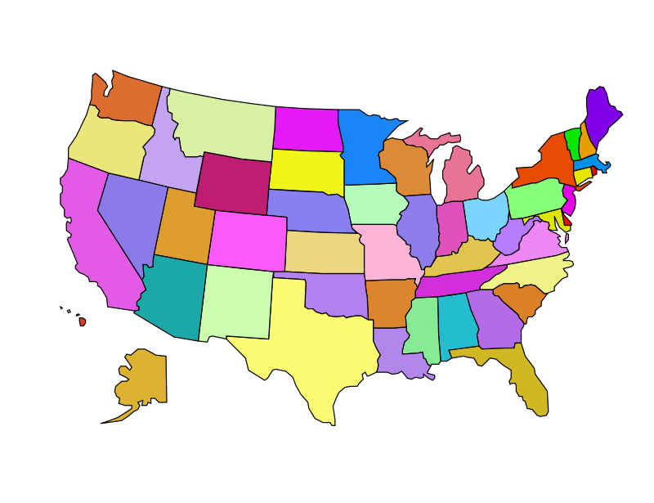
State Powers
Environment
States try to preserve their natural resources by regulating air and water pollution
Regulations impact the health of residents and the economy of the states
Difference Among the States
Federalism permits considerable freedom to each state in setting its own laws, regulations, taxes, criminal codes, and budget priorities
States can come into conflict because of federalism

Slide 18
Relations Among States
Privileges and Immunities
The Founders wanted to protect citizens as they traveled between the states
The Constitution provides that “the Citizens of each State shall be entitled to all Privileges and Immunities of Citizens in the several States.”
One state cannot discriminate unreasonably against citizens of another state
The courts have never given a complete listing of all possible “privileges and immunities.”
Residency of a state depends on how a state defines residency
States can treat out-of state residents differently if distinction is reasonable (example: higher college tuition to state colleges)

Slide 19
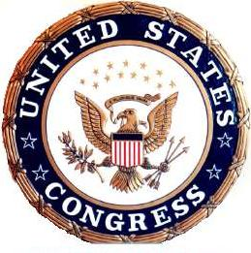
Relations Among States
Interstate Compacts
The Constitution requires the states to settle their differences with one another peacefully
Principal way states settle disagreements is by negotiating interstate compacts (written agreements between 2 or more states)
Congress must approve interstate compacts, this prevents states from threating the Union by making alliances among themselves
Once a compact has been signed and approved by Congress it is binding and enforced by the Supreme Court

Slide 20
Relations Among States
Lawsuits Between States
Sometimes states are unable to resolve their disputes through negotiation or interstate compacts, they can sue each other
Reasons to sue another state:
Cases in the West often involve water rights
States fight over the sewage from one state polluting the water of another
States fight over boundary lines

Slide 21
Lesson 4: Differing Views about Federalism

Slide 22
Federalism and Public Policy
State and Local Policies
States and local governments can serve as proving grounds for the development and testing of new policies
In many cases amendments get created because multiple states have laws already in place giving people that right (19th amendment, 18th amendment, 26th amendment)
Sunset law is a provision in a law that sets an automatic end date for the law
Sunshine law which prohibits public officials from holding official meetings that are closed to the public

Slide 23
Relations Among States
National Policies
Public policy is created at the national level and states follow
The national government may impose policies on states if it believed those states were infringing on group’s basic rights
National Power and the Commerce Clause
Supreme Court decisions have expanded the constitutional power of the national government to regulate interstate commerce
The Court has interpreted the term commerce to mean almost any activity connected with producing, buying, selling, and transporting goods across state lines
The Court has also issued few ruling that limit the legislative powers that the commerce clause grants to the federal government

Slide 24
Federalism and Political Parties
Supporters of Stronger State and Local Government Powers
21st century conservatives (Republican, Tea Party, libertarians)
They believe that the 10th amendment sets clear limits on the power of the national government and states have more power
They believe that the state and local governments are closer to the people and know how to best help them
Tend to use the term “big government”
They are more likely to oppose broad federal laws and regulations that limit states’ authority to legislate as they wish

Slide 25
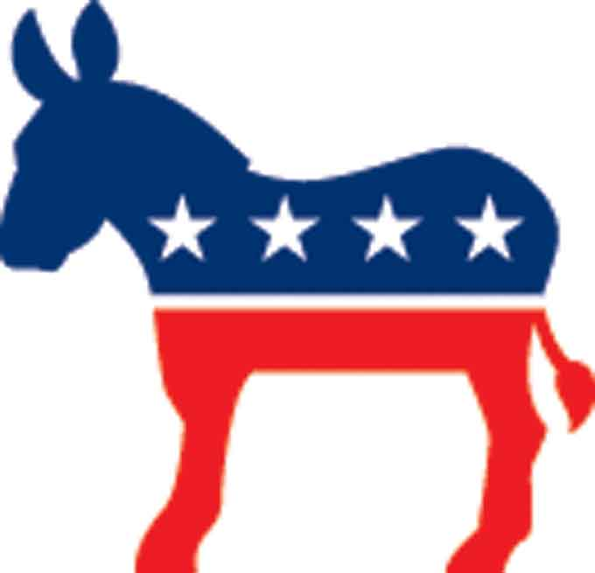
Federalism and Political Parties
Supporters of Stronger National Government Powers
21st century liberals (Democratic Party and Progressives)
They believe that the Founders confirmed that they tended to create a strong national government
They use the supremacy clause to argue tha the national government should be supreme in matters of public policy
They believe that under the elastic clause the powers expressly delegated to the national government should be expanded
They believe that the national government is better equipped to solve some major social and economic problems

Slide 26
Federalism and Political Participation
Federalism increases opportunities for American citizens to participate in politics
American federalism gives citizens many points of access to government and increase their opportunities for influencing public policy
Citizens may also work with special interest groups to influence national policies and state and local government agencies
A related effect of federalism is an increased chance that one’s political participation will have some practical impact on policy

