Slide 1
Foundations of Government
The US Constitution

Slide 2
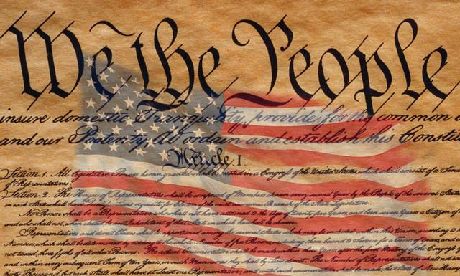
Lesson 1: Structure and Principles of the Constitution

Slide 3
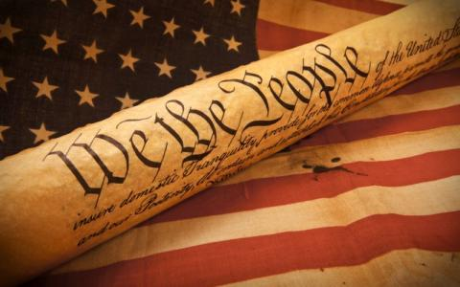
Structure of the U.S Constitution
The new country was a combination of their experiences under the Articles and as a British colony
The Founders solution to all the problems they experienced was a central government with limited powers
They divided power between three branches with a system to check the other two branches
Power was divided between the states and federal government
The Constitution presents the government’s purposes, principles, powers, and limitations

Slide 4
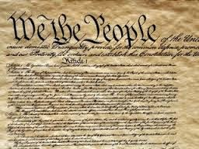
Structure of the U.S Constitution
The Preamble
Explains why the Constitution was written and spells out the purposes of the government
Articles
Each article covers a different topic about how the government is structured
Articles 1-3 create the three branches
Article 4 explains the relationship of the states to one another and to the national government
Article 5 explains the ways that Constitution can be amended
Article 6 established the Constitution as the “supreme Law of the Land”
Article 7 addresses ratification

Slide 5
Structure of the U.S Constitution
Amendments
27 amendments
Some amendments describe people’s individual rights
Most are modifications to the structure of government

Slide 6
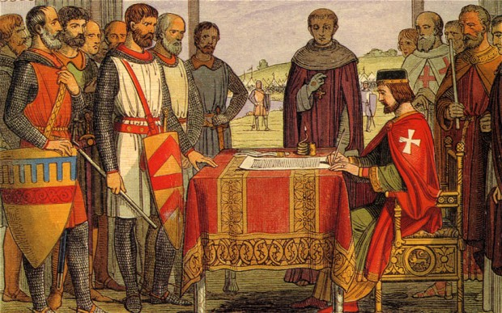
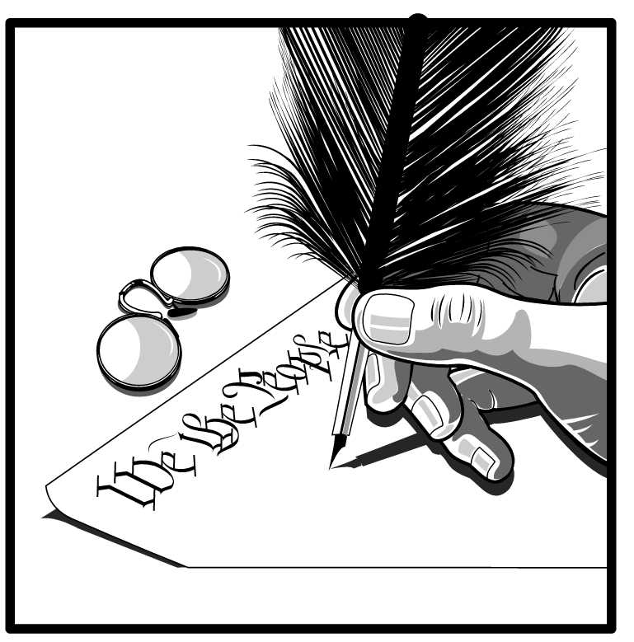
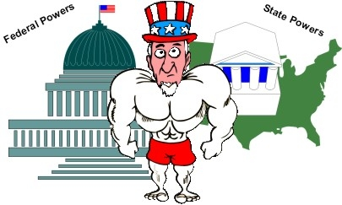
Principles of The Constitution
Limited Government – powers are limited by the Constitution. King John signed Magna Carta in 1215 limiting the powers of the ruler.
Popular Sovereignty – the people hold the power and give the government its power. We consent to be governed.
Federalism – power is divided between the national government and the states. Some are shared, some only for national government, some only for the states.

Slide 7
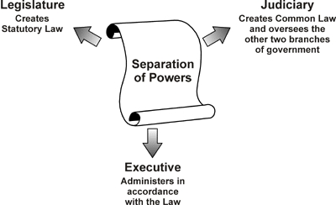
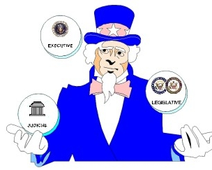
Principles of The Constitution
Separation of Powers – federal government is divided into three separate branches.
Checks and Balances – prevents any one branch from becoming too powerful, each branch can stop or ‘check’ the other two.
Republicanism– the people elect representatives to rule on their behalf

Slide 8
Lesson 2: Three Branches of Government

Slide 9
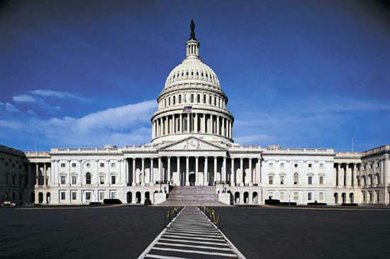
The National Government
The Constitution balances powers between the states and the national government
It created three branches of government each having its own power
The structure of this systems was to ensure that not one group or person could have all the power
To ensure the principle of limited government the Founders assigned different powers to the three branches and gave each branch a way to check the power of the other

Slide 10
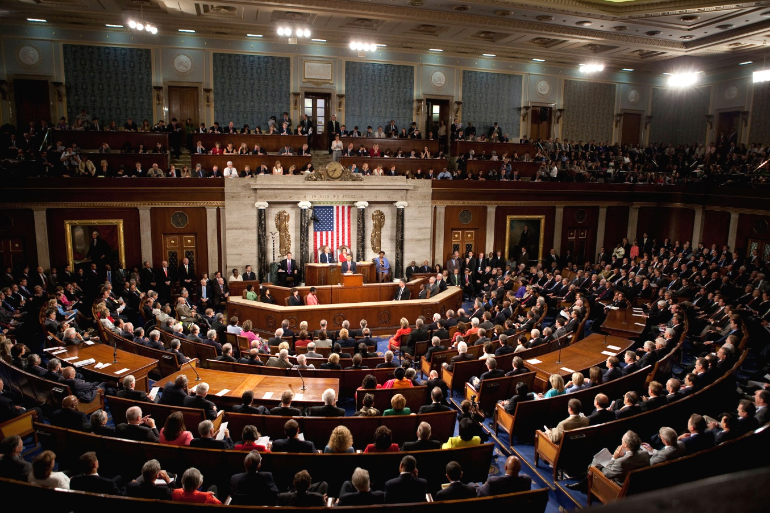
Legislative Branch
Role is to make the laws
It is divided up into two houses
House of Representatives
Senate
The House of Representatives is determined by state population
The Senate each state can only send two

Slide 11
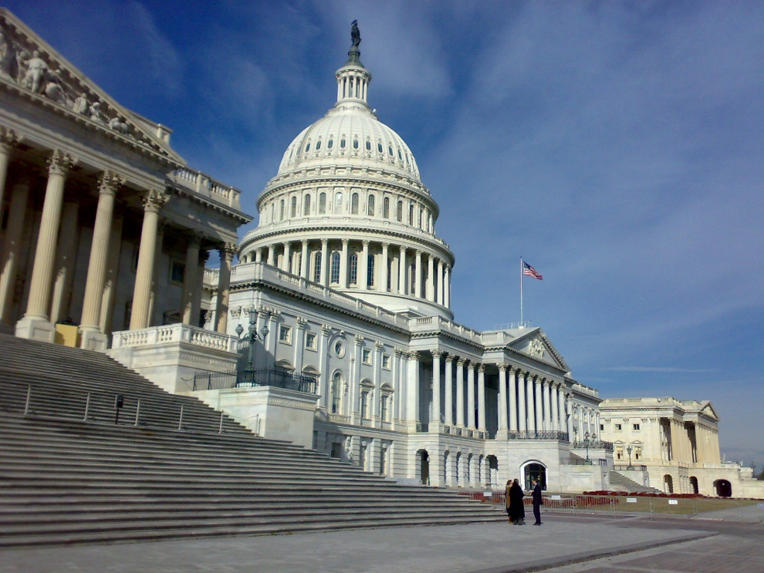
Legislative Branch
Enumerated and Express Powers
The powers of Congress are listed under Article 1, Section 8 in the Constitution
Enumerated powers are listed powers that Congress have, such as:
Power to levy taxes
Borrow money
Coin money
Punish counterfeiting
Regulate commerce
Make laws for national defense (example: declare war)
They can also naturalize citizens
Establish post offices & courts

Slide 12
Executive Branch
The President is the head of the executive branch
The executive branches job is to enforce the laws passed by Congress
There are 15 departments that are part of the executive branch
The executive branch includes numerous federal agencies, boards, commissions, government corporations, and advisory

Slide 13
Executive Branch
Specific powers of the President (Article II, Sections 2 & 3):
Grant pardons
Make treaties
Appoint ambassadors & Supreme Court justices
Fire officials in the executive branch
Make agreements with foreign nations
Take emergency actions to save the nation
Commander of all military forces but can only ask congress for a declaration of war

Slide 14
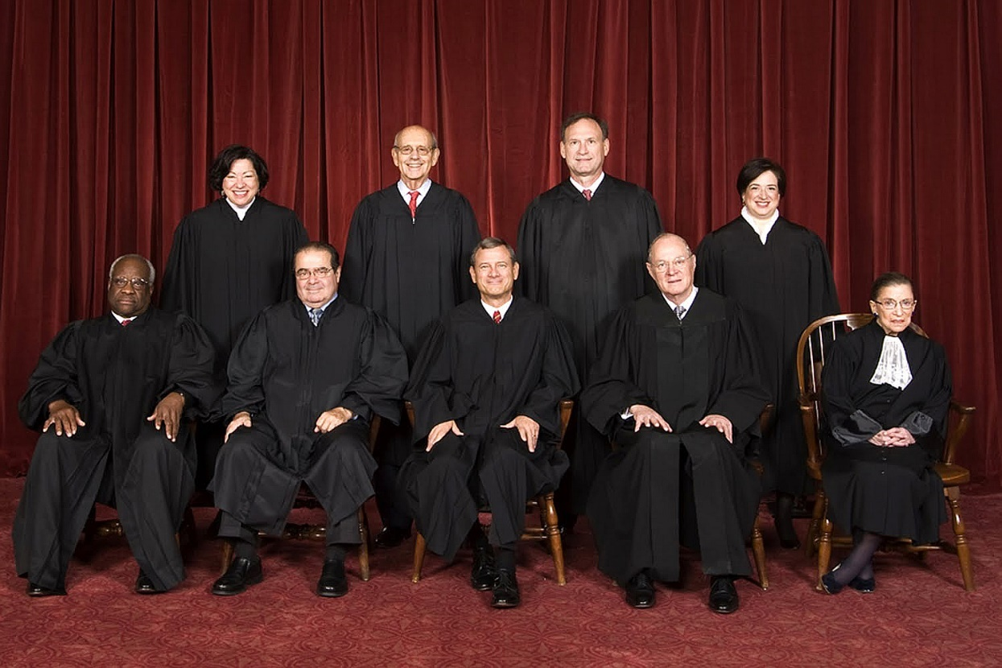
Judicial Branch
Article III establishes the federal court system (Supreme Court)
Judges hold office for life unless they commit a crime or choose to retire
Federal courts hear cases about the US Constitution, federal law, foreign treaties, international law, and bankruptcies
We have a dual court system, each court has the authority to hear certain kinds of cases

Slide 15
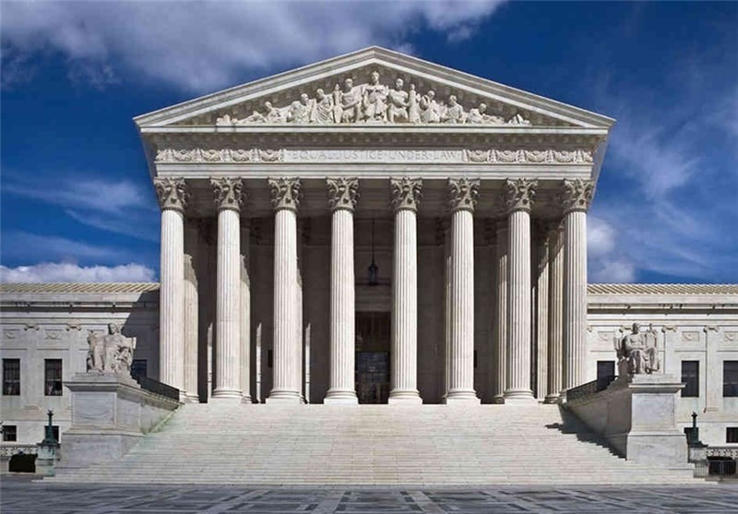
Judicial Branch
Judicial Review
Allows the courts to interpret the Constitution and overturn laws that violate the Constitution
This is not specifically mentioned in the Constitution
Federalist Papers No. 78 discusses the power of judicial review
Marbury v. Madison (1803) stated that Judiciary Act of 1789 which gave the Court more power than the Constitution allowed was unconstitutional
Marbury v. Madison established judicial review

Slide 16
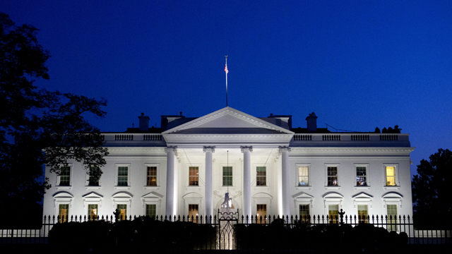
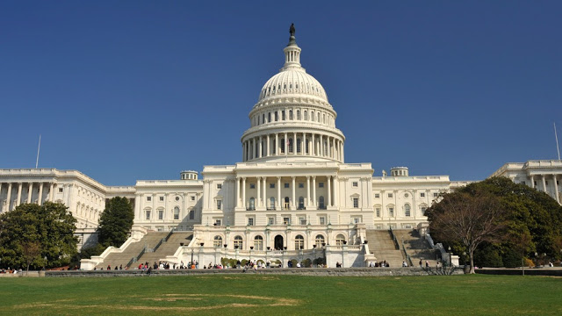
Relations Among the Branches
Sharing Power
To ensure a President doesn’t get too powerful they have to share many responsibilities with Congress
Example: President has the power to negotiate treaties with foreign countries but the Senate must approve them before becoming law
Congress is limited by the need for Presidential approval
Example: Congress passes but laws must be signed by the President. The President can veto bills but Congress with two-third vote can override it.

Slide 17
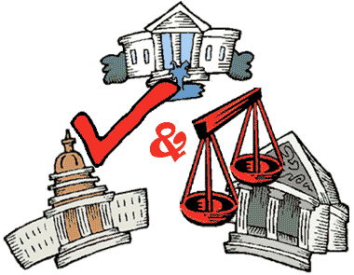
Relations Among the Branches
Checks and Balances
The ability to limit the other branches has caused a certain amount of conflict:
Congress’s power to monitor how the executive branch enforces laws
Presidents have sometimes charged Congress with trying to encroach upon the proper powers of the executive to lead and protect the nation
Sometimes the executive branch and legislative branch come into conflict with the judicial branch
In some rare cases a President has refused to enforce a Supreme Court decision

Slide 18
Lesson 3: Amendments

Slide 19
Proposing and Ratifying Amendments
Two methods of proposing amendments
Two-Thirds vote in the House and Senate (all amendments were proposed by this method)
Two-Thirds of the states ask Congress to call a convention to debate and then vote on the proposed amendment
Once an amendment is proposed Congress must choose how to obtain state approval:
Legislatures in three-fourths of the states can ratify the amendment
State holds special conventions and then to have three-fourths of the convention approve it
11,000 amendments have been proposed over time, but only 27 have been ratified
Founders wanted to make sure that the procedure was difficult because they believed most issues could be handled with the regular political process.

Slide 20
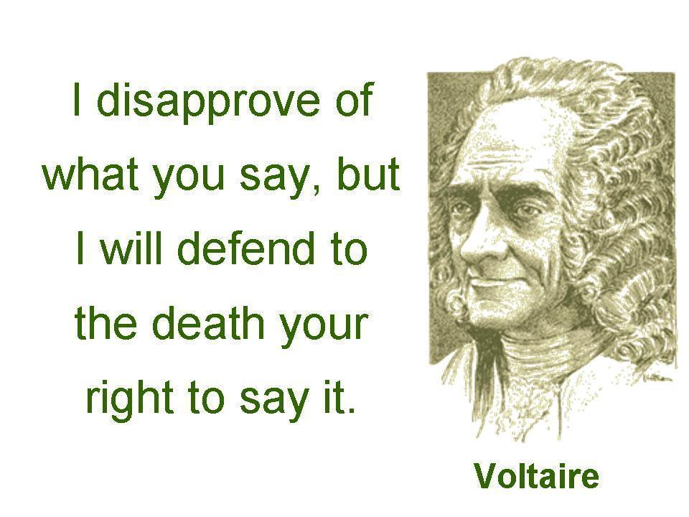
The Bill of Rights
1st Amendment
The First Amendment is actually 5 different amendments.
Freedom of Religion
many who came to America came for religious freedoms, they didn’t want to be told by their government what they had to believe in.
Freedom of Speech
Protects our freedom to say or write most things.
You cannot be jailed for criticizing your government, as was formerly done.
BUT, you cannot create a ‘clear and present danger’ with your speech that might harm others, such as yelling fire in a crowded place.

Slide 21
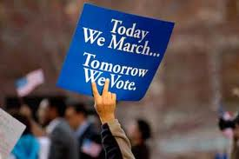
The Bill of Rights
1st Amendment
Freedom of the Press
Allows newspapers, radio, television, or the internet to write or publish what they want to without fear of punishment.
People need a free press in a democracy to be informed voters!
Freedom of Assembly
During the Revolution it was illegal to gather in groups of more than three, we now have the right to peaceful assembly.
Freedom to Petition
You have the right to write to government officials asking them to change a law or create a law without fear of punishment.

Slide 22
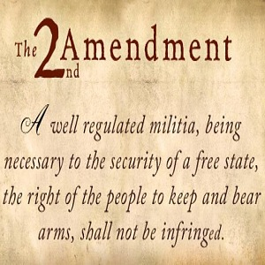
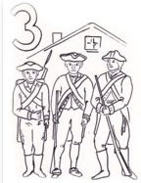
The Bill of Rights
2nd & 3rd Amendments
2nd - Right to Bear Arms
People have a right to ‘bear arms’.
a well regulated military is necessary to the security of a free state.
What about automatic weapons????
3rd - Prohibits Quartering of Soldiers
During Revolution the King placed troops in homes of civilians at the homeowners expense.
This prevents the government from placing soldiers in a civilian’s home.

Slide 23
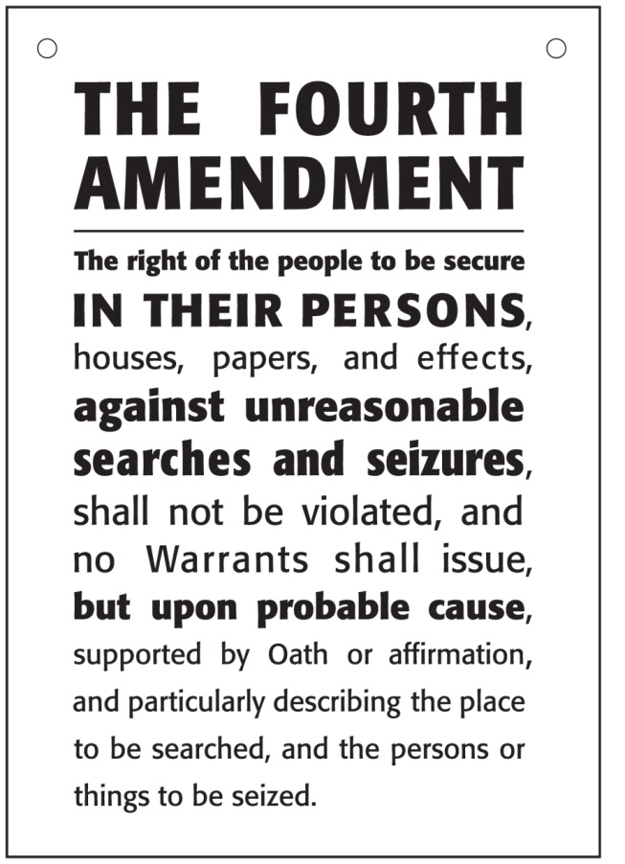
The Bill of Rights
4th Amendment
4th – No Unreasonable Searches
Colonists were smuggling products so as not to pay the British taxes,
British government officials would randomly search a colonists property looking for smuggled goods.
Now a judge has to sign a ‘search warrant’ before your property can be legally searched

Slide 24
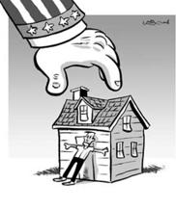
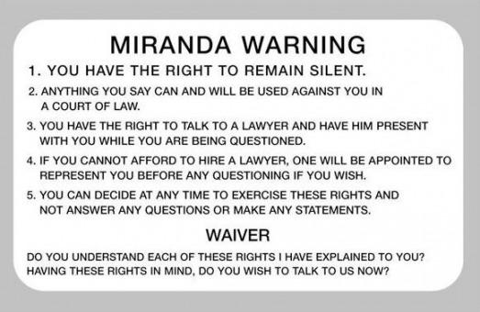
5th Amendment
5th - A person cannot be deprived of life, liberty, or property without “due process of law”. Certain legal procedures must be carried out before a person can be punished.
Eminent Domain gives government the right to take private property for public use, but they must give you fair compensation (payment) for the property. Like taking your home to build a road.
Double Jeopardy cannot be tried for the same crime twice. Like OJ Simpson.
Grand Jury is required to issue an indictment before you can be tried for a serious crime.
Self-Incrimination cannot be forced to testify against yourself. Supreme Court ruling of Miranda v. Arizona says you must be informed of your rights or what you say cannot be used.

Slide 25
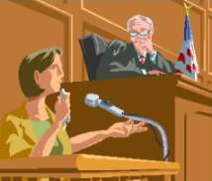
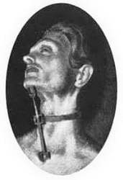
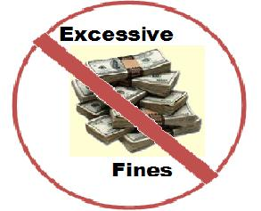
The Bill of Rights
6th , 7th, 8th Amendments
6th Fair and Impartial Trial
Must be told of charges against them
Right to a trial by jury
Right to be represented by a lawyer
7th Amendment
Right to jury trial in federal courts to settle all disputes about property worth more that $20
8th No Cruel or Unusual Punishment
No high bail
Punishment must fit the crime
No cruel punishments
No torture

Slide 26
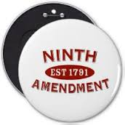
The Bill of Rights
9th & 10th Amendments
9th & 10th attempt to limit the powers of the government
9th Amendment
Just because the Constitution doesn’t list a right doesn’t mean we don’t have it.
the people have all rights not specifically given to the government.
10th Amendment
The federal government has only those powers specifically given to it in the Constitution.
All other powers are reserved for the states or the people!

Slide 27
Later Amendments
11th Amendment
Prohibits a state from being sued in federal court by citizens of another state or another nation
12th Amendment
Calls for the Electoral College to use separate ballots in voting for president and vice president
13th Amendment
Banned slavery in the United States
14th Amendment
Granted citizenship to former slaves
15th Amendment
Voting rights for former slaves

Slide 28
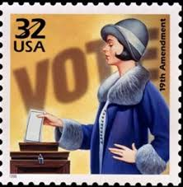
Later Amendments
16th Amendment
Established the federal government to tax a person income
17th Amendment
Direct election of US senators
18th Amendment
Made the manufacturing, transportation, or sell of alcohol illegal (Prohibition, repealed by the 21st Amendment)
19th Amendment
Gave women the right to vote in the US
20th Amendment
Set new dates for when the President and vice president are inaugurated and when congress can begin its term

Slide 29
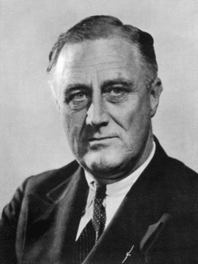
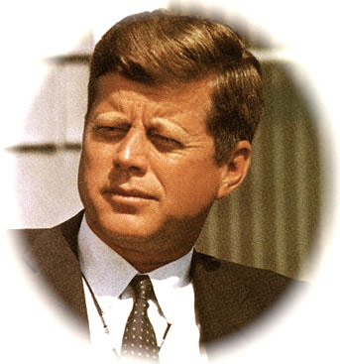
Later Amendments
22nd Amendment
Limits the President term in office to two elected terms
23rd Amendment
Granted voters in Washington, D.C. the right to vote for president and vice president
24th Amendment
Forbade requiring the payment of a poll tax to vote in a federal election
25th Amendment
Provided for succession to the office of president in the event of death or incapacity and for filling vacancies in the office of vice president

Slide 30
Later Amendments
26th Amendment
Lowered the voting age from 21 to 18
27thAmendment
Banned Congress from increasing its members salaries until after the next election

Slide 31
Lesson 4: State Constitutions and Local Charters

Slide 32
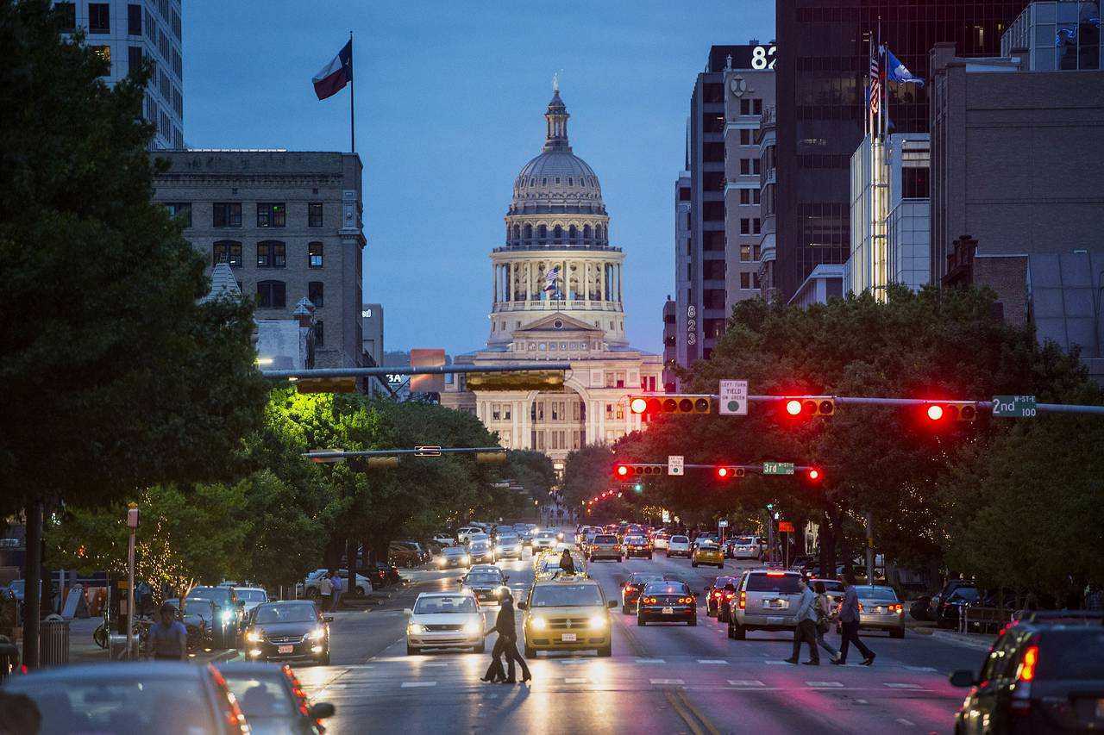
The Structures of State Governments
Legislative Branch
Pass laws that deal with a variety of matters
State legislatures have more power than US Congress
Each legislature have bicameral, Nebraska only has one chamber

Slide 33
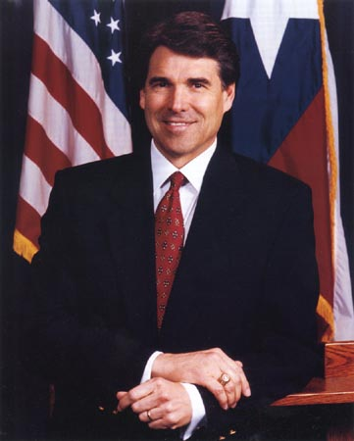
The Structures of State Governments
The Executive Branch
Called the Governor
Power to carry out state laws
Responsibilities
Sign legislation
Budgeting
Appointing officials
Planning economic growth
Coordinate the work of executive departments
Amount of control over the executive branch varies between the states
In some states the people vote for all members of the executive branch
Governors must work close with the national government especially when it comes to federal funding
They are commander and chief of the national guard

Slide 34
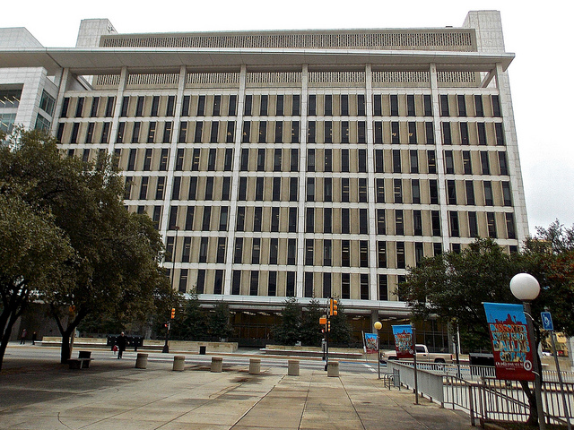
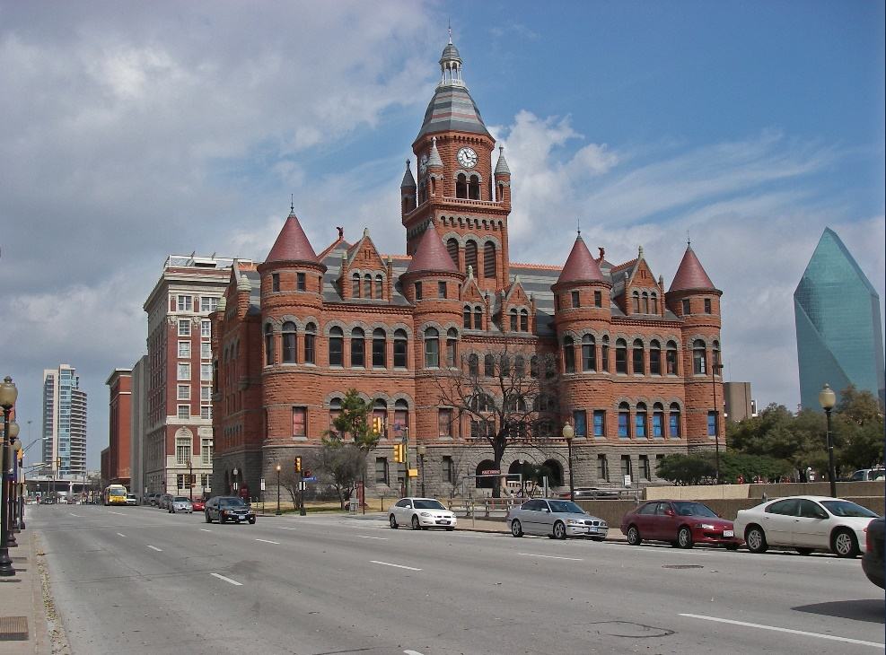
The Structures of State Governments
The Judicial Branch
They uphold and interpret state laws
Help to resolve conflicts with citizens or business disagreements
Courts can punish criminals
Level of courts:
Minor Courts
Trial Courts
Appellate Courts
Highest Court: Supreme Court

Slide 35
Rights and Amendments in State Constitutions
All states contain a bill of rights
State Constitutions tend to have enormous number of amendment
Average: 115
Amendments might change the structure of the state government, redefine the powers allocated to the different parts of government, or expand/restructure individual rights

Slide 36
Local Governments
Exist only if a state constitution creates them and gives them local authority
Types of local government are based on their size and population
State constitutions create cities, counties, townships, municipalities, special districts, parishes, and boroughs
State constitutions can regulate the ways local governments can raise and spend money
They are limited in their taxing powers

Slide 37
Local Charters
Documents that state government issues to local governments
They grant communities a legal status and allow them to have separate governments
They explain the powers and responsibilities of the local government
Explains how they elect officials

