Slide 1
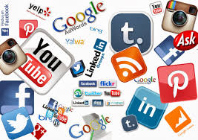
Chapter 20 – Mass Media in the Digital Age

Slide 2
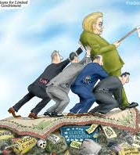
LESSON 1 How Media Impact Our Government
Since the founding of the United States, journalists have served a watchdog role, keeping a close eye on government officials to keep the public informed and to guard against corruption and the abuse of power. Today the media environment has changed drastically: Several television networks broadcast news 24 hours a day, sometimes with a very particular slant or bias.

Slide 3
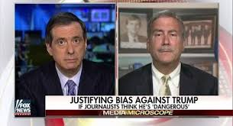
Mass Media
The mass media include all the means for communicating information to the general public. Media have covered the government since George Washington was president. Newspapers had the field to themselves until they were challenged by magazines, radio, television, and the Internet. Each additional medium has influenced the way news is reported. What once took days and weeks to reach readers can now reach them in seconds.
News is available around the clock, and people with no experience or training as journalists have outlets for publishing their videos, photos, and stories.

Slide 4
Journalism
Digital media have enabled citizens to act as amateur journalists and professional journalists to be on the job anytime and everywhere. Some people are reexamining the definition of journalist. Are journalists only trained reporters working in media companies? Are bloggers journalists because they comment on the news on their websites? What about fake news?
http://www.ronpaullibertyreport.com/archives/revealed-the-real-fake-news-list
This may surprise some of us who are here [in Congress] every day or the people who cover politics on a daily basis, but most Americans are not tuned into C-SPAN 24 hours a day. They get their news in tidbits in the morning when they are making coffee. They have the radio on. They hear some stuff on the radio when on the way to work. . . . They get home, they have to do homework with the kids, make dinner, put them to bed. . . .They are not in touch with all of this on a daily basis. They have lives to lead.”
—Senator Marco Rubio, Congressional Record, March 13, 2013

Slide 5
Relationship Between Media and Government
Some interviews are on “deep background,” where the reporter will tell the story but agrees not to identify the source of the story. Reporters will make this kind of information public by saying, “Government sources said …” or “A senior White House official said….” Backgrounders give government officials the opportunity to test new ideas or to send unofficial messages to other policy makers or even foreign governments. The media can, in this manner, make information public without making it official.

Slide 6
The Executive Branch and the Media
Advisers to executive branch leaders at all levels of government try to manage relations with the mass media by controlling the daily flow of information. To do so, they use news releases and briefings, press conferences, background stories, leaks, and media events.
http://www.redflagnews.com/headlines-2016/fbi-insider-leaks-all-clinton-foundation-exposed-involves-entire-us-government

Slide 7
News Releases and Briefings
A government news release is a ready-made story prepared by officials for members of the press. Also called a press release, it can be printed or broadcast word-for-word or used as background information. A news release usually has a dateline that states the earliest time it can be published.
During a news briefing, a government official makes an announcement or explains a policy, a decision, or an action. Briefings give reporters the chance to ask officials about news releases or follow up on leads they have developed in their research. The president’s press secretary meets daily with the press to answer questions, and the State Department also provides a daily press briefing.

Slide 8
Other Means of Sharing Information
Another way top officials try to influence the flow of information to the press is through a leak, or the release of secret information to the media by anonymous government officials. These officials might be seeking public support for a policy that others in the government do not like. Top officials do not control all leaks, however. Sometimes low-level officials leak information to expose corruption or to get top officials to pay attention to a problem. When the information leaked is classified, the person who leaked that information can be prosecuted.
Modern presidents often stage a media event, a visually interesting event designed to reinforce the president’s position on some issue.

Slide 9
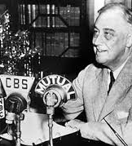
The President and Television
Franklin D. Roosevelt was the first president to master the use of broadcast media. Broadcast television did not exist at the time of his presidency, and most newspaper owners did not support him. Therefore, Roosevelt presented his ideas directly to the people with “fireside chats” over the radio.

Slide 10
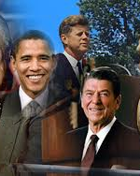
Television and Presidential Campaigns
John F. Kennedy and Ronald Reagan were examples of good candidates for the television age. They had strong features and projected the cool, low-key style that goes over well on television. Television has also made it much easier for people who are political unknowns to gain exposure and quickly become serious candidates for major offices. Barack Obama’s televised speech at the 2004 Democratic convention catapulted him to national prominence.

Slide 11
Television and Presidential Campaigns
The mass media have fundamentally changed the nomination process for president through horse-race coverage of elections, especially primaries. Horse-race coverage treats the campaign as if it were a sporting event, generating excitement by focusing on who is ahead, who is making a comeback, and so on. Exploring issues and policy positions is secondary in this type of coverage.
Much of the electorate was surprised if not shocked to see Donald J. Trump defeat Hillary Clinton in the 2016 election. Much of this can be attributed to a media that heavily favored Hillary Clinton. http://thehill.com/blogs/pundits-blog/media/301285-media-and-trump-bias-not-even-trying-to-hide-it-anymore

Slide 12
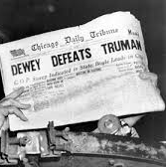
Television and Presidential Campaigns
How about polls for the 2016 Presidential Election? Many knew that they were over sampling potential democratic voters, which led us to believe that Hillary Clinton had a commanding, insurmountable lead. http://www.realclearpolitics.com/epolls/latest_polls/president/

Slide 13
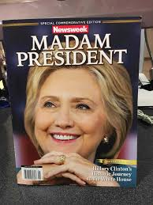
Television and Presidential Campaigns
The media declare a candidate who wins an early primary, even if by a very small margin, a front-runner, or early leader. The press largely determines the weight attached to being a front-runner. The label carries great significance, however, because it is much easier for front-runners to attract the millions of dollars in loans and campaign contributions as well as the volunteer help they need to win the long, grueling nominating process.

Slide 14
Television and Presidential Campaigns
Around 1900, candidates began using advertisements in newspapers and magazines and mass mailings of campaign literature. In 1924 candidates began radio campaigning, and in 1952 the Eisenhower campaign began television advertising. Television has continued to be a major vehicle for advertising, but actual news coverage on television now involves only brief opportunities for politicians to share their views. In the 20 years between 1968 and 1988, the average length of a sound bite—the actual words of a candidate or elected leader included in a news story—shrank from 43 seconds to 9 seconds, where it has remained since.

Slide 15
Covering Congress
Thousands of reporters have press credentials to cover the House and Senate. Several hundred spend all their time on Congress. Nearly every member of Congress has a press secretary to prepare press releases, arrange interviews, and give out television tapes. Most important congressional work takes place in committees and subcommittees over long periods of time. Congress’s slow, complicated work rarely meets television’s requirements for dramatic, entertaining news.
Nationally known lawmakers often are seen as spokespersons for their political parties rather than for Congress. Most members of Congress devote their efforts to attracting local coverage, which helps them gain recognition among their constituents. Some members, especially those in seniority or leadership positions, work to get national coverage to help promote their goals.

Slide 16
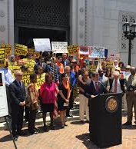
Covering Congress
In addition to covering big congressional debates and bills, the media also report on controversial confirmation and oversight hearings. While most confirmation hearings are ignored in the media, if a reporter uncovers damaging information about a presidential appointee or a nominee holds views unpopular with members of Congress, hearings on their nomination may suddenly become major news.

Slide 17
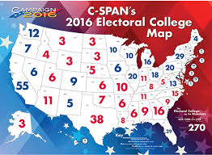
C-SPAN
Cable-Satellite Public Affairs Network (C-SPAN) began as a “gavel-to-gavel” coverage of the speeches, debates, and votes on the floor of the House of Representatives. Since then, C-SPAN has expanded its coverage to include the Senate and major national events. Like other media, C-SPAN’s format has expanded, too. C-SPAN can now be found on radio, satellite radio, and on the web.

Slide 18
The Judiciary and the Media
Much of the media’s coverage of the judiciary is related to criminal trials. Generally, journalists have access to trials, in part because the Sixth Amendment guarantees a defendant’s right to a public trial. Courts are sometimes concerned, however, that intense media coverage could bias jurors. In those instances, the judge will order that the jury be sequestered, or isolated from the public and media, during the trial. In some cases, the trial will be moved to a different jurisdiction if media exposure in the local community may have influenced the potential juror pool. Some criminal trials attract huge public interest, and the media capitalize on this interest and provide extensive coverage of these trials. This is true particularly of cable news broadcasters, who might provide hours of coverage every day during a trial

Slide 19
Covering the Supreme Court
The Supreme Court and other appellate courts receive less media coverage than trial courts as well as less coverage than Congress or the president. The nature of these courts’ work—their appellate jurisdiction—means that they are deciding issues of law, not ruling on whether or not a crime was committed. These issues are sometimes very technical and abstract, sometimes of little interest to the general public.
The media typically cover the Supreme Court cases that deal with issues of nationwide importance. They will report when the Court decides to hear a case, on oral argument in the case, and on the decision in the case. They work to simplify and distill the complex legal arguments for a lay audience.

Slide 20
Networks and the Issues
How do the media decide what to cover? Of course, journalists’ professional judgment plays a role. Reporters, editors, and news directors have views of what issues are most important, informed by their experience covering the news. Most media are businesses, however, and business considerations also play a part. The likely size of the audience is part of the answer. This is especially true for television. Each network competes to attract the biggest audience in a viewing market since a larger audience allows it to charge higher advertising rates. Thus, a network might cover a high-profile political scandal instead of the federal budget because they know most people will quickly switch to another channel if they report on budget details at length

Slide 21
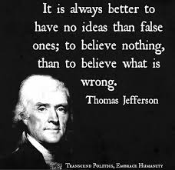
LESSON 2 Regulating Print and Broadcast Media Media Protections
The people are the only censors of their governors…. The only safeguard of the public liberty … is to give them full information of their affairs through the channel of the public papers & to contrive that those papers should penetrate the whole mass of the people.”
—Thomas Jefferson, 1787

Slide 22
Media Protections
In the United States, the First Amendment means that print media are free from prior restraint, or government censorship of information before it is published. Prior restraint on a publication is allowed only if publication of the information would cause certain, serious, and irreparable harm to our national security, and the prior restraint would be effective in avoiding this harm while no lesser means could do so. This means that, in almost every case, editors and reporters have freedom to decide what goes in or stays out of their publications.
Freedom of the press, however, is not absolute. False written statements intended to damage a person’s reputation are called libel.

Slide 23
Media Protections
If a publication damages someone’s reputation with false statements, that person can sue the publication and recover damages. The value placed on our freedom of speech makes it difficult for public officials to win defamation lawsuits. The press must be free to criticize public officials without fear of being sued.
Does the First Amendment give the media special rights of access to courtrooms or government offices? Further, does it give reporters special protection for their news sources—the people they consult to get information?

Slide 24
The Right of Access to Information
Sometimes the government tries to control the press by denying access to certain information. In 1966 Congress passed the Freedom of Information Act (FOIA), which requires federal agencies to release files to the public, unless the material falls into certain exceptions for national security or other confidential information. Members of the press often file “FOIA requests” to force the government to release information. Many states have laws similar to FOIA that apply to state agencies.

Slide 25
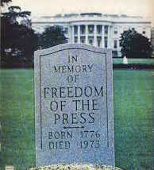
The Right of Access to Information
Generally, the Supreme Court has rejected the idea that the media have special rights of access above and beyond public access. For example, in the 1972 case Branzburg v. Hayes, the Court said that “the First Amendment does not guarantee the press a constitutional right of special access to information not available to the public generally.”

Slide 26
Protection of Sources
Reporters often need secret informants when investigating abuse of power, scandals involving public officials, or crimes. Success in gathering news may depend on getting information from people who do not want their names made public. However, the government sometimes wants to know what journalists were told or who gave them information, in order to prosecute crimes. If the courts, the police, or legislatures force reporters to name their sources, these sources of information may vanish.
The press and the U.S. government have fought many battles over the media’s right to keep sources secret. Forty-nine states and the District of Columbia have shield laws to protect reporters from having to reveal their sources. While no federal shield law exists, the Privacy Protection Act of 1980 prevents all levels of government from searching for and seizing source documentation, except in a few circumstances.

Slide 27
Regulating Media
The Federal Communications Commission
Content Regulation
Over the years, the extent of FCC content regulation has varied in response to developments in technology, court rulings, and changes in political ideas about the proper role of government. Originally, the FCC set rules that broadcasters must cover issues of interest in the community and present contrasting viewpoints. Broadcasters were given wide leeway in deciding what counts as community issues and how to provide contrasting views. This was known as the fairness doctrine.
The Federal Communications Commission (FCC) is a government agency with authority to regulate interstate and international communications by radio, television, telephone, telegraph, cable, and satellite. The FCC has five commissioners appointed by the president with Senate approval.

Slide 28
More Content Regulation
The doctrine was supposed to discourage one-sided coverage of issues and encourage stations to present a range of issues.
The Supreme Court had upheld the fairness doctrine as constitutional; however, some broadcasters and political activists claimed that the fairness doctrine was actually censorship. They argued that it caused stations to avoid reporting on any type of controversy. In 1987 the FCC decided to drop the fairness doctrine. Congress then passed a law requiring the FCC to keep it, but President Reagan vetoed the bill. Reagan said the growth of cable television had added many new outlets for different ideas and the fairness doctrine was no longer needed. Ending the fairness doctrine led to a burst of syndicated radio talk shows in which commentators expressed strident political opinions. Although often extreme and one-sided in their views, these commentators argued their points of view offered listeners an alternative to the mainstream media.

Slide 29
Ownership Regulation
Owners can influence the message their outlets present. Shortly after its creation, the FCC began setting rules to prevent the ownership of media from being concentrated in the same hands. It limited the number of radio stations that one company could own in the same large market like Chicago or New York. It also limited cross-ownership of media by stating that companies could no longer own a newspaper and a television or radio station in the same market.
Telephone lines could carry the same signals that cable companies carried, and cable companies could offer phone service.
Both could offer Internet service, videoconferencing, and other services. Both the phone companies and broadcasters sought changes in the federal law.

Slide 30
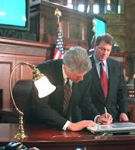
Telecommunications Act of 1996
In 1996 Congress passed the Telecommunications Act. This law ended or relaxed many FCC limits on media ownership. The law removed any limits on how many radio or television stations a company could own as long as the company did not control more than 35 percent of the national market. It allowed cross-ownership of cable and broadcast systems.

Slide 31
Media and National Security
Tension often arises between the government’s need for secrecy in national security matters and citizens’ need for information. This is most obvious in foreign and military affairs where intelligence information is involved. The government tries to control this information by classifying some information as secret and limiting press coverage of military actions. During the Vietnam War, the New York Times and other papers published a secret Defense Department study on how the United States became involved in the war. The government tried to stop the publication of this study, commonly referred to as the Pentagon Papers. In New York Times v. United States (1971), the Supreme Court ruled that the publication did not harm national security.

Slide 32
Media and National Security
Government restriction on media coverage during wartime has varied. During the Vietnam War, there were few limits. Reporters who roamed freely across combat zones learned from soldiers that they had doubts about the way the war was being fought. To prevent such negative reports during the 1991 Persian Gulf War, the Defense Department limited coverage to a small group of reporters, with most having to depend on official briefings for information.
When the war in Iraq began in 2003, the Pentagon allowed 500 reporters to accompany troops into battle. These “embedded” journalists reported live on encounters, but they did not have complete freedom: they could not announce the exact location of where they were traveling. Critics worried that reporters who shared military life and grew close to the troops would not want to write anything negative about the war.

Slide 33
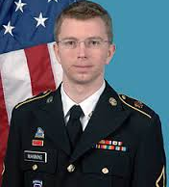
Media and National Security
In 2010 a website called WikiLeaks provided thousands of U.S. State Department documents to news media around the world. A U.S. Army private was charged with having provided many of the documents, which dealt with the wars in Iraq and Afghanistan. The government believed that the leaks had jeopardized American lives. But when government prosecutors sought legal action against those responsible for the breach of national security, they found that prosecution would be difficult because of the First Amendment’s protection of a free press. The Army private was, however, convicted of espionage charges in a military court.

Slide 34
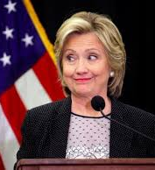
Media and National Security
Do we know of anyone else who WikiLeaks exposed recently? https://www.youtube.com/watch?v=Dy91I0Fgjq8
In 2013 a computer expert who had worked at the National Security Agency (NSA) told a reporter that the NSA was spying on U.S. citizens using computer programs that can monitor cell phone calls, e-mail, and Internet traffic. The leaker, Edward Snowden, fled the United States to escape prosecution.

Slide 35
LESSON 3 The Internet and Democracy
Civic Participation and Digital Media
These online activities include signing online petitions, contacting government officials via e-mail or text, commenting on an online news story or blog post, “liking” or promoting information about political issues on social networks, sharing information about politics, and more. In 2012 almost 40 percent of American adults took part in some sort of political activity in the context of a social networking site, while two-thirds of all 18- to 24-year-olds engaged in some sort of social network-related political activity.

Slide 36
Civic Participation and Digital Media
“On an ‘every day’ level, Americans are three times as likely to discuss politics or public affairs with others through offline channels (in person, by phone call, or by letter) as they are through online channels. Even the most tech-savvy users—such as young adults, college graduates, or those with high incomes—discuss politics with greater frequency offline than online.”
—Pew Research Internet Project, 2013
Will social media prompt Americans to become more involved in their communities, or will Americans come to believe that social media effectively replace the need to be involved? According to one study, nearly one-fifth of social networking site users report being motivated to take action by posts on the site.

Slide 37
Gathering Information
Thanks to the Internet, Americans today can gather information about government and politics much more easily than their parents or grandparents could. Websites devoted to political issues are commonplace.
News outlets, government agencies, Congress, political parties, universities, and various interest groups all host websites designed to inform, entertain, or persuade Americans. Many political websites have a bias, meaning they offer information and ideas that support only their own point of view on issues

Slide 38
Gathering Information
A good website will tell you who owns and maintains it and when it was last updated. Good news organizations also have editors or other people to check facts before the stories are printed. Ultimately, though, it is the responsibility of the user to evaluate the information on a website and determine whether it is reliable, accurate, and up-to-date.
Many people who are interested in following political issues sign up for electronic mailing lists, typically sponsored by interest groups or political parties. They might also follow interest groups, parties, or elected officials on Twitter or a social network.

Slide 39
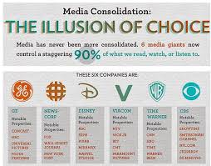
Gathering Information Who owns these media outlets?

Slide 40
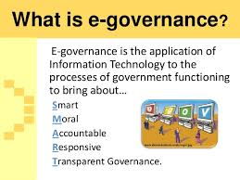
e-government
All levels of government now provide services and information over the Internet. At the local level, residents can access property tax bills, get forms for marriage licenses, find town board meeting times, pay parking tickets, or report abandoned cars or illegal dumping. States facilitate registering to vote, requesting absentee ballots, viewing the state budget, or obtaining a hunting or fishing license online.

Slide 41
Communication with Officials
Telling legislators and other government officials what you think is one of the most basic ways individual citizens can participate in representative democracy. Many people do so digitally—according to the Pew Foundation, in 2012 18 percent of American adults contacted their elected officials online, by e-mail, or by text message. Interest groups and political organizers frequently send out action alerts, calling upon members to phone, fax, or e-mail a specific lawmaker, group of lawmakers, or other officials

Slide 42
Communication with Officials
Some action alerts include links to find contact information for your officials, and a sample script to use in the communication.
Another tool for communicating with elected officials is an electronic petition. This is a message that asks you, along with many other people, to “sign” your name electronically to a request that is going to an official. The petition organizers check the signatures, removing those that seem questionable, and give the results to officials.

Slide 43
Digital Media and Elections
During the 2012 presidential election, President Barack Obama made headlines when he hosted an “Ask Me Anything” question-and-answer session on the then up-and-coming social news site Reddit. President Obama became the first candidate to engage with this popular site. The Democratic candidate’s savvy use of social media helped attract a large number of younger voters to his campaign and encouraged them to go out to vote.
In 2002 Congress passed the Help America Vote Act, which required states to replace old voting methods such as punch cards. Many states have begun using electronic voting machines, where voters cast a ballot in person, using a computerized machine.

Slide 44
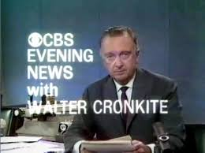
Mass Media and New Media
Traditionally, mass media was unidirectional, meaning that communication went in one direction. Radio, television, and newspapers provided a shared experience for huge audiences, but they did so through one-way transmission of images and ideas. By contrast, the Internet supports interactive communications. This allows readers and viewers to respond to the news they received.

Slide 45
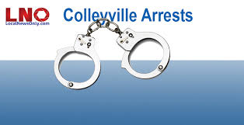
Enhancing the Mass Media
The Internet and social media have encouraged growth of hyper-local news. As traditional local news sources have reduced coverage in many markets, new online media that enable people to share information about their immediate community have proliferated. E-mail groups, blogs, and social media sites enable residents to share information about local government and issues

Slide 46
Challenges to Mass Media
The types of news stories that many people see have also been impacted by the interactivity of the Internet. So-called news aggregators like Google News provide links to the most popular news stories as determined by computer programs (trending), and some social news sites rely on user votes to promote stories.
Every page view, “like,” and share is tracked online, and advertising revenue is based on the number of views a story will generate. Web editors are sensitive to this, and often want to publish or promote the stories that will “draw eyeballs.”

Slide 47
Blogging and Citizen Reporting
Anyone with a cell phone can take relatively high quality video and share it online. Anyone can create a blog and publish material about politics for millions of others to read and comment upon.
By 2011, the popular platform WordPress was hosting more than 20 million blogs. Using sites like Wikipedia, YouTube, Pinterest, and Facebook, millions of Americans became creators, curators, and distributors of information
In the process, average Americans sometimes uncover stories that were missed by the major media.
A handful of conservative bloggers uncovered the fabrication of a key document in a controversial 60 Minutes report about George W. Bush’s military service.

Slide 48
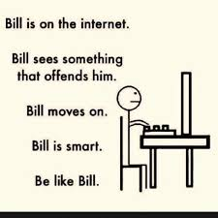
Public Policy and the Internet
The rise of a major technology like the Internet creates a need for new laws to deal with its impact on politics, business, and people’s lives. Everyone from lawmakers in Congress to local school board officials has struggled to keep up with the legal implications of the Internet.
The Internet’s global nature ensures that this medium represents a wide range of content and opinions; this diversity is one of the Internet’s major strengths. At the same time, the Internet is a decentralized medium with few rules.

Slide 49
Broadband Access
As of 2013, about 70 percent of American adults had broadband, or high-speed, Internet access at home. More and more daily activities necessitate (or are made easier by) an Internet connection, from communicating, to finding and applying for a job, banking, or interacting with government.
In early 2011 President Obama announced an initiative to make high-speed Internet available to at least 98 percent of Americans.
https://www.whitehouse.gov/the-press-office/2011/02/10/president-obama-details-plan-win-future-through-expanded-wireless-access

Slide 50
Net Neutrality
In 2010 the FCC issued an Open Internet Order, saying that Internet service providers must not discriminate against any one type of data or application as it transmits it to users. Some Internet service providers would prefer to be able to charge content providers tiered rates for transmitting different types of content at different speeds.
There is widespread support for rules against such discrimination based on content and applications, known as “net neutrality.”

Slide 51
Offensive Content
The Internet gives anyone with a personal computer the ability to spread his or her ideas to a global audience. This has led to an explosion of creativity and new opportunities for civic participation. However, it has also allowed anyone, anywhere, to access obscene content in the privacy of their own homes.
In 2000 Congress passed the Children’s Internet Protection Act, which permitted libraries to install anti-pornography filters on computers used by the public. The Supreme Court, in United States v. American Library Association (2003), ruled that such filters did not violate the First Amendment rights of library users. If libraries erroneously blocked some materials, adults could ask to have the filter turned off.

Slide 52
Taxing E-Commerce
Internet growth has led to the expansion of e-commerce, or the sales of goods and services online. In 2010 the U.S. Census Bureau estimated that $4 trillion worth of sales were conducted online, amounting to 16 percent of all U.S. sales that year. This has created problems about collecting state sales taxes on these exchanges. States argue that they are losing billions of dollars in revenue from Internet sales.

Slide 53
Online Privacy
Much like searches of a person’s home or belongings, government officials must often receive permission to access someone’s digital information. There are two main ways that law enforcement officers can gain access to a person’s digital data: through a search warrant or through a subpoena. The government must have probable cause to search, meaning that they know they will probably find evidence of a crime, in order to obtain a search warrant. The police must obtain a warrant before searching someone’s house to gather evidence. Similarly, the police must obtain a warrant before listening in on a person’s phone calls, obtaining e-mails or texts sent within the last six months, or obtaining messages, photos, or videos posted on social networking sites like Facebook

Slide 54
Warning!
What is Prism?
Did President Obama give away the internet?
https://www.ted.com/talks/edward_snowden_here_s_how_we_take_back_the_internet
http://www.snopes.com/2016/08/19/america-to-hand-off-internet/

