Slide 1
Foundations of Government
Origins of American Government

Slide 2
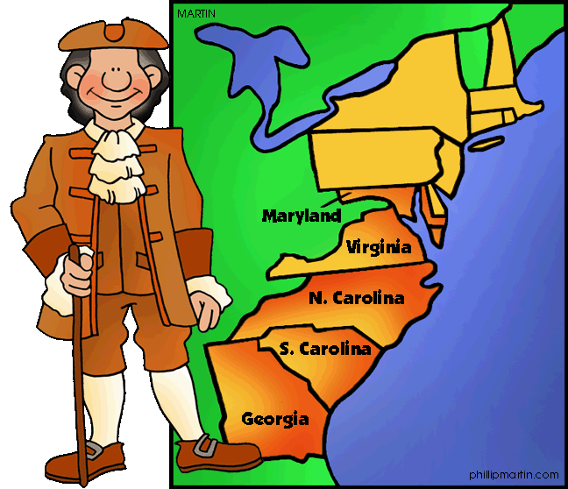
Lesson 1: Government in Colonial Government

Slide 3
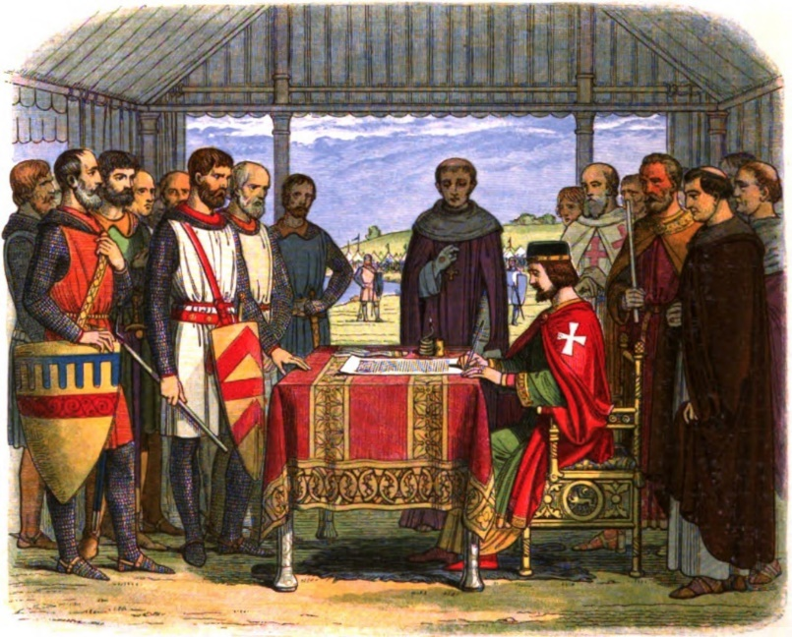
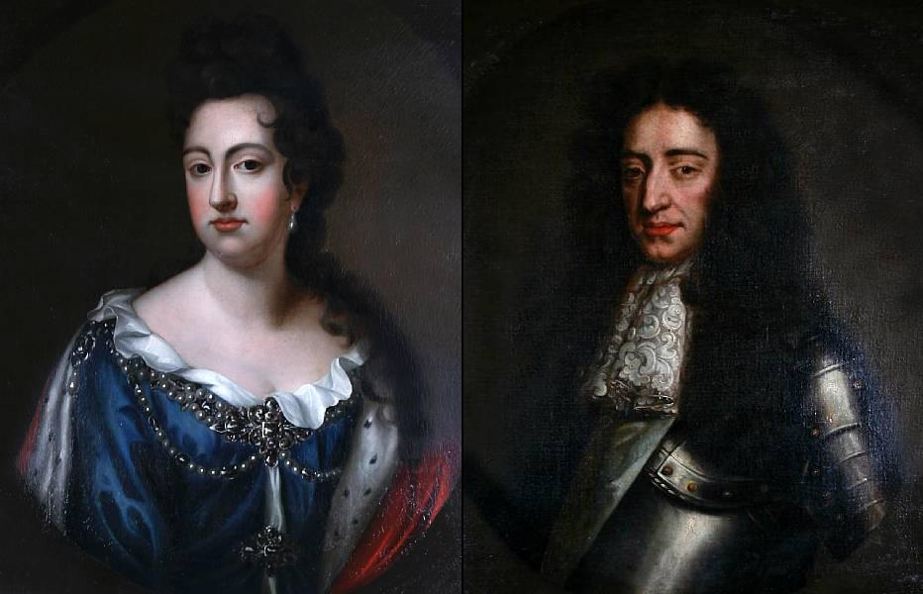
Basic Concepts of Government
The English colonists in America brought with them three main concepts:
The need for an ordered social system, or government.
The idea of limited government, that is, that government should not be all-powerful.
The concept of representative government—a government that serves the will of the people.

Slide 4
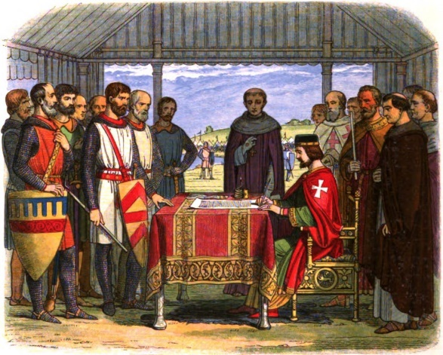
Important English Documents
The way our government works today can be traced to important documents in history:
English Bill of Rights
Made the monarchy responsible to the people and recognized Parliament as supreme
1215: Magna Carta
It placed limits on the power of the king

Slide 5
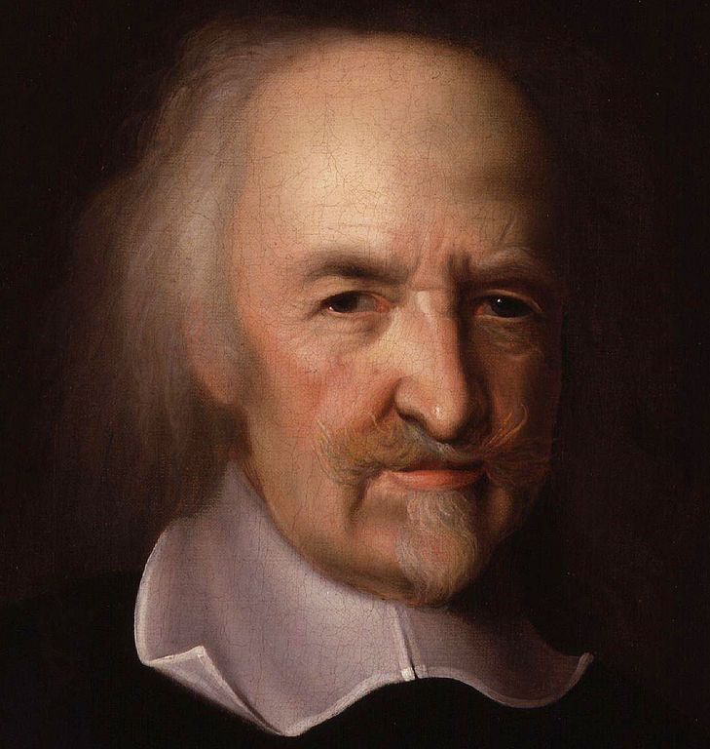
Our Political Heritage
Social Contract
Thomas Hobbes argued that people create a society by entering into a social contract
He believed that people needed government to maintain order
People would give up their individual sovereignty in exchange for the government to provide peace and order
Natural Rights
John Locke believed that people have “natural rights”, those rights people have simply because they are human beings
Also called “unalienable rights” or the right to “life, liberty, and pursuit of happiness”
Locke argued that the people had the right to protect these rights and that people were justified to rebel and change the government to ensure these rights

Slide 6
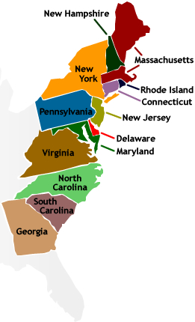
The Thirteen Colonies
There were three types of colonies in North America: royal, proprietary, and charter.
The royal colonies were ruled directly by the English monarchy.
The King granted land to people in North America, who then formed proprietary colonies.
The charter colonies were mostly self-governed, and their charters were granted to the colonists.

Slide 7
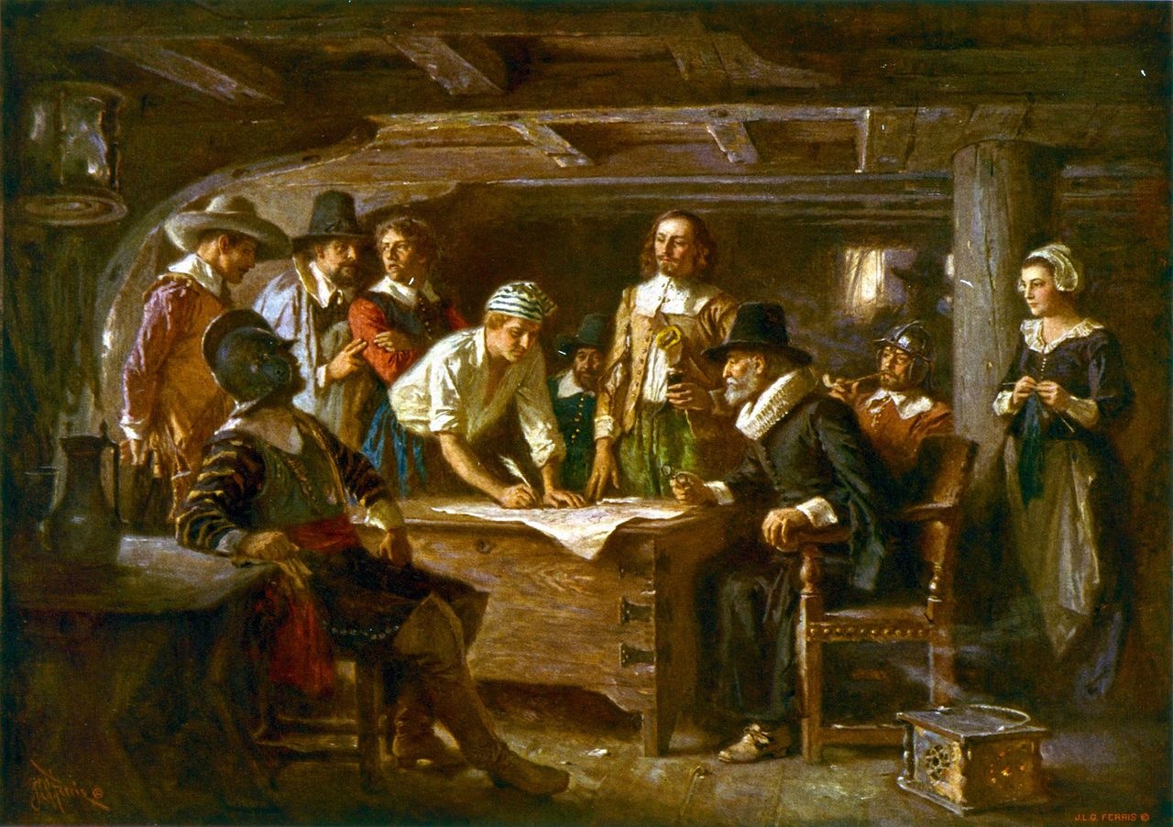
Written Constitutions
Government according a written plan was a key feature of the colonial period
The Mayflower Compact signed in 1620 by the Pilgrims was the first of many plans for self-government
In 1639, Connecticut created the first formal constitution, called a charter
The Fundamental Order of Connecticut gave the people the right to elect their own officials
Colonial charters divided the power among the governor, legislative assembly, and courts

Slide 8
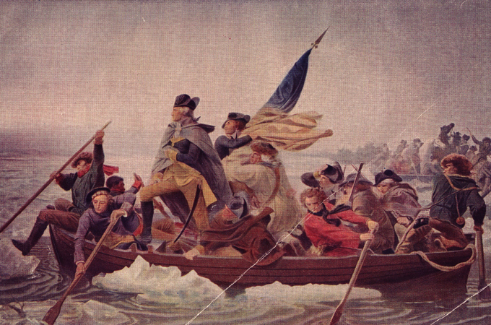
Lesson 2: Uniting for Independence

Slide 9
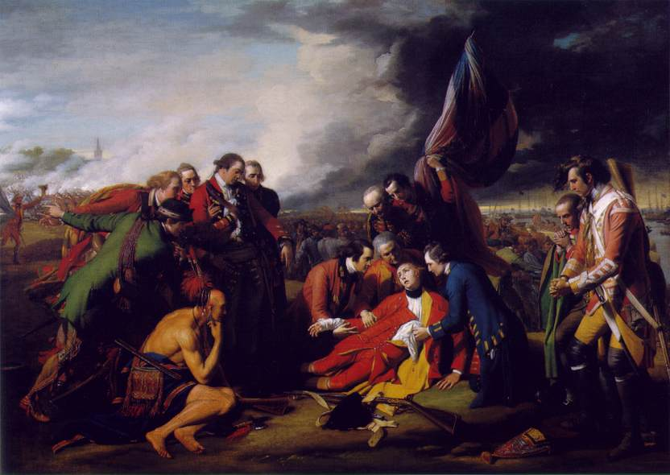
British Colonial Policies
Until the mid-1700s, the colonies were allowed a great deal of freedom in their governments by the English monarchy.
In 1754-1763, Britain fought a war with France, the colonies had to be protected and it left Britain in debt
In 1760s, King George III imposed new taxes and laws on the colonists.
taxes on tea, sugar, glass, paper, and other products

Slide 10
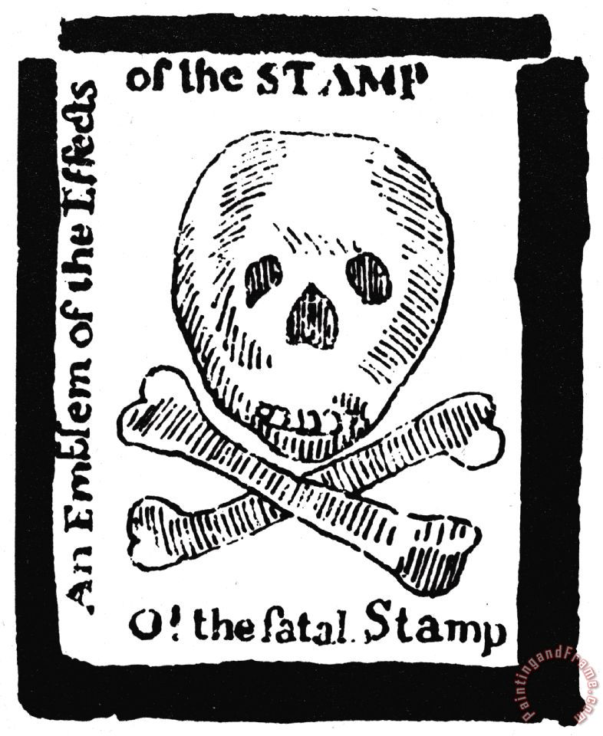
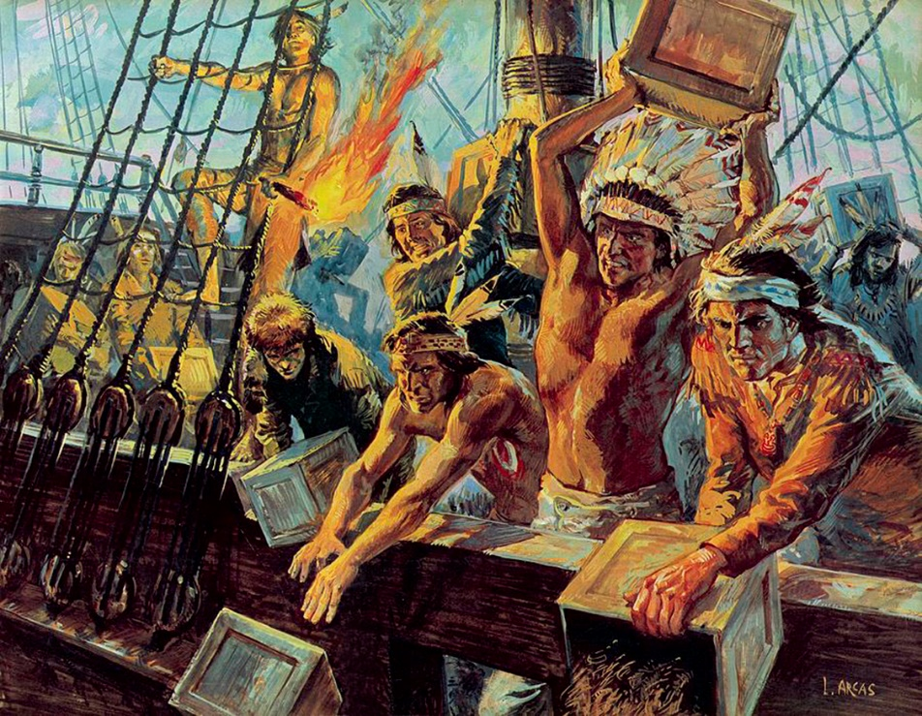
Taxing the colonies
1765, Stamp Act required them to pay tax on all legal documents
British parliament even passed laws to regulate trade so that Great Britain would benefit
The colonist believed that the British could not tax them without representation in parliament (“No Taxation without Representation”)
The colonist protested against all the taxes, for which Britain retaliated by placing more laws on the colonists

Slide 11
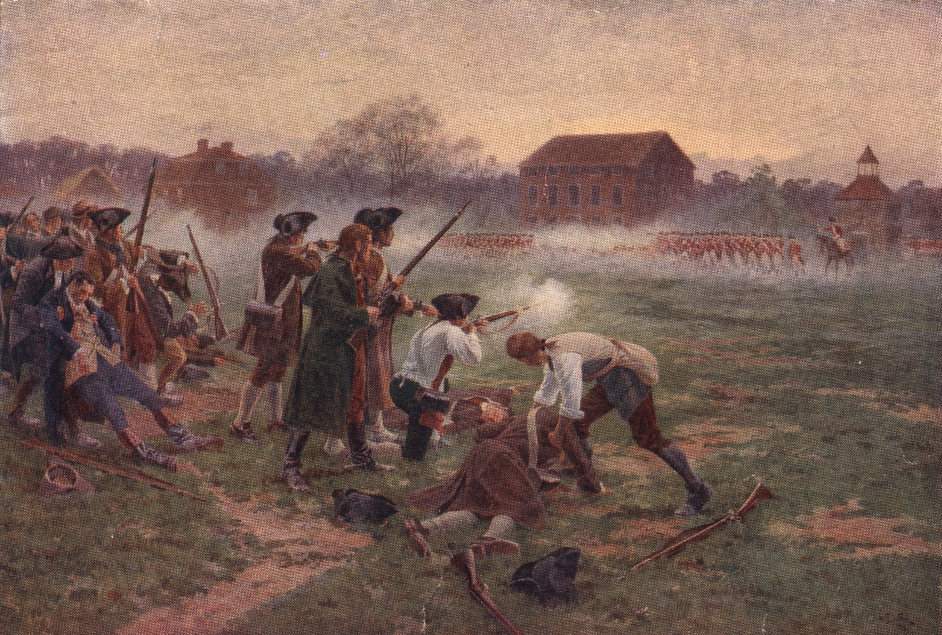
Taking Action
In 1765, nine colonies sent delegates to protest their treatment, the result was a petition to the king
By 1773, the colonies were organizing to keep in touch with each other and to urge resistance to the British
By 1775, the British and colonist met in open fight at Lexington and Concord starting the American Revolution

Slide 12
The Continental Congresses
First Continental Congress
The colonists sent a Declaration of Rights to King George III.
The delegates urged each of the colonies to refuse all trade with England until British tax and trade regulations were repealed, or recalled.
Second Continental Congress
In 1775, each of the 13 colonies sent representatives to this gathering in Philadelphia.
The Second Continental Congress served as the first government of the United States from 1776 to 1781.

Slide 13
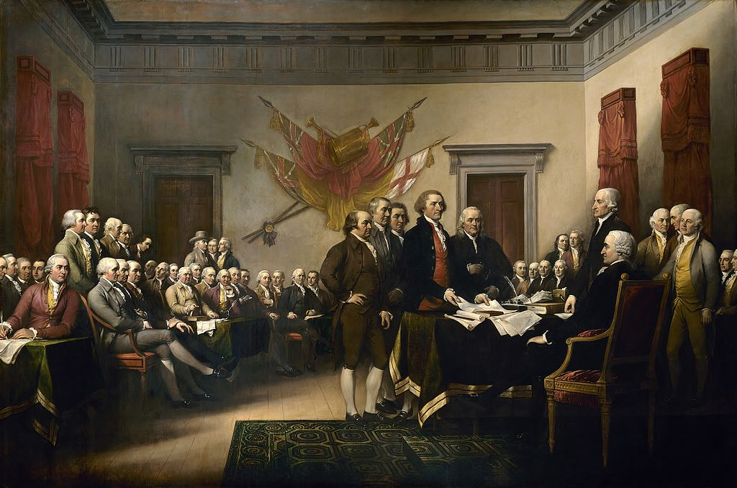
Declaration of Independence
Author: Thomas Jefferson
Jefferson got many of the ideas for the document from John Locke, and other philosophers
The Declaration explains the reasons the colonies were angry with Britain and confirmed why the revolution was justified.
Four parts of the Declaration
The Preamble: explains the basic rights of all men
2nd Section: explains purpose of the document
3rd section: lists the grievances against the King
4th section: explains the determination of the colonies to separate from Great Britain
The Declaration does not create American government but can be used a guide to understanding the Constitution.

Slide 14
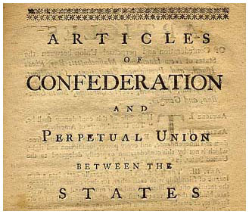
Lesson 3: The Articles of Confederation

Slide 15
The Articles of Confederation
The Articles of Confederation established “a firm league of friendship” among the States.
Powers
Congress was given the power to declare war, deal with national finance issues, and settle disputes among the States.
Obligations
The States promised to obey Congress, and to respect the laws of the other States. Most other powers were retained by each State.

Slide 16
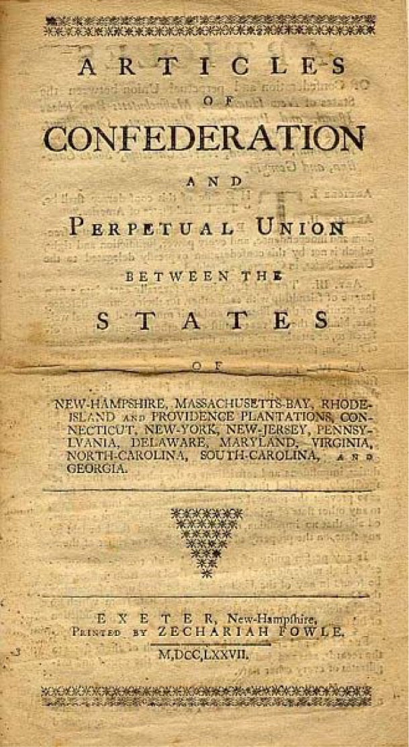
Government Under the Articles of Confederation
Each state would retain significant independence and there would be no strong central government
Powers of the Central Government:
No national court system
No president or king
Legislature would only have one chamber
Each state had one vote in congress

Slide 17
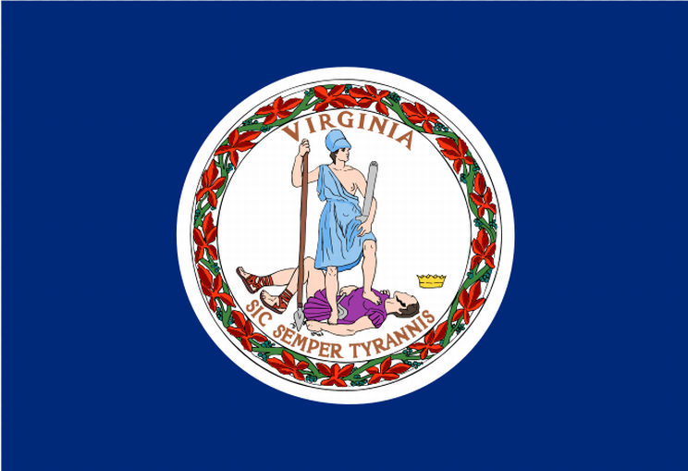
Problems with the Confederation
Thirteen Sovereign States
People identified themselves by the state that they came from after the revolution
States had created their own currencies, which made trade difficult among the states
Some states charged rival states tariffs
States could also have trade agreements with other nations
The states could ignore the requests by Congress to help fund the national government

Slide 18
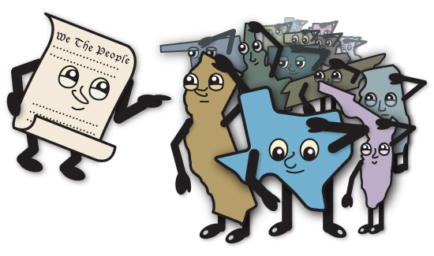
Problems with the Confederation
A Weak National Government
Congress could do little if a state refused its request to provide money
No standing army and no power to regulate trade
Congress passed very few laws because each bill could become law only if delegates from nine of the thirteen states voted for it
Congress could not force anyone to obey the laws they passed
No national court system to interpret and enforce laws
It became clear the confederation could not deal with the problems of the nations

Slide 19
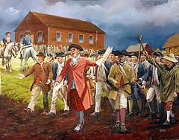
Problems with the Confederation
Achievements
In 1783 the Confederation signed a peace treaty with Great Britain, which recognized Americas independence
The Confederation developed fair and consistent policies for settling new lands west of the Appalachian Mountains (Land Ordinance of 1785)
Congress set up the departments of Foreign Affairs, War, marine, and the Treasury
Even with the success it took a rebellion, Shay’s Rebellion, to led to the Constitutional Convention

Slide 20
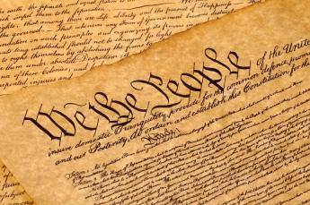
Lesson 4: Creating the Constitution

Slide 21
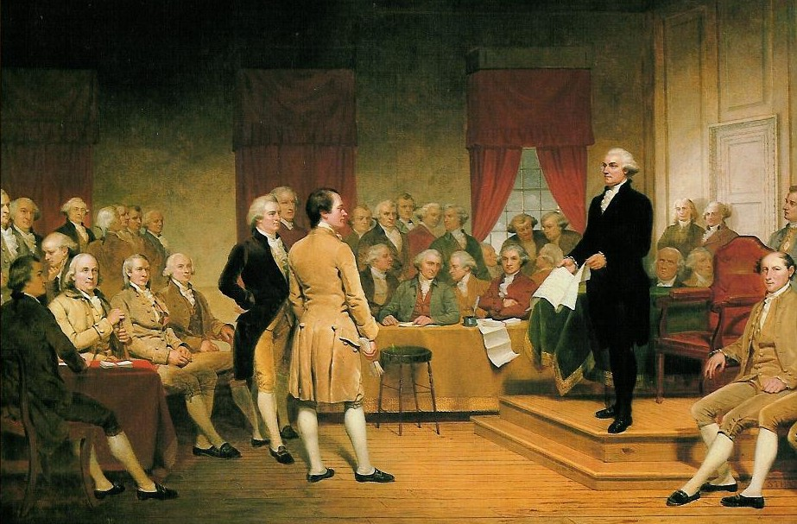
The Constitutional Convention
Key Agreements
The delegates all favored the ideas of limited & representative government
They all agreed that the national government should be divided into three branches and power shared between each
They agreed that the states should have limited power to coin money
They also agreed that the national government should have more power
The problem was how to put these ideas into practice

Slide 22
Different Constitutional Plans
The New Jersey Plan
Unicameral Congress
Equal representation for States of different sizes
More than one federal executive
The Virginia Plan
Three branches of government
Bicameral legislature
“National Executive” and “National Judiciary”

Slide 23
Constitutional Compromises
The Connecticut Compromise
Delegates agreed on a bicameral Congress, one segment with equal representation for States, and the other with representation proportionate to the States’ populations.
The Three-Fifths Compromise
The Framers decided to count a slave as three-fifths of a person when determining the population of a State.
The Commerce and Slave Trade Compromise
Congress was forbidden from taxing exported goods, and was not allowed to act on the slave trade for 20 years.

Slide 24
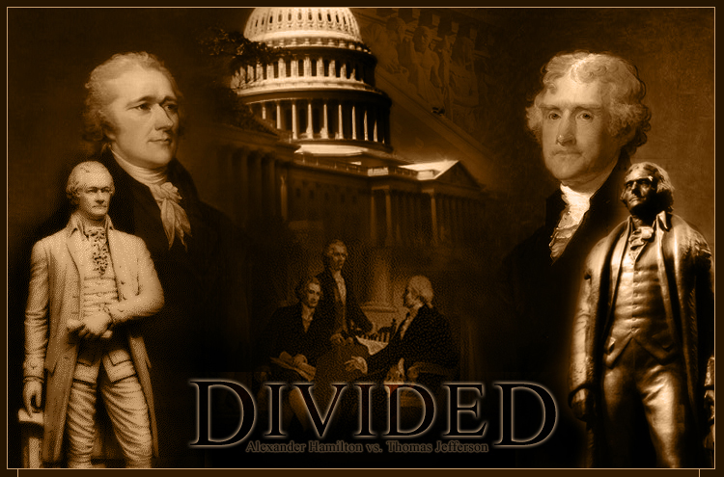
The Federalists and Anti-Federalists
The Constitution was very controversial at first, with some groups supporting it, and others attacking it.
Anti-Federalists
objected to the Constitution for many reasons, including the strong central government and the lack of a bill of rights.
Federalists
thought that the Articles of Confederation were weak, and argued for the ratification of the Constitution.

Slide 25
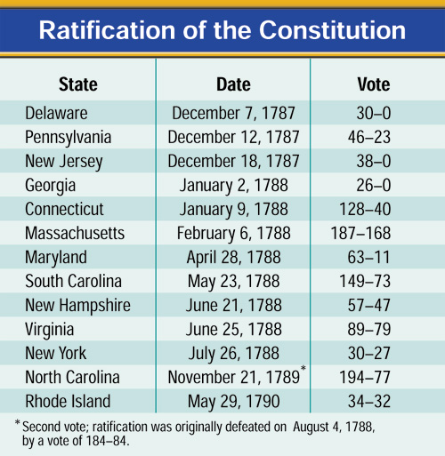
The Constitution is Ratified
Nine States ratified the Constitution by June 21, 1788, but the new government needed the ratification of the large States of New York and Virginia.
Great debates were held in both States, with Virginia ratifying the Constitution June 25, 1788.
New York’s ratification was hard fought. Supporters of the Constitution published a series of essays known as The Federalist.

Slide 26
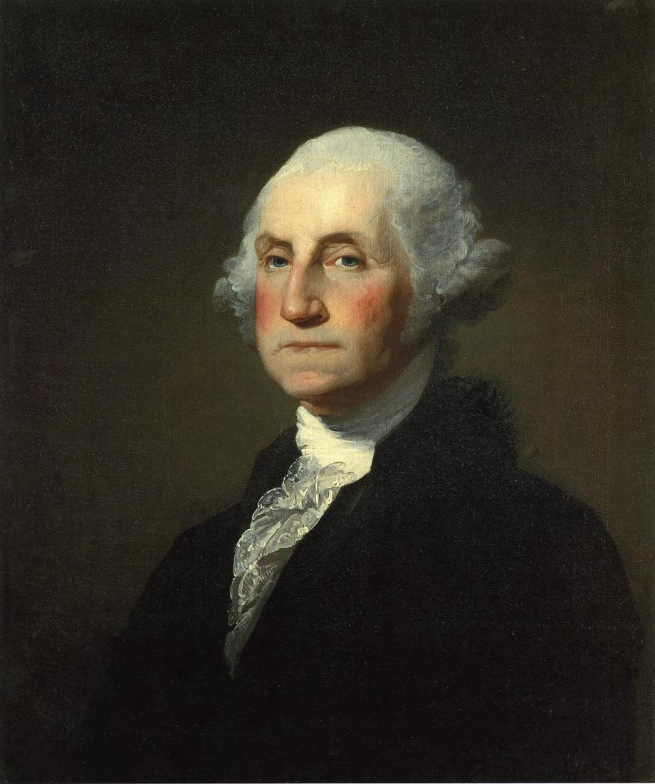
Ratifying the Constitution
Ratification
1789 the Constitution was ratified
George Washington became the first President and John Adams the vice-president
Congress approved 12 amendments and the states ratified 10 of them in 1791, which became known as the Bill of Rights

