Slide 1
Unit 5: Participating in Government
Chapter 19: Public Opinion and Interest Groups

Slide 2
Lesson 1: Shaping Public Opinion

Slide 3
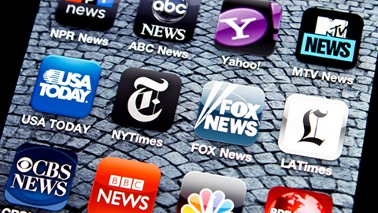
Public Opinion and Democracy
Two goals the Framers of the constitution wanted in our representative government:
Provide popular rule
Keep the government separate from the changing whims of an ill-informed public
Research shows that the government responds to public opinion
Influences on public policy: interest groups, political parties, the mass media, and activists
Citizens and public officials need to understand how opinions are formed, because public opinion does influence government

Slide 4
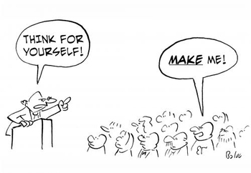
Political Socialization
This is the process for which individuals learn their political beliefs and attitudes
They can learn it from family, school, friends, coworkers, and other sources
The process starts early in life can continues till a person is an adult
Political socialization has a major influence on how people form their opinions

Slide 5
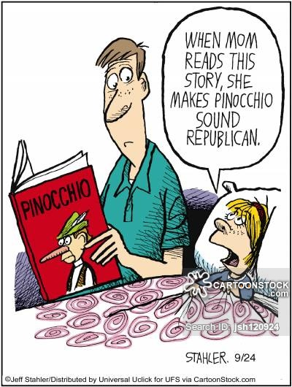
Family and Home Influence
This is where political socialization begins
Children learn many of their early political opinions from their parents
More than two-thirds of all adult voters continue to favor the political party their parents supported

Slide 6
Schools and Peer Groups
Schools also play an important part in political socialization
All students in the US learn the United States history & political system
Civic values are also learned in school clubs and through rules and regulations
A person’s peer groups can also play a part in political socialization
A person’s peer group often influence and shape opinions.

Slide 7
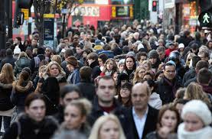
Personal Experiences
Personal experiences are the way a person interacts with the political and economic systems
A person’s economic and social statuses affect a person and thus influence their political socialization
A person’s political opinions may be affected by that person’s age
A person’s political opinions can also be influenced by their race, sex, or place where they live

Slide 8
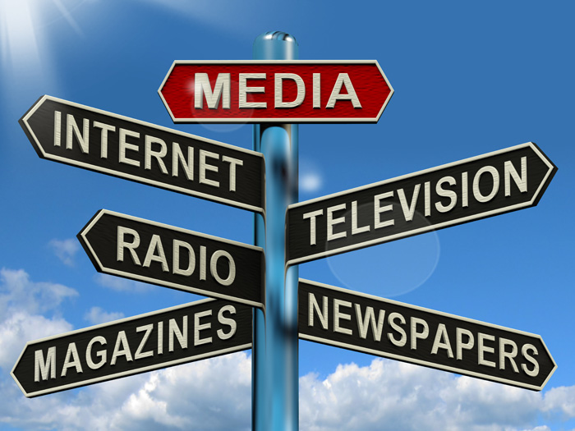
The Mass Media
The mass media does play a role in political socialization
Mass media from various sources of information such as the Internet, television, radio, newspapers, magazines, movies, and books
The Internet and television provide political information and images that can directly influence the political attitudes
The way the media show different groups can discredit stereotypes or reinforce them

Slide 9
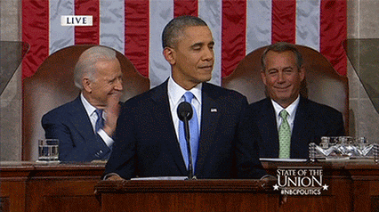
Other Influences
Government leaders, interest groups, and religious organization also play important roles in political socialization
The president because of the news media can influence people’s opinion
Members of Congress try to influence opinions, by talking to constituents or use mass media
Interest groups shape public opinion by trying to win public support of their groups goals

Slide 10
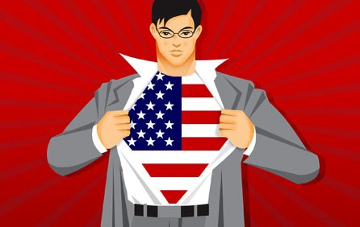
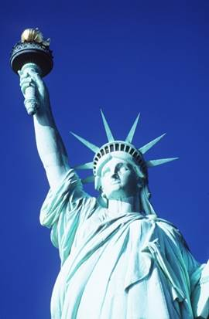
Political Culture
Political socialization is also where a person learns the political culture of your nature.
Political culture is a set of basic values and beliefs about a nation and its government that most citizens share.
Political culture in liberty and freedom can be seen in many patriotic songs
The American political culture includes the Constitution, and Bill of Rights, and commitment to the idea of political equality
Political culture sets the boundaries within which citizens develop and express their opinions

Slide 11
Political Culture
A nation’s political culture also influences how its citizens interpret what they see and hear every day
Political culture affects how Americans see the world

Slide 12
Political Efficacy
Political efficacy refers to a person’s belief that he or she can have an impact on government and policy
Some people join interest groups because they believe being party of group will increase their political impact
This is an important part of a democracy
Democracies would be unable to carry out the concept of government “of the people, by the people, and for the people” if their citizens did not participate.

Slide 13
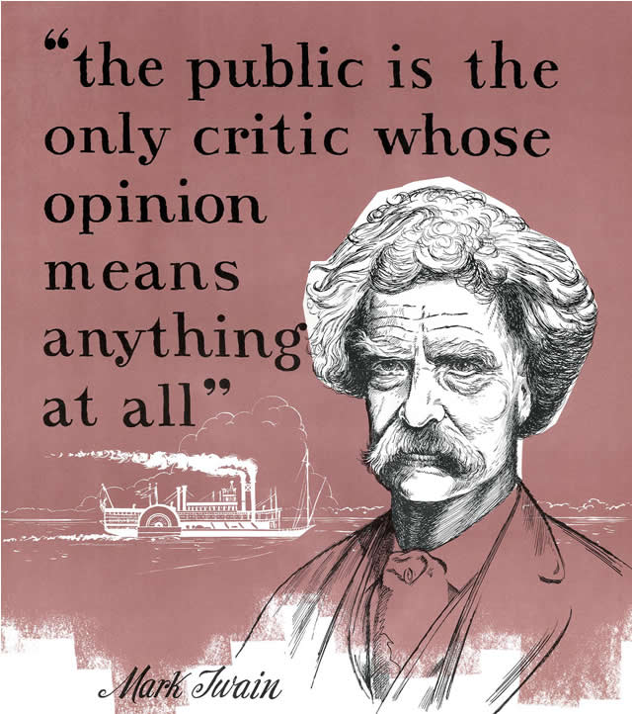
The Nature of Public Opinion
Public opinion is a major reason that affects an American’s opinion
Public Opinion refers to the ideas and attitudes that a significant number of Americans hold about government and political issues
Three factors describe the nature of public opinion
Diversity
Communication
Significant Numbers

Slide 14
Lesson 2: Measuring Public Opinion

Slide 15
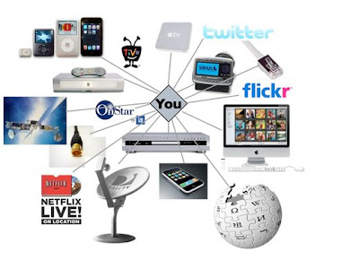
Nonscientific Methods
American express their opinions at the ballot box
Party organizations have long been a reliable source of information about public opinion
Mass media is another source that shows public attitudes
Many of the sources that show public opinion may give a distorted view of public opinion
One way that officials gauge public opinion is by the number of letters, emails, calls, and faxes they receive on different issues

Slide 16
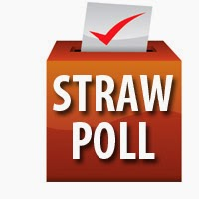
Nonscientific Methods
Straw poll is an unscientific way to measure public opinion
Straw polls are where newspapers, tv shows, radio stations, and websites ask their audiences to vote on different questions and then publish the results
Straw polls are always a biased sample of the population because the people who take the poll self-select.
A biased sample is a group that does not accurately represent the larger population

Slide 17
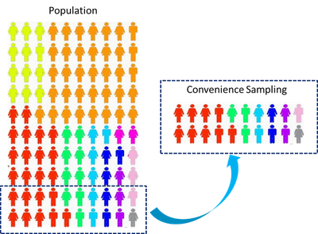
Sampling
A group of people that will be studied in a poll is called the universe
Representative sample is a small group of people who are typical of that universe
Random sampling is a technique in which everyone in that universe has an equal chance of being selected.
Sampling error is a measurement of how much the sample results might differ from the sample universe

Slide 18
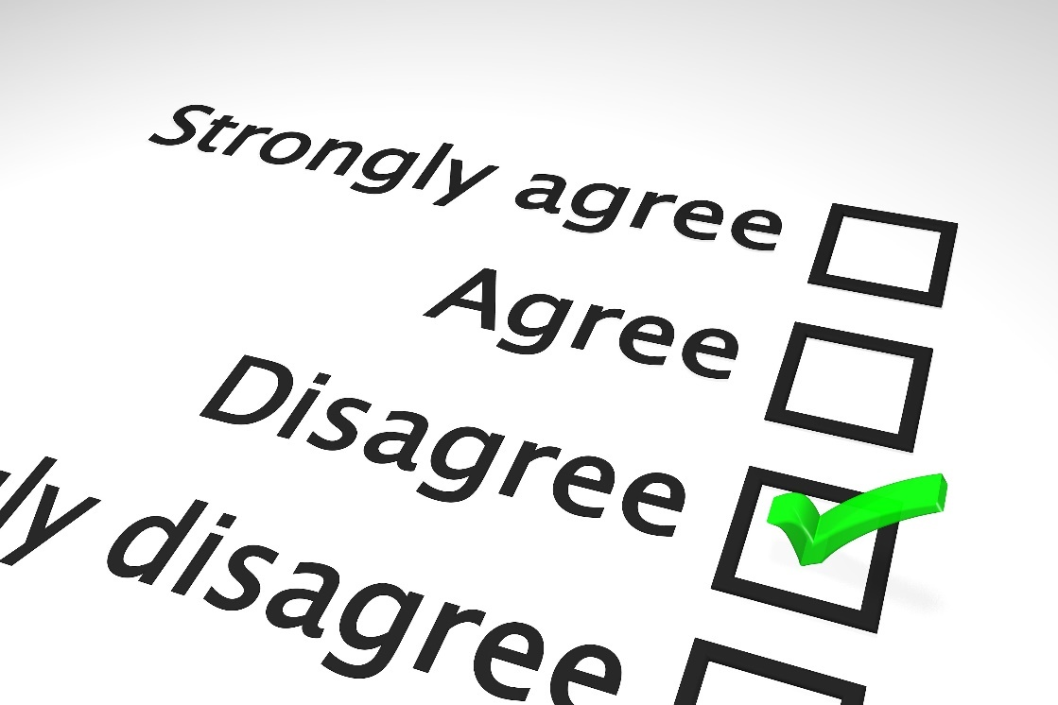
Asking Questions
They way a question is worded can greatly influence people’s responses and the poll results
Poll questions must be clearly worded so there is no confusion
Questions that include too many parts produce results that are hard to interpret.
Polling questions can take multiple forms

Slide 19
Interpreting Results
Polling is never completely accurate
Pollsters cannot be sure that the people they are interviewing are being honest
Polling organizations have learned how to conduct polls that are usually reliable within a few percentage points
Pollsters have to know the sampling error when interpreting polls
When interpreting polls you must also know who paid for the polls

Slide 20
Uses of Polling Data
Some polls show that constituents hold strong views on one side of an issue, and thus lawmakers will introduce a bill on the issue
Public officials must consider public opinion when making decisions
They report poll results as news, especially during election season
Exit polls involve interviewing voters as they leave the polling place and asking for whom they voted

Slide 21
Lesson 3: Interest Groups and Their Roles

Slide 22
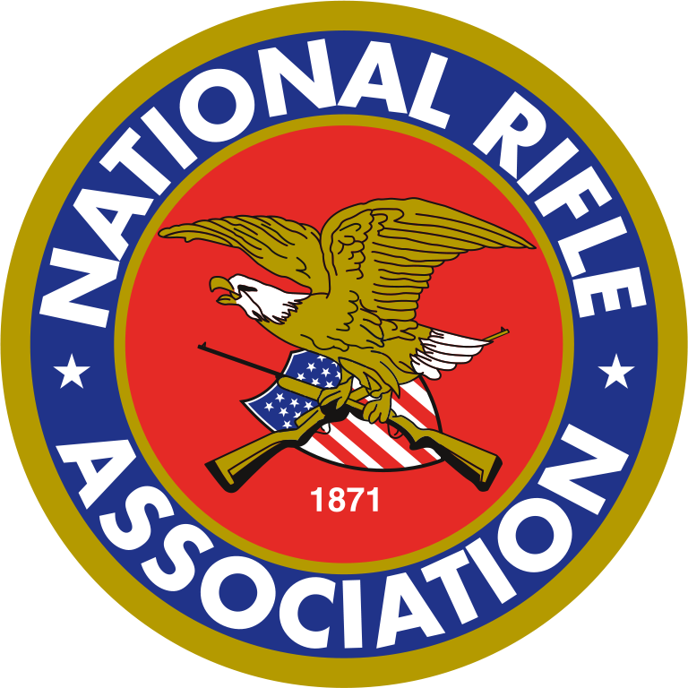
Power of Interest Groups
Interest group is a group of people who share common goals and organize to influence government
Interest groups are an important component of American civil society
Civil society is the network of voluntary associations that exist outside of government in any free society
Many of Americas early leaders believed that interest groups could make governing difficult
Today Americans have organized interest groups to pressure all level of government

Slide 23
The Purpose of Interest Groups
Interest groups help connect the people and the government
People communicate their “wants” or policy goals to government leaders through interest groups
Interest groups also act as watchdogs and protest government policies that harm their members
Most interest groups do not exist only to influence public policy, they also influence business practices and supporting research
Interest groups educate their members and the public, and meet the needs of their people

Slide 24
Political Power
Interest groups follow the old principle “There is strength in numbers.”
Interest groups are large and because of that interest groups have a stronger bargaining position with leaders in government than an individual would
The number of members needed to influence government leaders changes with the size of the community involved
An interest group draws from the financial resources and expert knowledge of its many members on the state and national levels
An interest group that is organized and has enough resources can have influence far beyond the power of its individual members

Slide 25
Leadership and Membership
Interest group leaders strengthen the political power of the group by uniting its members
People join interest groups to protect or promote their economic self-interest
People join to put their beliefs into policy or into direct action to help others
People join interest groups for social reasons, because socialization promotes group unity and political goals

Slide 26
Types of Interest Groups
Economic Interest Groups-are concerned about taxes, food prices, housing, inflation, and unemployment.
Public Interest Groups-focus their work on influencing policies that they believe affect the general public.
Civil Rights Groups-have been formed to protect the rights of various groups throughout US History
Single-Issue Groups-are the most effective interest group because they focus on one particular issue
Ideological Interest Groups-promote broad policies based on their core political or religious beliefs
Faith-Based Interest Groups-promote specific religious traditions
Professional Interest Groups-they represent specific professions
Government Interest Groups-represents the workers and leaders in American government at all levels

Slide 27
Lesson 4: Affecting Public Policy

Slide 28
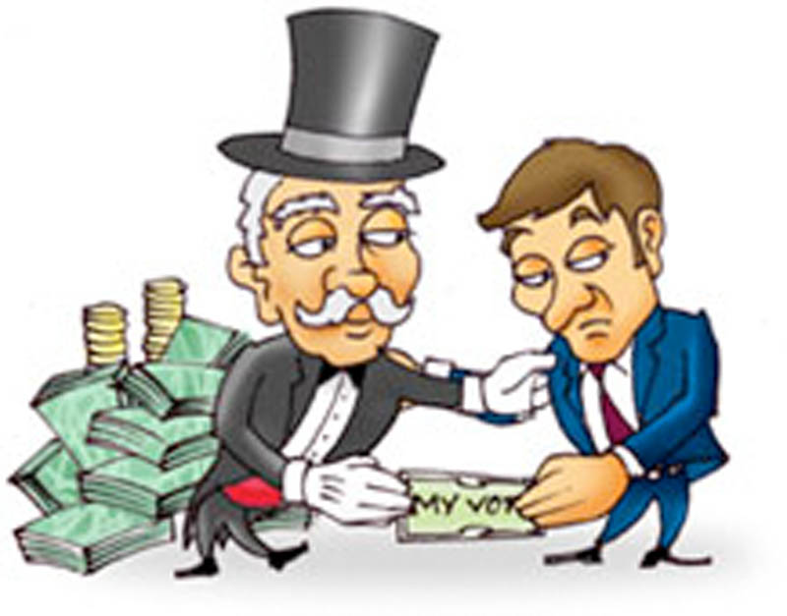
Lobbying
Interest groups work to influence public policy wherever it is made.
Lobbying is the direct contact that interest groups take to persuade lawmakers
Lobbyists are paid representatives of an interest group
Grassroots lobbying refers to political advocacy efforts carried out by the general public and members of interests groups
Lobbyists work to influence legislators at all levels of government

Slide 29
Who are Lobbyists?
Federal laws says that a lobbyist is anyone who:
Is employed by a client to contact government officials about federal legislation or policy
Makes more than one contact for the client
Spends more than 20% of his or her time serving the client
Professional lobbyists who work at the federal level must register with the federal government so their professional activities can be monitored
Many lobbyists are former government officials
Congress placed a time requirement on how soon senators and representatives may become lobbyists
Other lobbyists are often lawyers or public relations experts.

