Slide 1
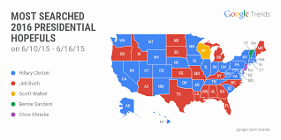
Chapter 18 – Voting & Elections

Slide 2
LESSON 1 Expanding Voting Rights
Voting Limitations in Early America
An election is an orderly process for making group decisions. Free and fair elections are the hallmark of democracy. Voting is making a choice among alternatives in an election.
Like other rights, the right to vote is not absolute but subject to regulations and restrictions. During periods of American history, law, custom, and even violence have prevented certain groups of people from voting.
Before the American Revolution, the colonies placed many restrictions on who had the right to vote. Women and most African Americans were not allowed to vote; neither were white males who did not own property or pay taxes. In some colonies, only members of the dominant religious group could vote.

Slide 3
Voting Limitations in Early America
As a result, only about five or six percent of the adult population was eligible to vote. These restrictions existed because educated white men of the time believed that voting was best left to wealthy, white, property-owning males, whom they assumed would make wiser choices. As John Jay, who served on the U.S. Supreme Court as the first chief justice of the United States, put it: “The people who own the country ought to govern it.”
After the Constitution was adopted, the states were allowed to set the time, place, and manner of elections. Each state could have its own rules about who could vote in national elections as long as these rules did not violate the U.S. Constitution. Despite having the power to do so, Congress did not make many laws regulating elections until after the Civil War.

Slide 4
Voting Limitations in Early America
During the first half of the 1800s, state legislatures gradually abolished property requirements and religious restrictions for voting. By the mid-1800s, the country achieved nearly universal white adult male suffrage, or the right to vote. Still, the vast majority of African Americans and all women could not vote.

Slide 5
African American Suffrage
When the Constitution went into effect in 1789, African Americans, both enslaved and free, made up about 20 percent of the U.S. population. Yet enslaved persons were not permitted to vote anywhere, and free African Americans who were allowed to vote could do so in only a few states.

Slide 6
The Fifteenth Amendment
The Fifteenth Amendment was ratified in 1870. The amendment provided that no state could deprive any citizen of the right to vote on account of race, color, or previous condition of servitude. This amendment marked the first time that the U.S. Constitution dictated rules to the states about who they must allow to vote.

Slide 7
Grandfather Clause
One such practice was the grandfather clause. It was incorporated in the constitutions of some Southern states. The grandfather clause provided that only voters whose grandfathers had voted before 1867 were eligible to vote without paying a certain tax or passing a literacy test.
Political leaders in Southern states set up a number of roadblocks to disenfranchise and discourage the participation of African American vote

Slide 8
The Literacy Test and Poll Tax
Until the 1960s, many states required citizens to pass a literacy test to qualify to vote. In many cases, white voters were judged literate if they could write their names, but African American voters were often required to do much more.
Another device that was designed to discourage African American suffrage was the poll tax. Usually amounting to a dollar or two, citizens had to pay a poll tax before they could vote. The poll tax had to be paid not only for the current year but also for previous unpaid years. It was a financial burden for poor people of all ethnic and racial backgrounds.

Slide 9
Literacy Test & Poll Tax

Slide 10
Literacy Test & Poll Tax
In 1964, the Twenty-fourth Amendment outlawed the poll tax in national elections. The use of the poll tax in state elections was not eliminated until a 1966 Supreme Court decision. (Harper v. Virginia Board of Election

Slide 11
The Voting Rights Acts
Despite gains, many discriminatory practices still prevented African Americans from voting into the mid-twentieth century, particularly in the South. One key pillar of the civil rights movement of the 1960s was the fight for voting laws that would prohibit this discrimination. With the passage of the Voting Rights Act of 1965, the federal government took new steps to directly regulate state-controlled election procedures.

Slide 12
The Voting Rights Act
In 1960 only 29 percent of all African Americans in the South were registered. By 2000, the figure had risen to more than 65 percent.
Until 2013, the Voting Rights Acts still placed special regulations on states with a history of voter discrimination. Those states had to ask for permission from the federal government before changing any of their voting laws. However, in a 2013 case called Shelby Co. v. Holder, the Supreme Court ruled that the formula Congress used to decide which states had to follow these special regulations was unconstitutional because the formula was based on discrimination in place over 40 years ago.

Slide 13
Suffrage for Women and Youth
It was not until the twentieth century that both universal adult woman suffrage and 18- to 21-year-old suffrage were achieved.
During World War I, women suffragists continued the fight for the right to vote. In 1917 the National Women’s Party, led by its founder Alice Paul, began picketing outside the White House and distributing leaflets. One such leaflet read:
“We women of America tell you that America is not a democracy. Twenty million women are denied the right to vote …. Tell our government that it must liberate its people.”
—from leaflet written by Alice Paul, 1917

Slide 14
Suffrage for Women and Youth
Not until after World War I, when the Nineteenth Amendment was ratified, was woman suffrage put into effect nationwide. While the struggle to get the vote was significant, once the Nineteenth Amendment passed, women did not face the cultural or legal barriers to voting that many African Americans were forced to hurdle well into the mid-twentieth century.

Slide 15
Suffrage for 18- to 21-Year-Olds
For many years, the minimum voting age in most states was 21. In the 1960s, many young Americans were fighting in Vietnam, and many others became involved in protests and politics. They also started a movement to lower the voting age to 18. The basic argument was that if individuals were old enough to be drafted and fight for their country, they were old enough to vote. The Twenty-sixth Amendment, which was ratified in 1971, ended this debate, lowering the voting age to 18 in every state.

Slide 16
LESSON 2 Influences on Voters The Structure of Elections
Both federal and state guidelines structure the U.S. electoral system. Election cycles, term limits for elected officials, and ballot issues all influence voter choices at the polls

Slide 17
Election Cycles
The Constitution dictates the length of the terms of members of Congress, the president, and the vice president.
Members of the House of Representatives serve two-year terms. Senators have a six-year term and the president serves a four-year term.
Every four years, we have a presidential election. Congressional elections held in the middle of a president’s term are called midterm elections.
The Constitution says that states may prescribe the time, place, and manner of elections, but Congress may, at any time, make or alter those regulations. Since 1845, Election Day has been on the Tuesday after the first Monday in November.

Slide 18
Term Limits
The Twenty-second Amendment limits a president to two terms. The Constitution does not limit the number of terms a member of Congress can serve. There have been proposals to limit their terms, but efforts to amend the Constitution to impose term limits have failed.
On the state and local level, governors in 36 states are limited in the number of terms they may serve; in some states, legislators and a few locally elected officials also face term limits. In some cases, officials may serve more than one term if the terms are not consecutive.

Slide 19
Ballot Questions
In a legislative referendum, the legislature refers a measure to the voters for their approval.
In a popular referendum, voters gather signatures to put specific laws passed by the legislature on the ballot. Citizens can vote to approve or repeal the laws.
In an initiative, voters who secure enough signatures can place their own proposed laws or state constitutional amendments on the ballot. If successful, initiatives can either force a state legislature to consider an issue or can bypass the legislature completely. In various states, voters have approved or rejected bans on abortion, same-sex marriage, tax increases, and collective bargaining by public employee unions via the initiative or referendum process.

Slide 20
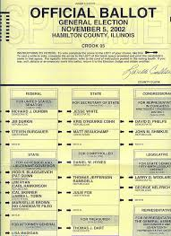
Voters’ Election Choices
There are four major factors that tend to drive voters’ election choices. They are the personal background of the voter, the degree of loyalty to a political party, issues in the campaign, and the voter’s perception of the candidates.

Slide 21
Personal Background
Voters’ personal backgrounds affect their decisions. A person’s background includes such things as family, age, education, religion, occupation, income level, where they live, and general outlook on life.
People who live in cities may be more likely to vote for a candidate who wants to invest in public transportation than people who live in more rural areas. As the U.S. population shifts to become more urban and suburban, this could affect voting patterns.

Slide 22
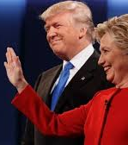
Personal Background
Individuals may have multiple traits that align them with different positions on issues or candidates, which make predicting how they would vote difficult. These cross-pressured voters face conflicting pressures from different elements of their identity—religion, ethnicity, income level, or peer group.

Slide 23
Party Loyalty
Another influence on voters’ decisions is their loyalty—or lack of it—to one of the political parties. The majority of American voters consider themselves either Republicans or Democrats, and most vote for their party’s candidates.
Strong party voters are those who select their party’s candidates regardless of the specific issues or candidates in any given election. They typically vote a straight party ticket, meaning that they choose all candidates affiliated with their party on the ballot.

Slide 24
Party Loyalty
Unlike strong party voters, weak party voters are more likely to switch their votes based on the issues or candidates at hand. People who choose not to identify with a specific party are known as independent voters. In the 2008 election, roughly 40 percent of the electorate was either independent or weak party voters. These voters factor importantly in presidential elections because strong party voters from both major parties tend to balance each other out. Because of this, candidates often try to tailor their messages to attract independent voters

Slide 25
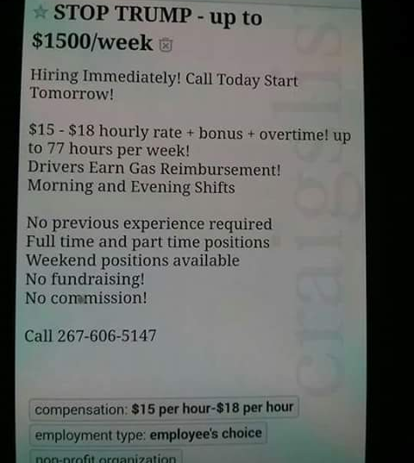
Party Loyalty
Candidates do their best to portray an image they believe voters value. Candidates want to appear to be strong and trustworthy leaders. At the same time, they may want their opponents to appear weak or otherwise unprepared for the job. Campaigns, aided by political parties and interest groups, help candidates cultivate their messages and images to appeal to potential voters.

Slide 26
Issues
Due to advances in education and access to new media technology, today’s voters have more opportunities to become better informed about a candidate’s stance on issues than the voters of earlier years. Despite this, many voters are still not informed about all of the issues in a campaign. Voters are typically most concerned with issues that directly affect them. In the past, important issues have included Social Security, health care, taxes, education, affirmative action, abortion, gun rights, and the environment.

Slide 27
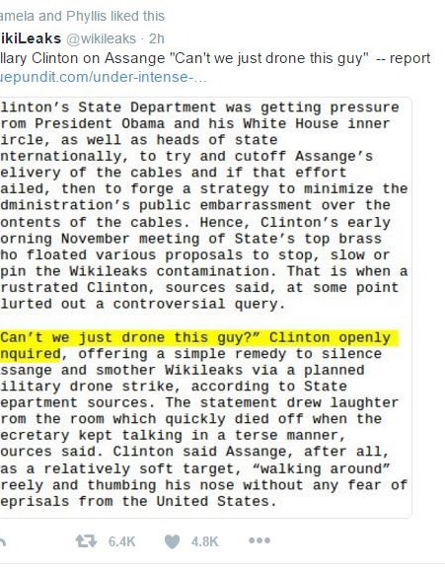
Voter Participation
The percentage of Americans voting in presidential elections declined from about 69 percent in 1964 to 56 percent in 2012. Even fewer Americans vote in congressional, state, and local elections. For example, in the 2014 midterm elections approximately 37 percent of the voting eligible population cast a ballot. Voter participation in the United States is quite low compared to many other democracies around the world.

Slide 28
Voter Participation
Why is it that so many eligible Americans do not go to the polls? One major reason is our complicated registration practices. In most European nations, the government automatically registers every eligible citizen to vote. In the United States, the burden of registering falls entirely on the citizen, and voters must re-register if they move

Slide 29
Why People Don’t Vote
Why is it that so many eligible Americans do not go to the polls? One major reason is our complicated registration practices. In most European nations, the government automatically registers every eligible citizen to vote. In the United States, the burden of registering falls entirely on the citizen, and voters must re-register if they move.

Slide 30
LESSON 3 Campaigns and Financing
At the head of this organization is a campaign manager, who is responsible for overall strategy and planning. In a national campaign office, various staff members handle media relations with journalists from television, radio, print, and digital media.
Other staff manage finances, fundraising, advertising, opinion polls, and campaign materials. For state and local elections, state and local party officials may help coordinate the campaigns. Party officials and campaign field workers contact voters, hold local rallies, and distribute campaign literature

Slide 31
Propaganda and Advertising
One of the largest expenditures for election campaigns is advertising. Candidates use advertising to inform voters of their position on issues, to portray themselves in an appealing light, and to criticize their opponents.
Propaganda involves using ideas, information, or rumors to influence opinion. It is not necessarily lying or deception, but it is not objective either.

Slide 32
Propaganda and Advertising
There are many propaganda techniques, most of which rely on arguments that may sound convincing but that are not necessarily valid.
Associating a candidate with a symbol, using negative words and labels to describe an opponent’s positions, pretending that an opponent supports a position that he or she does not, and quoting only favorable statistics are some examples of the types of propaganda that have played a part in every campaign since the 1800s.

Slide 33
Television
The most important communication tool for a presidential candidate is television. Watching television is the main way that many citizens find out about a candidate and his or her position on issues. Appearances on television news shows are vitally important for campaigns in order to remain in the public consciousness, and campaigns will routinely stage newsworthy events with their candidates in order to get favorable airtime. Televised debates, often occurring late in a campaign, can have an impact on undecided voters.
You can tell whether an ad was produced by a campaign or by a supporting group by whether or not the candidate being supported states during the advertisement that he or she approves of the message. This is a requirement of the Bipartisan Campaign Reform Act of 2002, written with the idea that fewer negative ads would be created if candidates had to actively affirm the language in their advertisements.

Slide 34
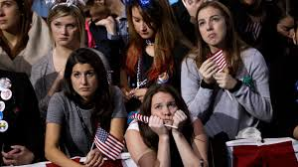
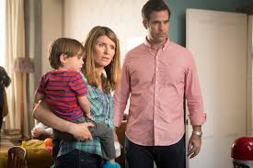
Television
Just in time for the 2012 presidential election, an election watchdog group developed a cell phone application that allows a user to point his or her phone at the television and then be automatically linked to a database containing information about the group sponsoring the ad.

Slide 35
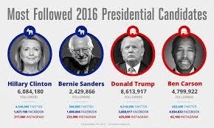
Internet and Social Media
President Barack Obama’s 2008 campaign broke campaign fundraising records and raised over $700 million, in part by making it even easier for individual donors to give and volunteer through his campaign websites.
It is no longer enough for candidates to have just one campaign website as their Internet presence. Campaigns tweet to supporters, are active on Facebook and other social media sites, maintain blogs, send e-mail blasts to their supporters, and use targeted advertising across the web
Social media can be a powerful and cost-effective campaign tool. Campaign supporters generate new content and spread this content to their friends and connections through the use of social media

Slide 36
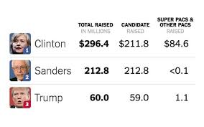
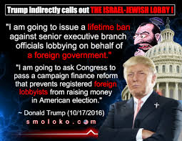
Campaign Finance
Running for political office is very expensive. In the 2011–2012 election cycle, presidential and congressional candidates spent more than $7 billion on election campaigns. Candidates need money for office space, staff salaries, travel, and advertising, among other things. In addition to candidate spending, unions, corporations, and other groups spend huge sums of money to independently advertise on behalf of the candidates and issues that they support.

Slide 37
Campaign Finance
Efforts to regulate money in campaigns are controversial. Those favoring strict regulation believe unlimited spending can have a corrupting influence on politics and gives an unfair advantage to those with a lot of money. They argue that, once elected, candidates will feel the need to give favors to those who contributed heavily to their campaign.
When a candidate seems to be motivated by specific monetary interests rather than by the good of the country as a whole, people accuse that candidate of corruption. Opponents of regulation believe money contributes to a broader political debate. They argue that giving and spending money in elections is a form of speech and thus protected by the First Amendment.

Slide 38
Efforts to Regulate Campaign Finance
Since 1908, Congress has tried to set limits on campaign funding in order to reduce corruption. This has proven to be a difficult balancing act, as limiting spending and donations can also be seen as limiting free speech. The early campaign finance laws tried to limit both how much individuals and businesses could donate to campaigns and how much campaigns could spend. These laws were challenged in court.
In 1975 the Federal Election Commission (FEC) was created to administer federal election laws.

Slide 39
Public Financing
Federal funding for presidential elections was established as part of a 1974 amendment of the Federal Election Campaign Act (FECA). Candidates that qualify can receive campaign funds from the federal government if they promise to limit the amount their campaigns spend to a specific amount.
Barack Obama elected not to receive public financing while Republican nominee John McCain chose to receive it. As a result, Obama was able to outspend McCain by a factor of two to one. In 2012, neither presidential candidate used public funding

Slide 40
Direct Funding
Direct contributions are called hard money and are limited based on regulations set out in FECA and its amendments. As of 2012, individual supporters can donate $2,500 to a presidential candidate; national and local party committees can give $5,000. Political action committees (PACs), which are groups established by interest groups to raise money to support candidates or parties, can donate $2,500.
Individuals are capped at donating $117,000 on political campaigns every two years

Slide 41
Indirect Funding
Indirect funding includes contributions to issue groups and political organizations that are independent from and not coordinating with a campaign. In the past, money given to these organizations was often funneled to national parties and used to advertise for candidates, hold voter registration drives, or stage get-out-the-vote campaigns. In 2002, Senators John McCain and Russ Feingold sponsored a bill to rein in this spending. The Bipartisan Campaign Reform Act (BCRA) banned these soft money transactions.
In 2010 the Supreme Court struck down these advertising limits in Citizens United v. FEC. Due to this and several other legal decisions, PACs that do not coordinate with campaigns can receive unlimited donations from individuals, corporations, unions, and other groups. PACs that take advantage of this new freedom are now commonly referred to as SuperPACs. These powerful SuperPACs collect and spend unlimited amounts of money to support or defeat a candidate.

Slide 42
LESSON 4 Voter’s Guide Voting Qualifications and Voter Registration
The Constitution gives each state authority to set its own rules about who can vote. However, federal law and several constitutional amendments set a basic standard that prohibits states from excluding U.S. citizens from voting based on gender, religious beliefs, income level, race, ethnicity, or for those aged 18 or older. Every state requires voters to be U.S. citizens and to be residents of the state for a certain period of time before they are eligible to vote.
Registration became common in the late 1800s as a way to stop voting fraud. In those days, the slogan “Vote Early and Often” was not a joke. In Denver in 1900, for example, one man confessed to having voted 125 times on Election Day!

Slide 43
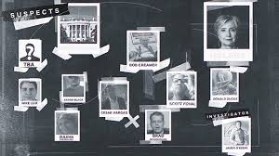
Voter Fraud
http://www.npr.org/2016/10/19/498587397/sting-video-purports-to-show-democrats-describing-how-to-commit-voter-fraud

Slide 44
Whatever you do, VOTE!
Where and How to Register
Who can Help you Register
You must complete a registration form in order to become eligible to vote. In some states, you can complete the form online; in other states, you must sign and mail it to the board of elections. Contact your state board of elections to download or request a copy of your state’s registration form.
Political parties and campaign staff are eager to help people register to vote, especially people who they believe will support their candidates. They tend to focus their registration strategies in communities and demographic groups that traditionally vote for their parties

Slide 45
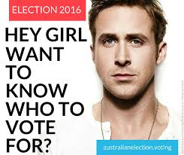
Voting
Many elections around the world—and at every level of government—have been won or lost by a miniscule margin.
The decision is yours to make, though. Voting is optional in the United States and in all but 16 democratic nations. In other countries, especially those with authoritarian governments, compulsory voting is enforced. In those countries, people who do not vote can be sanctioned with fines, jail time, or other penalties.

Slide 46
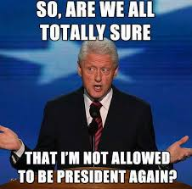
Preparing to Vote
Remember, elections are often about more than picking leaders. Some ballots also contain referenda, initiatives, or recalls. In some cases, these ballot questions may seem like minor changes to technical or legal language; in other cases, voters may be asked big questions such as whether students attending state colleges may receive in-state tuition if they are unable to prove they are U.S. citizens or if their county can raise tax rates. Be sure to find out if your ballot will contain such proposals. If so, consider your answers before the day you vote.

Slide 47
When and Where to Vote
You may vote on Election Day, like many Americans. If so, you will go to the polling place near your home, typically at a school or library. Your polling place will be in a particular precinct or voting district. Each city or county is usually divided into precincts containing between 200 and 1,000 voters. You may receive a notice from your state board of elections telling you the location and hours for your polling place.
If you live in one of the 33 states or the District of Columbia that allow early voting, you can cast a ballot in person during a designated period, usually for about three weeks prior to Election Day. No excuse or justification is required.
If you do not live in one of these states, and you will be out of town, in the hospital, observing a religious holiday, or working on Election Day, you may vote early via absentee ballot.

Slide 48
How to Vote
Voting procedures and ballots vary from state to state. If you vote in person, when you arrive at your polling place, you may see campaign workers or political party volunteers trying to persuade undecided voters. State laws restrict electioneering at polling places.
As soon as the polls close, all the ballots from your precinct will be forwarded to your city or county canvassing board. This official group has representatives from both political parties and is in charge of counting votes, called returns. These local boards bundle all the returns together and send them to the state canvassing authority. Within days of the election, this state authority certifies the election of the winner. Through television and radio, people usually know the winners before canvassing boards certify them. In close elections, the result might depend upon the official vote count and certification.

