Slide 1
Unit 5: Participating in Government
Chapter 17: Political Parties

Slide 2
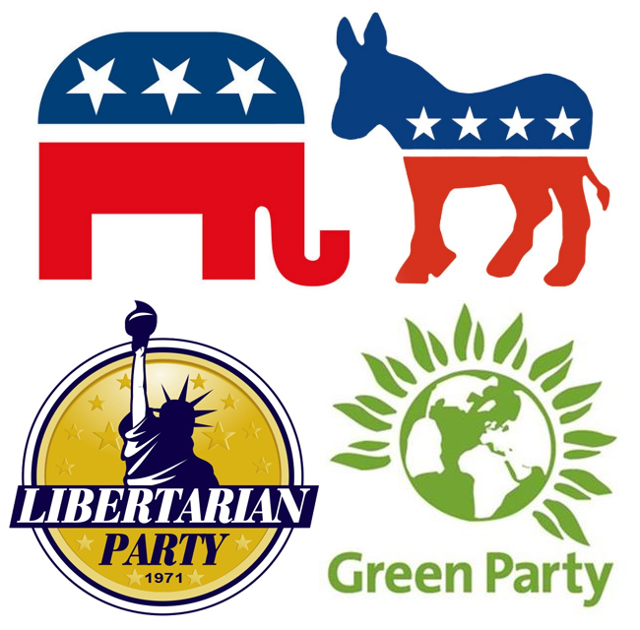
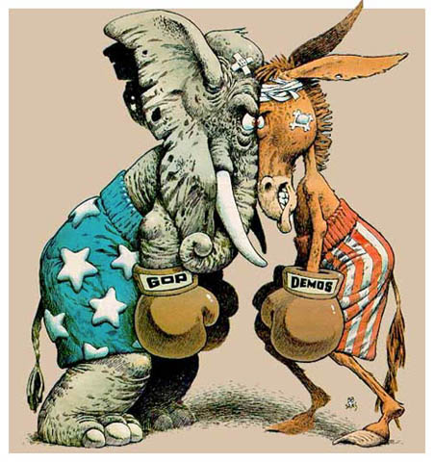
Lesson 1: Development of Political Parties

Slide 3
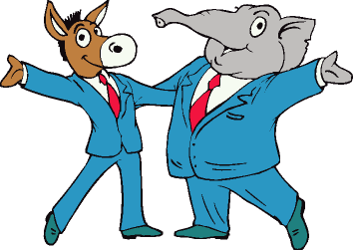
Functions of Political Parties
A political party is a group of people organized with common interests to win elections
After a political party wins an election the job then becomes how to implement their promises
The Constitution does not provide for political parties or even mentions them

Slide 4
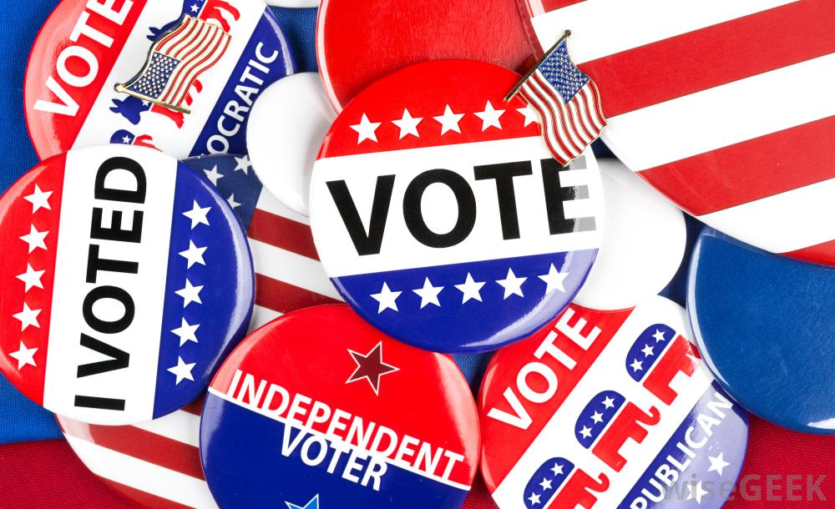
Functions of Political Party-Educating the Public
Political parties bring important issues to the public attention
Each party publishes its position on important issues
Candidates in the 2012 election used social media to educate the public
To inform the people on the issues political parties have simplified the election to key points
Political party affliction helps voters assess which candidate will be more acceptable

Slide 5
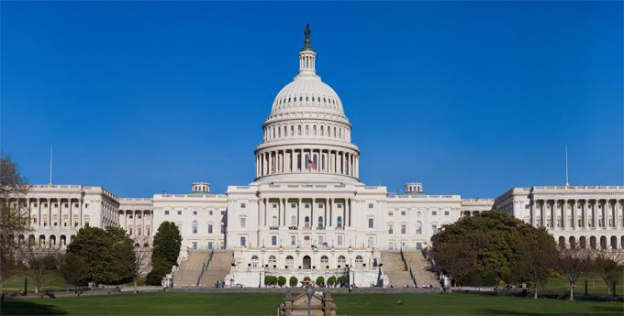
Functions of Political Party-Operating the Government
Political parties play key role in running and staffing the executive and legislative branches
A party also acts a link between the legislature and a chief executive

Slide 6
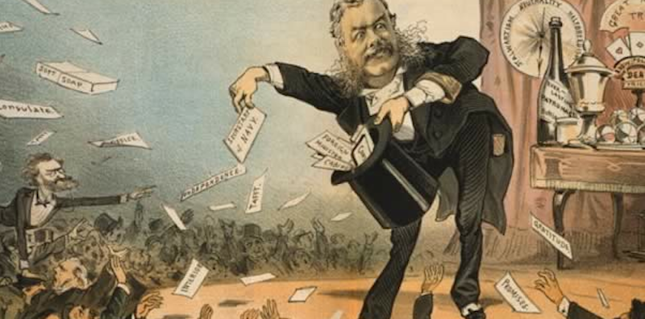
Functions of Political Party-Dispensing Patronage
Political parties dispense patronage (favors) to their loyal members
These favors could include jobs, contracts, or political appointments
Patronage allows the party in power to have loyal people in key positions of government

Slide 7
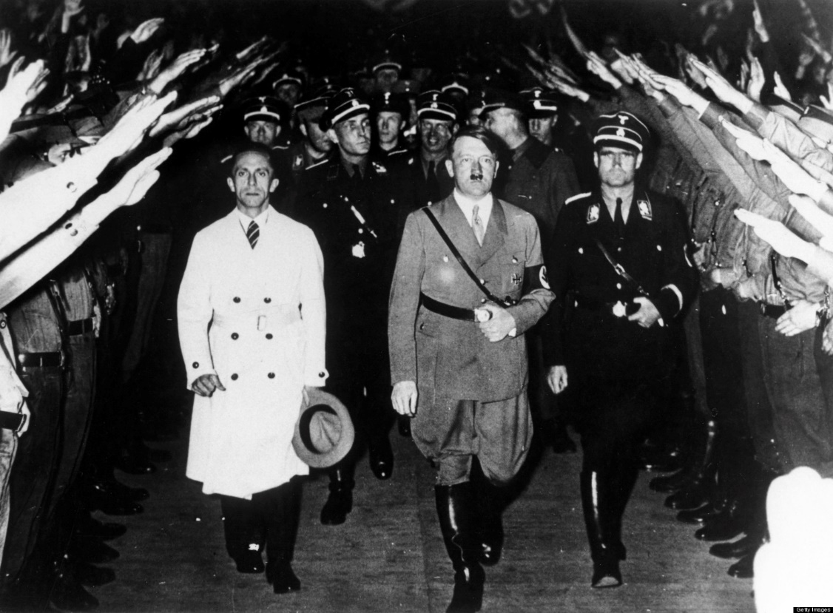
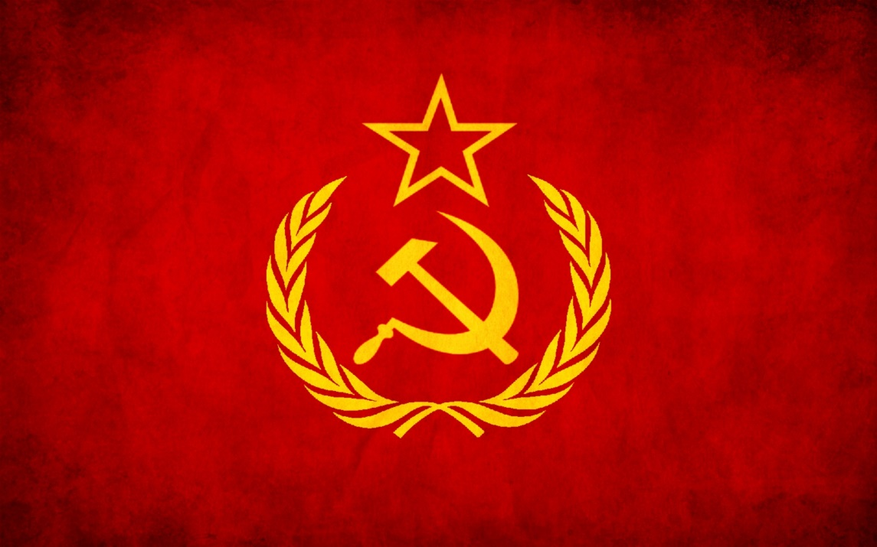
One-Party System
This system is usually found in an authoritarian government
The party leaders run the government and set all policy
This government uses force when political parties or the military take power
There is de factor one-party systems, in which there are multiple parties but one party wins all the time

Slide 8
Two-Party and Multi-Party Systems
Only about a dozen nations have a two-party system
The multi-party system is more common (5-7 political typically)
Multi-party systems do not allow for as much opposition as it may appear
Sometimes a multi-party system can operate as a one-party system
In a multi-party system, one party rarely gets enough support to control the government

Slide 9
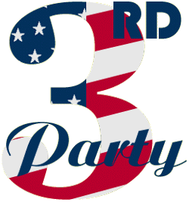
Minor or Third Parties
A third party is any party other than one of the two major parties
Third Parties believe that the two major parties do not meet certain needs of the country or group of people
A third party runs candidates who propose ways to remedy this situation

Slide 10
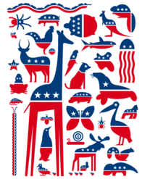
Types of Third Parties
Sing-issue parties: Focus on one major social, economic, or moral issue
Ideological parties: have particular set of ideas about how to change society
Splinter party: which splits away from one of the major parties because of some disagreement, like the failure of a political figure to gain the major party’s presidential nomination

Slide 11
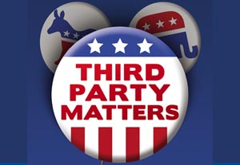
The Impact of Third Parties
They have influence over the outcome of an election.
They bring voters attention to urgent problems
Third parties can often influence politics by promoting new ideas
If third parties gain enough support, the major party adopts their issues

Slide 12
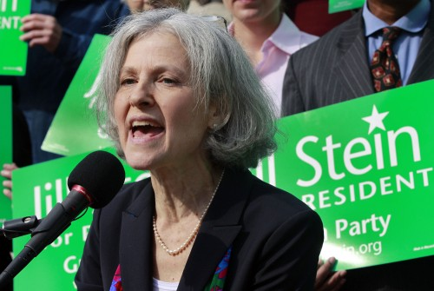
Obstacles of Third Parties
The two-party system makes third parties have more difficulties on the ballot
The electoral college system makes it difficult for third parties
Third parties often have problems with financing campaigns
Third party candidates also get less media coverage
If voters don’t think they can win, they don’t vote for them

Slide 14
Lesson 2: Party Ideology and Identification

Slide 15
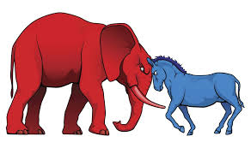
Political Ideology
Most Americans fall between the two spectrums of politics
Liberals believe that the government should take a more active role in lives of Americans
Conservatives typically believe in limiting governments role in peoples lives
Political ideology can give a person a framework for looking at government & policy
Political ideology can give a person a clue about which political party they identify with

Slide 16
Republican Party
Republicans supports individual rights to big government
Republicans believe that we should take a significant role in world affairs
Republicans usually oppose taxing the rich, increase military spending, support restrictions on labor unions

Slide 17
The Democratic Party
Democrats believe that the government should be more involved in social services
They encourage a variety of government regulations to protect the consumer
Democrats are less like to become involved in military conflicts around the world

Slide 18
The Minor Parties
The Green, Libertarian, and Constitution Party are the most prominent third party
Green party is generally more liberal, and focuses on environmental issues
The Libertarian party believes in personal responsibility and minimal government involvement
The Constitution Party is more conservative than the Republican party

Slide 19
Party Identification
This measures a voter’s sense of psychological attachment to a political party, it’s a state of mind
Voting is a behavior because one person may identify themselves as one party but vote another
The Republican party tends to have more white, male, educated, and religious members
Democratic party tends to have more women, minorities, and young members

Slide 20
Political Party Polarization
This means that party members and elected officials are more likely to stay true to their parties beliefs and not cross party lines on key issues
The parties are also more dominated by people with strong ideological beliefs
One proposed solution is to expand the electorate so that the third parties have more influence
Some argue that there doesn’t need to be change that this is just a phase and will pass

Slide 22
Lesson 3: Party Organization and Nominating Candidates

Slide 23
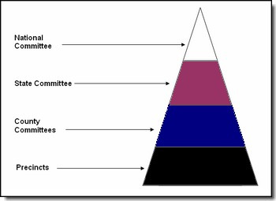
Party Organization
Both parties have a small paid staffs around the country
Local level parties just choose people to run under their name
State level parties choose help candidates get elected to state government office
The national party organization consists mainly of representatives from the 50 state party organizations
Each party has a committee to help members who run for Congress get elected

Slide 24
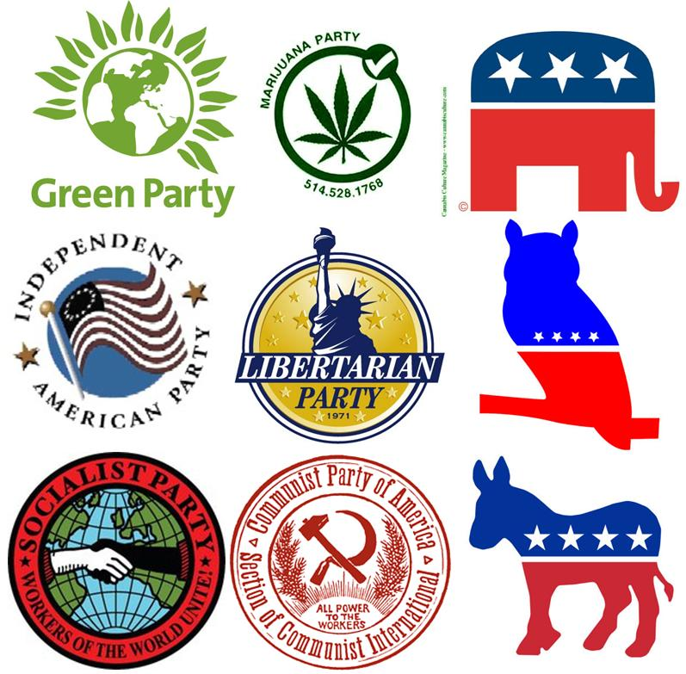
Party Membership
In many states citizens must declare their party preference when they register to vote
Joining a political party is not required in the US
Party membership involves no duties or obligations beyond voting
Members do not have to attend meetings or contribute to the party
Success of a political party relies in the contributions of willing volunteers

Slide 25
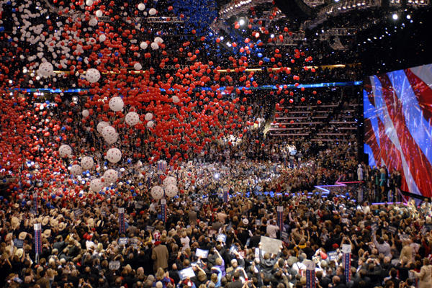
Selecting Candidates to Represent the Party
The parties want to nominate candidates that share the party’s values
They also want to select someone who will work to promote and implement the parties polices
Members of the party do give their opinion to help decide on who should be nominated
The process for which states collect this information varies

