Slide 1
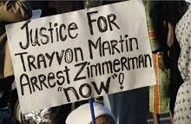
Chapter 16
Constitutional Right to a Fair Trial

Slide 2
Lesson 1 – Constitutional Rights before Trial
Since possible consequences of being convicted of a crime include loss of liberty or even loss of life, individuals accused of crimes retain important rights.
The Fifth and Fourteenth Amendments to the Constitution say that the government may not deprive anyone of “life, liberty, or property, without due process of law.”
In criminal cases, this right is known as procedural due process or fair procedures for handling cases. At the most basic level, procedural due process requires:
Notifying a person that he or she is accused of wrongdoing and the government intends to take action against that person.
Giving the affected person the right to respond to the accusation.

Slide 3
Lesson 1 – Constitutional Rights before Trial
The criminal justice process includes everything that happens to a person who commits a crime, from arrest through prosecution and conviction to release from prison.
Americans have always valued their privacy. They expect to be left alone, to be free from unreasonable snooping or spying, and to be secure in their homes. The Fourth Amendment to the U.S. Constitution protects Americans from unreasonable government searches and seizures.
The police need evidence to investigate and prosecute crimes, but getting that evidence often requires searching people or their homes, cars, offices, or electronic records. The Fourth Amendment does not mean that the government (or agents of the government, like police officers) cannot ever invade someone’s privacy to look for evidence of crimes.

Slide 4
Lesson 1 – Constitutional Rights before Trial
One way that police can show that a search is reasonable is by getting a search warrant before making the search.
A warrant is an official legal document issued by a judge. To get a warrant, the police must state under oath that they have probable cause (a reasonable belief) to suspect that someone has committed a crime. The warrant explains where the police plan to look and what they are looking for.
If the police have probable cause to believe that a vehicle contains contraband, they may search the entire vehicle.
Finally, police are allowed to seize an item that can be seen in plain view from a place that an officer has a right to be. For example, if an officer legally stops a car for a traffic violation and sees a gun lying on the car seat next to the driver, he or she may seize it without a warrant.

Slide 5
Lesson 1 – Constitutional Rights before Trial
An arrest is considered a seizure under the Fourth Amendment, which requires seizures be reasonable. An arrest takes place when a person suspected of a crime is taken into custody.
If a court decides that evidence in a case was gained through an illegal search, then the evidence cannot be used at trial against the defendant. This principle is called the exclusionary rule.
The exclusionary rule does not prevent the arrest or trial of a suspect. However, in some cases, it does mean that people who committed a crime might go free. This could happen when the prosecutor cannot obtain a conviction without evidence that has been excluded from trial

Slide 6
Special Issues in Search and Seizure
Students have limited fourth amendment rights in schools. In New Jersey v. T.L.O. (1985), the Supreme Court ruled that school officials do not need warrants or probable cause to search students or their property. They do, however, need reasonable suspicion that a student has violated the law or broken a school rule.

Slide 7
Racial Profiling
Racial profiling is the inappropriate use of race as a factor in identifying people who may break or have broken the law. Profiling occurs, for example, when an airport security guard selects an “Arab-looking” person to be searched solely because of his or her appearance. In some situations, officers may consider appearance when deciding whom to stop.
Rachel Dolezal – NAACP

Slide 8
Interrogations
After an arrest is made, it is standard police practice to question, or interrogate, the accused.
These interrogations may result in confessions or admissions of guilt that are later used in court.
The Fifth Amendment protects people from self-incrimination and the Sixth Amendment ensures the right to an attorney. Police must balance their interest in gathering information about a crime with the rights of the people in custody.

Slide 9
Forced Confessions

Slide 10
Forced Confessions
A confession cannot be used in court if it is not voluntary and trustworthy. This means that using physical force, torture, or threats to force a person to confess is prohibited. In the case of Escobedo v. Illinois (1964), the Supreme Court said that even a voluntary confession is inadmissible if it has been obtained after denying the accused person’s request to talk to an attorney.

Slide 11
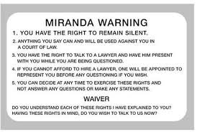
Miranda Rights

Slide 12
Miranda Rights
The Supreme Court also ruled in Miranda v. Arizona (1966) that the Fifth Amendment requires police to inform suspects in custody of their rights before questioning them.
These rights include:
The right to remain silent. Any statement made may be used as evidence against the defendant.
The right to the presence of an attorney, either hired by the defendant or appointed by the court.
These protections are commonly known as Miranda Rights.

Slide 13
Lesson 1 Reading for Understanding
You are accused of conspiring with a friend at work of stealing from your employer - explain the importance of “procedural due process?”

Slide 14
Lesson 1 Reading for Understanding
You’re not comfortable with asserting your rights, you’re unsure – you suspect your friend may know more than she is letting on – How can Miranda Rights be helpful to you when you are arrested?

Slide 15
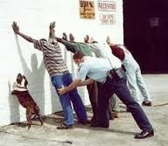
Lesson 1 Reading for Understanding
The trunk of your car is filled with stolen merchandise that your friend put there without your knowledge – The arresting officer takes your cell phone and finds a text from your friend asking to borrow your keys – Was this a legal search?
Notes:
all

Slide 16
LESSON 2 Constitutional Rights at Trial
The presumption of innocence means that the deciders of fact in a trial—the judge or jury—must regard the defendant as innocent until the government proves that he or she is guilty. This means that the government has the burden of proof in a criminal trial.
Many of the rights afforded to people being tried in the criminal justice system are protected by the fifth and sixth Amendments.

Slide 17
Right to a Jury
Juries consist of citizens from the community in which the trial is taking place. The jury is chosen by the attorneys for both sides of the case. The lawyers ask potential jurors questions to determine possible bias, and either lawyer can request that a potential juror be eliminated.
The Supreme Court has ruled in a number of cases that attorneys may not exclude prospective jurors from serving on a jury solely because of their race, gender, or national origin.
However, juries are not used very often. Many cases are settled by plea bargain before trial. This is a process whereby the defendant pleads guilty to a lesser crime than the one with which the defendant was originally charged in order to avoid a trial. This is a process whereby the defendant pleads guilty to a lesser crime than the one with which the defendant was originally charged in order to avoid a trial.

Slide 18
Right to an Attorney
What happens, however, when a defendant cannot afford to employ counsel? At one time, except in cases involving the death penalty or life imprisonment, a defendant had the right to an attorney only if he or she could afford one.
As a result, defendants who could afford to hired the best lawyers and stood a better chance of acquittal. Poorer defendants were often convicted because they did not understand the law and could not adequately argue their own cases in court.
However, in 1938 the U.S. Supreme Court ruled that federal courts must appoint attorneys for indigent defendants—those without financial means—in all federal felony cases.

Slide 19
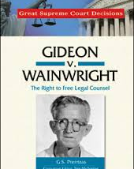
Right to an Attorney
. Twenty-five years later, in the case of Gideon v. Wainwright (1963), the Court extended this right to felony defendants in state courts as well. Today, governments are required to provide attorneys for defendants who cannot afford them in any case where a jail sentence could be imposed.

Slide 20
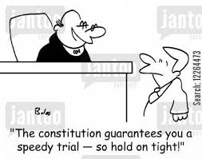
Speedy and Public Trials

Slide 21
Speedy and Public Trials/Confrontation of Witnesses
The Sixth Amendment provides a right to a speedy and public trial in all criminal cases.
The Sixth Amendment provides people accused of crimes with the right to confront (be face-to-face with) the witnesses against them and to ask them questions by way of cross-examination.

Slide 22
Freedom from Self-Incrimination
Freedom from self-incrimination means that you cannot be forced to testify against yourself in a criminal trial. This right comes from the Fifth Amendment and can be exercised in all criminal cases. The protection against self-incrimination is also usually available to witnesses who appear before a congressional committee or grand jury. If Congress grants an individual immunity from prosecution, that person will often testify.
This is sometimes referred to as “taking the fifth.”

Slide 23
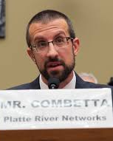
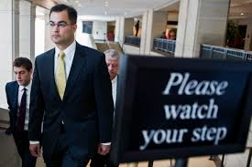
“ Oh, I’ll be taking the fifth”
Bryan Pagliano

Slide 24
The Juvenile Justice System
In the United States, juveniles in trouble with the law are treated differently from adults. Juveniles may be taken into custody for committing crimes that are also illegal for adults. However, juveniles can also be taken into custody for status offenses—acts that would not be crimes if they were committed by adults.

Slide 25
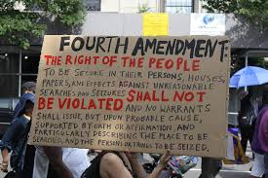
Lesson 2 Reading for Understanding

Slide 26
Lesson 2 Reading for Understanding
You are given a court appointed attorney, she has worked for the DA’s office for 2 months – she recommends that you plea to a lesser charge = 90 days in jail and 2 years probation – If you don’t take the deal = 2 years in jail – What is your best chance for justice?

Slide 27
LESSON 3 Constitutional Rights After Trial
When a defendant is found guilty, a judge usually decides the sentence, or punishment. Most criminal laws set out basic sentencing structures, but judges generally have considerable freedom in choosing the type, length, and conditions of the sentence. Sentences may require time in prison, a fine, community service, or probation. In many states, judges have the option of handing down the death penalty for the most serious offenses. In a few states, jurors play a role in sentencing.

Slide 28
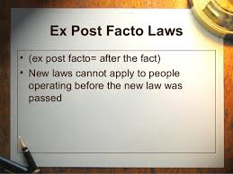
Ex Post Facto Clause
The U.S. Constitution’s ex post facto clause prevents the government from punishing anyone for doing something that was not a crime when the act was committed.

Slide 29
Disproportionate Incarceration

Slide 30
Disproportionate Incarceration
Disproportionate incarceration challenges the basic assumption that everyone receives equal justice under the law. There may be unintended consequences to what was intended to be a good law.
http://abcnews.go.com/Politics/inside-controversial-1994-crime-bill-plaguing-clinton-campaign/story?id=38313757
Hillary Clinton now struggles to explain to BLM her support for the legislation that has caused disproportionate incarceration. She also struggles to explain her use of the term; Super-predator.

Slide 31
Cruel and Unusual Punishment
The Eighth Amendment prohibits “cruel and unusual punishment.” It is the only place in the Constitution where criminal penalties are specifically limited. Courts have ruled that the Eighth Amendment also means that punishments must be proportionate to the crime committed.

Slide 32
Three-Strikes Laws
In the 1990s, many citizens became frustrated with the short sentences some serious criminals were receiving and with the number of repeat offenders. Beginning with the state of Washington in 1993, many states passed three-strikes laws—a nickname referring to the baseball phrase “three strikes, you’re out.” These laws typically impose an automatic minimum sentence of 25 years or life imprisonment when a person is convicted of a serious offense for the third time.

Slide 33
Capital Punishment
Capital punishment, or the death penalty, is the most controversial sentence given to defendants. It has a long history in America—the first person executed for murder among European settlers in America was hanged in 1630. Capital punishment was once used for a variety of crimes, but today it is reserved only for murder and crimes against the nation, such as treason and espionage.

Slide 35
Capital Punishment
In 1972 the Supreme Court ruled the death penalty as it was then applied unconstitutional.
Many states have chosen to abolish the death penalty. As of 2013, 18 states and the District of Columbia did not have the death penalty.

Slide 36
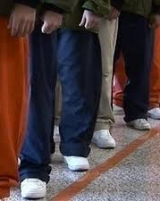
Juvenile Sentencing
In 2011 and 2012, the Supreme Court examined life without parole sentences for juveniles. In Graham v Florida (2010), the Court decided that juveniles cannot be given life without parole for a crime other than murder. In Miller v Alabama(2012) the Court ruled that mandatory sentences of life in prison without parole are unconstitutional for juveniles, regardless of the crime.

Slide 37
Rights After a Conviction or Acquittal
If a defendant is found not guilty, this is normally the end of the case. The government cannot appeal after the defendant is acquitted. The Fifth Amendment’s protection against double jeopardy means that a defendant cannot be prosecuted a second time for the same offense.

Slide 38
Habeas Corpus
Habeas corpus is a way for people who are imprisoned to challenge their confinement. A defendant can apply to a court for a writ of habeas corpus, asking the court to determine whether his or her imprisonment is unlawful. Someone else can also file this writ on behalf of a prisoner.
Habeas corpus was used by the prisoners detained at Guantanamo Bay during the war on terrorism. The Supreme Court ruled that all the Guantanamo Bay prisoners, including foreigners, have a constitutional right to seek a writ of habeas corpus in federal court.

Slide 39
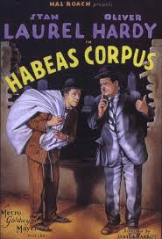
Lesson 3 Reading for Understanding
You decide to reject the plea bargain because you are innocent and you ask for another attorney. Unfamiliar with your case and over-worked, your attorney misses that you were searched without a warrant – you are convicted of Grand Larceny and sentenced to 2 years in prison.
What recourse do you have after being convicted?

