Slide 1
The Judicial Branch
Chapter 15: Constitutional Freedoms

Slide 2
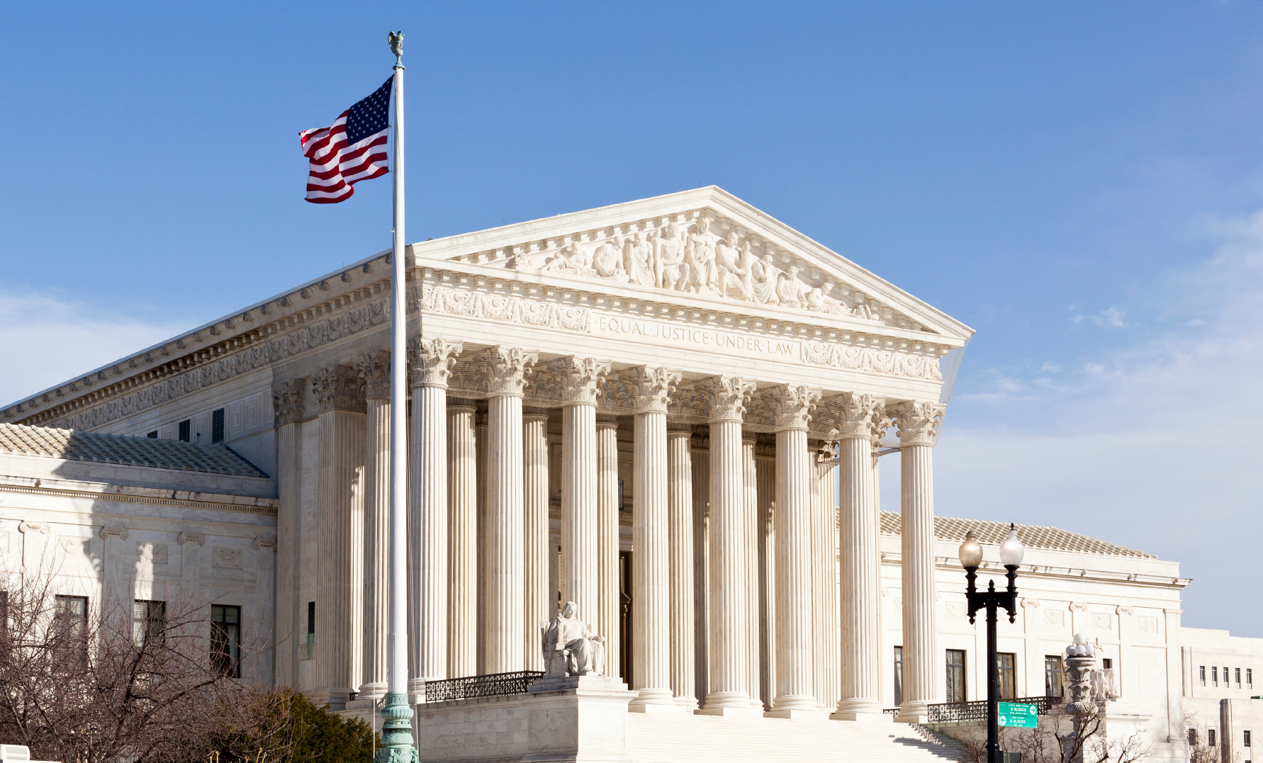
Lesson 1: Freedom of Speech

Slide 3
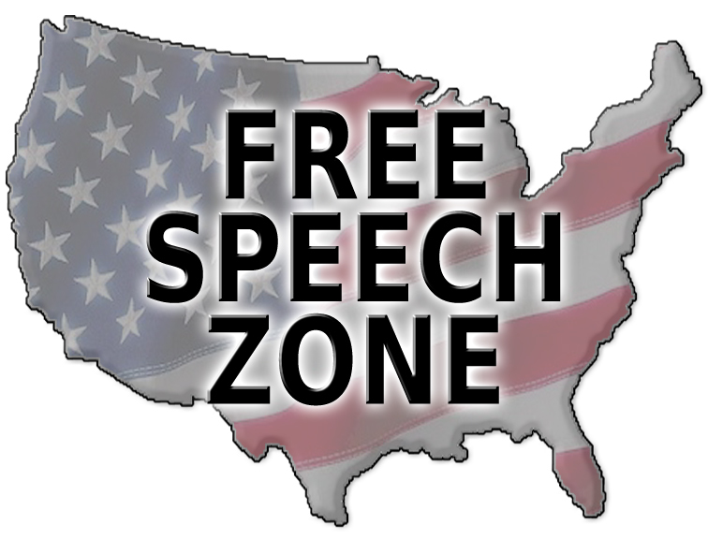
Free Speech in Democracy
Citizens and noncitizens have the right to speech, read and write what they choose
The first Amendment’s protection of speech and expression is central to US democracy
This gives the people the ability to obtain information from a diversity of sources
This gives the people the opportunity to make decisions and communicate these decisions to the government
The first amendment was intended to protect people from having their speech punished by the federal government

Slide 4
Free Speech in Democracy
The first amendment exists to protect ideas that may be unpopular or different from those of the majority

Slide 5
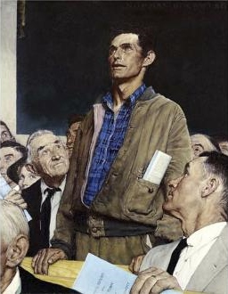
Types of Free Speech
Pure speech refers to verbal expression to an audience that has chosen to listen
Expression may be symbolic as well as verbal or nonverbal
Symbolic speech is conduct that expresses an idea

Slide 6
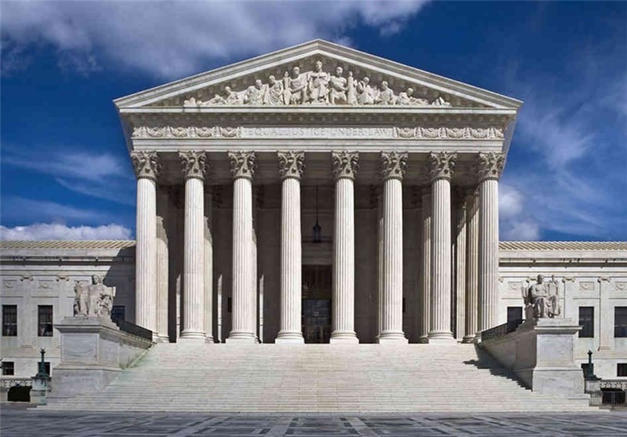
Content Restriction on Speech
Like other constitutional rights, the government can place some restrictions on the freedom of speech
Conflicts involving freedom of expression are among the most difficult ones that courts are asked to resolve
Free speech cases frequently involve a clash of the fundamental values

Slide 7
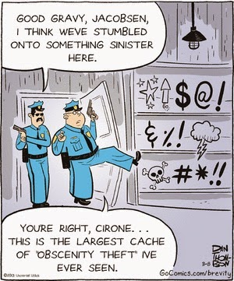
Obscenity
In 1957 the US Supreme Court ruled that obscenity is not speech protected by the Constitution
The Supreme Court also stated that standards for what is considered obscene may be different from one community to the next
In 1997, in the case called Reno v. ACLU the Supreme Court ruled that a law prohibiting the distribution of material online was unconstitutional.

Slide 8
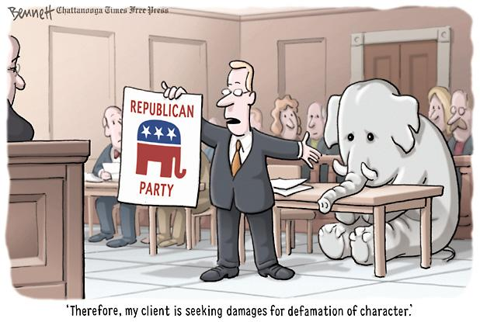
Defamation
This is a false expression about a person that damages that person’s reputation (slander)
Someone who commits slander may be sued and pay money damages to the person harmed
This is a hard case to win in court because of the value placed on freedom of speech
New York Times Co. v. Sullivan (1964) the Supreme Court stated that even if a newspaper story about a government official is false it was still protected speech unless the person knew it was false

Slide 9
“Fighting Words”
The First Amendment does not protect you if you use words that are abusive that they amount into violence
The value of “fighting words” are outweighed by society’s need to maintain order
Courts very rarely use the “fighting words” doctrine today because provocative speech could make listeners angry

Slide 10
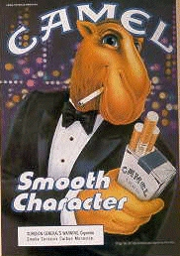
Commercial Speech
Most advertising is consider commercial speech
The courts have ruled that commercial speech is protected but not like political speech is protected
Governments are allowed to ban commercial speech that is false or provides information about illegal products
Governments can place restrictions on other forms of commercial speech (billboards) if they have good reason

Slide 11
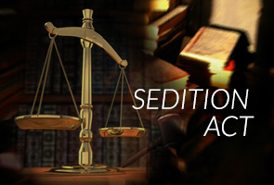
Seditious Speech
Congress have outlawed seditious speech, any form of speech that is urging the resistance to lawful authority
In 1919, Schenck v. United States gave the court the ability to punish a person that presents “a clear and present danger"
The Supreme Court has altered this by stating that if it does not incite violence its not “clear and present danger”

Slide 12
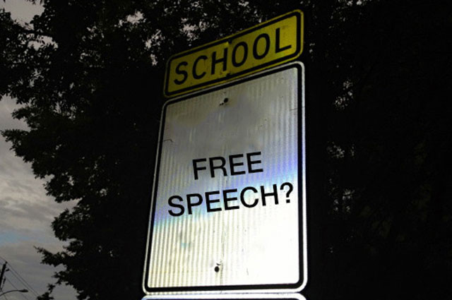
Free Speech in Public School
Free Speech in public schools exists only if it doesn’t come into conflict with rights of others or violates learning environment
Courts allow greater expression rights in public parks and on street corners than in schools
Courts have ruled that they can punish lewd or indecent speech even though the same speech would be protected outside school
Courts consider age of the students and the precise educational setting when deciding these cases

Slide 14
Lesson 2: Freedom Press, Assembly, and Petition

Slide 15
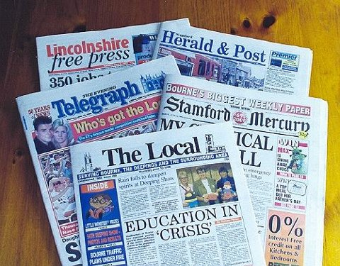
Freedom of the Press
The 1st Amendment protects us from government censorship of any media source
Traditionally, courts have protected the press from government censorship
The most important reason to having a free press is that the press subjects all our political and legal institutions to public scrutiny
Sometimes it does clash with other rights

Slide 16
Prior Restraint
Prior Restraint is censorship of information before it is published
Prior Restraint is unconstitutional unless it is going to cause certain serious and irreparable harm
New York Times Co. v. United States the Supreme Court up held the New York Times right to publish information that could prove an embarrassment to the US government

Slide 17
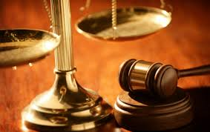
Fair Trials
The First Amendment’s freedom of speech and the Sixth Amendment’s right to a fair trial can come into conflict
The Supreme Court has stated that newspapers can publish information about a trial and the defendant of a trial can still get a fair trial

Slide 18
New Media
Modern media has created new issues regarding freedom of press
The problem with modern media is the use of video clips showing the crime taking place could influence a jury
does this still mean that the defendant gets a fair trial?
Judges still have to decide on a case by case basis if the defendant can get a fair trial

Slide 19
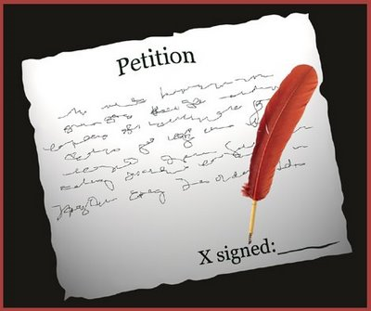
Freedom of Petition
Petition includes such things as signing a petition, filing a lawsuit, writing an e-mail, testifying before tribunals, or collecting signatures for a ballot initiative
The right to petition has roots in the Magna Carta and English Bill of Rights

Slide 20
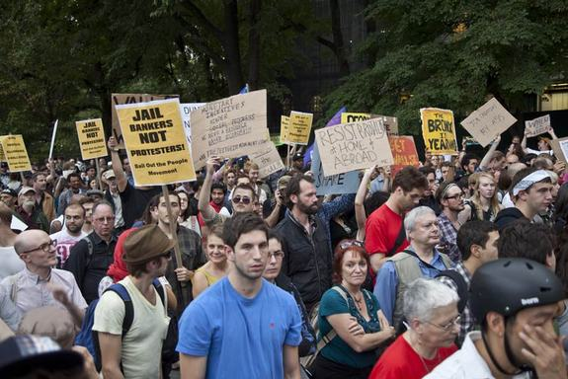
Freedom of Assembly
This means people can participate in protests, parades, and other large events peacefully
This freedom also allows us to meet in each others homes or other private places, peacefully
The freedom of assembly must be balanced with government’s interest in maintaining order and safety
The government can reasonably regulate the time, place, and manner of assemblies

Slide 22
Lesson 3: Freedom of Religion

Slide 23
Religious Freedom
The Founders of the United States believed that individuals should be able to practice their religion freely
the government is prohibited from either endorsing or punishing religious people for their religious beliefs
The government can not make a law that favors one religion or favor religious activities over non religious activities
Between 1791 and 1940, the US Supreme Court heard only five cases dealing with separation of church and state

Slide 24
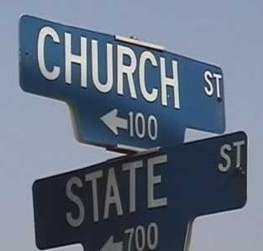
The Establishment Clause
This is the first phrase of the 1st amendment
It forbids the state or federal government from favoring one religion
It also forbids the state and federal government from requiring that the people attend church
This were the term “separation of church and state” comes from
The cases involving the establishment clause are the most controversial to reach the Supreme Court

Slide 25
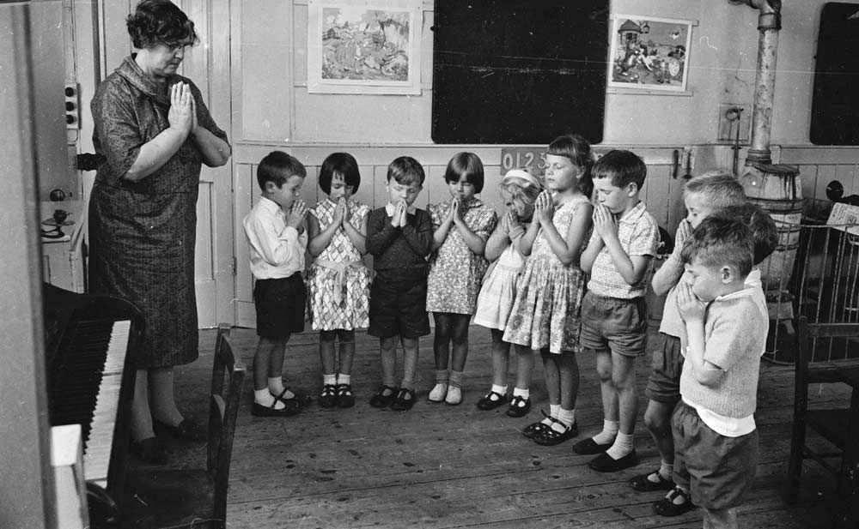
School Prayer
These types of cases in the courts are the most controversial
Since public schools receive funds from the government, this make them part of the government
Engle v. Vitale the Supreme Court has held that public school-sponsored prayer violates the establishment clause

Slide 26
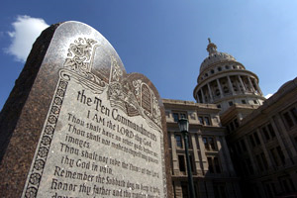
Religious Displays by Governments
The establishment clause also prohibits some religious displays by the government
Constitutional displays would be more than one religion being shown or displays done with a secular purpose

Slide 27
The Free Exercise Clause
Protects the right of individuals to worship as they choose
Sometimes this can be taken away if it comes into conflict with other important interests
Governments can pass laws that don’t intend to harm religion but it still happens to punish someone or force someone to act in a way that violates their religion
Some of the most discuss cases on free exercise deal with children saluting the American Flag

Slide 29
Lesson 4: The 14th Amendment

Slide 30
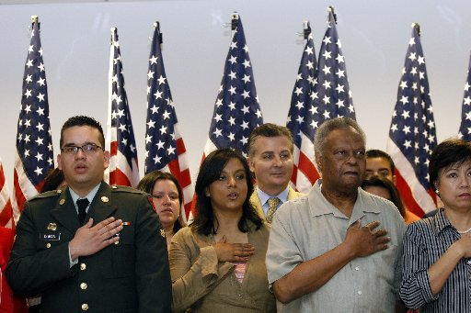
Citizenship
The 14th Amendment clearly established what constitutes citizenship
Anyone born or naturalized as long as they are in the US jurisdiction
This also meant that people of all races who were born here were US citizens

Slide 31
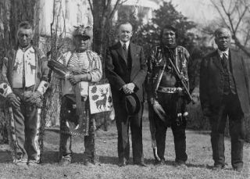
Native American Citizenship
The 14th amendment did not grant citizenship to Native Americans
In 1924 the Indian Citizenship Act granted citizenship to all Native Americans born in the US

Slide 32
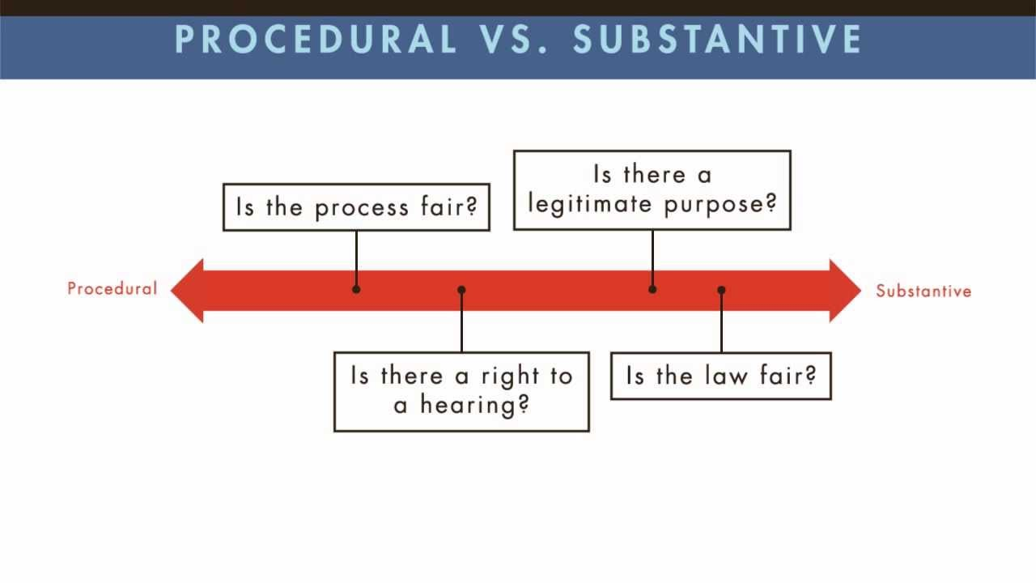
Procedural Due Process
Means that the government must follow fair procedures if it is going to deprive someone of their unalienable rights
It guarantees that anyone who goes to court will go through a fair process and have the opportunity to assert their legal rights

Slide 33
Substantive Due Process
Means that laws themselves have to be fair
A law cannot unreasonably interfere with a fundamental or basic right
A law will not necessarily be declared unconstitutional simply because it affects a fundamental right

Slide 34
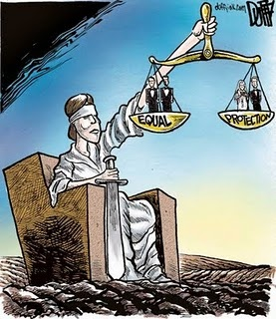
Equal Protection
Means that laws must apply to all people who are in a similar situation unless the state has a very good reason
It also means the government cannot draw unreasonable distinctions among different groups
When a law or government action is challenged as violating the equal protection clause judges determine if it is constitutional

Slide 35
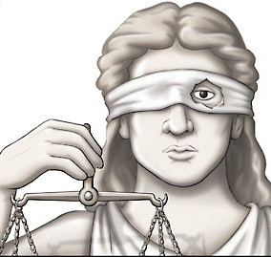
Rational Basis
Judges use this when discrimination cases go to court
This exists when there is a logical relationship between the treatment of some group of people and the purpose of the law

Slide 36
Substantial Relationship
They use this test in gender discrimination cases
This is a middle ground between rational basis and strict scrutiny
When determining causes using this test there must be a close connection between the law or practice and its purpose
Laws that classify based on gender must serve an important governmental purpose

Slide 38
Lesson 5: Equal Protection and Discrimination

Slide 39
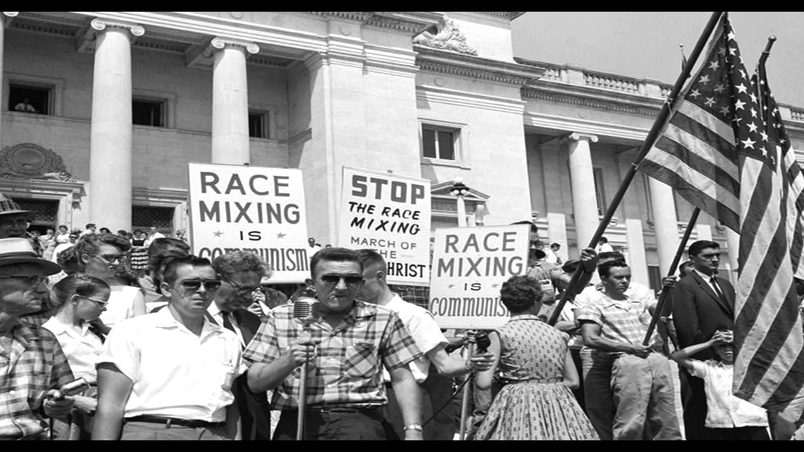
Protection from Unfair Discrimination
The promise of equality is set out in the Declaration of Independence
Discrimination occurs when some people are treated differently than others
Sometimes, the government must treat different groups of people differently
Other laws or government actions discriminate in a way that is unconstitutional

Slide 40
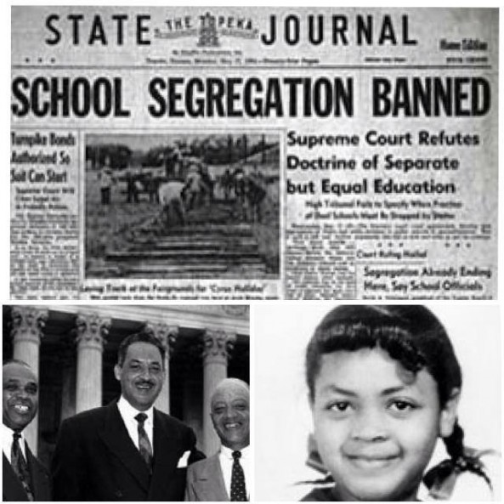
Brown v. Board of Education (1954)
Is the first case that challenged segregation in public schools
The Court unanimously descried that segregated school could never ben equal and thus unconstitutional
This overturned the “separate but equal” doctrine of Plessy v. Ferguson
In 1967 LBJ appointed Thurgood Marshall to the Supreme Court becoming the first African American justice

Slide 41
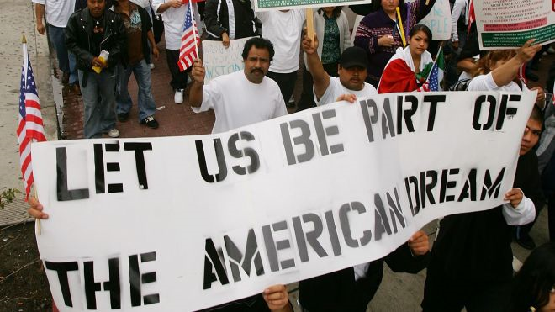
Discrimination Based on National Origin
In 1954 the Supreme Court made it clear the 14th Amendment protects people based on national not just race
Hernandez v. Texas the Court ruled that excluding one race from a trial deprived defendants like Hernandez of equal protection
Civil rights laws protect against employment discrimination based on national origin
In Plyler v. Doe the Supreme court stated that undocumented immigrants are protected under the 14th Amendment

Slide 42
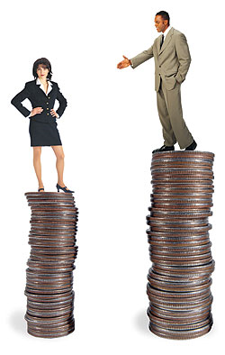
Discrimination Based on Sex and Gender
22 states have passed specific protection against gender discrimination by 2012
A variety of state and federal laws protect women and girls from discrimination
Despite many advances, women continue to earn less money than men

Slide 43
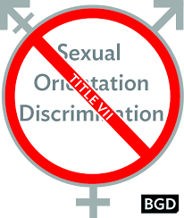
Discrimination Based on Sexual Orientation
There are no federal laws that prohibit discrimination on the basis of sexual orientation a number of states, cities, and towns have passed laws that provide some protection
These laws vary from place to place and may protect individuals in areas of employment, housing, education, family matters, and public accommodations
In 2011, the federal government struck down “don’t ask, don’t tell” policy in the armed services
In 2013 the Supreme Court ruled that the federal government was required to recognize same-sex marriage

Slide 44
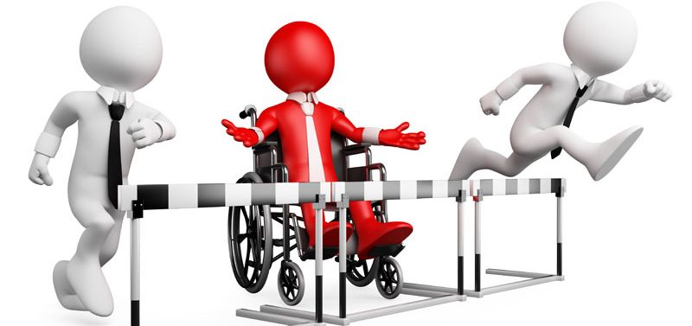
Discrimination Based on Disability
Many people with disabilities suffer discrimination in certain areas of daily life
Since the 1970s, numerous laws have been passed banning discrimination against a person with disabilities
These laws require consideration of a person’s special needs involve such issues as education, employment, building design, and transportation

Slide 45
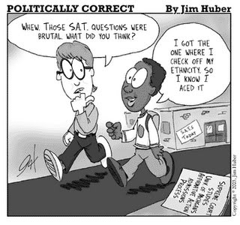
Affirmative Action
This involves governments and employers taking steps to correct past and present discrimination in workforce & education
Many states have voted to ban or limit these programs
The Court has been mixed when it comes to voting on this area of equal rights.

Slide 47
Lesson 6: Right to Bear Arms and to Privacy

Slide 48
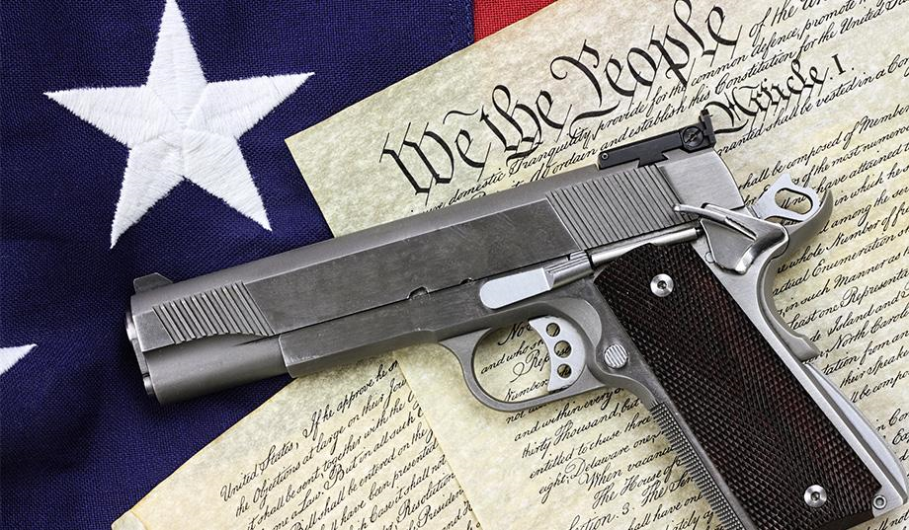
2nd Amendment
Many Americans disagree about exactly what the 2nd amendment means
The Supreme Court has clearly ruled that it protects an individuals right to keep a gun

Slide 49
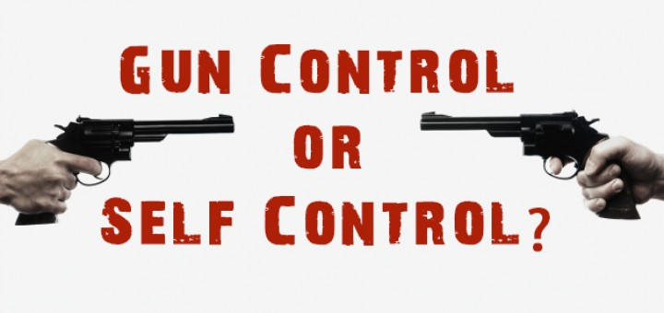
Gun Control
This is a controversial issue when it comes to the government
Gun Control Act of 1968-is the primary gun control law that prohibits certain people from buying or possessing a gun
Some states have given people more freedom to own and carry guns
When looking at firearms laws the Court has to balance protection of rights over the interest of public safety

Slide 50
Right to Privacy
This is a right that does not appear in the Constitution but many argue that it is a basic right
The Court has used the 1st, 3rd, 4th, and 5th amendments when ruling on privacy related cases
The government may limit privacy rights if it conflicts with important government interests
Most states have added a right to privacy clause in their state constitutions

Slide 51
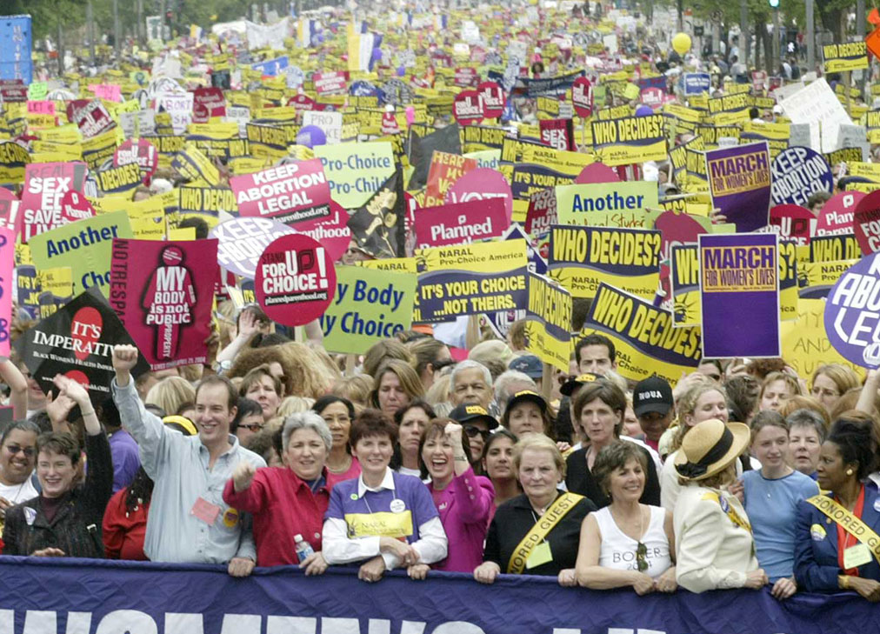
Reproductive Rights and Privacy
The Court first recognized this right in the 1960s, when they stated a state couldn’t outlaw access to contraception
The most controversial ruling the Court decided was Roe v. Wade which made abortion legal
Abortion has been an important issue in elections and in judicial nominations

Slide 52
Information Gathering and Privacy
Online privacy is also threatened by websites and hackers who gather information on people who use the internet
Companies can even spy on your online activity to develop targeted advertisements
As long as the actions by individuals and businesses does not violate the Constitution or cause harm to an individuals it is legal
Some actions can be regulated by the state and federal government

