Slide 1
The Judicial Branch
Chapter 13: Federal and State Court System

Slide 2
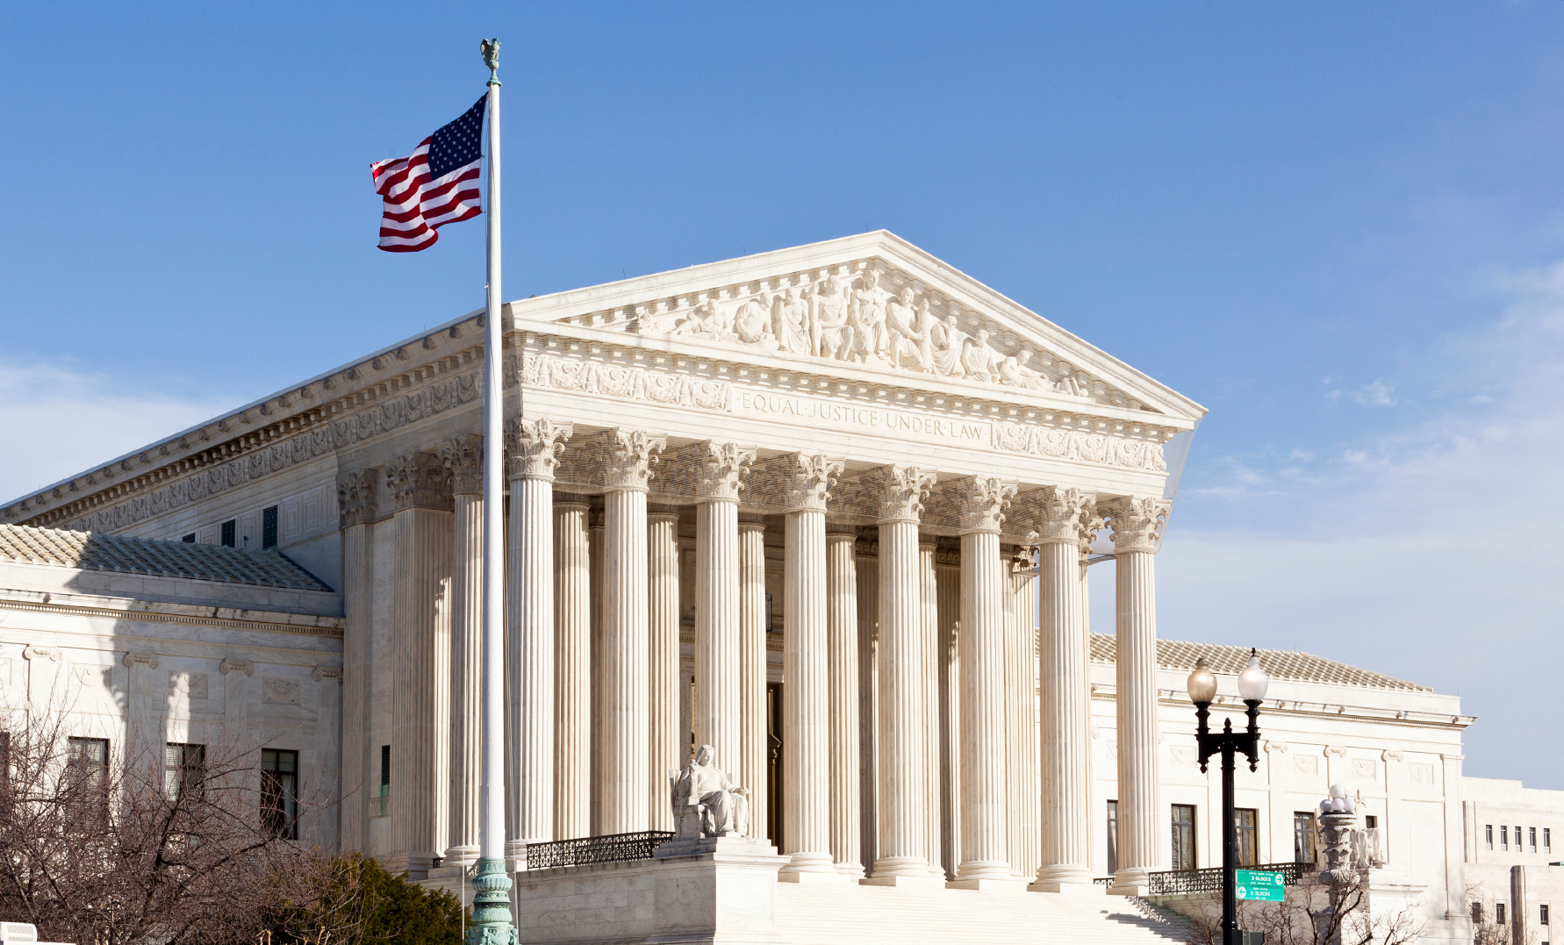
Lesson 1: Judicial System in Our Democracy

Slide 3
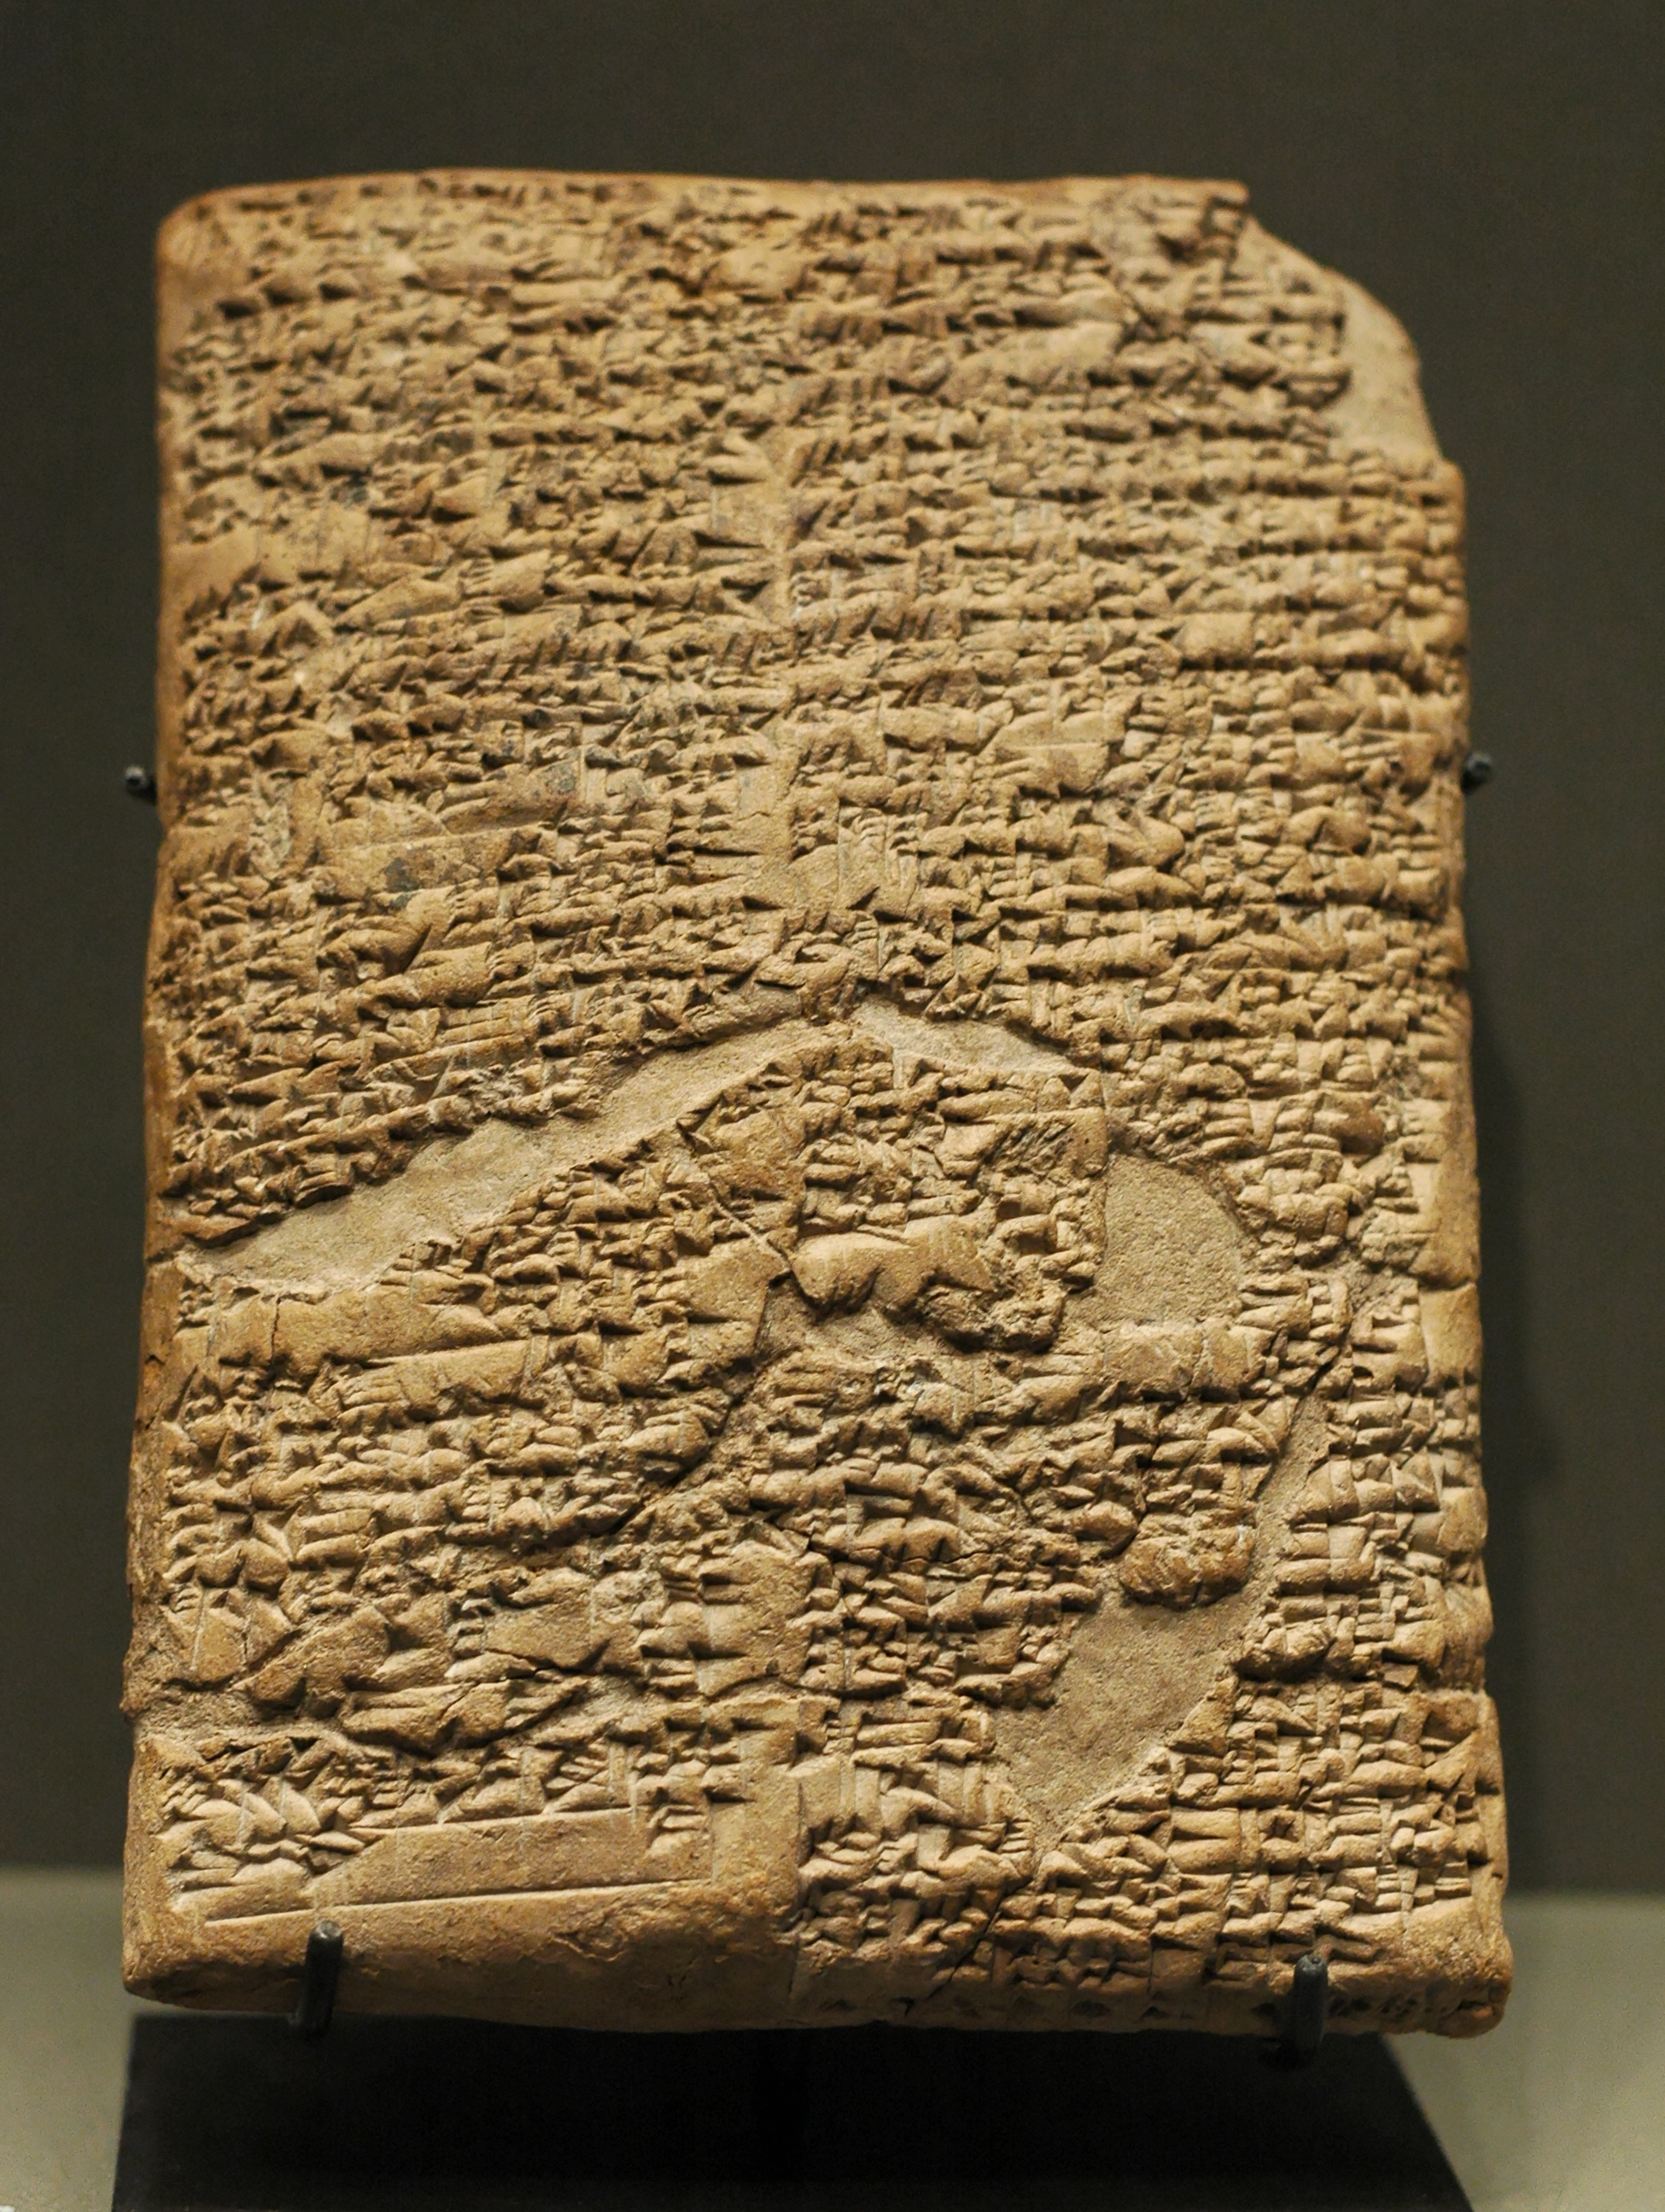
Early Systems of Law
Law is the set of rules and standards by which a society governs itself
The earliest known written laws were based on practices in tribal societies
The Code of Hammurabi gave us how to categorize a crime and the punishment for crimes
The ten Commandments emphasized social justices and individual and communal responsibility (this form gave us ethical laws)

Slide 4
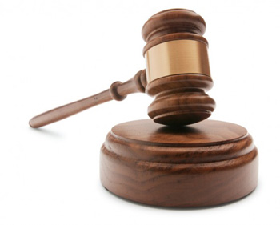
Early Systems of Law
Ancient romans gave us the written law
The Justinian Code gave us a simplified version of law
The basis of American law was common law in which judges resolve individual cases

Slide 5
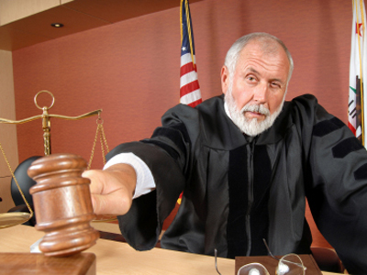
Principles of Democracy in the Judiciary
When individuals have conflict in spite of the laws our courts provide a solution
Our courts help resolve conflict without resorting to violence
Courts also determine what laws mean

Slide 6
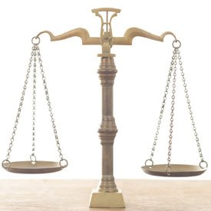
Rule of Law
The idea behind rule of law is that no individual, group, organization, or governmental entity is above the law
Laws must be clear and known to all
Laws must be equally, fairly, and consistently enforced

Slide 7
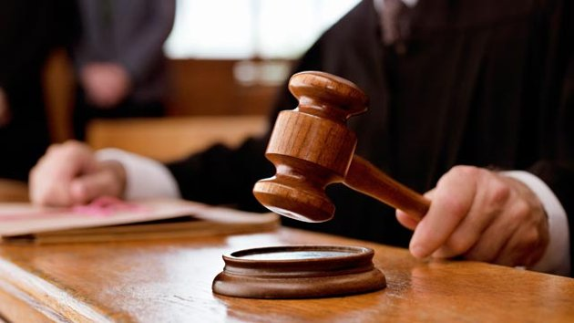
Controls on the Abuse of Power
Judicial Review is a way that the court can check the power of the Executive and Legislative branches
The Legislative and Executive branches has power to ensure the court doesn’t abuse its power
The rules of our legal system also limit the courts
Courts are also limited in the types of cases they hear

Slide 8
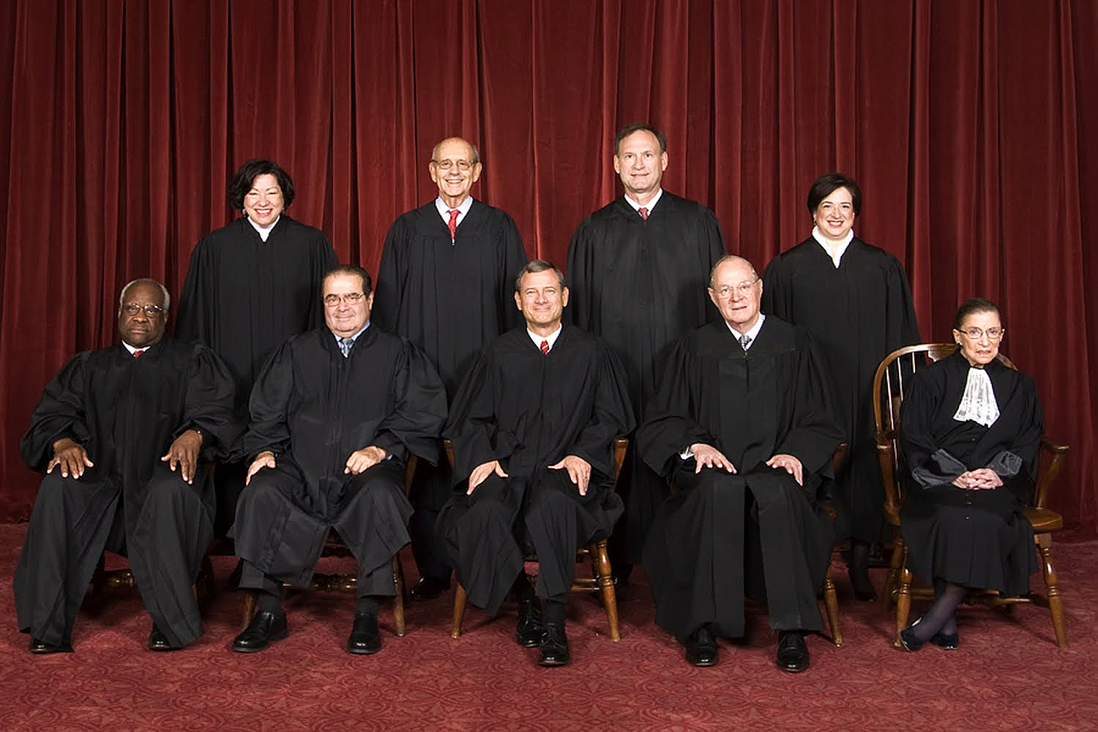
Judicial Independence
The key element of a democracy is for the courts to act impartially and make fair decisions
Judicial independence includes: selection of judges, judicial review, and the president enforcing laws
In the federal court system judges are appointed for life terms
Critiques believe that life time appointments take away judicial independence

Slide 10
Lesson 2: Trials

Slide 11
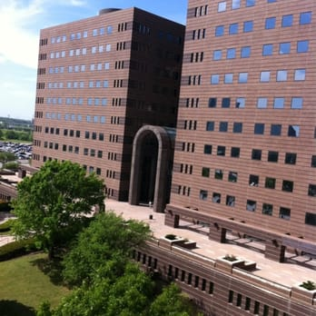
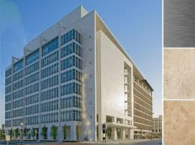
The Function of Trial Courts
Criminal trial courts can hear cases about crimes
Civil trial courts hear cases are where you sue someone for damages
In both types of courts judges or juries determine the facts of the case and then use the law to determine the outcome
In theory trial courts are where the truth comes out about a persons guilt

Slide 12
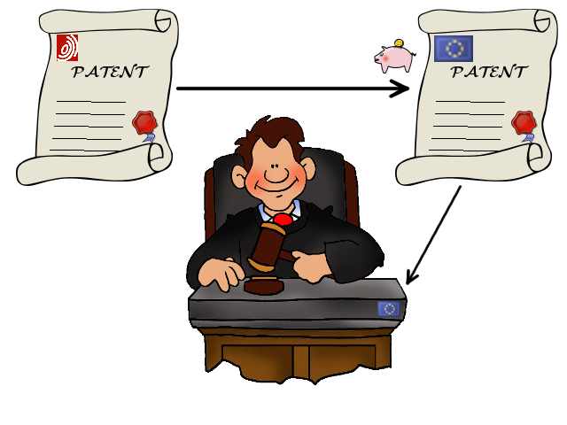
Jurisdiction
Trial courts have original jurisdiction over criminal cases and civil disputes
Before a case can get to court, someone must be formally accused of a crime or have caused damage to another person

Slide 13
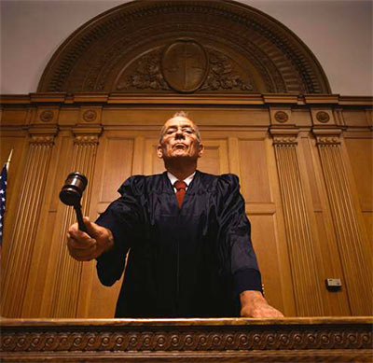
Adversarial System
Trial system in the US is an adversarial system
This means it is a contest between opposing sides
Supporters of the adversarial system state that this system is the best way for the truth to come out
Critics of this system say that it is not the best method of discovering the truth or who is at fault

Slide 14
Roles in Trial
In a trial there are two parties or sides to each case
Judges presides over the trial
attorneys follow the rules of evidence and trial procedures
A jury is a group of citizens who are sworn to give a verdict based on evidence
Each party may have an attorney
In Gideon v. Wainwright (1963) the Supreme Court ruled that states must provide an attorney not only in federal court but in state court (lower courts) as well.
Witnesses are people with knowledge about the facts of the case.

Slide 15
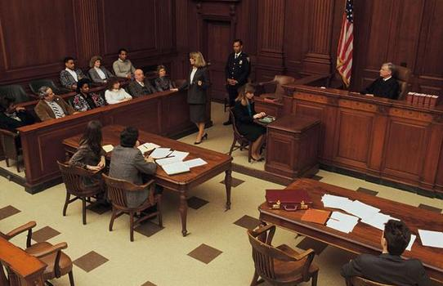
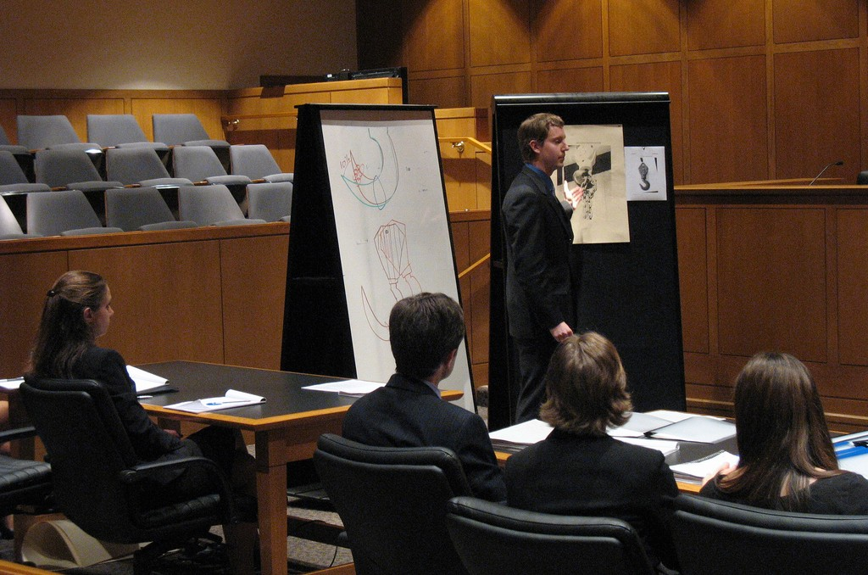
Steps of a Trial
Opening Statement by Plaintiff or Prosecutor
Opening Statement by Defense
Direct Examination by Plaintiff or Prosecutor
Cross-Examination by Defense
Motions
Direct Examination by Defense
Cross-Examination by Plaintiff or Prosecutor
Closing Statement by Plaintiff or Prosecutor
Closing Statement by Defense
Rebuttal Arguments
Jury Instructions
Verdict

Slide 16
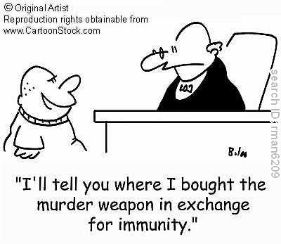
Settling Cases without Trial
Most legal cases never go to trial
Civil cases usually result in out of court settlements
Most criminal cases end up with a plea bargain
Supporters of the plea bargain claim they are efficient and save the state the cost of a trial
Opponents argue that plea bargains allow some criminals to get off lightly

Slide 17
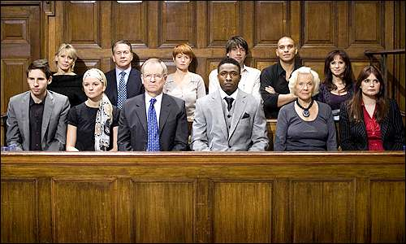
Juries
Juries are an integral part of our democracy and the right to a jury trial is guaranteed in the Constitution
Juries serve to protect the rights of the parties and make it more likely that justice is impartial
Juries give people a voice in government, which make trials more democratic
Some states and the federal government use a grand jury to determine if a case can even go to trial for serious crimes

Slide 18
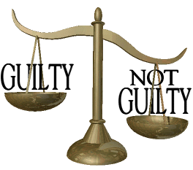
Right to a Jury
The Sixth Amendment to the US Constitution guarantees the right to trial by jury in criminal
The Seventh amendment guarantees the right to jury trial in a civil case
The Constitution protects the right to trial by jury, but does not mean that a jury is required in every case

Slide 19
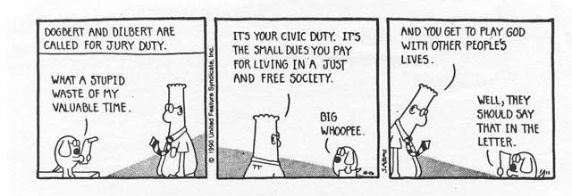
Jury Service
Serving on a jury is one of the most powerful actions that citizens take in a democracy
Juries represent the people’s opportunity to participate directly in government
Citizens have a civic duty to serve on juries when called upon
To serve you must be 18 years old, able to speak and understand English, and a resident of the state where the trial is taking place
Jury selection should reflect the diversity of the community in which the trial is taking place (Texas v. Hernandez)

Slide 21
Lesson 3: Appeals

Slide 22
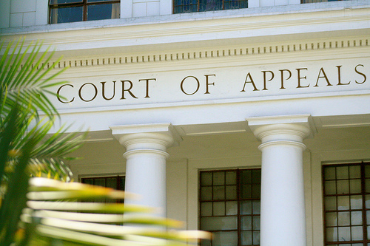
Errors of Law
Appeals are possible when the losing party can claim that the trial court made an error of law
Error of law occurs when the judge makes a mistake about the law applicable in the case
A judge’s error is considered minor as long as it does not affect the outcome of the trial

Slide 23
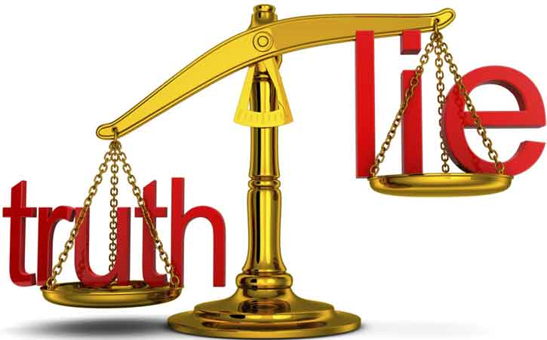
Procedural Due Process
The fair administration of justice is called procedural due process
Fair procedures help prevent arbitrary, unreasonable decisions
Due process also ensure that all levels of the judicial system must follow the same basic procedures

Slide 24
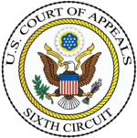
Procedures at an Appeals Court
In an appeals court, one party presents arguments asking the court to review the decision of the trial court
There are no juries or witnesses in an appeals court, and no new evidence is presented
Only lawyers appear before the judges to make legal arguments
Justices decide appeals
Appeals courts may uphold the trial court decision, reverse the trial court’s decision, or send the case back to be tried again

Slide 25
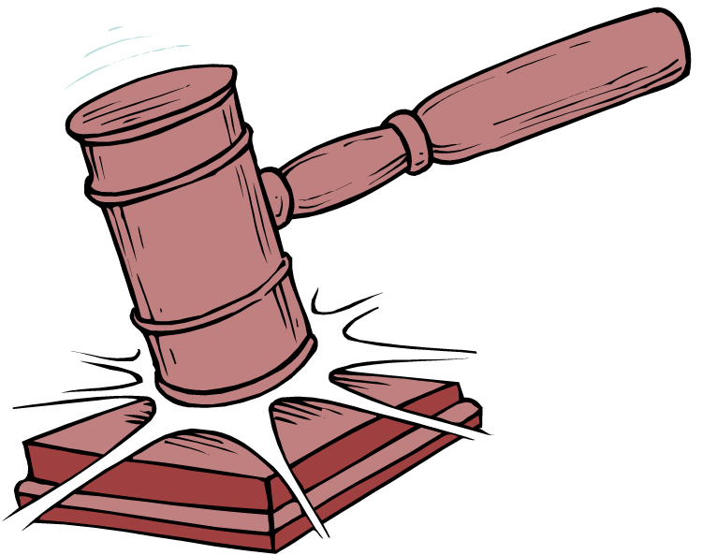
Precedent and State Decisis
Precedents are legal principles created by an appellate court decision that lower court judges must follow when deciding similar cases
The basic legal principle is often called stare decisis, which means “let the decision stand”
Stare Decisis makes the law predictable and leads to stability in our society
Appellate courts have the power to overrule one of their earlier precedents, but this does not happen often

Slide 27
Lesson 4: Local, State, and Federal Courts

Slide 28
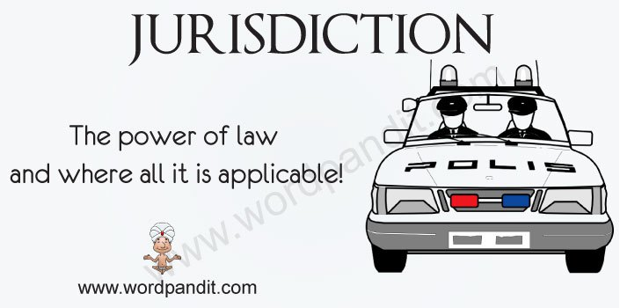
Jurisdiction
Cases must start in courts with original jurisdiction
The federal courts are considered to be courts of limited jurisdiction
Federal courts usually hear cased that raise questions about federal law (statute)
Federal courts can hear certain state law disputes when it comes from a different state
State courts are considered to be courts of general jurisdiction able to hear a wide variety of cases

Slide 29
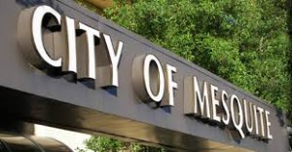
State and Local Courts Jurisdiction
State and local courts interpret and apply state and local laws
State courts decide most cased involving state laws
Local courts are part of their state court system and decide cases involving local laws

Slide 30
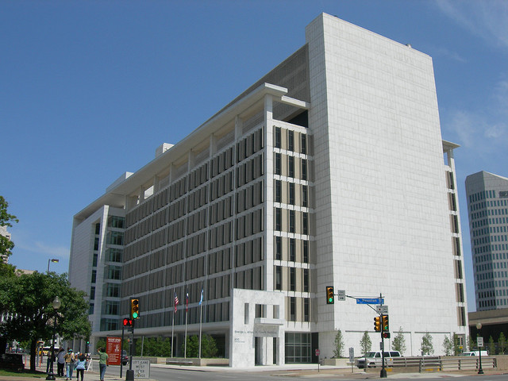
State Trial and Appeals Courts
Minor courts often specialize in dealing with specific types of legal issues (family courts)
General Trial Courts can hear anything from civil or criminal cases
Appeals court decides on if a court decision on a case gets overturned, kept, or if the case goes back to trial

Slide 31
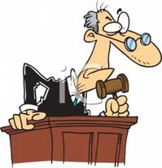
Judges
There are about 30,000 state court judges in the US
Judges are selected in four different ways: popular election, election by the legislature, appointment by the governor, or by a combination of appointment and popular election.
People disagree over the best method for selecting judges
Some states choose judges in a method known as merit selection
Merit Selection: a commission chooses based on the governors recommendation who would be the best fit for the job

Slide 32
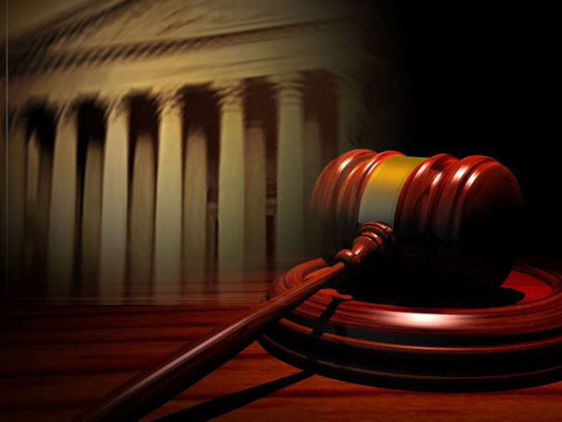
Jurisdiction of the Federal Courts
Federal courts generally hear cases that raise questions about a federal law or the federal constitution
Federal courts sometimes decide on cases that deal with state law or a large amount of money is involved
Overall, federal courts handle more than 375,000 case per year and more than 1 million bankruptcy petitions

Slide 33
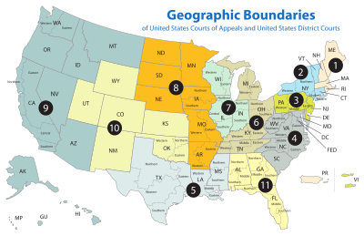
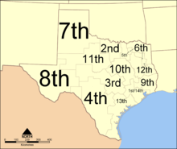
Federal Trials and Appeals Courts
Congress divided the US into 94 federal judicial districts these federal trial courts handle both civil and criminal cases
Some federal judicial districts over an entire state, while other states have several districts within its boundaries
The trial courts are grouped into 12 regional circuits each of which has a federal courts of appeals

Slide 34
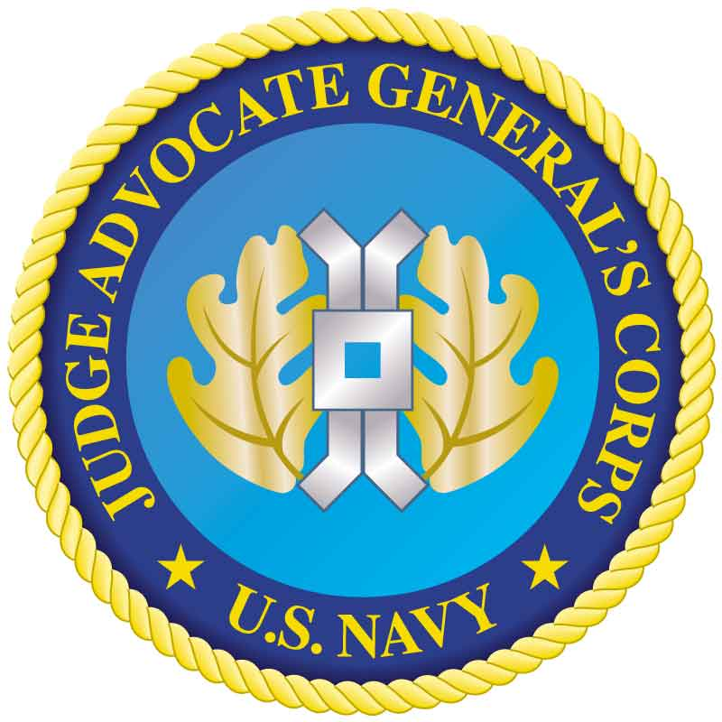
Military Courts
This court created by Congress, from the Constitution (Article 1 Section 8), is overseen by the President
The current regulations that the military courts follow is the Uniform Code of Military Justice, which is very similar to criminal codes
The UCMJ is also different because it contains punishments for specific military conduct
Violation of the UCMJ are heard in proceedings called court-martial
Each military branch has its own court of appeals

Slide 35
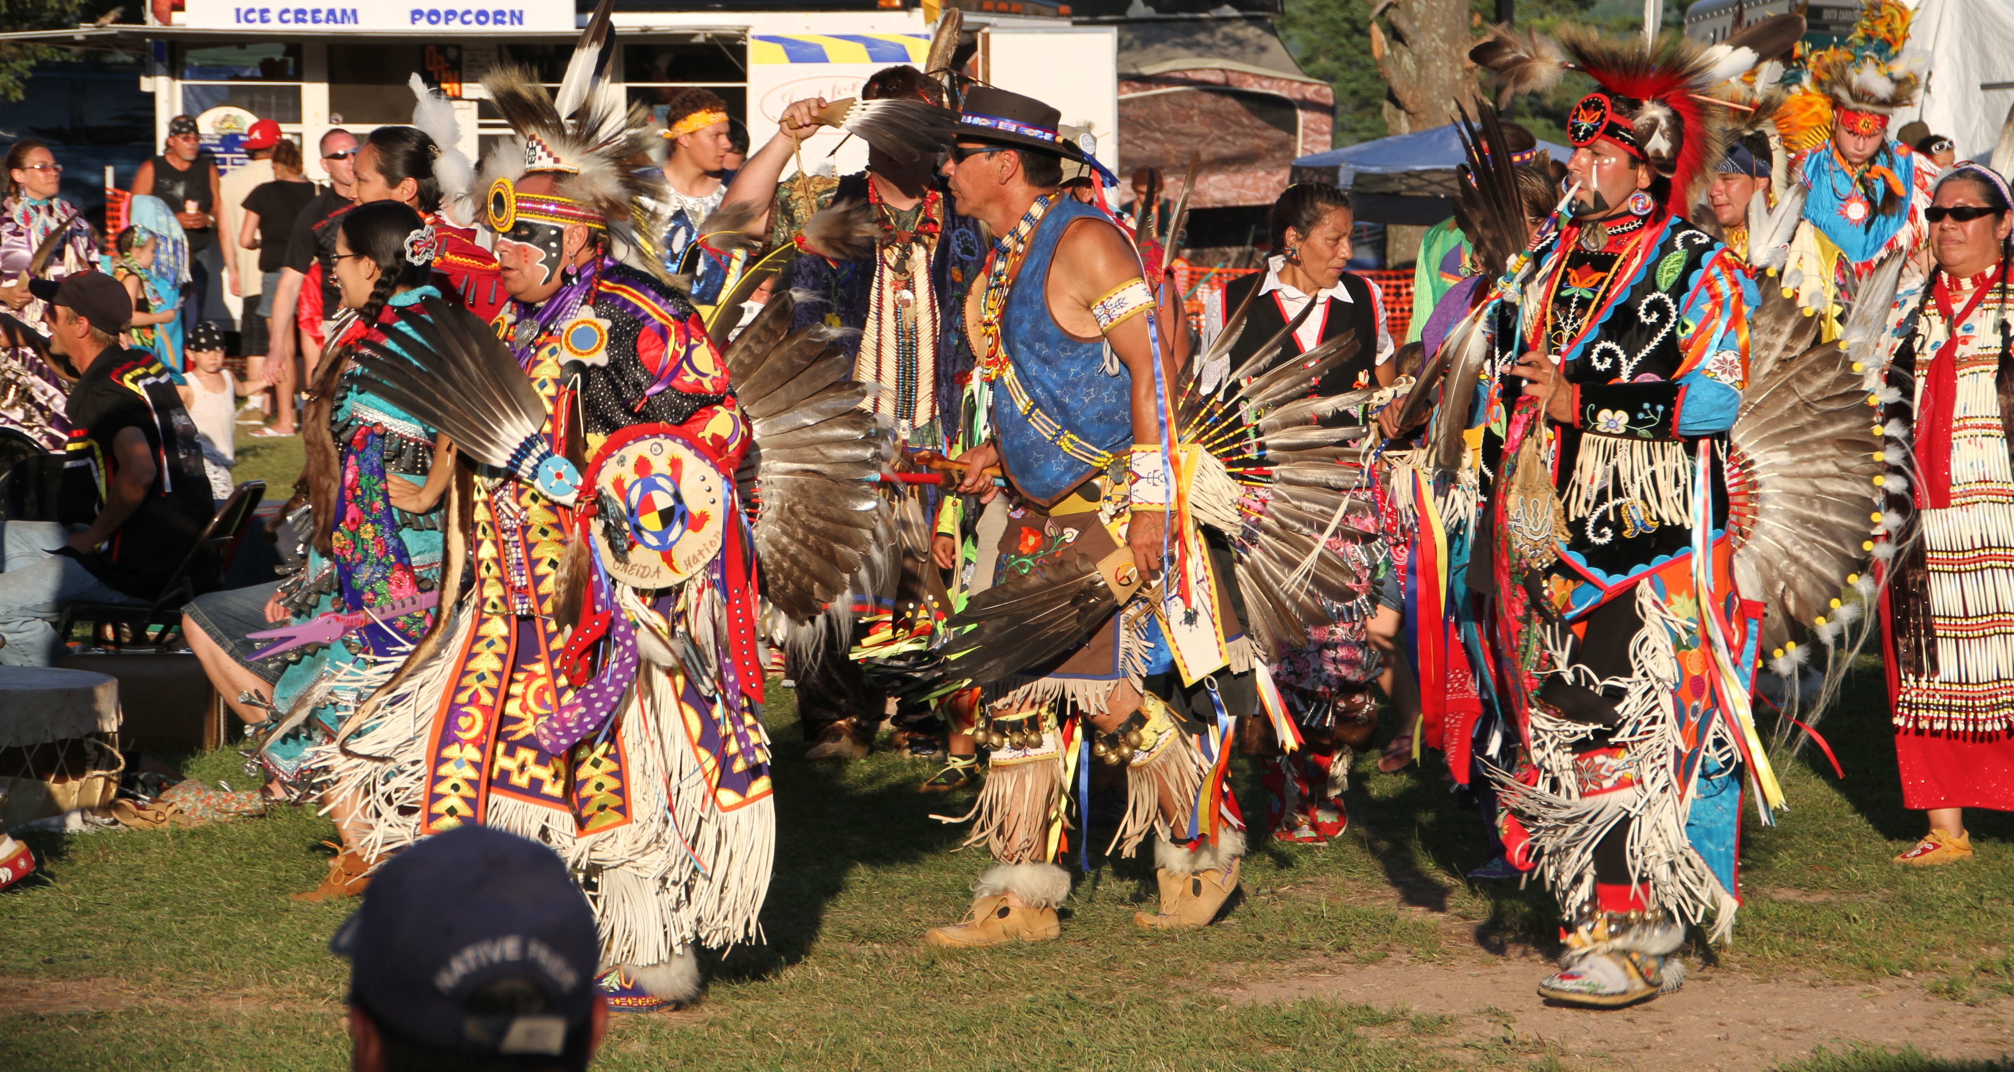
Tribal Courts
Tribal courts hear a broad range of both criminal and civil cases involving Native Americans and non-Native Americans
The work of the tribal courts strongly reflects the culture of the people they serve
The jurisdiction of such courts varies on location of the offense
Federal courts have jurisdiction over many felonies committed by Native Americans on the reservation
Tribal courts cannot prosecute non-Native Americans for crimes committed on the reservation

