Slide 1
Executive Branch
Structure and Function of the Executive Branch

Slide 2
Lesson 1: Powers and Roles of State and Local Executives

Slide 3
Responsibilities, Roles, and Powers of Governors
The executive leader of the state is the governor
Over the last 100 years states have made changes to the structure of the governors office
Some states have even extended the term limits for their governor
All states have a constitution that established the powers and role of the governor
Governors do not have the role as chief diplomat because that role is reserved for the federal govt.
All but seven states have a Lieutenant governor

Slide 4
Head of State and Party Leader
Governors like presidents have ceremonial functions
They represent the state at important events, state fairs, press conferences, and ribbon cutting events
Governors are “the face” of the states at national an international meetings
Governors address the people of the state in times of crisis or celebration
Governors are also leaders of their state-level political parties

Slide 5
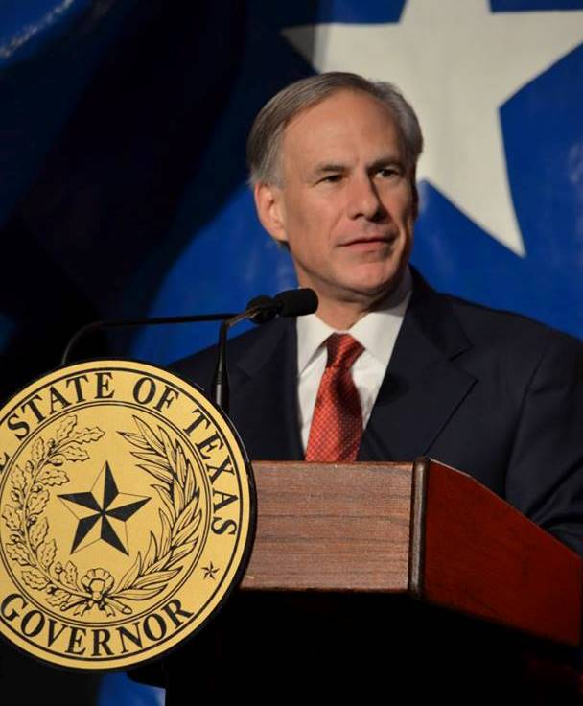
Chief Executive
Governors have the power to carry out the law and the power to supervise the state’s executive branch
Governors can issue executive orders that create a task force to study issues or address immediate concerns
Governors can declare a “state of emergency” after natural disasters
Citizens communicate to the governor though different departments and agencies of the state
Most governors have the power to appoint judges
Governors of most states have the power to issue pardons for state crimes

Slide 6
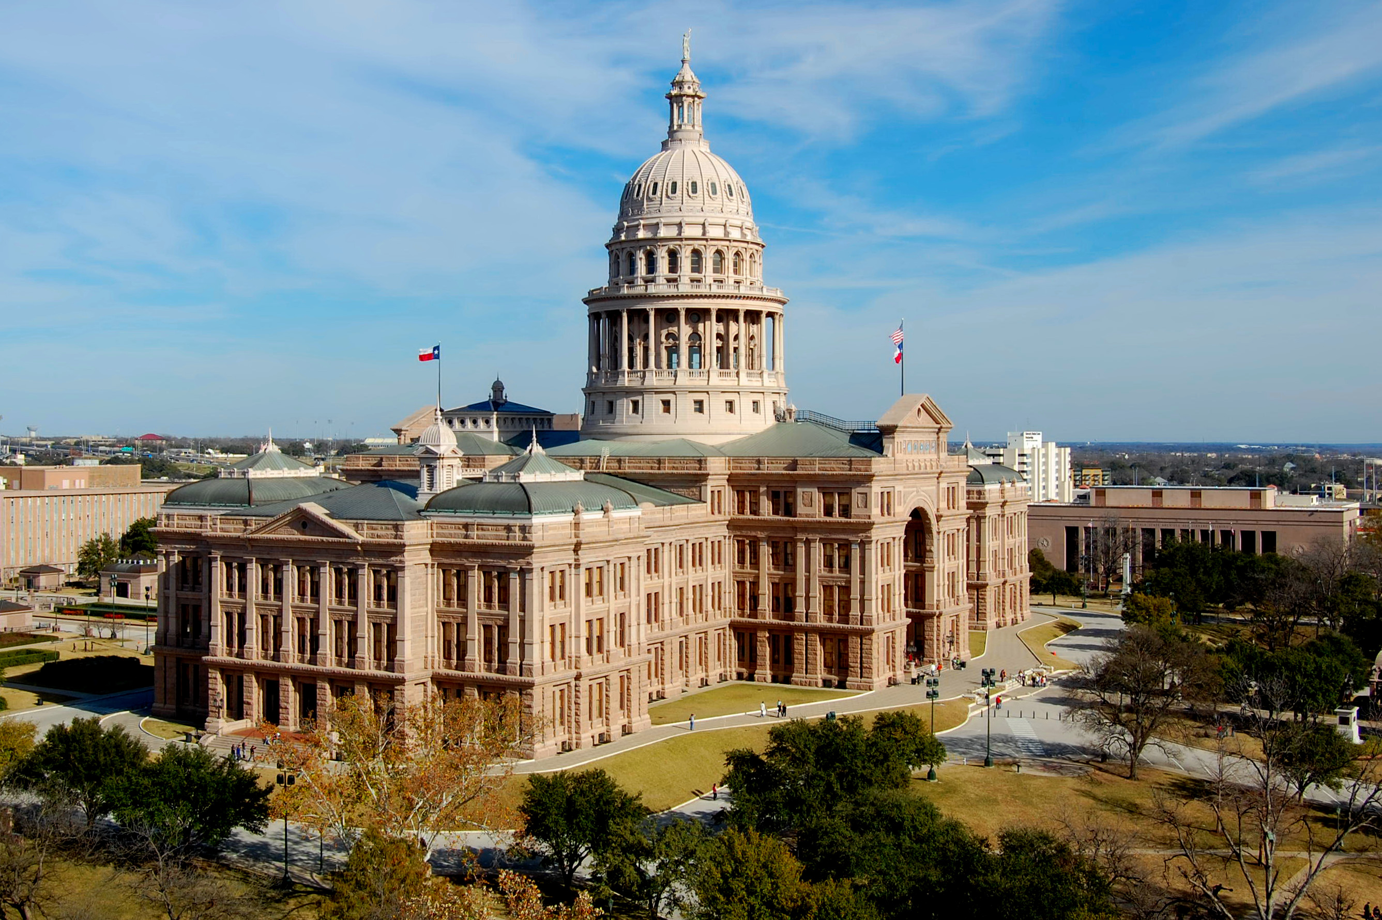
Legislative Leader
Governors need to set a legislative agenda and propose solutions to state problems
Governors can purpose legislation to the state, send message to the legislature, or present new programs
Governors have the power to call state legislature into special session
All governors have veto power over an entire bill
Some governors have line-item veto
Some governors can even veto a bill and send it back to congress with recommendations for amending it

Slide 7
Guardian of the State Economy
Governors try to steer their state’s economy to increase employment and revenue
Most governors try to obtain grants from the national government for their state’s school, highways, and pollution control
Governors plan the state budget
In states that give the line-item veto governors can veto unnecessary spending from budget legislation

Slide 8
Commander in Chief of the State National Guard
Governors can use the national guard to maintain law and order during state emergencies
National guard are part time soldiers having full time civilian jobs
Usually the national guard is called out to keep the peace during civil disturbances or natural disasters
The President can call the National Guard up during war time to serve in combat

Slide 9
Federalism and the Gubernational Powers
Governors have limited power and their actions are checked by the state’s legislative & judicial branch
If a state receives funds from the federal government they must administer programs that use those funds to ensure those funds are being used appropriately (federalism)
Governors can advance their agendas together through their membership in the National Governors Association (NGA)
The NGA is used to represent the states’ interests in Washington as a “collective voice”
The NGA also helps new and incumbent governors with management and technical assistance

Slide 10
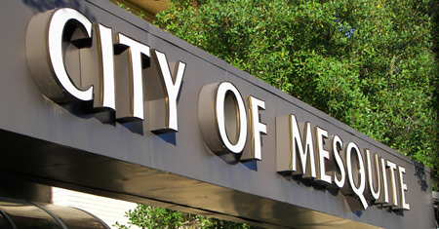
Roles and Powers of Local Executives
Local governments have no legal independence
State governments have total control over local governments because they create them
Local governments have more variety than state government when it comes to power and roles
Local government usually have two tiers: counties and municipalities
Local governments also set up special districts such as school districts

Slide 11
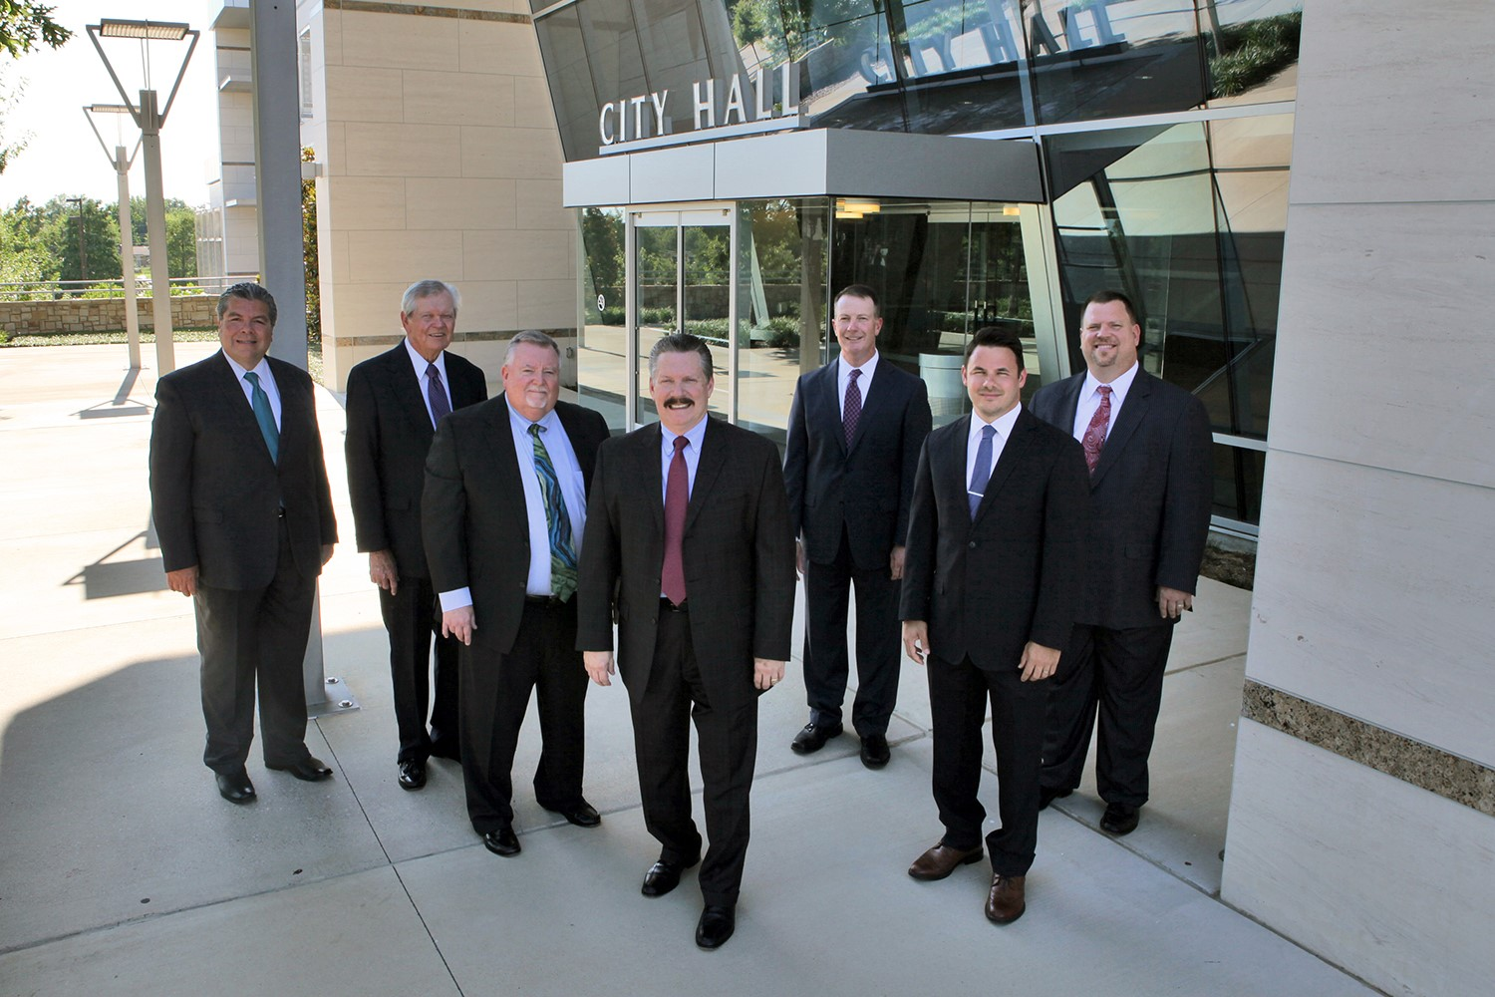
Mayors in the Mayor-Council System
This is the oldest and most widely used from of municipal government
The mayor-council form follows the traditional concept of separation of powers
Strong mayor system usually gives the mayor power to veto measures that are passed by the city council
Weak-mayor system depends on the mayor and city council working together
To improve the management under both systems some cities have a city manager that can help run day to day operations

Slide 12
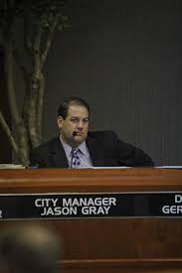
City Mangers in the Council-Manager System
Under this system the legislative and executive powers are separated
The city manger is appointed by the council and acts as the chief executive
The City manager then appoints and fires municipal workers, prepares the budget, and runs the day-to-day affairs of the city
They can recommend policy to the city council
They are subject to dismissal by the council
Most cities have moved away from this system to elect a major with more powers

Slide 13
Commissioners
This form of local govt. combines the executive and legislative powers in an elected commissioner
The commission is made up of five to seven members
Each commissioner heads a specific department and performs all the duties of that department
The most common are police, fire, public works, finance, and parks
They meet together to pass laws and form policies
One member of the commission usually has the title of mayor.

Slide 14
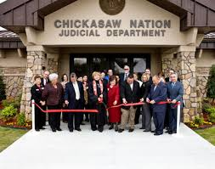
Tribal Government
Some states have a separate level of government that serves the Native American population
In New Mexico the Pueblo Native American culture is divided up into 22 governing units, to preside over 19 Pueblo land formations
Each tribal office has a governor and a lieutenant governor

Slide 15
Lesson 2: Choosing Governors and Mayors

Slide 16
Qualifications of Governors
The governor must be at least 30 years old
An American citizen
Must be a resident of the state for five or more years
Citizenship and residency requirements differ widely among the states
Governors must have served in the state and local government before running
Governors must be skilled as a manger to organize the different state departments
Must have a good personal relationship with legislators

Slide 17
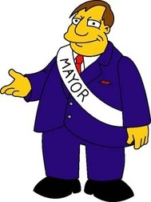
Qualifications of Mayor of City Managers
It varies for mayors/city manager depending on the city
They have to be citizens of the state and city they are located
Set minimum age for mayor 18 to 25 to run for office
Mayor candidates need to live in the town or city for one year
Mayors typical serve two or four years

Slide 18
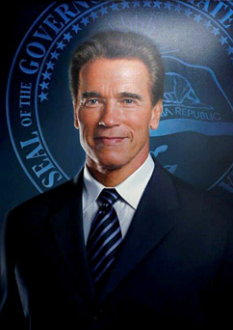
Term of Office and Succession
Most governors serve four-year terms, only two states have set it at two years
27 states have a two term limit for governor
Depending on the city depends on the term limit for mayors and other chief executives at the local level

Slide 19
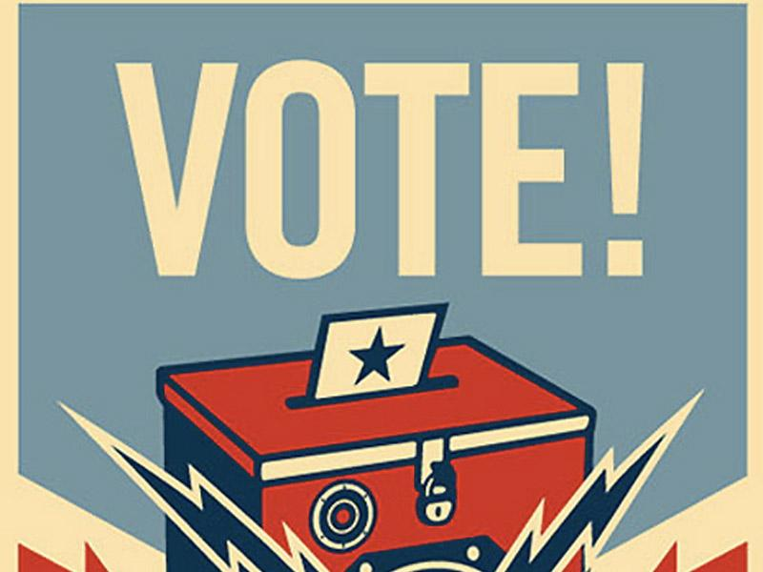
Elections
To elect a governor, first you must gain the nomination from the political party
Second step for a governor election is to run in the general election
The candidate who wins the plurality wins
Plurality-largest number of votes in an election
Most states also elect the lieutenant governor
Each county, municipality, township, and special district each has its own rules for running an election

Slide 20
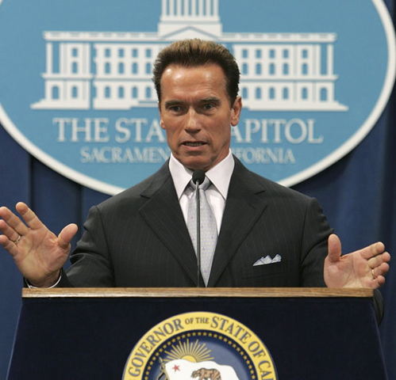
Impeachment and Recalls
All states but for Oregon allow for impeachment proceedings against a governor
Procedures and reasons for impeachment vary between the states
Grounds for impeachment are typically corruption, bribery, or other crimes
Recall-is the process of voting to remove officials from office
19 states voters can go to the polls and vote for governor to be removed from office
Most states only recall if the governor has done something criminal or has had a serious breech of misconduct

Slide 21
Lesson 3: States & Local Executive Branches at Work

Slide 22
State Executive Branch Offices
No state gives its governor power to appoint an entire executive team
44 states have a lieutenant governor
8 states have an attorney general
Secretary of State of a state usually deals with licensing business, various professionals and drivers, but they also keep state records and documents
State treasure manages the money collected and pays out the money
State and local executive branches are divided into numerous departments

Slide 23
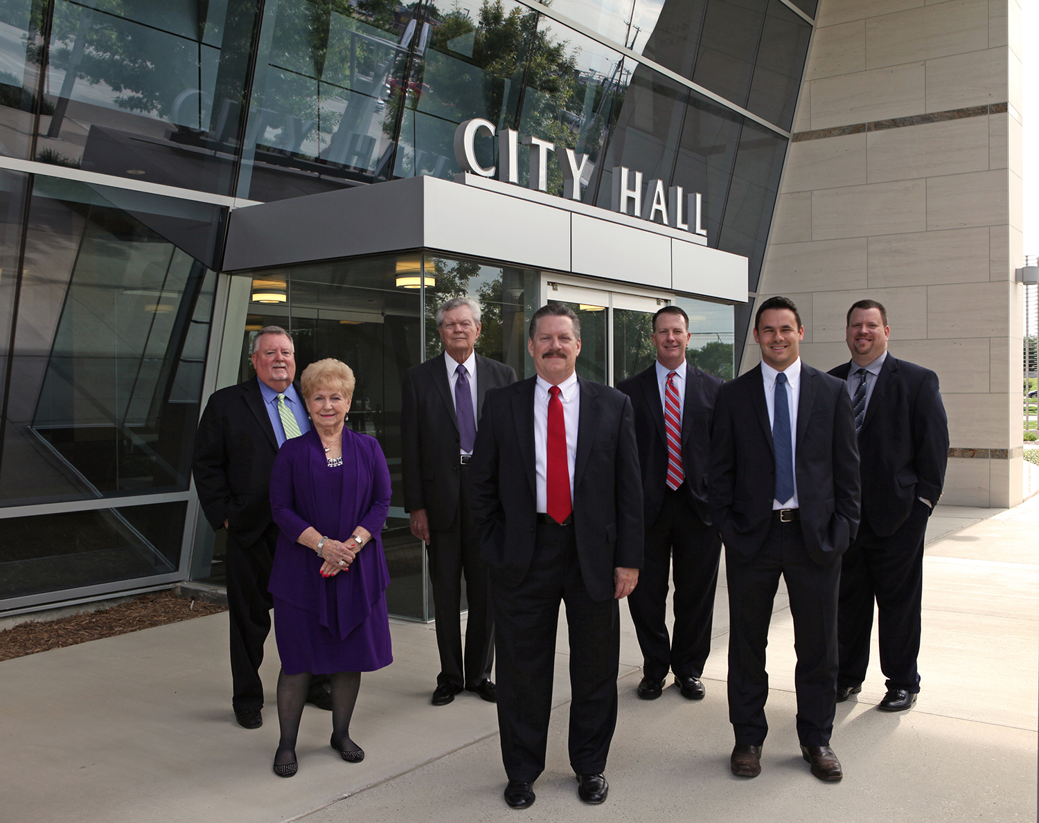
Local Executive Branch Structures
At this level the power is usually shared between multiple individuals
Most towns run government like a business with a border of directors making all the decisions
Smaller towns may only have a handful of employees to carry out the city’s work

Slide 24
Police and Criminal Corrections
State police have investigative powers in many states, but most only give them broad powers
Local police departments handle most day-to day patrolling, emergency response, and investigations of crime
State courts handle the great majority of criminal cased in the US
State prisons, county and municipal jails, and other houses of detention throughout a state make up a state’s correction system

Slide 25
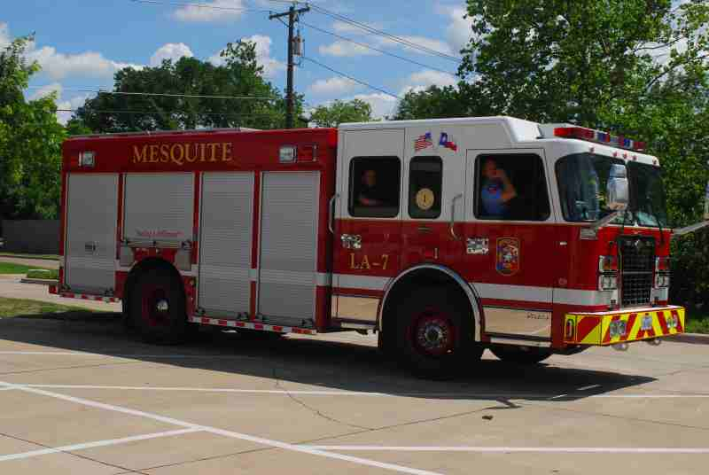
Fire Protection
Fire protection is a local function
Fire protection varies with the size of the community
Small towns usually have volunteers to staff the fire department
Professional fire departments also serve some small towns that have many factories & businesses

Slide 26
Education
State governments establish local school districts and give them the power to oversee the administration of the schools
States do regulate the taxes a school district can borrow
Federal government provides 10% of funding for public schools
Local school districts provide half of the money and make the key decisions on public school policy
States also set some standards that public schools have to follow

Slide 27
Health
States give out license to doctors and dentists, as well as regulate sale of drugs & require vaccines for school children
States provide numerous services for people to receive health care within their state
State governments often pay the bill for pubic health services that local authorizes deliver and administer
Medicaid is a program that is jointly funded by the state and federal government

Slide 28
Social Services
State and local governments offer important services to citizens who cannot afford them
State and both administer federal programs and fiancé and administer state-level programs with some local support
States also have their own social welfare programs
Local governments provide services to people who have special needs
Special needs: unemployment, low income, ill health, permanent disabilities

Slide 29
Recreation and Cultural Activities
Some local communities offer swimming, dancing, and arts and craft programs
Many local governments provide baseball, football, and other sports programs
They maintain parks, zoos and libraries
Many cities and counties have helped build stadiums, arenas and convention centers that are used for sports and entertainment

Slide 30
Business Regulation
State governments have a special obligation to regulate certain kinds of business
Regulations affect many kinds of corporations, but laws regulating banks, insurance companies, and public utilities are especially rigorous
In the United States, most public utility companies are owned by private stockholders
States can give public utility companies the right to supply service in the state or in part of the state

Slide 31
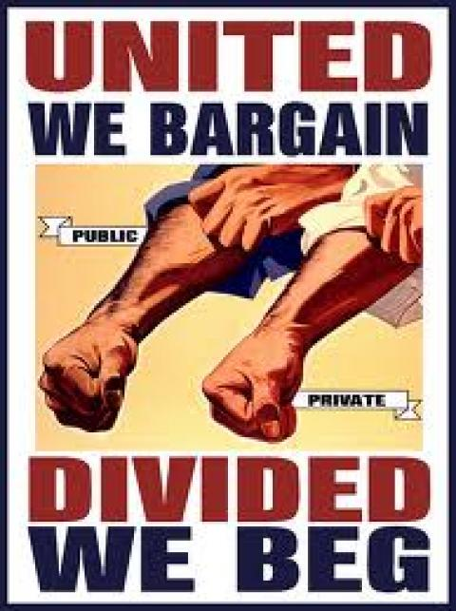
Labor Laws
States provide workers compensation payments to people who are unable to work as a result of job-related injury or ill health, and unemployment
Workers in all states have the right to join unions
1/3 of every state have passed laws that are often called right-to work-laws that prohibit union shops
Union shop: is an agreement between a union and an employer to only hire workers who join the union

Slide 32
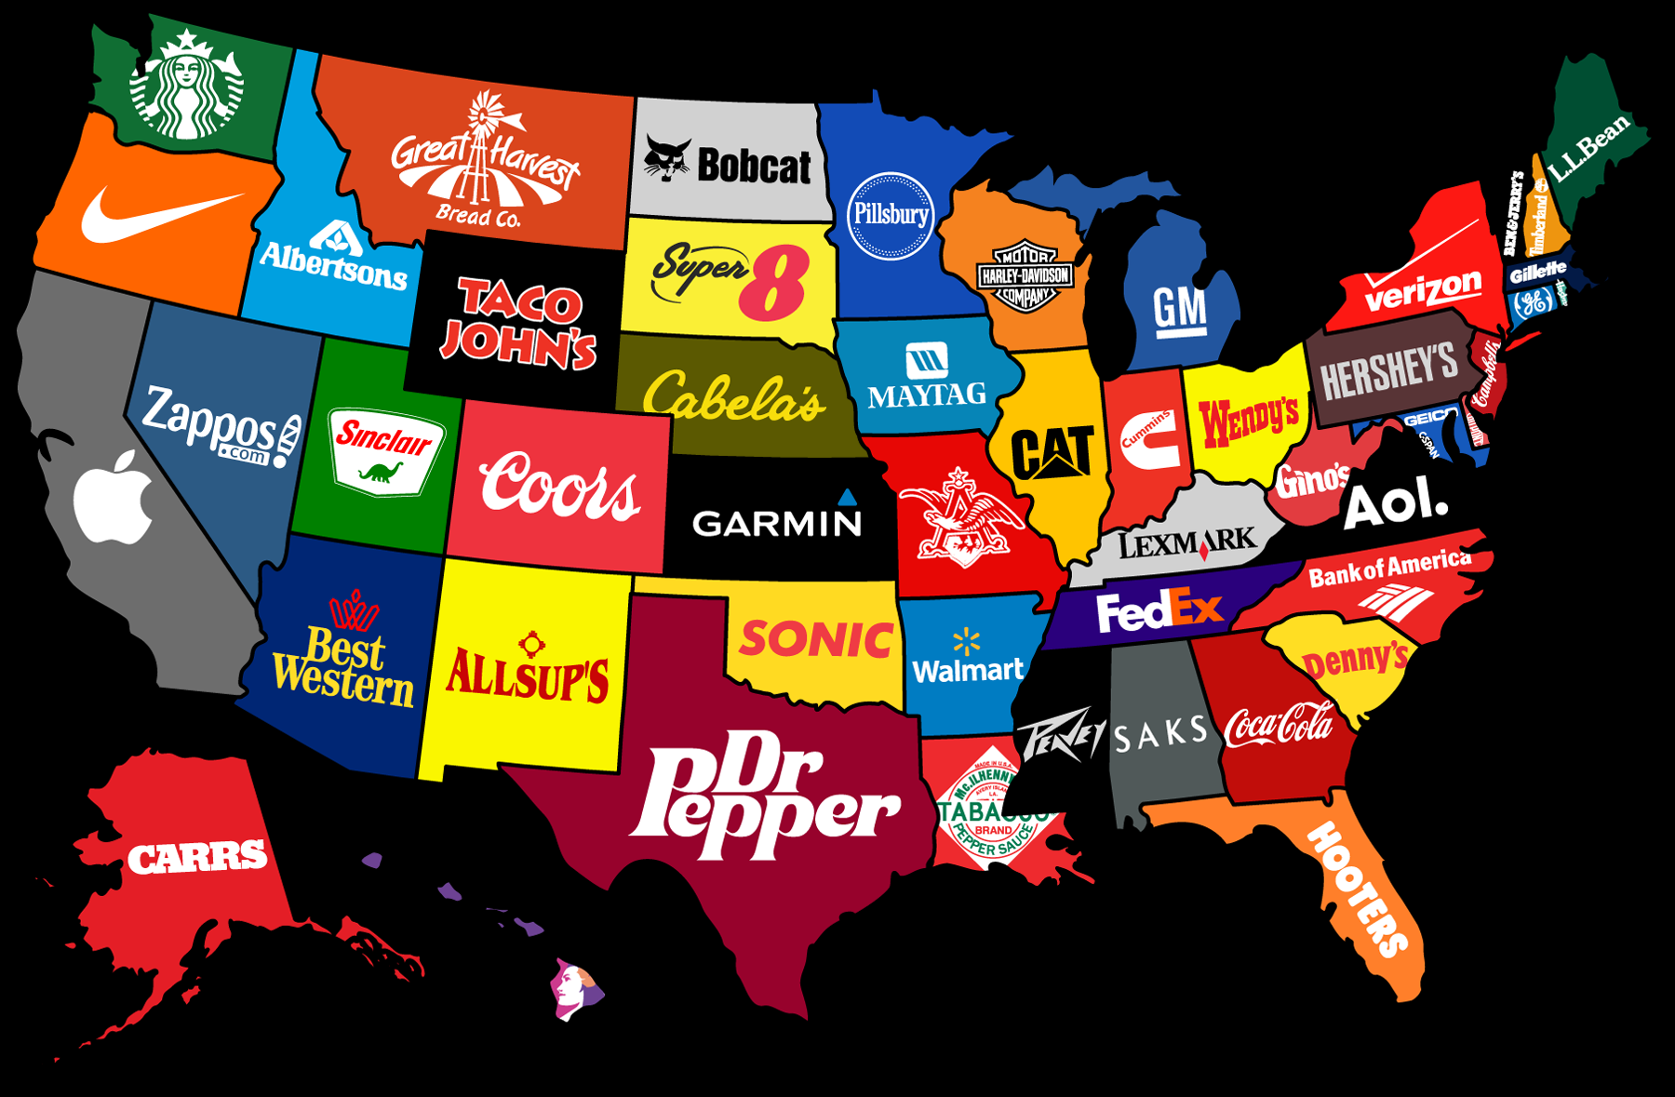
Business Development
State governments are active in trying to attract new business and industry
Governors travel the country or aboard to bring business to their states
States and cities often give businesses short-term incentives such as a reduced tax rate in hope to bring the company in

Slide 33
Types of Government Services
Zoning-the way the government regulates the ways land and buildings are used, which shows how a community develops
Housing Shortages-governments answer this problem by renovating older housing
Housing Discrimination-this is hard to prove for people and often governments have a hard time enforcing the laws
Infrastructure and Transportation-this refers to the government improving roads, highways, railroads and provide transit for their citizens
Water Supply-governments have to make vital decisions regarding water services including, supply of water, water pollution, and water shortages
Sewage and Sanitation-governments have to figure out a way to treat sewage, and find places to place the trash within a city
Environmental Issues-states have to be involve in many activities related to the environmental health of the citizen, example: pollution control

