Slide 1
Chp 11 Lessons 1 & 2 Executive Branch
Structure and Function of the Executive Branch

Slide 2
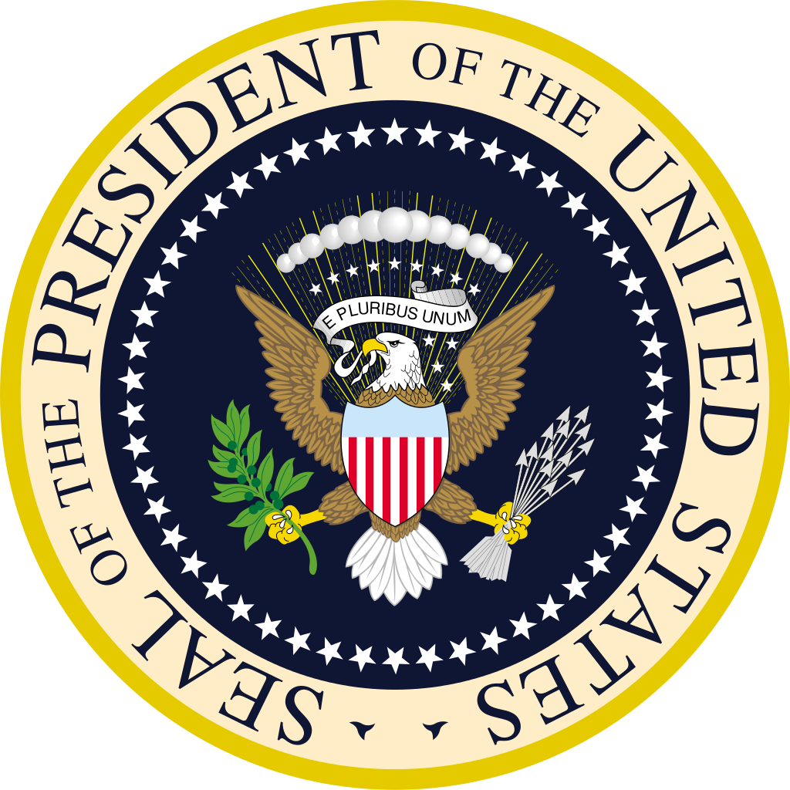
Lesson 1: The Cabinet and Executive Office

Slide 3
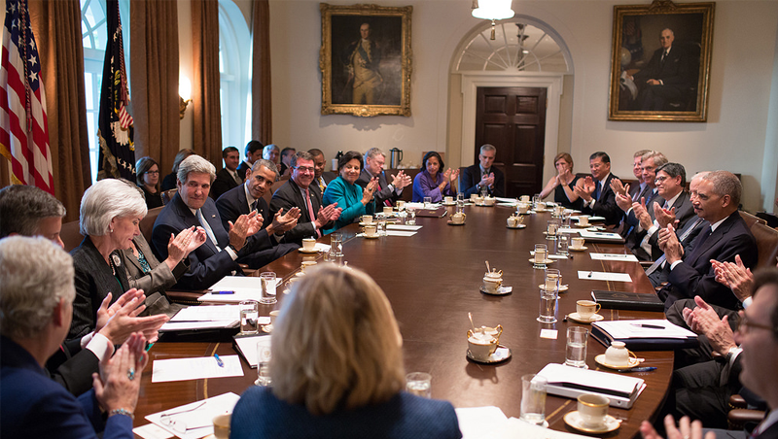
The Cabinet
The President appoints his cabinet but the Senate must confirm each person
The president-elect draws up a list of candidates after consulting with campaign advisers, congressional leaders, and representatives of interest groups
The selection of a president’s cabinet is largely political process
Decisions the President must make in the selection process:
Experience in a Particular Policy Area
Administrative and Supervisory Experience
Support for the President’s Goals and Plans
Support from Various Groups that Hold Political Power
Demographic Diversity

Slide 4
The Cabinet
Some people chosen by the president have turned down the position
The Senate holds confirmation hearings on the president’s nominees for cabinet posts
Appointments are not automatic
In some cases, a president has withdrawn a nomination after it became clear that the Senate or the public did not support the nominee
Other nominees have received just enough votes to be confirmed, but the process illustrates conflict among the executive and legislative branches over the right course of policy
The Constitution does not require the President to get congressional approval to fire a cabinet member

Slide 5
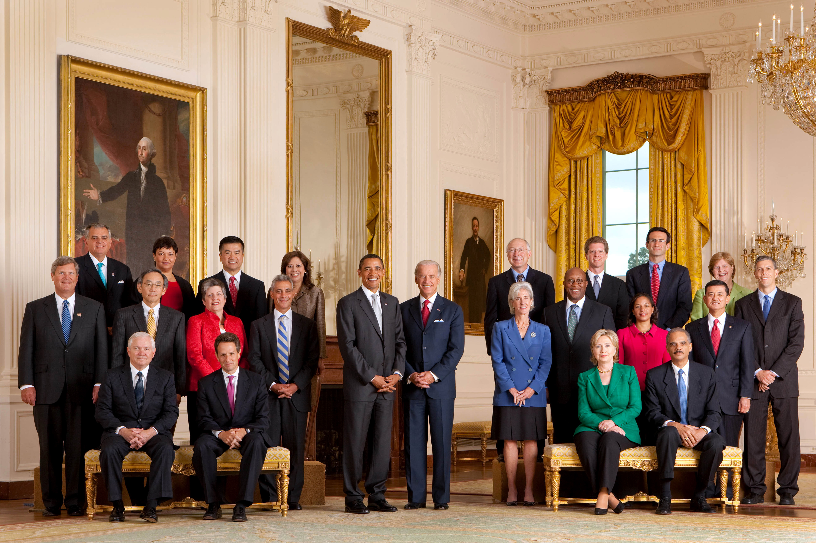
Factors Limiting the Influence of the Cabinet
No president commands the complete loyalty of cabinet members
Sometimes disagreements arise among the different cabinet secretaries
The political factors that must be considered, presidents can end up appointing relative strangers to their cabinets

Slide 6
The Executive Office of the President
This group is supervised by the White House chief of staff and has become the president’s closest group of advisers
They gather information, develop policy, and advise the president
EOP agency staff includes attorneys, scientists, social scientists, and other highly technical or professional personnel.
Reorganization act of 1939: created the EOP which has grown dramatically under each president
Many of today’s huge federal programs require that several executive departments and agencies work together, EOP coordinates these efforts
Three of the oldest EOP agencies include:
Office of Management and Budget
National Security Council
Council of Economic Advisers

Slide 7
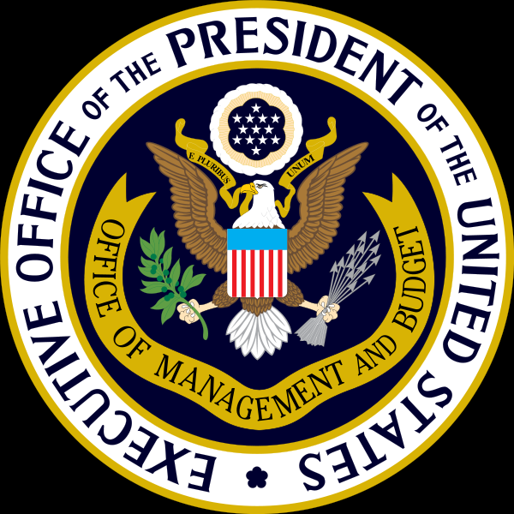
The Office of Management and Budget (OMB)
It is the largest agency within the EOP
It prepares the national budget for the president, then the president presents the budget to Congress.
OMB also reviews agency regulations and legislative proposals
The OMB’s budget reflects what the federal government will spend money on and how much
Every year each department and agency submit their budgets to the OMB, then the OMB reviews them and recommends where to make cuts
This system gives OMB real and continuing influence over executive agencies

Slide 8
The National Security Council (NSC)
Is composed of the president’s senior national security advisers and cabinet officials
They coordinate the government’s plan for and response to domestic terrorism and catastrophes
The responsibilities and composition of the current NSC illustrates how EOP can change under different presidential administrations

Slide 9
The Council of Economic Advisers
Since the Great Depression, the president has been the nation’s chief economic planner
By law, the Council is composed of three members who must be confirmed by the Senate
The council is supported by a team of economists, statisticians, and research assistants
The Council assesses the nation's economic health, predicts future economic conditions, and supports other executive agencies that are involved in economic planning
The Council also prepares an annual report that the president gives Congress on the state of the economy

Slide 10
Other EOP agencies
The number and size of EOP agencies can vary because presidents can have different priorities
Office of Economic Opportunity tracks problems that involved unemployment and other social problems in the inner cities and all of America
OEP advises the president on environment issues and works closely with the EPA and the departments of Interior, Agriculture, and Energy

Slide 11
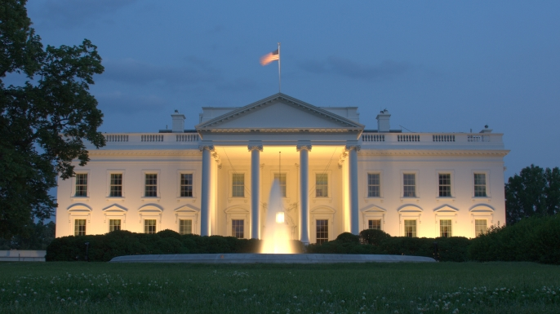
The White House Office
George Washington had no personal staff, and ever since then the office staff began to grow
Today the EOP includes a special unit called the White House Office
The WHO is another key set of advisers and assistants for the president
WHO gathers information, advise the president about policy and political strategy, communicate on behalf of the president and runt he day-to-day operations of the White House
White House staff can be chosen without Senate confirmation

Slide 12
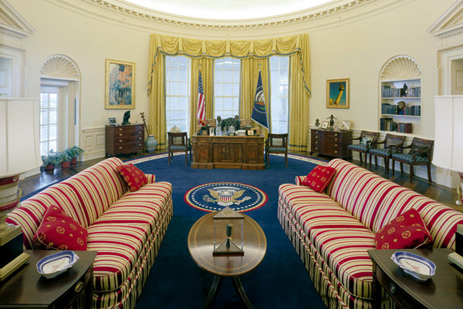
The White House Office
The president’s most trusted adviser is usually the White House chief of staff
Other White House staffers present the president’s views to the public
Some White House staffers, usually aides, determines what issues or people get to been seen or see the president

Slide 13
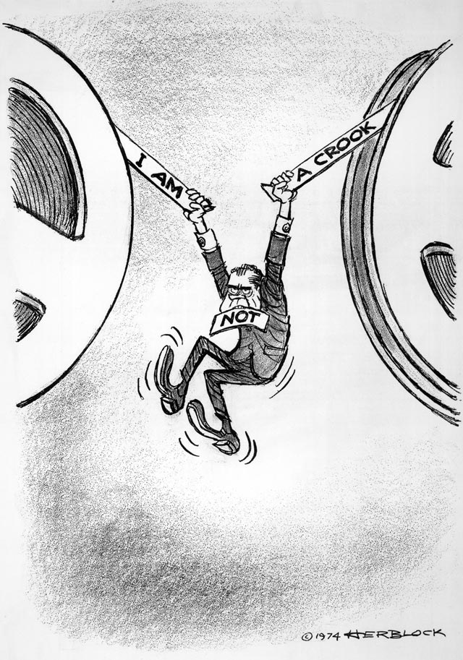
Executive Privilege
This is the right of the president to keep information from becoming public knowledge
This means that the president can refuse to provide documents or other records to the legislative and judicial branches
This is an implied power to the Constitution because it comes from the ideal of separation of powers
Courts have also ruled that the president has some right to executive privilege but it is not absolute
Three major areas where this is used:
Foreign relations & Military affairs
Law enforcement investigations
Executive “deliberative process”

Slide 14
Lesson 2: Cabinet Departments & Independent Agencies

Slide 15
Cabinet Departments
The president’s cabinet includes each of the heads of the 15 executive branch departments
The Founders anticipated the need for creating federal agencies that would carry out the day-to day business of the government
Today, nearly 2.8 million civilians works for the federal government
The government owns 900,000 buildings scattered across the nation and around the world

Slide 16
Cabinet Departments
The title for a person who heads each executive department is secretary, except for the Department of Justice who is named attorney general
Under the cabinet are the directors of major units that make up each cabinet department
These units have various names that include:
Bureau
Agency
Office
Administration
Division

Slide 17
Cabinet Departments
State Department
is responsible for developing and implementing the foreign policy of the US
This department represents the US to the UN and liaison to more than 180 countries through its network of ambassadors and civilian foreign service employees
The department assists US citizens living abroad and foreign nationals who wish to enter the US
List of activities:
Countering international crime
Providing aid to other countries
Promoting democracy and cultural exchanges

Slide 18
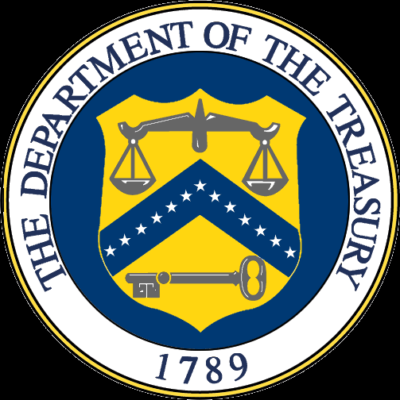
Cabinet Departments
Department of Treasury
This department manages monetary resources of the country
The largest bureau in the department is the Internal Revenue Service (IRS)
The IRS collects taxes paid by American citizens and businesses each year
The treasury department is responsible for making payments to the public and for borrowing money needed to operate the federal government
The department also coordinates with other agencies to protect the nation’s financial and banking institutions from foreign threats or economic crisis

Slide 19
Cabinet Departments
Department of the Interior
This department executes federal policy and programs to protect natural resources including public lands and minerals
It maintains the extensive national park system and hundreds of national dams and reservoirs
It issues permits and leases to companies who use national resources for energy, minerals, grazing, and timber
The department also carries out our nation’s policies towards Native Americans tribes.
Department of the Agriculture
Develops and executes policy on farming, agriculture, and food
It contains 17 different agencies that carry out laws to support farmers and ranchers

Slide 20
Cabinet Departments
Justice Department
Enforces federal laws designed to protect public safety, reduce crime, punish people who break laws, enforce civil rights, and ensure justice for all Americans.
The attorney general represents the US in legal matters, and advises the president and the heads of the executive departments of government
Commerce
Supports the economy by developing and executing policies to promote American businesses and industries
Labor
Administers federal programs to protect and improve the productivity of workers
It issues patents and trademarks, and administers laws on scientific and technical research

Slide 21
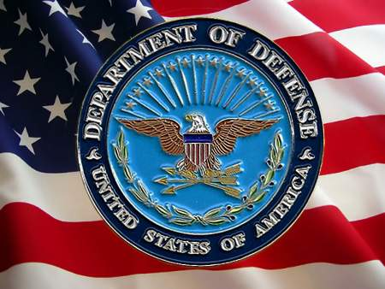
Cabinet Departments
Defense
Protects the security of our country
It consist of the US Army, Navy, Marines, and Air Force
In addition to fighting wars and providing national security, the DOD is involved in efforts to deter war, assist in disasters, and provide humanitarian aid
Health and Human Services
Is concerned with protecting public health and providing social services to those least able to support themselves
It provides health insurance and administers programs such as Medicare and Medicaid
It funds medical research to improve public health and to prevent disease

Slide 22
Cabinet Departments
Housing and Urban Development
Is responsible for national policies and programs that address America’s housing needs, improve and develop the nation’s communities, and enforce fair housing laws
HUD supports homeownership for lower-and-moderate income families
It provides rent subsidies and administers public housing and assistance programs for people who are homeless
HUD also manages programs that help communities with economic development and tries to ensure equal access to housing opportunities for all

Slide 23
Cabinet Departments
Transportation
Develops policy and administers a variety of programs relating transportation
Its programs oversee the nation’s mass transit systems, railroads, bridges, and waterways
The Federal Highway Administration (FHWA) runs programs to improve driver and pedestrian safety as well as to reduce distracted driving and driving under the influence.
The Federal Aviation Administration (FAA) regulates air travel and works to ensure air safety
Energy
Executes law and policies about the nation’s energy
It administers funding for research and innovation in science and engineering
They also oversee the nation’s nuclear energy and nuclear weapons programs

Slide 24
Cabinet Departments
Education
Provides assistance to public and private schools, collects data from schools, distributes research results, and administers federal financial aid programs
They also work to prohibit discrimination in education and ensure equal access to educational opportunities for students regardless of their race, ethnicity, national origin, physical disabilities, and level of proficiency in English
Veterans Affairs (VA)
Administers benefit programs for veterans and their families and survivors
Benefits include pension, education, disability compensation, home loans, life insurance, vocational rehabilitation, survivor support, medical care, and burial benefits

Slide 25
Cabinet Departments
Homeland Security
Coordinates national efforts to protect against acts of terrorism that would jeopardize the American people, key resources, critical infrastructure
It administers immigration laws and responds to national disasters

Slide 26
Independent Agencies, Government Corporations, and Regulatory Commissions
The federal bureaucracy includes more than 100 independent organizations that are not part of the executive departments
Some independent agencies perform services for the executive branch
The federal government runs approximately 60 government corporations
Government corporations are organized like private business
Government corporations are supposed to be more flexible than regular government agencies
Money from Congress supports government corporations
Regulatory commissions are independent agencies that have the government’s authority to issue licenses and punish people and groups that violate the laws under their authority
The commissions are independent of all three branches
The commissioners of the commissions do not report to the president, nor can the president fire them
Regulatory commissions were created to make rules for large industries and businesses that affect the public

