Slide 1
Chp 11 Executive Branch
Structure and Function of the Executive Branch

Slide 2
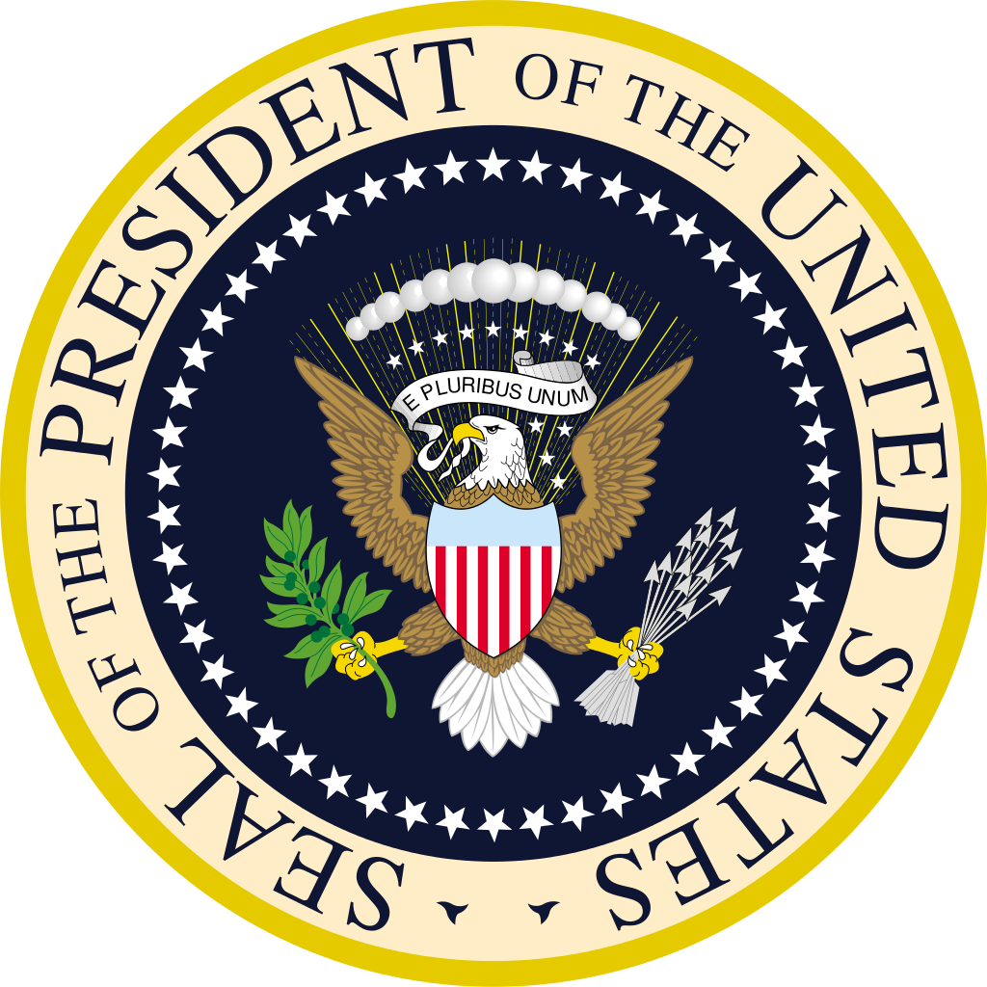
Chp 11 Lesson 3: The Federal Workforce & Civil Service

Slide 3
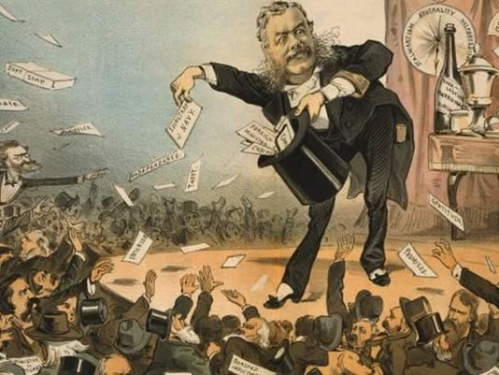
The Spoils System
George Washington declared that he appointed government officials according to “fitness of character”, but he still favored members of the Federalist Party
Andrew Jackson fired about 1,000 federal workers and gave their jobs to his won political supporters
The spoils system became a phrase used to describe Jackson’s method of appointing federal workers
Today spoil system refers to the practice of victorious politicians rewarding their supporters with government jobs

Slide 4
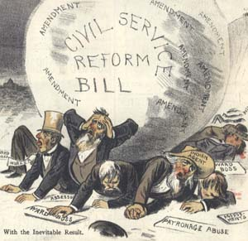
Calls for Reform
The spoils system fostered inefficiency and corruption
Corruption developed as people used their jobs for personal gain
Calls for reform began in the 1850s when newspapers and magazines described the problems with the spoils system
It took a tragedy to get reform, when President James Garfield was assassinated
The Pendleton Act diminished the power of political parties and the president by putting most of the responsibility for running the day-to-day functions of executing and enforcing laws in the hands of people with close political ties

Slide 5
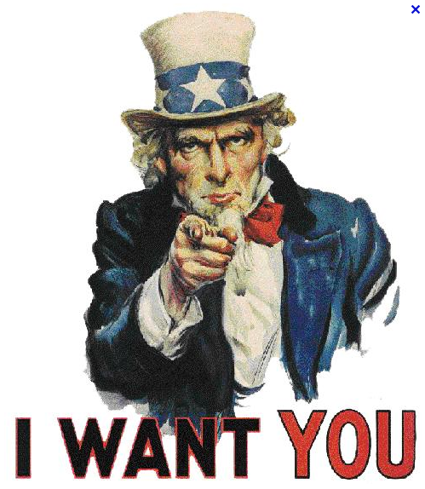
Getting a Job
Competition for federal jobs today is stiff
Every job opening has had about 80 applicants
The Office of Personnel Management, along with individual agencies is responsible for filling federal jobs
Government jobs are attractive because of the many benefits they offer
Salaries for most federal workers are competitive with those in private industry
Benefits include: paid vacation days, sick leave days, sick leave days, health insurance, and a retirement package

Slide 6
Protections for Civil Servants
All civil service workers have job security
They may be fired only for specific reason and only after a very long, complex series of hearings
Laws do allow most executive branch employees to be allowed to join unions, but my not be forced to do so
Federal employees who report corruption or wrongdoing by the government are known as whistleblowers
Whistleblower Protection Enhancement Act was designed to protect workers legal first amendment protections

Slide 7
Restrictions of Civil Servants
In 1939, the Hatch Act was passed which prevented federal workers from participating in election campaigns
The Hatch Act has been subject to two Supreme Court decisions.
Opponents argue that the law violates freedom of speech
Supporters believed that government workers needed to be politically neutral
Supporters also argue that the act protects workers from political pressure from superiors and it prevents employees from using their government positions to punish or influence people for political reason
In 1993, the law was amended to prohibit federal workers from engaging in political activities during working hours
The new amendment to the law also prohibits employees from running for elective office or solicit public contributions

Slide 8
Political Appointees in Government
In each presidential election year, the House or Senate publishes a book known by Washington DC insiders as the Plumb Book.
The Plumb Book is a book that holds a list of jobs the new president can award to supporters
Every president has the chance to fill about 3,700 jobs in the federal bureaucracy
These jobs are outside the civil service system, which means that a person does not need to take a competitive civil service exam to win the position
The president appoints close to 800 top-level jobs that require Senate approval
Filling these jobs gives presidents a chance to put loyal supporters into critical positions
Political appointees are subject to more ethical restrictions than career civil servants
In 2009, an executive order was issued to ensure that full-time political appointees did not commit to accepting gifts from lobbyists or lobbying organizations

Slide 9
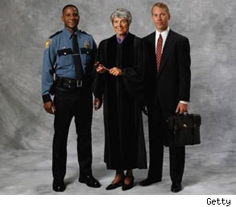
People at the Top
The people appointed to leadership and political positions are first and foremost the president’s political supporters
All of these are college graduates
Majority have advanced degrees, and a significant percentage are usually lawyers
Some of the people in these positions have expertise in the specialized work of the agency they are appointed.
They may or may not have served in government before
They do all have administrative or managerial expertise
When the president leaves office, most of them return to jobs outside the government

Slide 10
Lesson 4: Executive Branch at Work

Slide 11
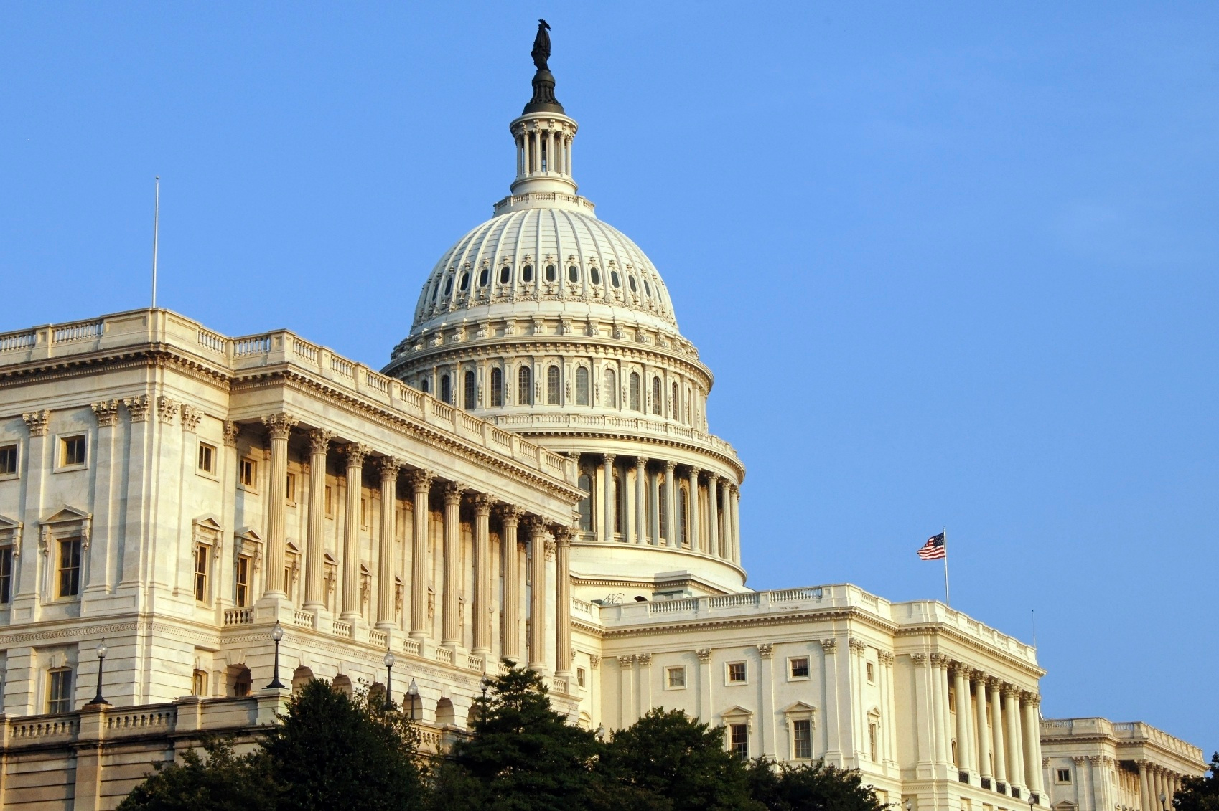
Public Policy, Rules, and Regulations
Public policy is the stated course of action the government takes to address problems or issues
Public policy includes actions the government requires or forbids
The entire complement of agencies and departments that implement laws and make related policy is called the bureaucracy
Bureaucrats are in change of several policies, most of these programs affects almost all aspects of national life

Slide 12
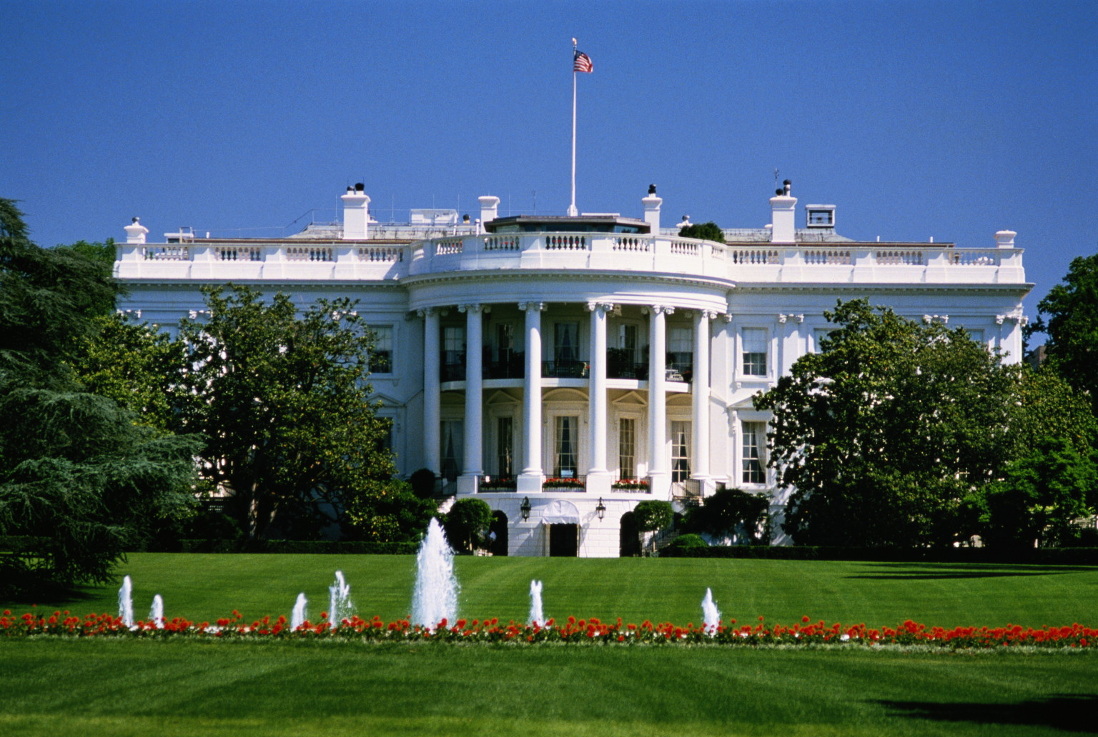
Bureaucratic Involvement in Lawmaking
Before a law is passed the executive staff will likely watch its development and consider its implication
Each cabinet department has liaison officers who develop relationships with the elected officials and congressional staff members who have the authority over the work of their departments
Liaison officers keep track of bills moving through Congress, and supply lawmakers with information when they are analyzing bills
Liaison officers may help draft new bills for Congress as well as testify about legislation
Ideas for new laws often come from within the bureaucracy

Slide 13
Making Rules and Policy
Federal bureaucrats carry out the policies the Congress makes and the president signs
When Congress does not make a law it cannot spell out exactly what needs to be done to enforce it
The bureaucracy shapes what the law actually means
The main way federal agencies do this is by issuing rules and regulations designed to translate the law into action
The bureaucracy formulates many rules or regulations to carry out each law
Complex laws contain many more rules and regulations than the average law
Rules made by federal agencies have the force and effect of law
The bureaucracy makes public policy
Executive branch employees often play key roles in setting specific goals and making rules for government programs
Some have criticize this process because people are concerned that the people who are making policy were not elected by the people

Slide 14
Public Input
Executive agencies seek input from private citizens and others who will be affected by potential rules and regulations.
Lobbying groups also attempt to influence the ways rules and regulations are written
When agencies draft new rules, they must publish drafts of those rules and allow the public to see and comment on them before they go into effect
The process of getting public input varies by agency, but the procedures are very specific and must be followed
Interests groups use various strategies to encourage their members to weight in on rules that might affect them

Slide 15
Checks & Balances on the Bureaucracy
Citizens or interest groups are not satisfied with a rule or regulation they can take their case to court
They may ask a federal court to issue an injunction (an order that will stop an action or enforce a rule or regulation)
Court rarely reverse decisions of federal regulatory commissions
Congress can check the power of executive agencies and departments in three ways:
They can pass laws to alter the rules or regulations
They can hold agencies more accountable for what they do
Lawmakers can use reports to make sure the executive branch is carrying out laws as they were expected to do.

Slide 16
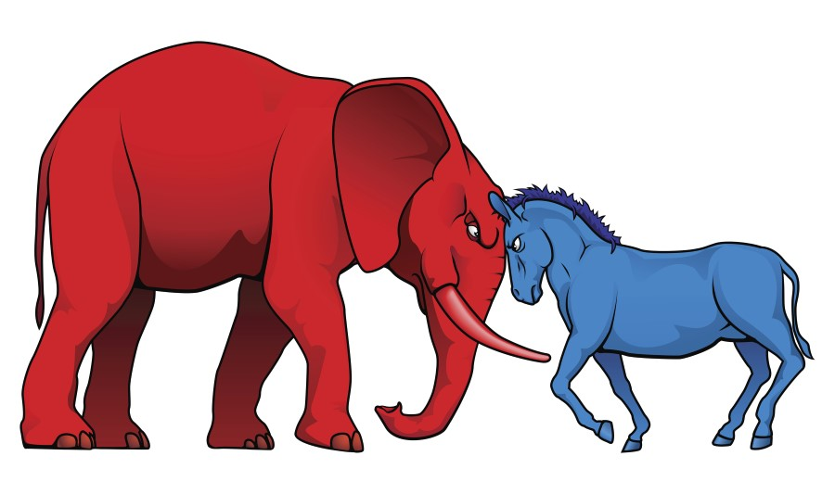
Debates about the Size of Bureaucracy
People have different about the federal bureaucracy
The arguments can be traced back to the arguments of the federalist and anti-federalist
Some people today worry that the national government is too big, too inefficient, and too costly
Some people believe that the federal government programs are vital to the nation and should be maintained or expanded.

Slide 17
Factors Contributing to Growth in the Bureaucracy
Several forces have driven the growth in size and importance of the federal bureaucracy:
Population Growth
Industrial and Technological Advances
Growing Global Economy
Threats to National Security
Economic Crises
Critics of big business say all this growth is unsustainable, costly, and overextension of the proper role of the federal government
Some argue that these tasks are best accomplished at the state and local level of government, where elected officials and the bureaucracy are closer to the people

Slide 18
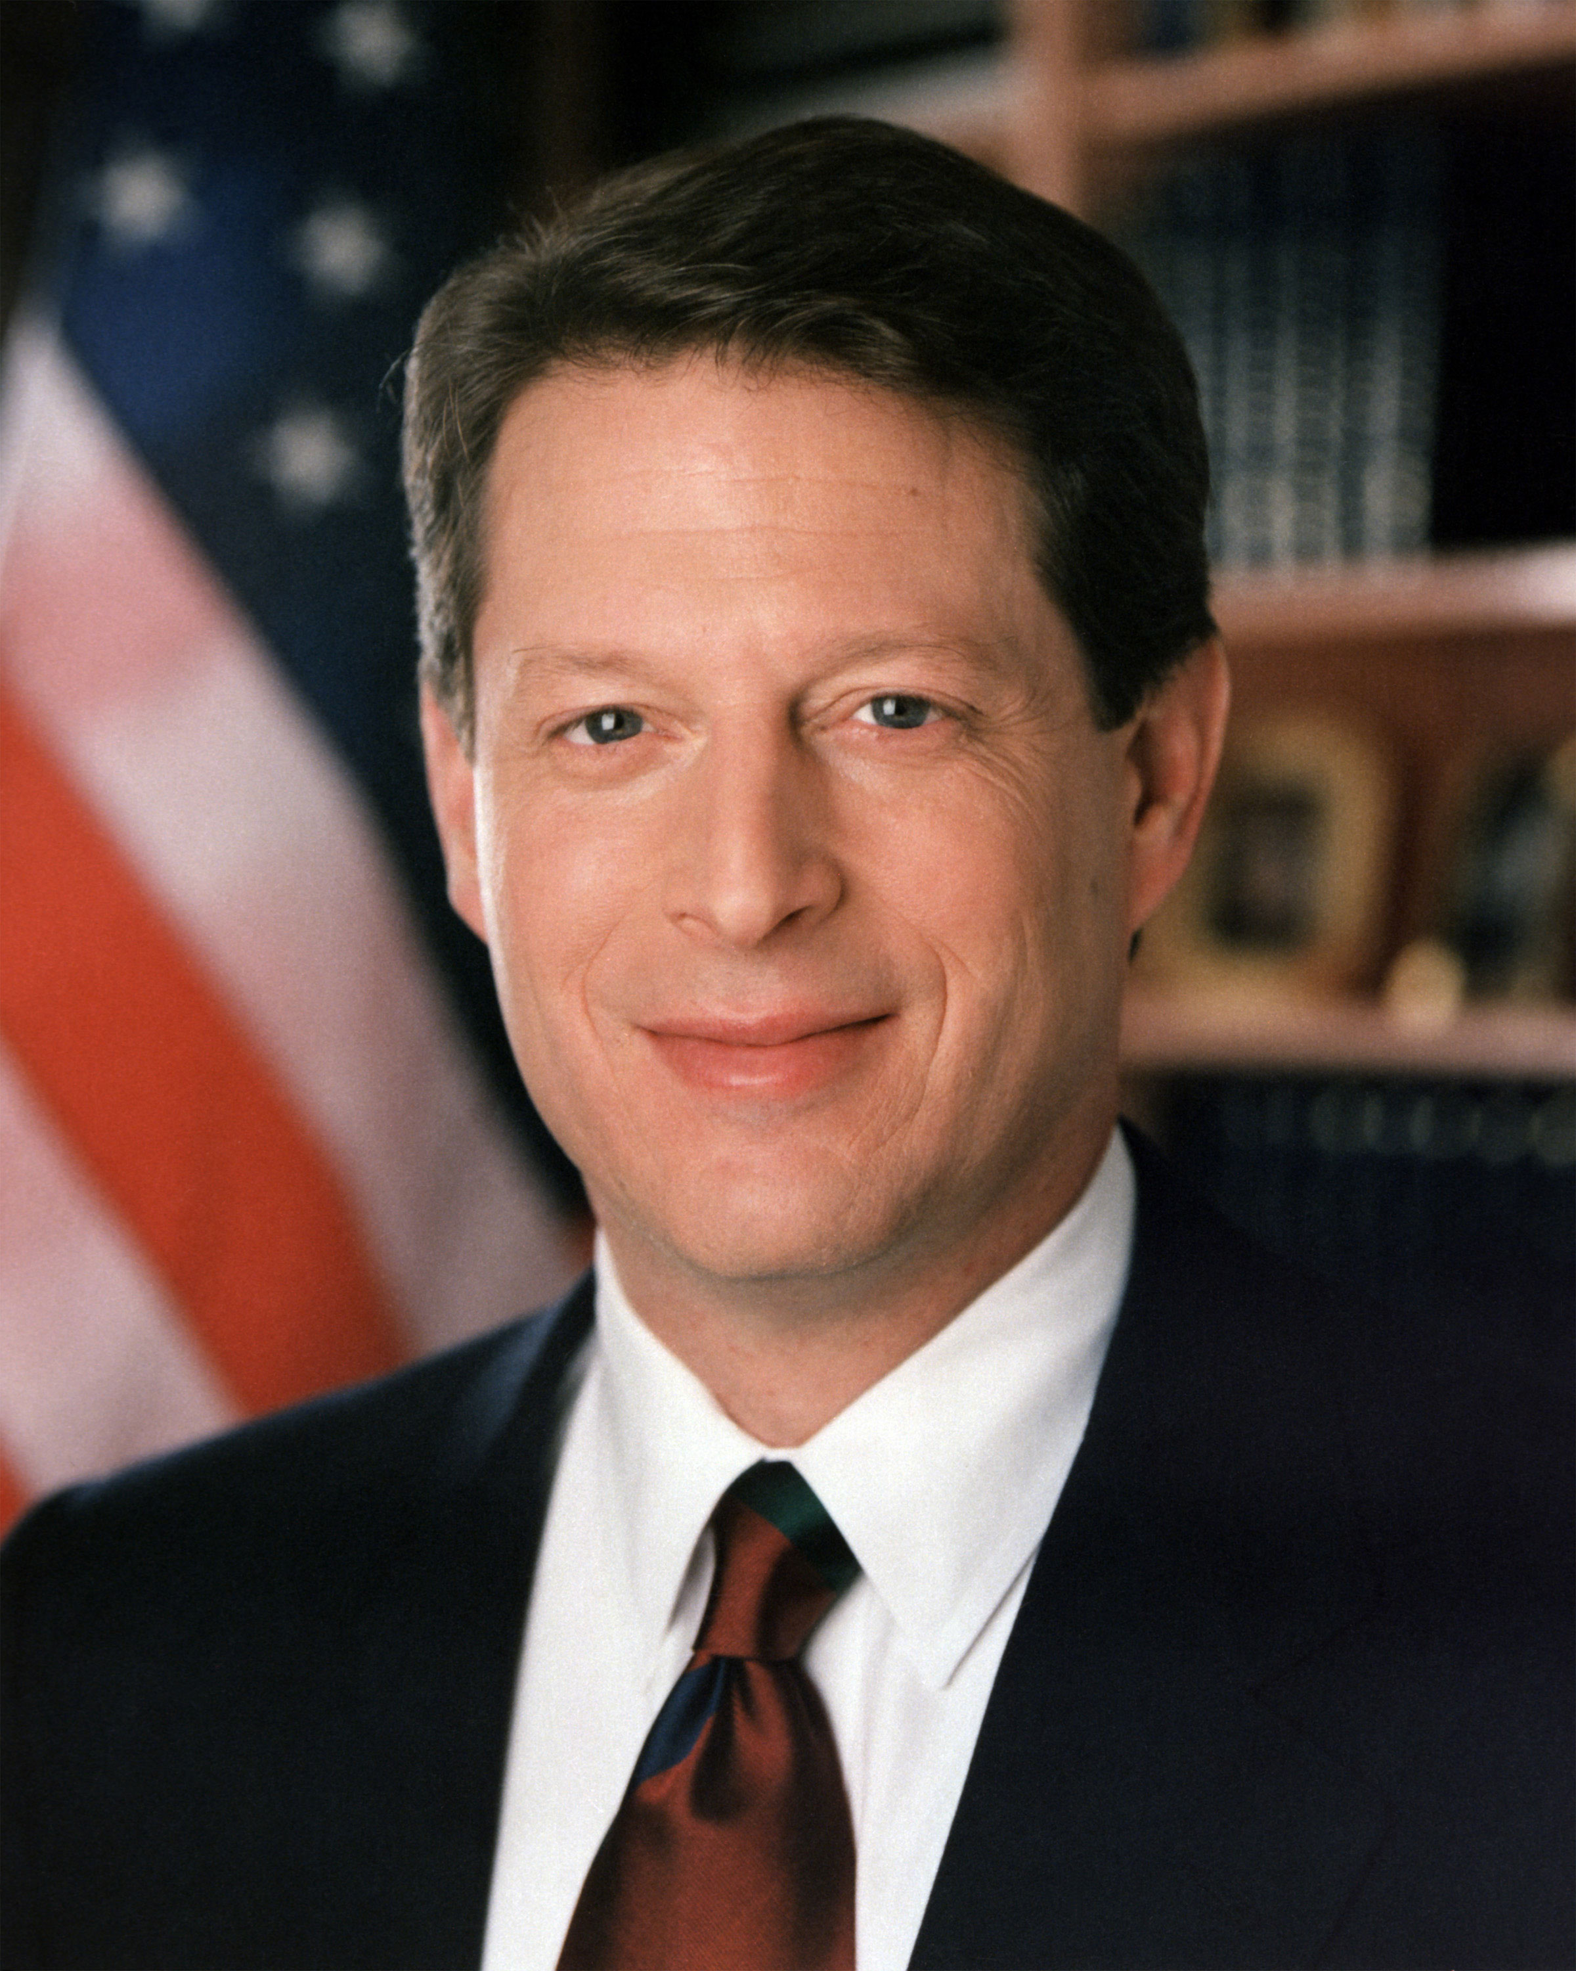
Efforts to Reduce Size of Bureaucracy and the Federal Workforce
Many elected officials and public figures have proposed ways to reduce the size of federal bureaucracy
During the Clinton Administration, VP Al Gore led a massive effort called “reinventing government”, its mission was to reform the way the federal government works by creating government that “works better, cost less, and gest results Americans can care about.”
One way to reduce the size of government is to reduce the number of government employees
Another way is to cut or freeze their pay or to require them to take unpaid days off called furlough
Agencies handle their budget cuts in different ways
Some agencies place a freeze on all new hiring, leaving the work to be done by existing staff

Slide 19
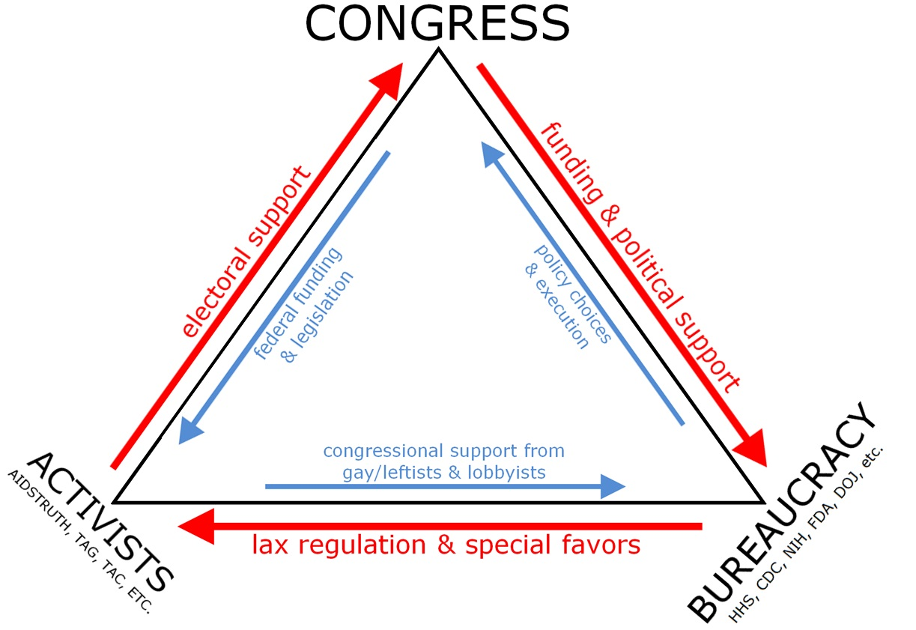
Influence of Interest Groups and the Bureaucracy
Each agency has client groups made up of individuals and groups who work with the agency and are most affected by its decisions
Client groups often attempt to influence agency decisions through lobbyists
Congressional committees, client groups, and a federal department or agency often cooperates closely to make public policy
Iron Triangle-is when the committees, client groups and federal departments continually work together
Critics of the iron triangle say that it makes it difficult for outside groups to make their voices heard and that it makes it hard for the government to do anything

Slide 20
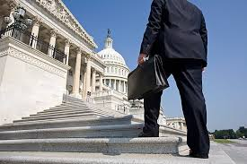
Influence of Interest Groups and the Bureaucracy
Many presidents, to address the concerns, have initiated ethics requirements and rules for lobbyists
While few would give lobbyists or interest groups unlimited influence on the bureaucracy there are few arguments against tighter restrictions
In some cases, lobbyists are experts in their field with technical knowledge and experiences that can provide valuable information on complicated issues.

Slide 21
The Costs and Benefits of Regulation
Typically business owners and manufacturers disdain regulation, arguing that regulations drive up their prices and higher prices hurt consumers
Regulations sometimes hurt profits, which in turn hurts consumers and workers
Many regulations are designed to protect workers, consumers, and the environment
President Obama proposed the creation of a new federal agency called the Consumer Financial Protection Bureau, which was designed to protect families from un fair or deceptive practices

Slide 22
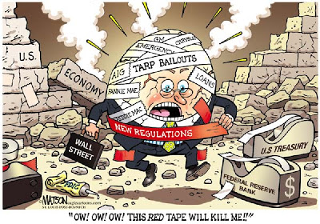
“Red Tape” and Paperwork
Red Tape is used to refer to overly burdensome regulations and requirements
Red Tape occurs when large and unwieldy organizations put so many convoluted procedures in place that it is difficult to get anything done
Politicians often campaign on promises of cutting red tape and making government organizations more efficient and responsive
Red tape usually comes with a lot of paperwork
Most of the time the paperwork is confusing, unnecessary, or difficult to complete which is a burden on businesses and individuals
The general goal to reduce red tape is shared by people in both political parties and across government

