Slide 1
Executive Branch
Choosing the President

Slide 2
Lesson 1: Qualifications and Leadership

Slide 3
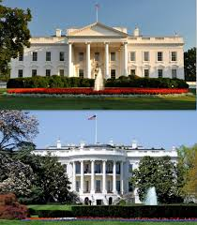
Qualifications for the Presidency
Constitutional Requirements
Article II section 1 of the Constitution defines the formal requirements for the presidency.
Must be a natural born citizen of the US
Must be at least 35 years old
Must be a resident of the US for at least 14 years before taking office
The same requirements apply to the vice-president
Informal Requirements
To have a real chance at being elected president, the most important qualification would be experience in government
Since 1900, candidates who have served as US Senators or state governors have won their major parities presidential nomination

Slide 4
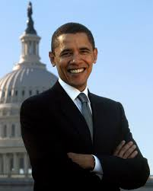
Qualifications for the Presidency
Political Beliefs
Extremely liberal or conservative candidates have little chance of being elected
Most candidates who are chosen by the major parties are moderate
Personal Characteristics
Historically, most presents have come from northern European backgrounds
Very few have been from poor families
Most of the presidents have come from middle class families
To date, every president has been a man and each has identified as Christian

Slide 5
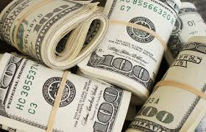
Qualifications for the Presidency
Financial Backing
Running for the presidency demands large amounts of money.
Candidates pay for advertising, salaries of campaign staff and consultants, plus travel
The Federal Elections Commission tracks campaign spending based on reports required by the candidates
Presidential candidates to amass the sums required usually have strong financial support from many people
Candidates who accept public financing for their campaigns are limited on how much they spend to the specific dollar
Candidates who forgo public financing can spend as much as they can collect

Slide 6
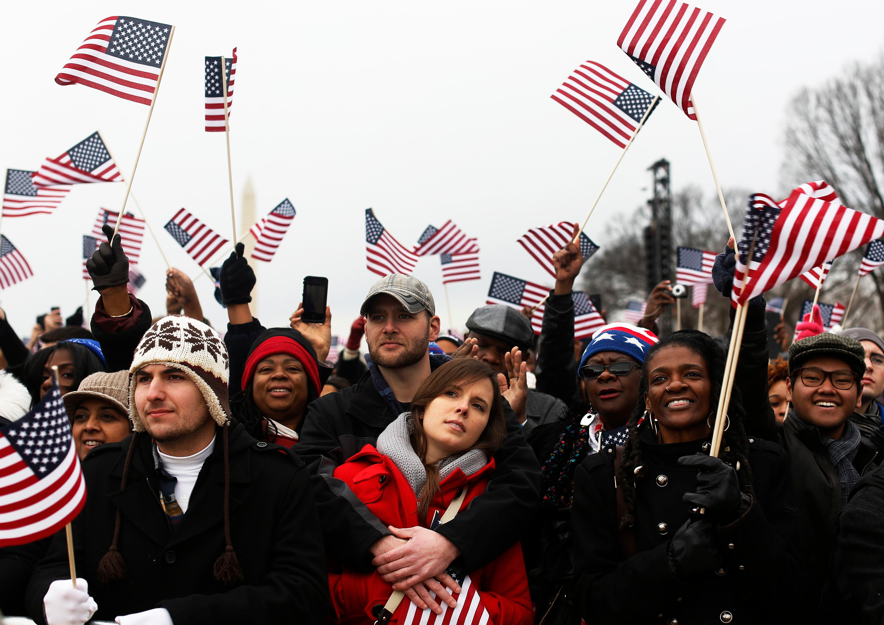
Leadership Skills
Understanding the Public
A president must know and understand the people
Understanding the people is necessary to gain and hold their support
Public support, in turn, can give a president real leverage in influencing lawmakers
When a president is popular, presidential proposals and policies are better received by Congress, than when the public holds a president in low regard
Failure to understand the public mood can prove disastrous for a president.

Slide 7
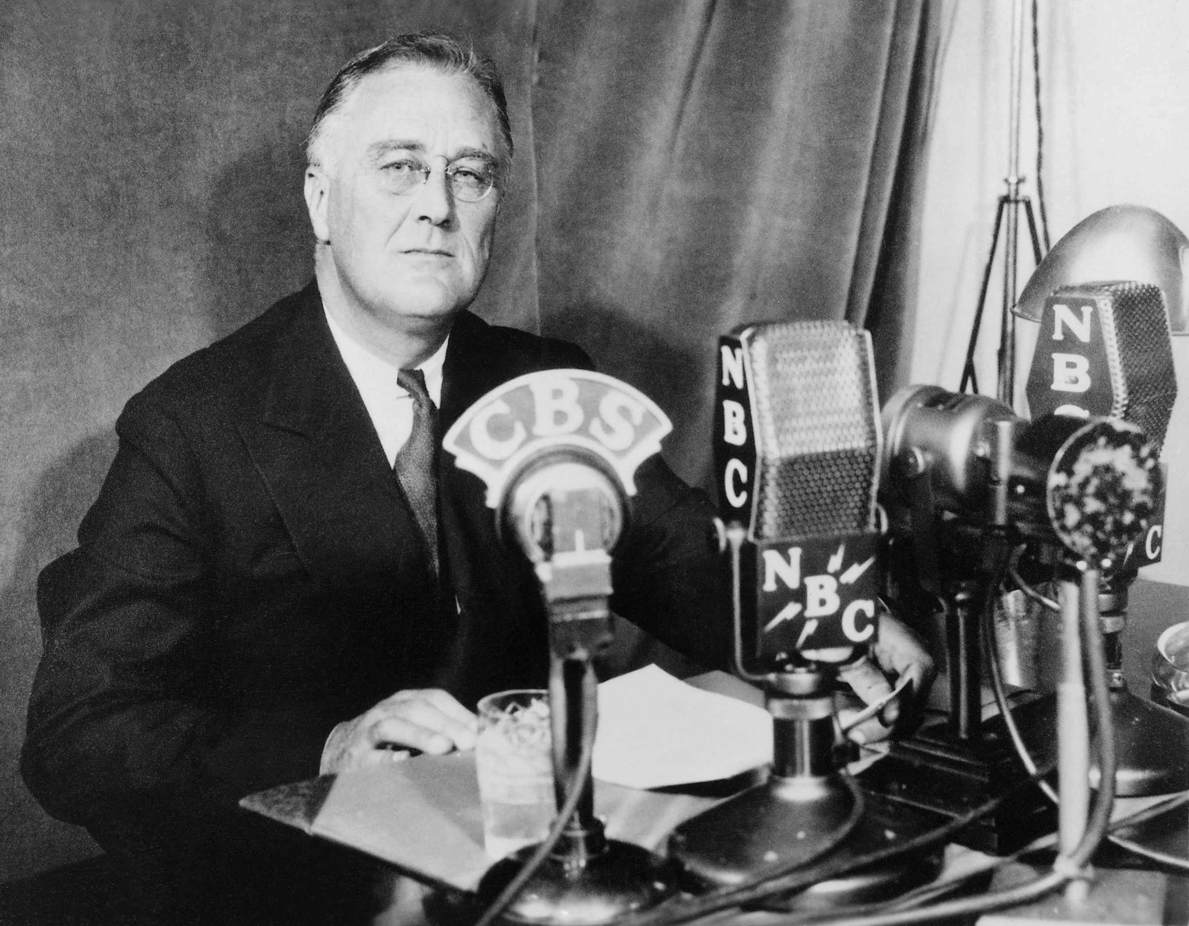
Leadership Skills
Ability to Communicate
Successful presidents must be able to communicate effectively and to present their ideas in a way that inspires public support
Modern presidents often use a strategy of “going public” to appeal directly to voters
Going Public-when the President uses public opinion to persuade the Congress to follow his programs.
Sense of Timing
A successful president must know when the time is right to introduce a new policy, to make a key decision, or to delay such actions
Skillful presidents often use their assistants or cabinet secretaries to test the timing of a new policy initiatives
Public response to the issue may influence whether the president pursues, delays, or quietly drops a policy initiative

Slide 8
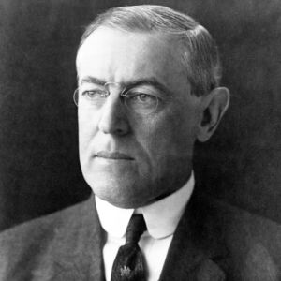
Leadership Skills
Ability to Compromise
Good leadership requires the capacity to be flexible and open to new ideas
Successful presidents have to be able to compromise
Presidents who are successful leaders are able to recognize that they have to settle for legislation that provides only part of the programs they want
Presidents who will not compromise risk accomplishing nothing at all.

Slide 9
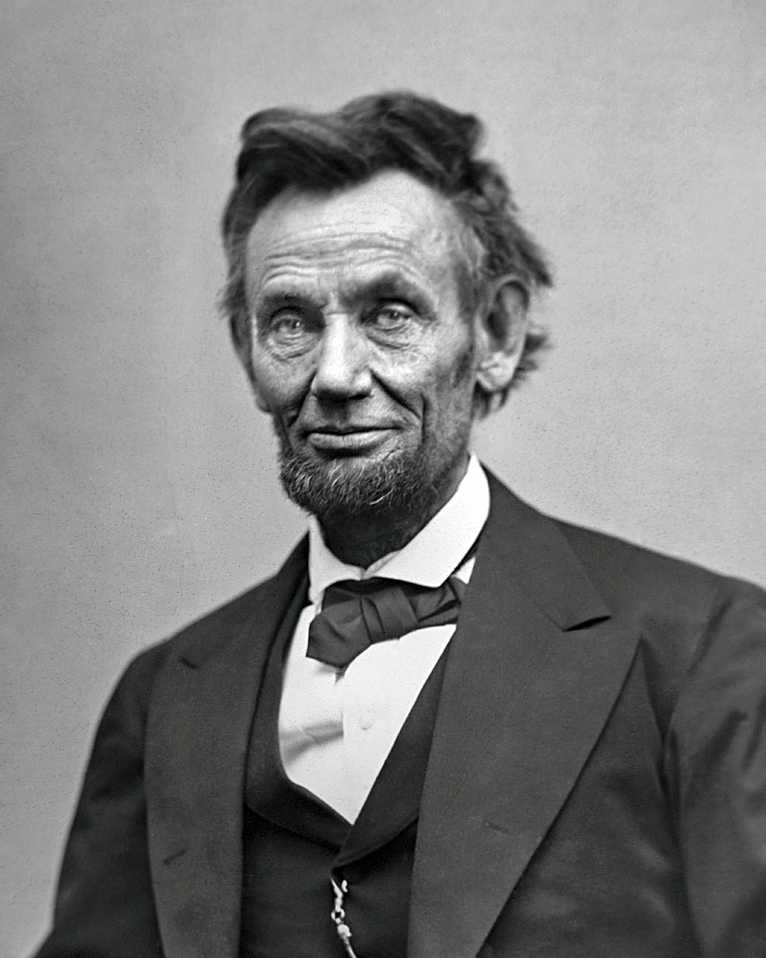
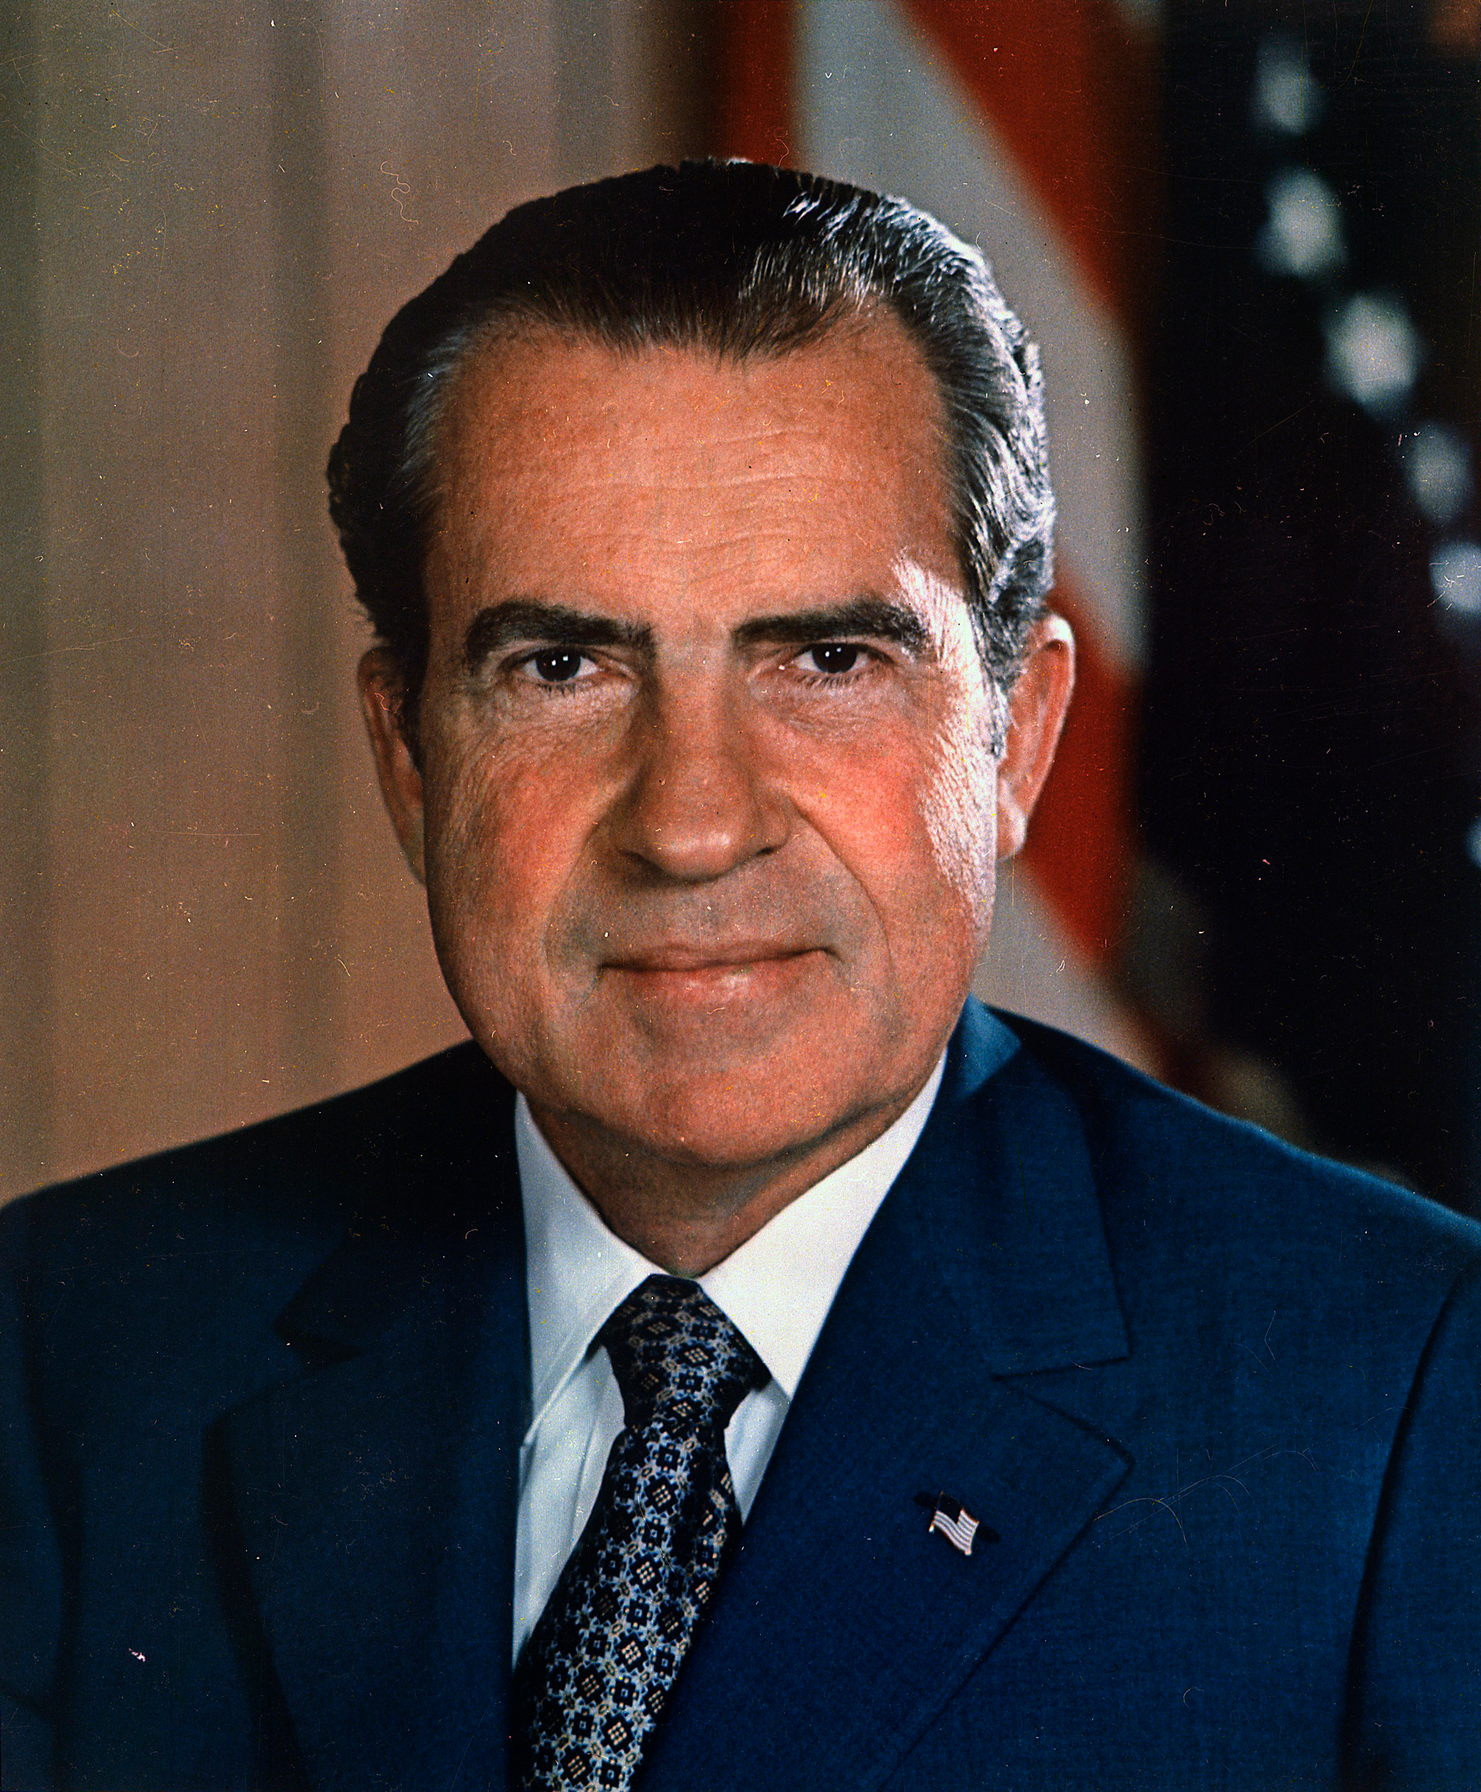
Leadership Skills
Political courage
Successful presidents need political courage because sometimes they must go against public opinion to do what they think is best
At times, presidents have shown leadership and courage by going against traditional views of their own political party.

Slide 10
Lesson 2: Presidential Salary, VP, & Succession

Slide 11
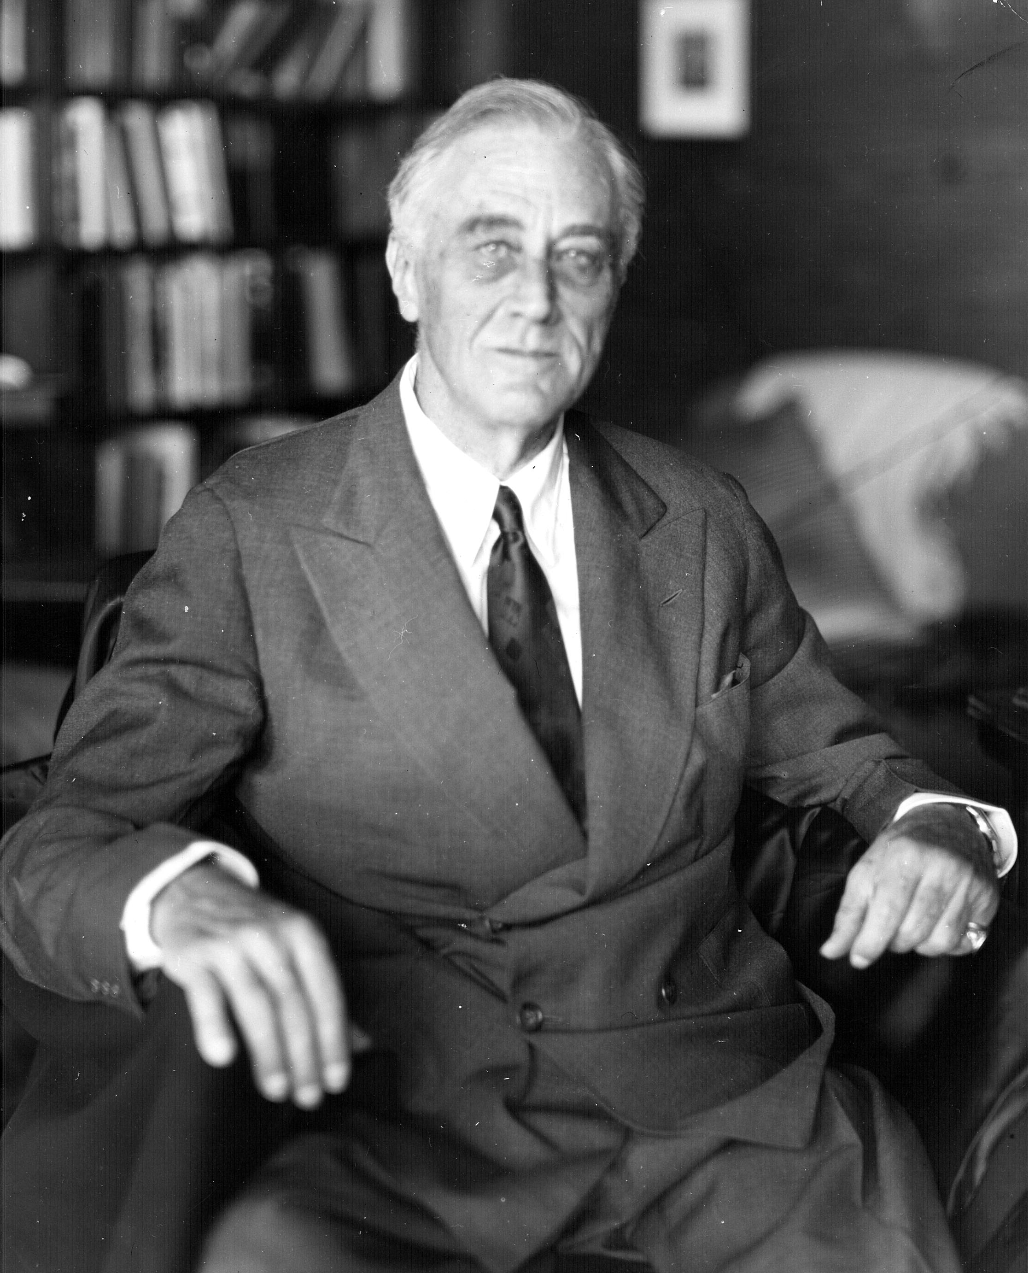
Terms, Salary, and Benefits
The Constitution, originally, did not specify how many four-year terms a president could serve
After FDR and his four year term in office, and concerns over too much executive power the 22nd Amendment was ratified (1951)
22nd Amendment-limits the terms of a president to two, four-year, terms.

Slide 12
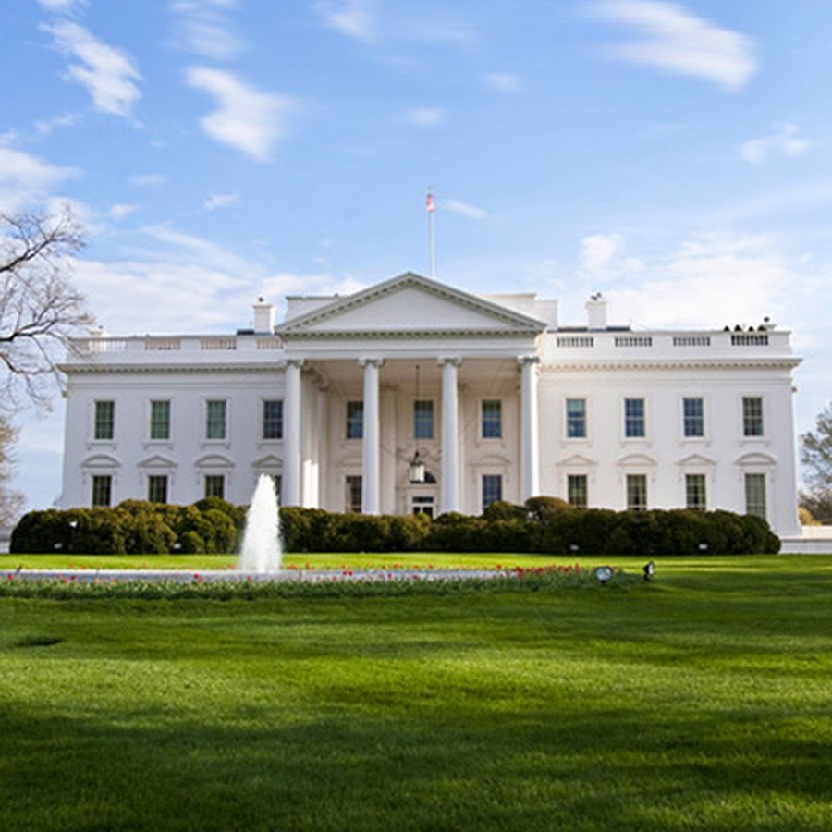
Terms, Salary, and Benefits
Salary and Benefits
The Constitutional Convention determined that the presidents should receive compensation but left it up to congress to decided the amount
Current presidential salary: $400,000 per year
Congress cannot increase or decrease the salary during a president’s term
Other benefits are given to the president for security reasons

Slide 13
Terms, Salary, and Benefits
Salary and Benefits
When a president retires, they will receive:
199,700 per year (same pay as cabinet secretaries)
Free office space
Free mailing services
Lifetime Secret Service protection (for whole family)
96,000 per year to pay for their office help
When the president dies, their spouses are eligible for a pension of 20,000 per year

Slide 14
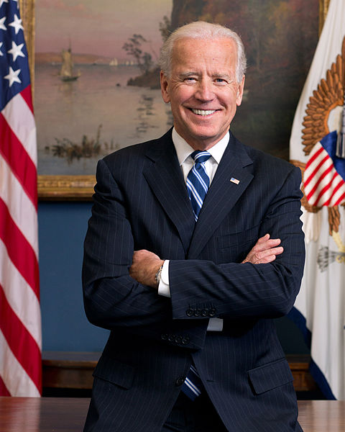
The Vice President
Constitutional Responsibilities
Three duties of the VP:
The Vice President takes over the presidency in case of the presidential death, disability, impeachment, or resignation
The Vice President presides over the Senate and votes in case of a tie (most VP’s don’t spend much time at this job)
Under the 25th Amendment the Vice President helps decide whether the president is unable to carry out his or her duties and acts as president should that happen

Slide 15
The Vice President
Modern Responsibilities
The work and power of the VP can be much greater than the Constitution mentioned, it depends on the duties the president assigns to the VP
In the beginning the VP was more of a ceremonial role
Modern VP’s have had greater power from participating in policy meetings to undertaking special assignments
Qualifications when looking for a VP
To add expertise to the future of the administration
To appeal to the voters

Slide 16
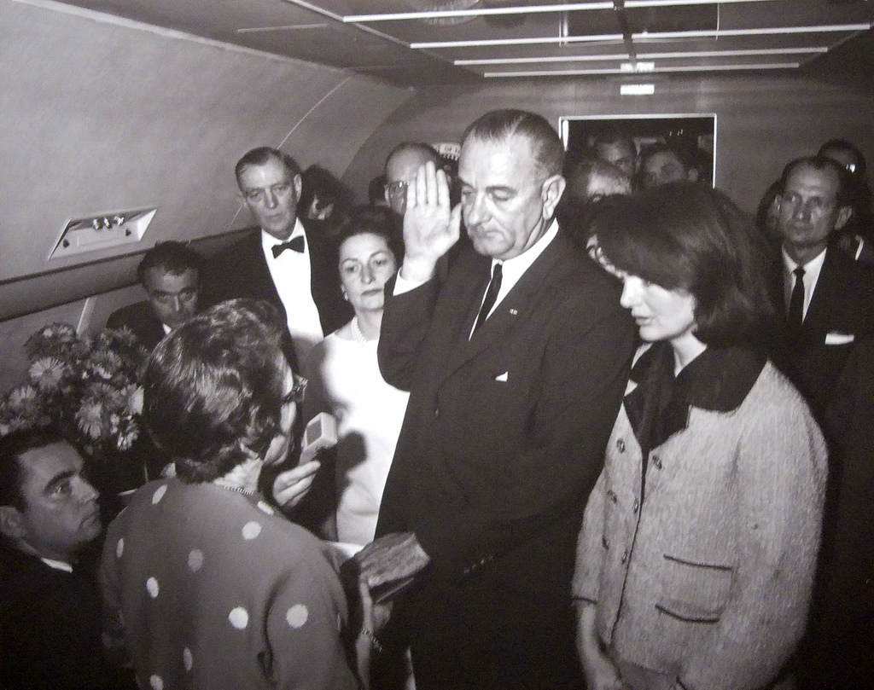
Succession
25th Amendment was created to clarify the succession to the presidency and the vice presidency
The amendment first applied in 1973, when Spiro Agnew resigned as Nixon’s VP and Gerald Ford was nominated as to succeed him
The Succession Act of 1947 established the order of the presidential succession if both the president and vice president both became incapacitated
The order of succession:
VP
Speaker of the House
President Pro tempore of the Senate
Cabinet officers starting with secretary of state

Slide 17
Succession
25th amendment describes what should be done when a president is disabled
If the president informs Congress of an inability to preform in office
If the VP and a majority of the cabinet or a body authorized by Congress inform the Congress of this conditions (only takes effect if the president is unwilling or unable to inform Congress)
The 25th amendment also spells out how a president can resume the powers and duties of the office.

Slide 18
Lesson 3: Electing the President

Slide 19
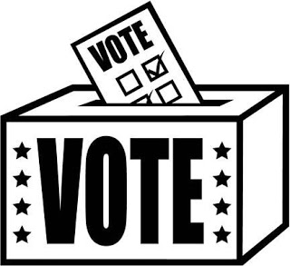
Road to the White House
Role of the Electoral College
The Constitution sets the basic rules for electing a president, including the role of the Electoral College
When drafting Article II, the Framers argued about whether the president should be elected directly by the people, so they set up a system of electors for each state.
Electoral College today:
Includes 538 electors (set up based on its senators and representatives)
Texas has 38 electoral vote
To be elected president or VP a candidate must win 270 of the 538 votes
The candidate who receives the most popular votes in a given state wins all the electoral votes for that state

Slide 20
Road to the White House
Preparing to Run for President
Years before a presidential election, potential candidates being to plan their campaigns
It starts by informing a political action committee, this organization of supporters test whether a candidate has enough national appeal to win
PACs also begin raising large sums of money that would be needed for a campaign
Candidates also form exploratory committees who meet with potential supporters and find well-respected public figures to endorse the candidate
Candidates may also make their run official by registering with the Federal Election Commission (FEC) an independent regulatory agency created by Congress to enforce federal election laws

Slide 21
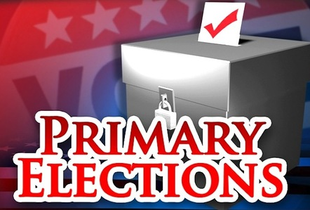
Road to the White House
Primaries, Caucuses, and National Party Conventions
First phase of the presidential campaign is to convince members of their own party to choose them over other candidates within their party
In a primary members of the party go to the polls to vote on which candidate they want to see earn their party’s nomination.
Each state runs its own primary or caucus, and the dates and rules for these vary from state to state
As they campaign for primaries candidates will focus on issues that are important to the party’s active members
Candidates will also focus on issues important to party voters in a particular region
Late summer, when all states have held their primaries, the major political parties hold national nominating conventions to determine who will actually run for president

Slide 22
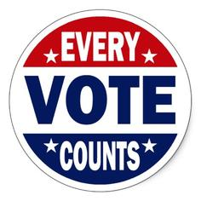
Road to the White House
General Election
Second phase in the electoral process is to appeal to a wider circle of potential voters
Campaigns will spend vast amounts of money on commercials, and candidates will travel around the states they believe are most necessary to win the national election
Campaign advisors study electoral maps to predicts which states electoral votes a candidate has a chance to win.
Campaigning will often be concentrated in “swing states” where polls show voters closely divided
It is customary for presidential candidates to debate one another in the run-up to an election
On a presidential election day, millions of Americans go to the polls and cast their votes for president and vice president
The media reports on the results of the election as soon as the polls close in the evening and often project a winner by midnight

Slide 23
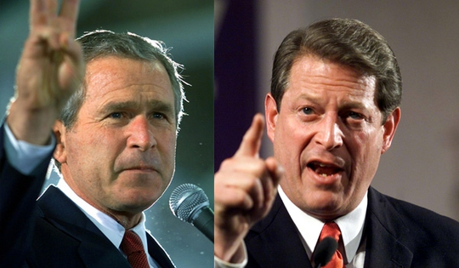
Electoral College Issues
Winner Takes All
Some critiques of the system believe that the electoral college system is unfair to those who voted for a losing candidate
The winner-take-all system makes it possible for a candidate who loses the popular vote to win the electoral vote
This usually happens when a candidate wins several large states by narrow margins
Third-Party Candidates
Third Party is someone who represents a political party that is not the democrats or republicans
3rd party candidates could win enough electoral votes to prevents either major-party candidate from receiving a majority of the votes
Third parties could then bargain to release electoral votes to one of the two major-party candidates

Slide 24
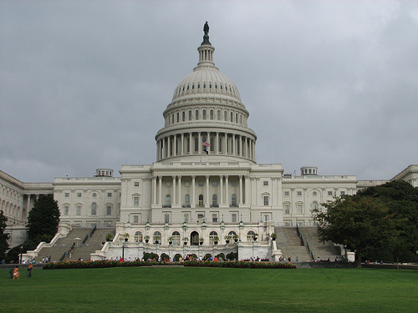
Electoral College Issues
Election by the House
When neither presidential candidate wins 270 electoral votes, the House of Representatives must decide the winner
Each state casts one vote, the candidate who receives 26 or more votes is elected
Election by House raises three issues
States with small populations have as much eight as populous states
Under the rules if a majority of a state’s representatives cannot agree on a candidate the state loses its vote
If some House members favor a strong third-party candidate it could be difficult for any candidate to get the 26 votes needed to win

Slide 25
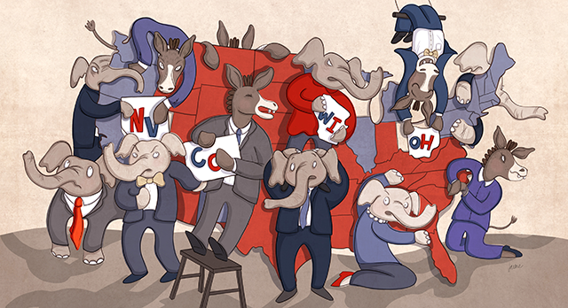
Ideas for Reform
One idea for reform is to choose electors from congressional districts.
Another idea is to assign electoral votes based on the winner of the nationwide popular vote (this method would not require amending the Constitution)
Third proposed plan would allow the presidential candidate to win the same share of a state’s electoral vote as they received of the state’s popular vote
Other plans include the elimination of the Electoral College, and allow the people to directly elect the president and VP

Slide 26
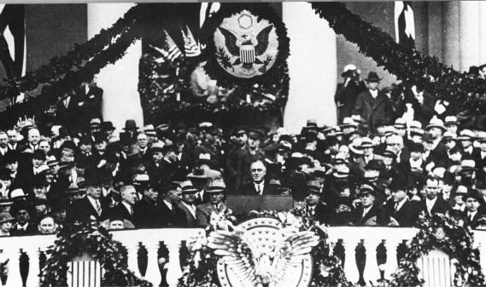
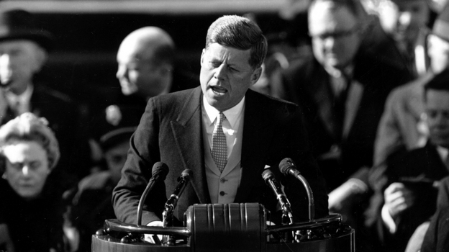
The Inauguration
Until the inauguration in late January, the new president is referred to as the president-elect
The new president takes office at noon on January 20th in the year following the election
The Constitution requires the president to take an oath.
By custom, the incoming president rides with the outgoing president from the White House to the Capitol for the inauguration when the chief justice administers the oath of office
After the oath of office, the president gives an inaugural address, several inaugural address have become part of the nation’s heritage.

