Slide 1
Unit 1
Foundations of American Government

Slide 2
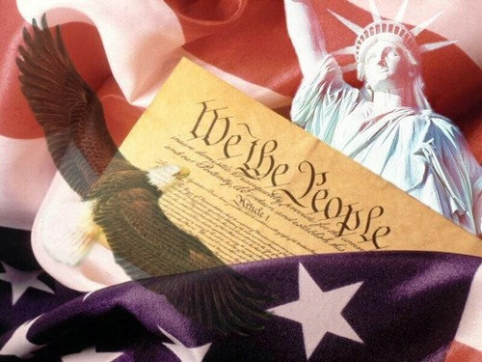
Foundations of Government

Slide 3
Lesson 1: Purposes and Origins of Government

Slide 4
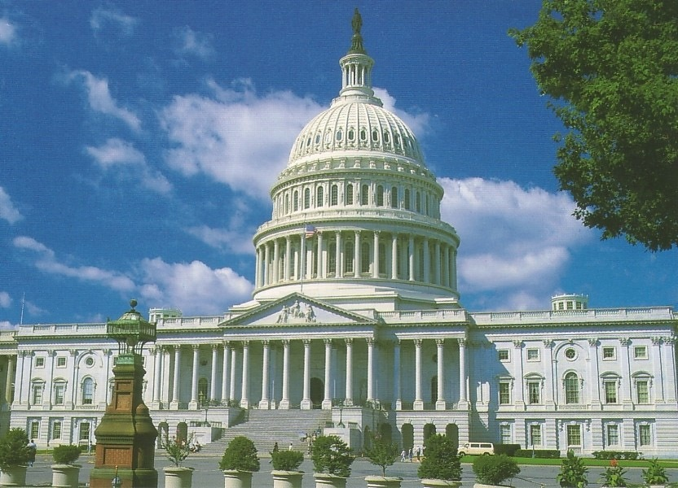
The Functions of Government
Legitimate governments create order, protect people, and give people ways to settle disagreements
Governments provide leadership, order, security, and defense
To fulfill its purpose governments make rules that everyone must follow
Providing Leadership
Government officials set priorities and make all sorts of decisions on behalf of the people.
They can require that people do things they not do voluntarily
Without leadership there would be anarchy

Slide 5
Maintaining Order
Governments try to control and contain conflict between people
Governments provide some sort of domestic security force
Governments provide courts and other ways for people to resolve conflicts
Providing Public Services
Creating schools, build sewer systems, pave roads, and provide other services that individuals cannot or would not do on their own
They can also promote public health and safety

Slide 6
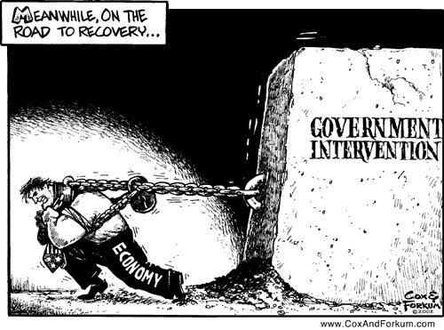
Providing National Security
They also provide protection against attacks from other countries or terrorists
Some states do have trade relationships with other nations that the national government can put limitations on
Providing Economic Security & Assistance
They protect the economic security of their people
Governments might intervene in the economic affairs of another nation to promote it’s own national security
They set policies to protect people’s economic security

Slide 7
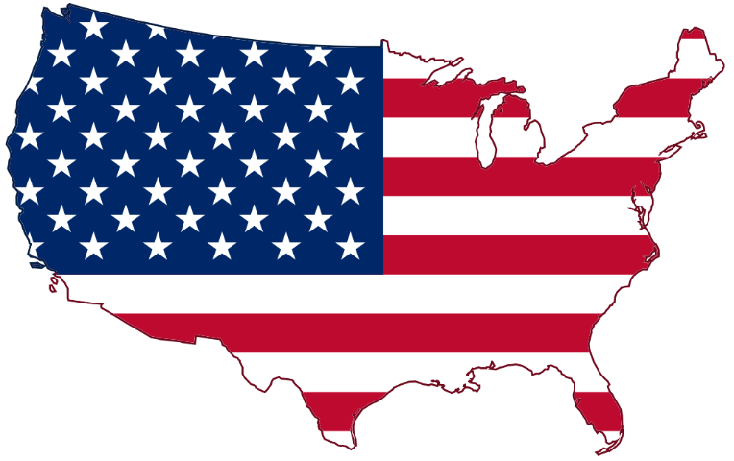
Nation, State, and Country
These terms can sometimes be interchangeable
A nation is considered a sizable group of people who believe themselves united by common bonds of race, language, custom, or religion
In the United States a state is considered a subdivision of the whole country
A state could also mean a political community that occupies a definite territory and has an organized government (same thing as a country)

Slide 8
The State
The state can be defined as having these four characteristics:

Slide 9
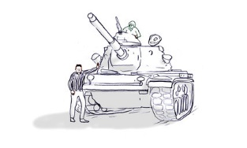
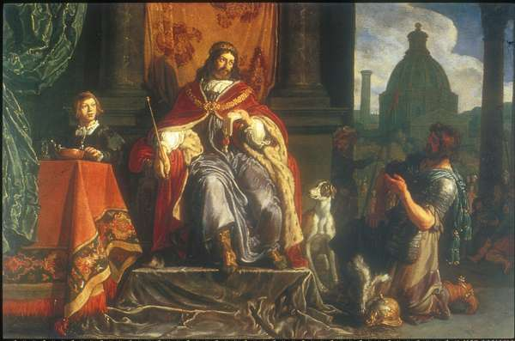
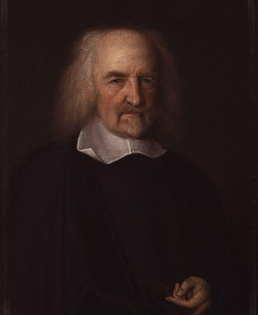
Origins of the State
The Force Theory
The force theory states that one person or a small group took control of an area and forced all within it to submit to that person’s or group’s rule.
The Evolutionary Theory
The evolutionary theory argues that the state evolved naturally out of the early family.
The Divine Right Theory
The theory of divine right holds that God created the state and that God gives those of royal birth a “divine right” to rule.
The Social Contract Theory
The social contract theory argues that the state arose out of a voluntary act of free people.

Slide 10
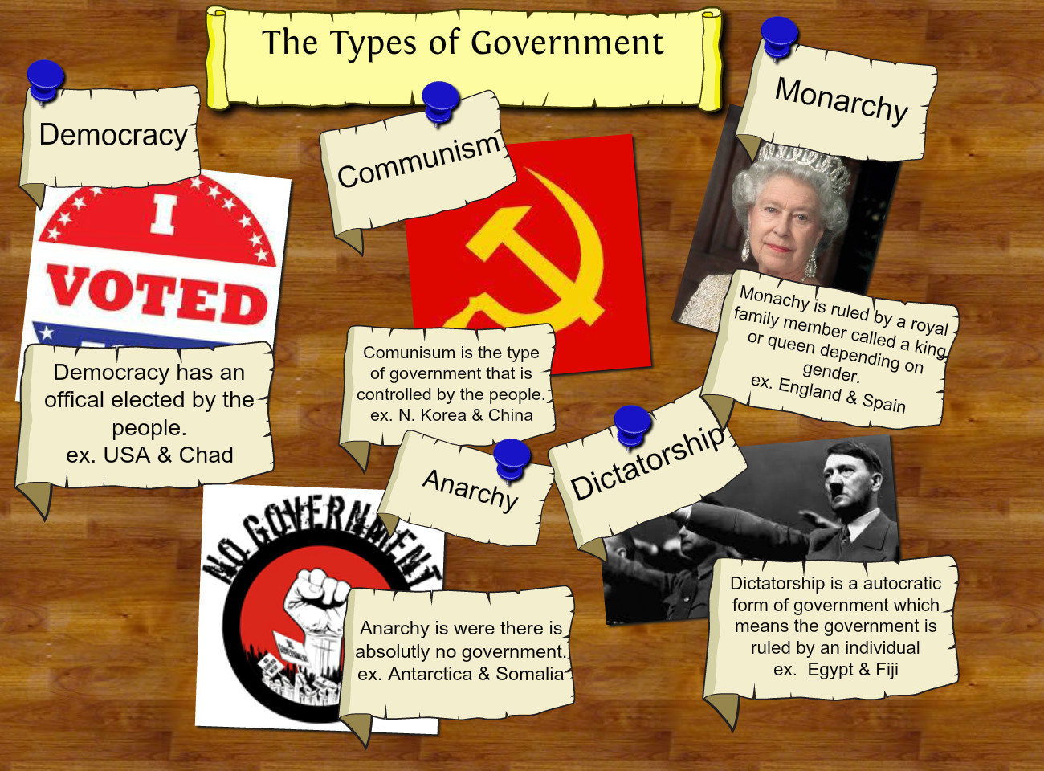
Lesson 2: Types of Government

Slide 11
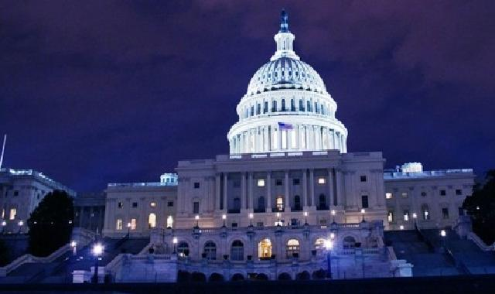
Classifying Governments
Governments can be classified by three different standards:
(1) Who can participate in the governing process.
(2) The geographic distribution of the governmental power within the state.
(3) The relationship between the legislative (lawmaking) and the executive (law-executing) branches of the government.

Slide 12
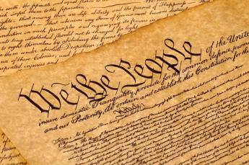
Constitutional Governments
A constitution is a plan that provides the rules for government
Major purposes of a constitution
It sets out ideals that the people believe in and share
It establishes the basic structure of government
It provides the supreme law for the country
Constitutions may be written or unwritten
Constitutions have the authority to place clearly recognized limits on the powers of those who govern (limited government)
They are incomplete guides on how the country should be run
The constitution doesn’t always reflect actual government practices

Slide 13
Major types of Government
Democracy
In a democracy, supreme political authority rests with the people.
A direct democracy exists where the will of the people is translated into law directly by the people themselves.
In an indirect democracy, a small group of persons, chosen by the people to act as their representatives, expresses the popular will.
Dictatorship
A dictatorship exists where those who rule cannot be held responsible to the will of the people.
An autocracy is a government in which a single person holds unlimited political power.
An oligarchy is a government in which the power to rule is held by a small, usually self-appointed elite.

Slide 14
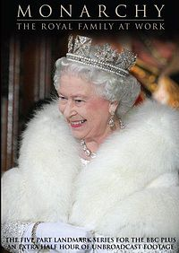
Major types of Government
Unitary Government
A unitary government has all powers held by a single, central agency.
Confederate Government
A confederation is an alliance of independent states.
Monarchy
Some are not authoritarian
Monarch’s power can be limited by tradition or law
Most monarchies today are constitutional monarchies (example: Great Britian)

Slide 15
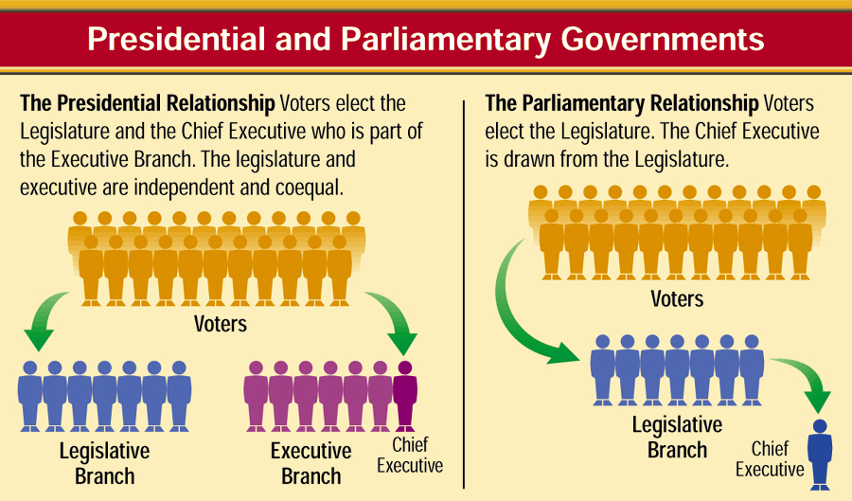
Classification by the Relationship Between Legislative and Executive Branches

Slide 16
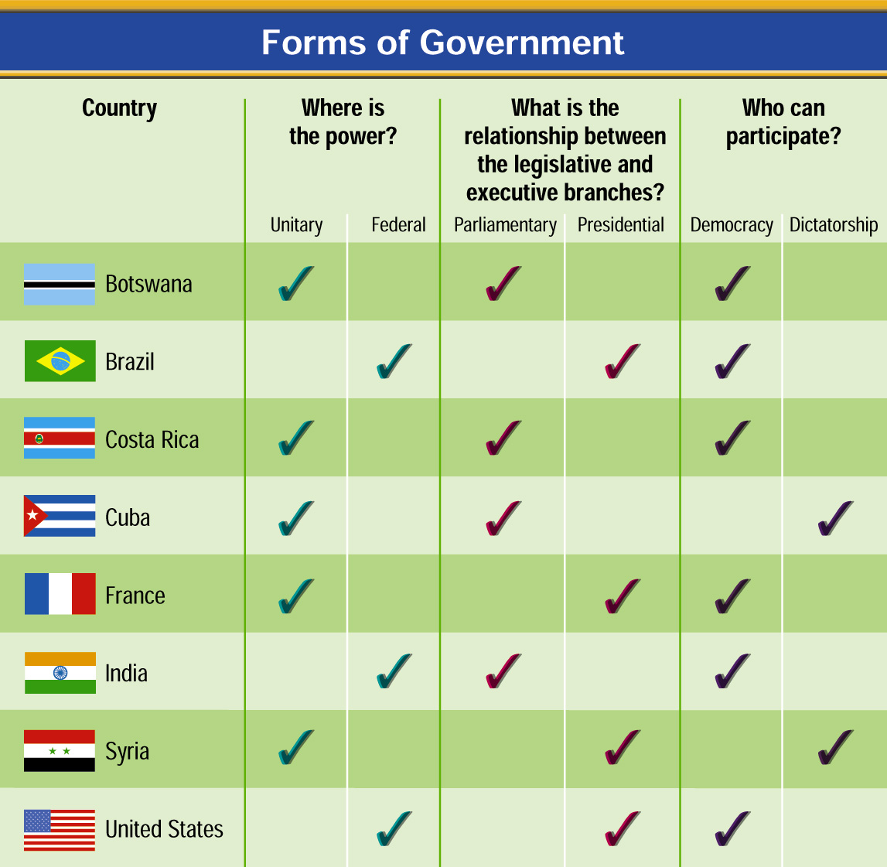
Forms of Government

Slide 17
Lesson 3: Roles of Government in Economic Systems

Slide 18
Fundamentals of Economics
Economics is the study of how people and nations use their limited resources to attempt to satisfy wants and needs
Some political systems let free market determine how resources are used
Other systems the government regulates/controls resources
A key function of government is to make essential decisions about the economy
All economies must answer three key questions:
What and how much should be produced?
How should goods and services be produced?
Who gets the goods and services that are produced?

Slide 19
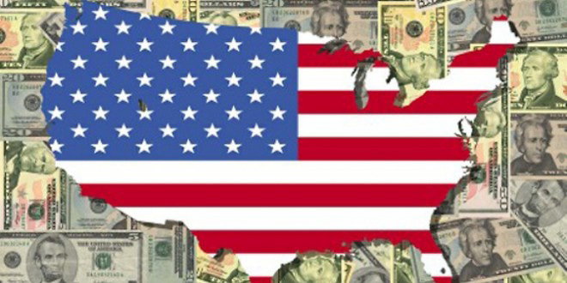
Capitalism
Is an economic system that emphasizes private ownership of the factors of production, freedom of choice, and individual incentives
The government does not interfere with the economy
This economic system assumes that the best way to serve society is to let people produce, sell, and buy as they wish
Free Enterprise in the United States
A true and total capitalist system does not exist in reality, but the US is the closest example
The US society is deeply rooted in the value of individual initiative
The US respects the right of all persons owning private property
The US also recognizes the freedom to make economic choices
The US government does regulate many aspects of the economy, which makes it not a pure capitalistic system

Slide 20
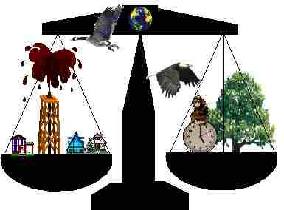
Mixed Economies
Combine elements of capitalism and socialism
Examples of countries with mixed economies: US and Mexico
Why is the US classified as a mixed economy
The federal government has grown to become the single largest buyer of goods and services
The federal government has become more involved in regulating industries to protect the consumer
The Great Depression created an economic emergency that propelled government action

Slide 21
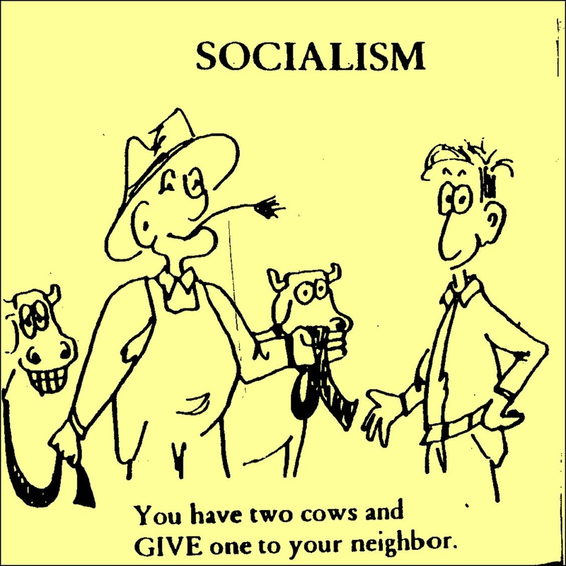
Socialism
Is an economic system in which the government plays a significant role in the economy, but does not completely control it
It owns most land, basic industries, and other means of production
Government planners determine the use of resources and distribute the products and wages
The government provides extensive social services such as education, health care, and welfare for its people
The goal is to distribute everything equally

Slide 22
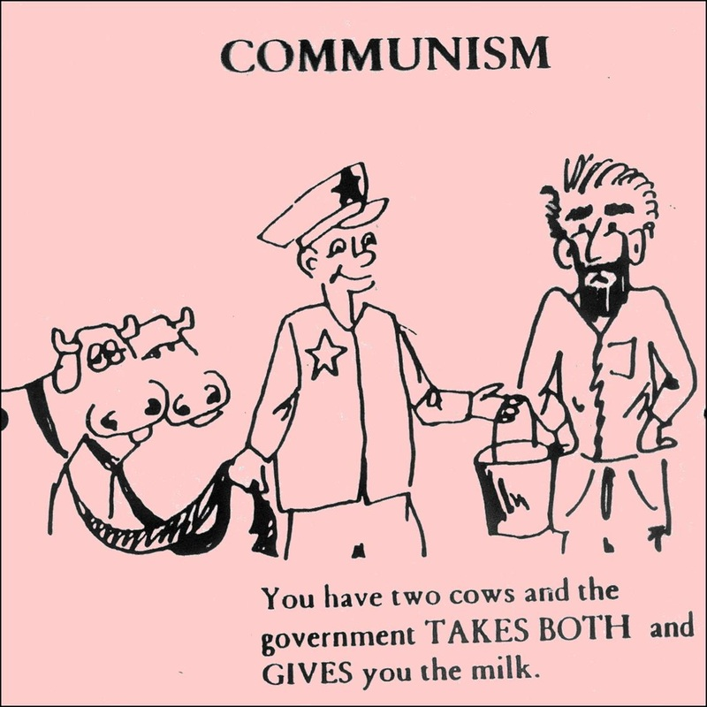
Communism
The government decides how much to produce, and how to distribute the goods and services produced
The state owns land, natural resources, industry, banks, and transportation facilities
There is no private property
Government controls mass communication
All decisions on how the country should be done are handed down by the upper levels of government
Communism Today
Only a handful of countries that are communist exist (North Korea)
Most communist states vary on how much of the economy is state controlled (China)

